Slide 1
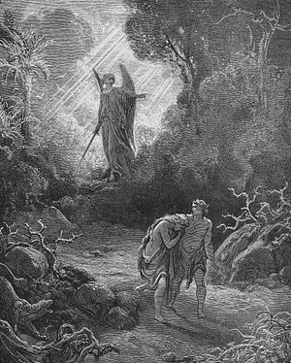
Exile From Eden
Reading – Genesis 3:1‑12

Slide 2
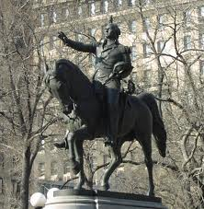
Deception Is Almost Expected
"If George Washington never told a lie, how did he ever get to be president?"

Slide 3
“Do Not Be Deceived”
(1 Corinthians 6:9-10)
People can find a church for their particular vice without accepting what Christ has to say about repentance.
That is self-deception of the highest order.
1 Corinthians 15:33
There are consequences for our behavior.
(Galatians 6:7)

Slide 4
Genesis 3:1‑6 - The First Lie
Small changes in Eve's version of the law imply she doesn't like it.
Do you notice that she minimizes blessings that she could, “Freely eat of every tree.
She does not name the specific tree of knowledge of good and evil.
When she emphasized the restrictions was the first time she uses God's name.
She says, “Lest you die,” omitting the word "surely"

Slide 5
Sealing The Deal
Finally Satan tells her she'll be like God if she eats.
In this temptation Eve has been exposed to every avenue of sin.
1 John 2:15-16
The fruit looked good to her [the lust of the eyes]. Most sins look inviting.
For all we know the fruit was sweet to the taste. Many sinful things satisfy the lusts of the flesh such as intoxication or fornication.
The pride of life appeals to being equal with God

Slide 6
More deceptions
The Greatest lies are the ones we tell ourselves!
!

Slide 7
(Genesis 3:7)
Adam and Eve made fig leaf aprons to deal with the symptoms of sin.
God made them coats from skins to cover themselves.
This was the first sacrifice for sin that we can find.

Slide 8
Other “fig leaves” of the world
Psychotherapy to salve a guilty conscience
Placing “Feelings” before morality
(Hebrews 13:4)

Slide 9
Self Deception “Hiding From God”
(Genesis 3:8-11)
Jonah tried to run from his responsibility.
Adam tried to hide from his accountability.
Those who try to hide from God in a bottle of alcohol or pills many times reap all the physical, mental and financial miseries associated with the addiction.
As far as I know there is only one place you can go to be away from God – and that place is described as hell!
(Romans 6:23)

Slide 10
“It’s Not My Fault” [Genesis 3:12]
Adam blames the woman who God gave to be with him.
Sin changed Adam from protector to accuser of his wife.
In reality Adam was trying to blame God for making Eve.
In the final analysis he admits, "I did eat", but it’s not my fault.
Who held a gun to you head the last time you sinned?

Slide 11
“It’s Not My Fault” [Genesis 3:12]
Eve in turn blamed the serpent. (Genesis 3:13)
God curses each of them in turn.
(Genesis 3:14-19)
The curses should remind us of sin: birth, life, and death are with us today because of sin.

Slide 12
The real question is not ---
“Will I sin, but will I truly repent and come to God when I do? “
!

Slide 13
The real question
Will I complicate the first sin by lying to myself as I continue to hide from the only source of salvation?
!

