Slide 1
The Gospel Of Baptism
He that believes and is baptized shall be saved.
Mark 16:9-16
Notes:
Begin with the conversion of the Ethiopian Eunuch – Ac 8:35-38

Slide 2
The Command
Of Baptism
The Command Of Baptism...
Jesus commanded baptism
Matthew 28:18-20
The apostles commanded baptism
Acts 2:38
Acts 10:48

Slide 3
The Mode
Of Baptism
It involves water Acts 8:35-38
John 3:5
It involves a burial Romans 6:4
Colossians 2:12

Slide 4
The Subjects
Of Baptism
Must believe in Jesus Mark 16:16; Acts 8:36-37
Romans 1:16
Must have repented of sins Acts 2:38
Luke 24:46-47

Slide 5
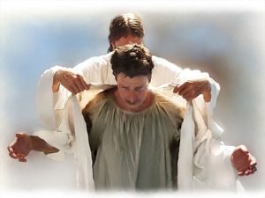
The Purpose
Of Baptism
For the remission of sins Acts 2:38;
Acts 22:16
To be united with Christ Romans 6:3-4
Galatians 3:26-27

Slide 6
The Purpose
Of Baptism
To have newness of life Colossians 2:12-13
Romans 6:4-6
Titus 3:5
To be saved! Mark 16:16
1 Peter 3:21

Slide 7
What Conclusion Can We Make Concerning The Gospel
Of Baptism?
Is Baptism Necessary or Not?
Consider the examples of conversion
Found in the book of Acts

Slide 8
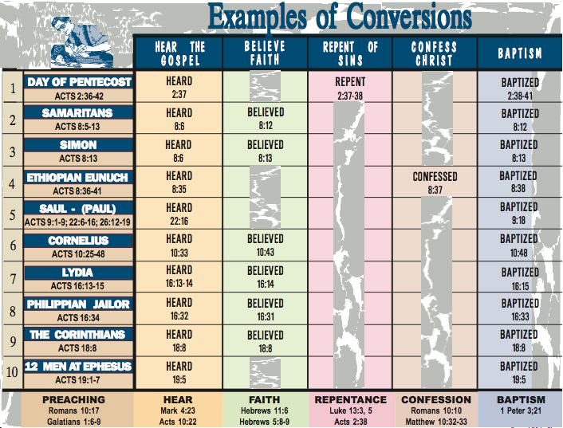

Slide 9
The Gospel Of Baptism
What Is Your Condition Without Baptism?

Slide 10
The Gospel Of Baptism
And now why are you waiting? Arise and be baptized, and wash away your sins, calling on the name of the Lord.
Acts 22:16

