Slide 1
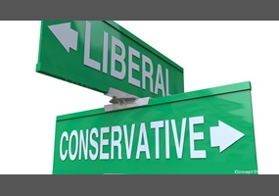
Religious Opposites
Reading - Matthew 25:14-30

Slide 2
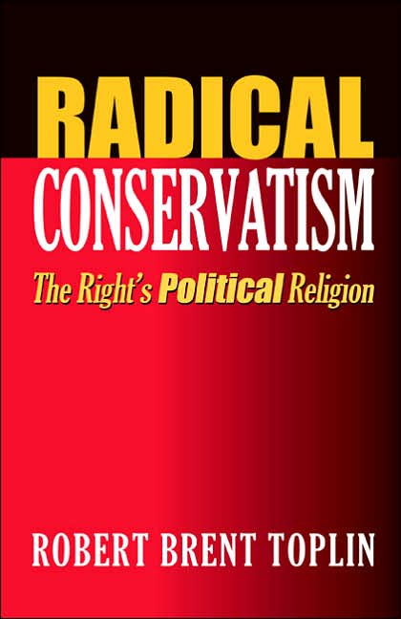
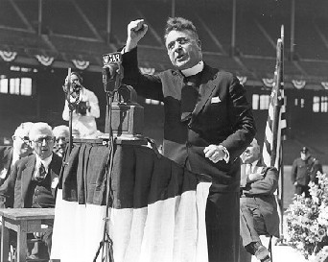
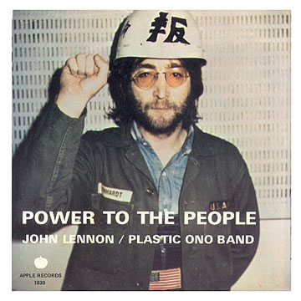
Liberals & Conservatives stand fundamentally at opposite ends.
1. The labels come with a lot of emotional “baggage”.
2. These emotional reactions have overshadowed any issues at hand.
3. Neither label is completely understood by the other.

Slide 3
Definition of “conserve”: to preserve from loss.
They tend to take the defensive position as opposed the offensive.
No war has ever been won, no crop was ever harvested, or no city was ever built from a constant defensive position.
In conserving the status quo, he works, but without growth.
Inevitably he loses what he has through stagnation. [Ex. Pharisees]

Slide 4
Liberal by Definition:
1. Not limited to or by established, traditional, orthodox, or authoritarian attitudes, views, or dogmas; free from bigotry.
2. Favoring proposals for reform, open to new ideas for progress, and tolerant of the ideas and behavior of others; broad-minded.

Slide 5
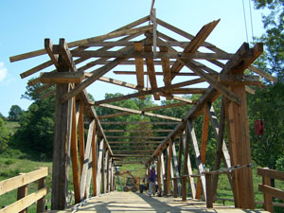
The Radical Liberal is hard to hold back.
By definition he favors reform or progress
Principal concern is to try new things & conquer new territories.
BUT he often forgets to defend and hold what he already has.
When he stops he finds himself a long way from where he started.
1. To get back would be difficult, if not impossible.
2. Like “borrowing wood” to build a bridge.
3. The Liberal works but doesn’t really gain because he loses what he had through neglect

Slide 6
Neither position is that static but is found in ever-changing degrees.

Slide 7
Liberalism - drifts away from established authority.
Sees little or no danger from departure
Puts confidence in the reasoning of good men, popular movements, or well-intended aspirations.
God’s word is relegated to second place.
The tendency is to walk by sight rather than by faith.
Motto “the end justifies the means”
Main concern is results... not truth or principle.

Slide 8
No wonder liberals have problems among themselves...
Not all of them are that liberal.

Slide 9
Conservatism confuses custom & tradition with authority.
The tendency is to walk by fear than by faith.
Changes are NOT GOOD!
Every new method or untried approach to the Lord’s work is a departure OR a potential departure from the faith;
There is a tendency to be intolerant in Conservatism- Even to the point of preserving personal preferences & prejudices.

Slide 10
No wonder Conservatives have problems among themselves...
Not all of them are that conservative.

Slide 11
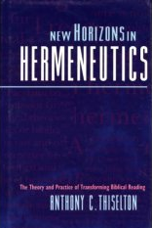
the “Social Gospel” as observed today
It appeals to man’s “need” of self-esteem, meaningful relationships, etc.
It should appeal to man’s sense of sin and what God has required of him.
A Liberal justification is to reinterpret the Bible.
This is seen in the “New Hermeneutics”
Notice the re-interpretation of elders & deacons
Notice the reinterpretation of homosexuality
Notice the reinterpretation of adultery

Slide 12
the humanist way of thinking
This makes man’s word the standard
God’s word is there for a good reference not the authority
Woe unto the man who would pervert the gospel of Christ. But though we or an angel from heaven, preach any other gospel unto you than that which we have preached unto you, let him be accursed. [Galatians 1:7-8]
We are witnessing a fatal conversion from the “words of life” to a “school of thought”

Slide 13
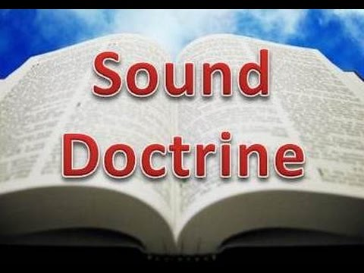
virtue in holding fast the form of sound doctrine
...For I know whom I have believed, and am persuaded that He is able to keep that which I have committed unto him against that day. Hold fast the form of sound words which you have heard of me, in faith and love which is in Christ. [2 Timothy 1:12-13]

Slide 14
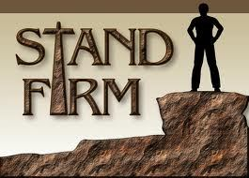
[1 Corinthians 15:58] we are commanded to be steadfast, unmovable, always abounding in the work of the Lord.
There is a BIG difference in standing firm & standing still.
We aren’t going anywhere if we are not walking

Slide 15
problems with liberalism
This view tends to be subjective rather than objective
The end justifies the means instead of book, chapter & verse...And whatever you do in work or deed, do all in the name of the Lord (by His authority) [Colossians 3:17]
There is a double condemnation for a leader of God’s people (elder) if he fails to...hold fast the faithful word as he has been taught, that he may be able by sound doctrine both to exhort and to convince the gainsayers. [Titus 1:9]

Slide 16
[Numbers 20:8] Moses is given this command...Take your rod, and gather the assembly together. You and your brother, Aaron, and speak to the rock before their eyes...
Notice what he did in verse 10 --- Moses & Aaron gathered the congregation together before the rock, and he said to them, “Hear now, you rebels, must we fetch you water out of this rock?”
The “grace/unity” movement places much emphasis on personal feelings as per James 4:17 Therefore to him that knows to do good, and does it not, to him it is sin.

Slide 17
problems with conservatism
Fear can serve to discourage the hearts of brethren to deter (and sometimes prevent) solid scriptural work.
Consider the spies’ report. [Numbers 13 & 14]
The people believed the report of 10 of the spies and elected to do the Conservative thing and go back to what was ‘comfortable (?)’ in Egypt
Because of their fear they made no progress for 40 years.

Slide 18
problems with conservatism
Judge not according to the appearance, but judge righteous judgment. [John 7:24]
Judgments can be made on appearances or preferences rather than what is right.
Since “we’ve never done this before” it invariably must be wrong
The Pharisees were a perfect example of “conserving” the Law of Moses by establishing their own code of rules and conduct. Standards

Slide 19
common faults
Both views can be reactionary
(Liberal reaction to) 1 Timothy 2:12 a woman must not teach, nor usurp the authority over the man, but to be in quietness...in other words not to preach in a public assembly.
A charge is made in the community that a church is “discriminating” against women.
Then comes the reasoning “after all, we don’t want people in the community to think we’re sexist” Now there are women in the pulpit

Slide 20
Neither view is consistent with the faithful life as described in the New Testament.
1. Liberal plays it loose in hopes of gaining more.
2. Conservative plays it safe to protect what he has.
Conserving error is just as wrong as being Liberal with the truth.
Born a Catholic to die a Catholic is dangerous Conservatism.
Those who refuse to put away the religion of their fathers for the sake of what they know is the truth are no better than the Pharisees of Jesus’ day.
Every plant that my heavenly Father has not planted shall be rooted up. [Matthew 15:13]

Slide 21
be faithful
In the story of the 12 spies, Joshua & Caleb were the heroes because they put their trust in what the God said.
They determined to follow it regardless of their personal feelings.
They may have been just as apprehensive about or impressed with the same things the other 10 saw.
We should never be blind to the dangers, but that should never keep us from doing anything that is scriptural. [Ex. exercising discipline]
For God has not given us the Spirit of fear, but of power and of love and of a sound mind [2 Timothy 1:7]

Slide 22
Liberal or Conservative?
Why hold such a poor choice?
Why not be faithful?
Why not be perfectly united in our collective efforts to conservatively follow God’s Word only?
Why not be liberal in our love toward one another?
After all, it is the good & faithful servant who will enter into the joy of the Lord [Matthew 25:21]...not a Liberal or a Conservative.

