Slide 1
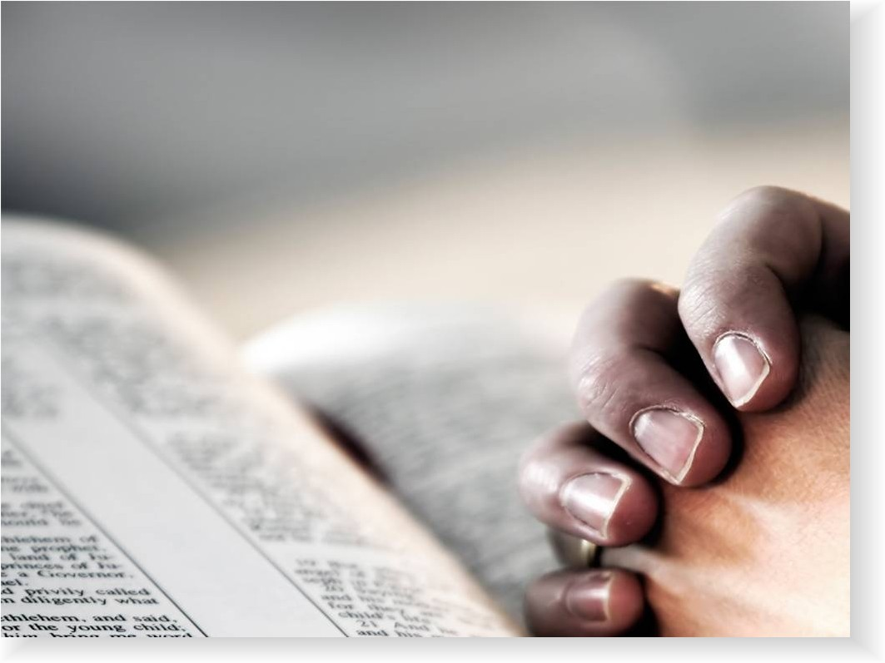
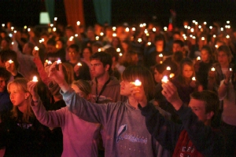
Our Fellowship with God
Reading: 1 John 1:1-10

Slide 2
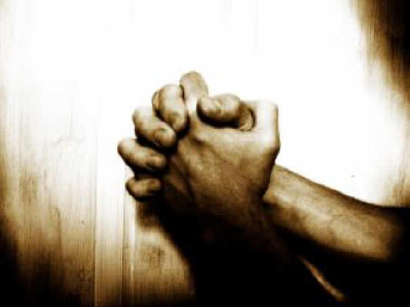
Prayer Is a dialogue between the individual and God
If you were not in tune with the prayers that we just had you were not in fellowship with God.
Saying “Amen” doesn’t validate a prayer that is not heartfelt.

Slide 3
Private Prayer Is Easy To Do – Public Prayer?
[Matthew 6:5 – 6]
“Pray without ceasing” [1 Thessalonians 5:17]

Slide 4
Public Prayer Is Harder To Handle
Prayers, Singing, and taking the Lord’s Supper are done communally --
However, they are still observed individually
1 Corinthians 11:26-29
2 Corinthians 5:10
Galatians 6:5

Slide 5
Public Prayer Is Harder To Judge
[Matthew 23:14] Woe to you, scribes and Pharisees, hypocrites! For you devour widows’ houses, and for a pretense make long prayers. Therefore you will receive greater condemnation.
Did that mean the others who may have been trying hard to pray at the same time were deemed as hypocrites as well?
God knows the heart of the one doing the praying and judges accordingly.

Slide 6
1 John 3:20-22 – Value of Self Examination
For if our heart condemns us, God is greater than our heart, and knows all things. ²¹Beloved, if our heart does not condemn us, we have confidence toward God. ²²And whatever we ask we receive from Him, because we keep His commandments and do those things that are pleasing in His sight.
On top of this God helps us in our prayers……

Slide 7
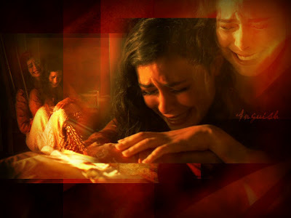
Romans 8:26-27
Likewise the Spirit also helps in our weaknesses…. but the Spirit Himself makes intercession for us with groanings which cannot be uttered…
When we are IN fellowship, God helps us to communicate with Him.

Slide 8
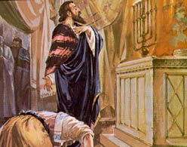
Luke 18:9-14
The Pharisee and the Publican both pray in the same location.
One goes home justified

Slide 9
James 5:13-16
What if one or all of the elders have secret sins that you don’t know about?
Does that negate your request? Are you still in your sins?
The same scenario could be applied to someone being baptized by a “sinner” or someone offering the Lord’s Supper.

Slide 10
In Regard to Fellowship ---
They may have sinned or they could have been out of fellowship with God
But You were whole-heartedly seeking God’s fellowship
(Proverbs 24:29) “… I will render to the man according to his work.“
When All is said and done all we have are sinners praying for other sinners and God sorting out who’s IN and who’s NOT!

Slide 11
John 9:31 [ex. Cornelius in Acts 10]
Now we know that God does not hear sinners; but if anyone is a worshiper of God and does His will, He hears him.
We don’t determine who is in fellowship with God and who’s prayer is heard or not heard.
We need to be more concerned with OUR fellowship with God than with each other.

Slide 12
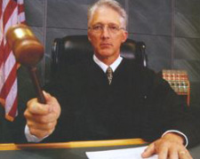
How Will You Be Judged?
We will all stand before the great tribunal one day.

Slide 13
Are You In Fellowship When You Pray? If not – Get Right Now!
1 John 1:1-10

