Slide 1
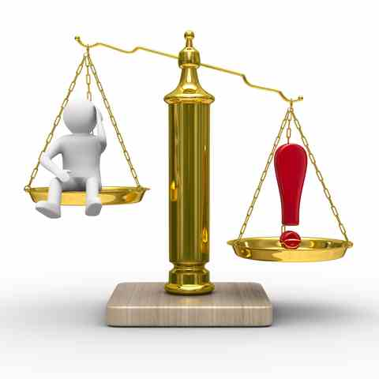
The Equalizer
Reading: Ecclesiastes 9:4-11

Slide 2
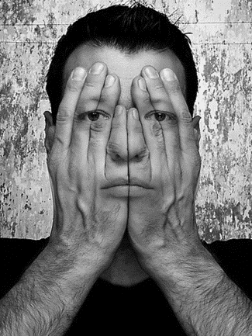
Ecclesiastes 8
(Ecclesiastes 8:1) Who is like a wise man? And who knows the interpretation of a thing? A man's wisdom makes his face shine, And the sternness of his face is changed.
You can tell a wise man from the expression on his face.
Likewise sin & guilt cannot be hidden.

Slide 3
Ecclesiastes 8
{3} "Do not be hasty to go from his presence. Do not take your stand for an evil thing, for he does whatever pleases him.“
Don’t be hasty to go out under the king’s authority to do it “YOUR WAY”. Don’t stand in an EVIL THING.
You can’t ever depart from God’s presence but you can depart from His authority. The king has power to do whatever He desires.
[Romans 13:1-2 &7]

Slide 4
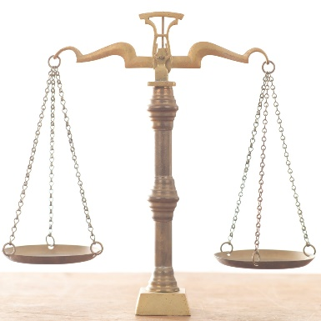
Ecclesiastes 8:4
The word of authority has power. “Last Impressions Are LASTING Impressions”. Try getting a good job without references from a former teacher, principal or employer.
In time each person will ultimately reap what they sow. (Galatians 6:7)
This is the sentiment of verse 7 of our text as well.

Slide 5
BUT WHAT IF I AM OPPRESSED?
Vs. 8 of our text says that no man has power over your spirit or will. No one can force you to sin.
The wise man does not “kick against the goads” [Acts 9:5]
Can a man fight against God and win? This was Gamaliel’s question in [Acts 5:34-39]
Sooner or later every wicked ruler dies. This is one war with no “Discharge”.

Slide 6
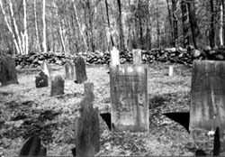
All this I have seen, and applied my heart to every work that is done under the sun: There is a time in which one man rules over another to his own hurt.
An oppressive ruler ultimately rules to his own hurt. Consider the Caesars, Hitler, Manuel Noriega and Saddam Hussein.
Ultimately all who live unrighteous and oppress others will have their day!
(Ecclesiastes 8:10) The wicked will be buried and their memory will be forgotten. Death is the great equalizer.

Slide 7
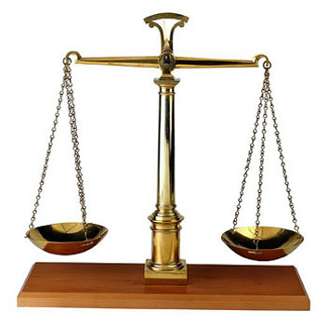
Vs. 11. Because the sentence against an evil work is not executed speedily, therefore the heart of the sons of men is fully set in them to do evil.
How many times have you thought about that passage in regards to our judicial system?
A man on death row won’t be executed for at least 6-9 years for his crimes. No wonder the death penalty has no sting to it.
Wisdom and patience are the deterrents for the righteous. That’s why the wise will do what’s right even though “Everyone Else Is Doing Wrong...” AND GETTING AWAY WITH IT!

Slide 8
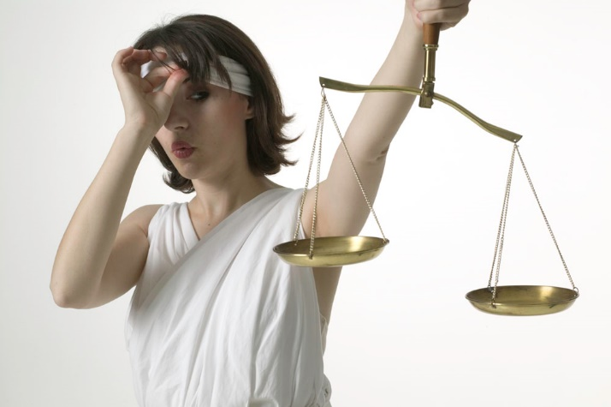
A Discrepancy
(Ecclesiastes 8:12-13)
Men will live in their wickedness for as long as they can get away with it.
But even if that man seems to be profiting from his wickedness, ULTIMATELY it’s better to fear God and keep His commandments.
(James 4:14)

Slide 9
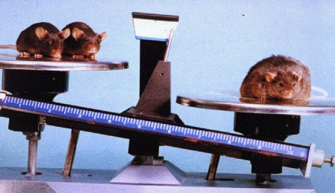
(Ecclesiastes 8:14-15)
There are no ironclad rules concerning the quality and character of my life with the consequences of that life.
If I do everything by the book, that does not guarantee me prosperity and a long and smooth life.
Truth of the matter is...Good things can happen to Bad People and Bad things can happen to Good People.

Slide 10
(Ecclesiastes 8:14-15)
The key words to these passages is “UNDER THE SUN”.
If this life is the only indicator, then EAT, DRINK, AND BE MERRY. (1 Corinthians 15:32)
(Ecclesiastes 8:17)
So “WHY ASK why?” All the wisdom in the world won’t give you this answer. FAITH is the ANSWER.

Slide 11
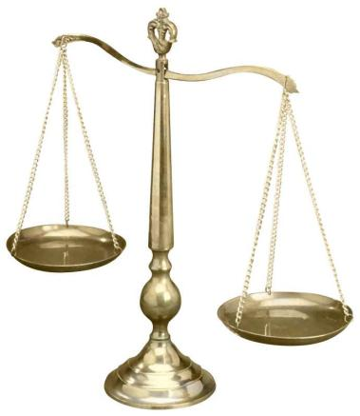
moving on to CHAPTER 9:1-3
(Hebrews 12:5-6)
The only way we know God chastises his beloved children is by Revelation...not life’s circumstances.
Some of the best people die early and some of the wickedest people go on & on & on. Maybe that’s God’s reward or His punishment.
There is only one event common to all...DEATH

Slide 12
Misconception Of Living In Relation To The Dead
(Ecclesiastes 9:4-6) … Nevermore will they have a share In anything done under the sun.
CONTEXT: A living “DOG” is still in the realm of opportunity as opposed to the dead lion.
The wise man will live with the knowledge that he only gets one shot at life.
No one likes to dwell on unpleasant things. Does ignoring the inevitable sound like a wise thing to do?
Again - Notice the important phrase ‘UNDER THE SUN’

Slide 13
(Ecclesiastes 9:10)
What ever you do, do it the best you can.
Why? Because you are trading some of your life for it. Whether you:
1. Sit on the couch and watch TV,
2. Go to the park and play with your children,
3. Go to work,
4. Teach others the gospel
5. Eat & sleep...
WHAT EVER YOU DO YOU’RE TRADING SOME OF YOUR LIFE FOR IT!!!

Slide 14
What have you traded your life for last week?

Slide 15
HUMAN RESOURCE IS NOT ALWAYS THE WHOLE STORY
(Ecclesiastes 9:11-12)
How many times have you seen?
The better team loses.
The least qualified person gets the promotion.
Those with the most ability & those with the most knowledge fail miserably.
We have a phrase “every dog has his day”. Any team can win on any given day. The key to success is found in the trying.
Too many of us judge a team by the scoreboard.

Slide 16
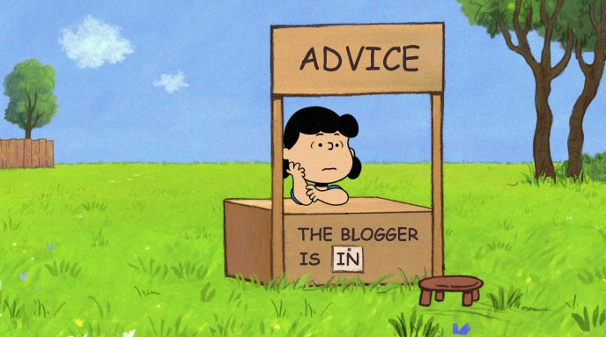
WHY WON’T THEY LISTEN?
(Ecclesiastes 9:13-18)
We live in time when any EXPERT can get on the TV or radio as an EXPERT and tell us how to live and raise our children.
What’s worse, people are listening to them!

Slide 17
Be careful which expert you listen to.
The expert who will never fail is Jesus when He calls you through His word.
WON’T YOU LISTEN TO HIM?

Slide 18
Matthew 7:21 – 23 “Not everyone who says to me, ‘Lord, Lord,’ will enter the kingdom of heaven, but the one who does the will of my Father who is in heaven. ²²On that day many will say to me, ‘Lord, Lord, did we not prophesy in your name, and cast out demons in your name, and do many mighty works in your name?’ ²³And then will I declare to them, ‘I never knew you; depart from me, you workers of lawlessness.’

