Slide 1
The Remnant
Reading – Romans 11:1-5

Slide 2
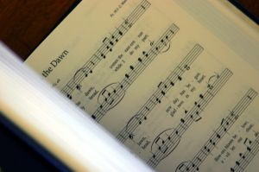
Popular Song [853]
When We ALL Get To Heaven

Slide 3
We need to take a lesson from God’s instruction to the Jews.
Sometimes we think that once we’re saved, God’s not really going to do to us what He’s going to do to all those who really disobey Him.
We preach against the theory of once saved, always saved -----

Slide 4
We need to take a lesson from God’s instruction to the Jews.
But deep inside, we act as if we believe it is true.
Following the “proper procedure” to get into Christ is not a once-for-all event.

Slide 5
The Jews took God for granted.
They STILL take God for granted.
They were born into this “Chosen” race
They thought they could have salvation based upon what Abraham or David did.

Slide 6
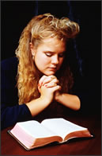
Do we have the attitude that takes God for granted?
We want to live our lives to ourselves and then call on God’s grace for salvation.

Slide 7
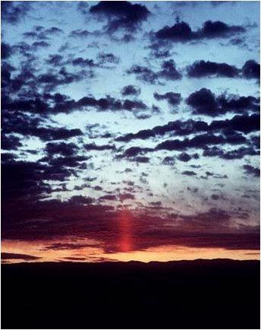
For the Remnant the “Song of Victory” will be sweet!

Slide 8
Jesus taught that only the obedient would be chosen.
(Matthew 7:21-23)
(Matthew 7:13-14)
(Matthew 22:1-14)
(Luke 13:23-28)

Slide 9
Who are those who will be rejected?
(2 Thessalonians 1:7-9 you who are troubled rest with us when the Lord Jesus is revealed from heaven with His mighty angels, {8} in flaming fire taking vengeance on those who do not know God, and on those who do not obey the gospel of our Lord Jesus Christ. {9} These shall be punished with everlasting destruction from the presence of the Lord and from the glory of His power,
Jesus says, "There will be weeping and gnashing of teeth,
That is the punishment for rebellion.

Slide 10
all is not hopeless
(Romans 11:5) Even so then, at this present time there is a remnant according to the election of grace.
Despite their rebellion God has not totally rejected Israel.
Rather He has chosen from this “Chosen People” a few good men. [vs.4&5]
They were not chosen by lottery or by chance.
These men were chosen because of their faith AND obedience.

Slide 11
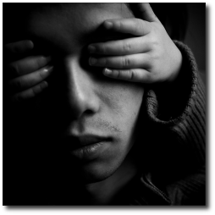
Why men will refuse to do God’s Will remains a mystery
(Romans 11:7-10)

Slide 12
Romans 11:11-15
God wanted them to appreciate being special again.
They needed to be born again (chosen again).
You never fully appreciate what you have until it’s gone.

Slide 13
shift of focus
Read (Romans 11:16-24)

Slide 14
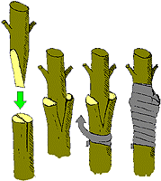
Illustration of the Gentile believers
We came to be in Christ by being grated into the TRUE vine.

Slide 15
Christ is the vine and we are the branches.
Many of the original branches were unfruitful, so they were cut off
God chooses a few obedient branches to graft in
This “grafting,” however, is permanent only as long as they remain fruitful.

Slide 16
Here is how "all Israel" can be saved.
Through a “blinding in part” mercy can now be shown to the Gentiles, (Romans 11:25-26)
By showing mercy to the Gentiles mercy will be available to disobedient Israel. (Romans 11:27-31)
{32} For God has committed them all to disobedience, that He might have mercy on all.
God is no respecter of persons and makes His plan of salvation available to all.

Slide 17
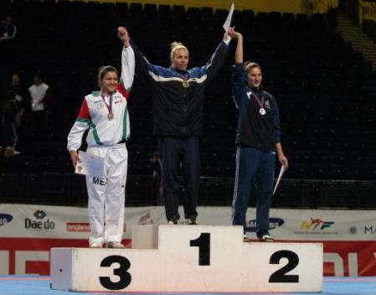
Salvation is available to all who are Obedient, but that number will be few!

Slide 18
Doxology [vs33-36]
(Romans 11:33-36) Oh, the depth of the riches both of the wisdom and knowledge of God! How unsearchable are His judgments and His ways past finding out! {34} “For who has known the mind of the LORD? Or who has become His counselor?” {35} “Or who has first given to Him And it shall be repaid to him?” {36} For of Him and through Him and to Him are all things, to whom be glory forever. Amen.

Slide 19
Won’t you choose to become one of the chosen?

