Slide 1
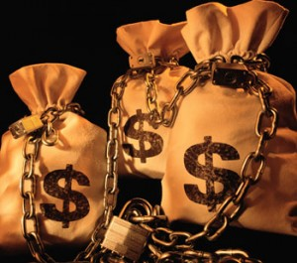
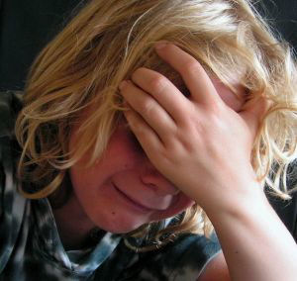
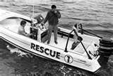
God’s Providence in Blessings & Trials
Reading – Philippians 4:4-10

Slide 2
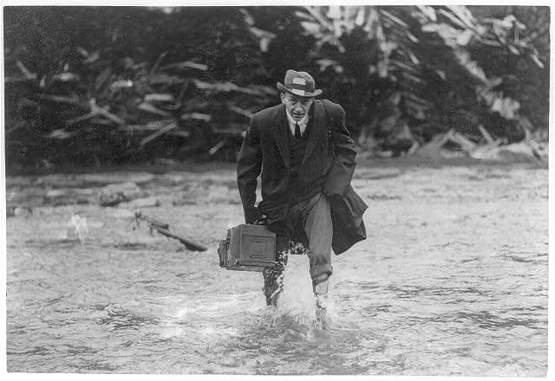
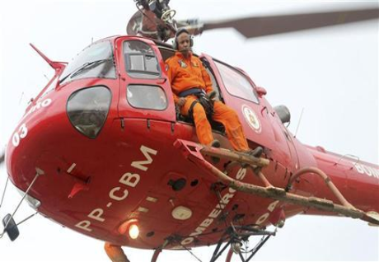
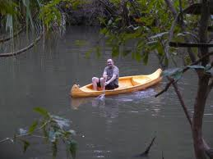
A great story about faith and action.

Slide 3
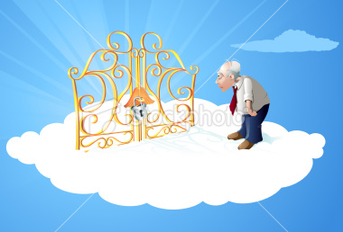
Standing At The Pearly Gates
Complaint: "The last thing I remember I was in trouble, praying up a storm, so why did you let me drown?"
Reply: "We sent you two boats and a helicopter. What more did you want?"

Slide 4
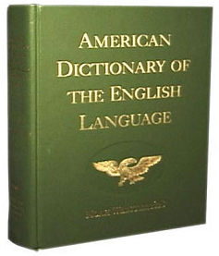
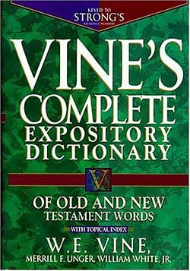
Providence Defined:
"divine guidance or care; God conceived as the power sustaining and guiding human destiny."
The word means basically "to provide, provision." (Vine's Expository Dict.)
The principle of the providence of God is taught everywhere.
God works through natural means (not by miracles) to provide for His people.

Slide 5
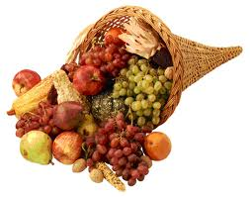
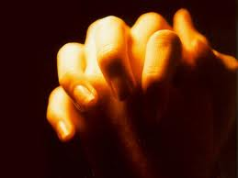
God’s Providence in Blessings
(Matthew 5:45)
(Acts 17:24-28)

Slide 6
Jesus told us that there are physical blessings
…seek first the kingdom of God and His righteousness, and all these [physical blessings] things shall be added to you. (Matthew 6:33)
This is a promise that we should rely on. We can’t escape the blessings.
We understand that spiritual blessings come to us as well through obedience to His Word; and those physical blessings come to us by means of His providence.

Slide 7
Some of these blessings are:
We are blessed an hundred fold.
(Mark 10:28-30)
Long life and good days.
(1 Peter 3:10-12)
It is a general rule that those who live a righteous lifestyle live a healthier lifestyle as well – thus living longer.

Slide 8
Blessings in disguise
(Romans 8:28)
(Philippians 1:12)
The story of Joseph in the book of Genesis best describes this principle.
(Genesis 50:14-20)

Slide 9
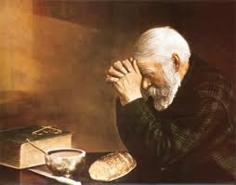
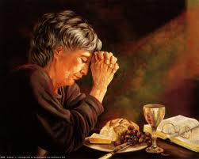
(Psalms 37:25-26)
I have been young, and now am old; Yet I have not seen the righteous forsaken, Nor his descendants begging bread. {26} He is ever merciful, and lends; And his descendants are blessed.
Truly, every need we have God has supplied through His providence.
(2 Corinthians 9:8)

Slide 10
In Contrast:
The Lord allows the folly of those who disobey Him to be visited upon themselves as well.
(Psalms 7:14-16)
[Living by the sword --]
(Psalms 37:15)

Slide 11
The path to success:
(Joshua 1:8)
In Spanish the word for success is exito. It's a helpful insight.

Slide 12
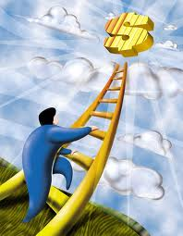
What Is Success?
Success is not a ladder you climb to riches.

Slide 13
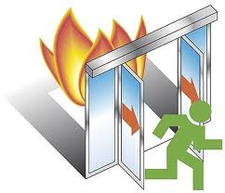
What Is Success?
Success is a fire escape, a way out of a bad situation to something better.

Slide 14
What Is Success?
Success is not the start of winning; it is the end of losing.
Also, remember that on top of the physical blessings are the spiritual ones, which are far greater. ...And in the world to come, eternal life." Mark 10:30

Slide 15
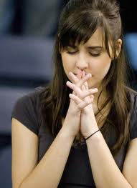
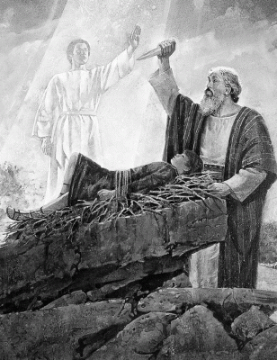
God’s Providence in Trials
(Hebrews 11:17)

Slide 16
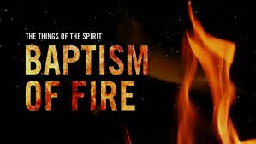
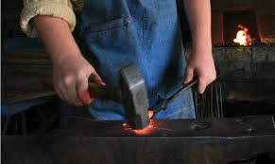
We also are tried and tested.
Thru His providence God allows us to undergo our baptism of fire.
(1 Corinthians 3:13)
(1 Peter 1:6-7)
(1 Peter 4:12)
(2 Timothy 3:12)

Slide 17
The Greek word "tempt" is defined as "trials of all kinds; trials with beneficial purposes and effects."
(James 1:2-3)
(1 Peter 1:3-7)
This passage tells us that the trials are for a little while with our ultimate good in mind.
At the same time in all tests, God provides a way of escape.
(1 Corinthians 10:13)

Slide 18
Trials vs. Temptations
God tries the righteous, but God never tempts them to do evil.
(James 1:12-14)
It is the deceiver, man's adversary, the old serpent that does the tempting to evil.
God allows Satan to tempt man on a limited basis in this present age, but in the next, Satan will be cast into the lake of fire. [Revelation 20:10]

Slide 19
God brings upon us things to prove and strengthen us.
(Romans 5:3-4)
It gives me comfort & strength to know that Jesus understands our predicament.
(Hebrews 2:17) For in that He Himself has suffered, being tempted, He is able to aid those who are tempted…(Hebrews 4:15) For we do not have a High Priest who cannot sympathize with our weaknesses, but was in all points tempted as we are, yet without sin.

Slide 20
God's providential care is working in:
Blessings. Romans 8:28
Trials. 1 Peter 1:7
Prayers. Matthew 7:11
Chastisement. Hebrews 12:5-6
Then we have the ultimate demonstration of His providence.
(Romans 5:3-11)

