Slide 1
Seek The Lord While He Still May Be Found Reading - Isaiah 55:6-11

Slide 2
THIS is the time when the Lord is available.
Isaiah’s Lament --The people had departed from God in their hearts.
Unfortunate situation: The ones who need to seek and call on the Lord are the ones who have departed and are the farthest away...or....
They have no desire to do so.

Slide 3
Similar Situation in Jeremiah’s day ---
Jeremiah 11:11-14
Jeremiah 14:11-12
The Lord is commanding Jeremiah not to pray for somebody who’s lost.
In essence God says, “My patience has run out!”
Jeremiah 15:1

Slide 4
So you always though God was available didn’t you?
There may come a time when God’s cup of patience is full.

Slide 5
Is America Next? Romans 1:26

Slide 6
There may come a time when He will not hear no matter how hard one prays.
What’s the first words that come from an ungodly persons lips as he’s about to have an auto accident or plane crash?

Slide 7
Who is called upon when a loved one is in the hospital and all human effort has failed?
When God doesn’t jump at the drop of a hat He is a cruel & merciless monster or else He doesn’t exist.

Slide 8
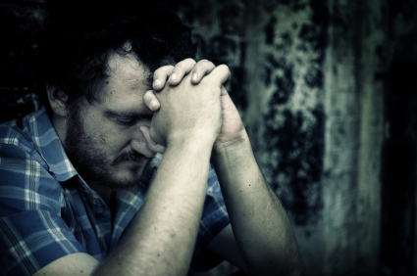
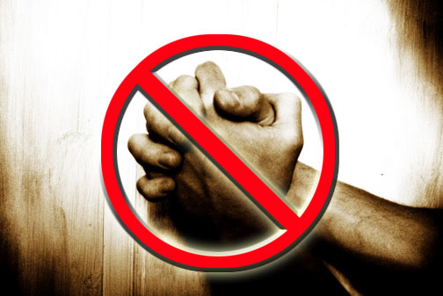
Who Does God Hear? John 9:31 Isaiah 55:7

Slide 9
1 Timothy 4:1-2 states a problem that arises in staying away from God for too long.
“In later days some shall depart from the faith giving heed to seducing spirits…” (live for today, co-habitating is OK, drunkenness & gambling are OK as long as you know when to say when)

Slide 10
1 Timothy 4:1-2 continued ----
“And doctrines of devils” (like humanism)
“Speaking lies in hypocrisy” (as several TV evangelists)
“Having their conscience seared with a hot iron.” (As a bar owner or a porn peddler)

Slide 11
Another Text By Way Of Context Isaiah 55:8&9

Slide 12
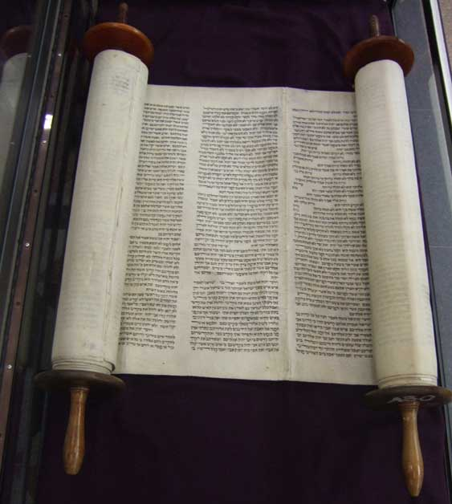
CONTEXT ----
God condemns Israel because they are not conforming their thoughts or their ways to the Law that God has already given.
The Law was clear and simple to follow.... DON’T WORSHIP ANY OTHER GODS! DO NOT KILL, DO NOT STEAL, DO NOT COVET!
These laws were attainable BUT the people just did not want to follow them. They wanted to have it their way!

Slide 13
CONTEXT ----
If you want to come back to God you must think HIS THOUGHTS
You must DO HIS COMMANDS
[Found in the Bible]
If you do this He will “abundantly pardon”

Slide 14
How can God forgive & forget?
Because that’s God’s way and He expects us to follow it.
Matthew 6:14-15
We are no more human than when we need forgiveness; we are no more godly than when we forgive.

Slide 15
You CAN Find Him Now!
2 Corinthians 6:1-2
Titus 2:11-12 ---
Compare that with Isaiah 55/5 & 6 it says the same thing!
We must change; We must conform
Romans 12:2 -- James 1:21
“AND HE WILL ABUNDANTLY PARDON”

Slide 16
Fallacy –
“THE WORD OF GOD WILL SAVE EVERYONE” ... That’s WRONG!
Truth: THE WORD OF GOD WILL SAVE EVERYONE WHO WANTS TO BE SAVED.

Slide 17
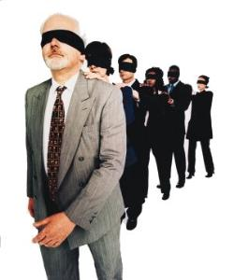
Those who will NOT SEEK THE LORD WHILE HE STILL MAY BE FOUND will not find Him.
Don’t wait until it’s too late!

