Slide 1
The Spirit & The Understanding Part 24
Reading -- 1Corinthians 14:1-15

Slide 2
Singing Is Not An Afterthought
Exodus recalls the song of freedom
The Psalms were all meant to be sung.
Isaiah has 17 references to singing in various ways.
Ephesians 5:17-20 Therefore do not be unwise, but understand what the will of the Lord is. And do not be drunk with wine, in which is dissipation; but be filled with the Spirit, speaking to one another in psalms and hymns and spiritual songs, singing and making melody in your heart to the Lord, giving thanks always for all things to God the Father in the name of our Lord Jesus Christ,
See also Colossians 3:16

Slide 3
Let’s Examine 5 Songs We Sing
More Love To Thee, O Christ – 700
My Jesus, I Love Thee – 701
We Praise Thee, O God -- 2
My Jesus, As Thou Wilt – 698
Lord, I’m Coming Home – 936

Slide 4
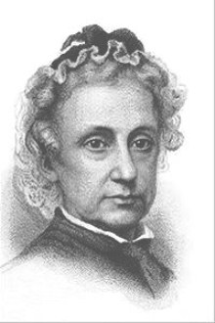
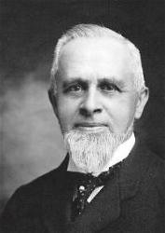
More Love To Thee, O Christ - 700
Words By Elizabeth Prentiss (1856)
Music by W. H. Doane (1870)
Scriptures:
John 15:12-15; Philippians 1:9-11; James 1:12

Slide 5
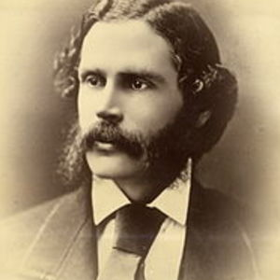
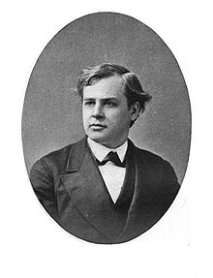
My Jesus, I Love Thee - 701
Words by William Featherstone (1876)
Music by A.J. Gordon Stebbins (1876)
Scriptures:
Ephesians 2:4-5; 1 Peter 1:8; 1John 4:9-11

Slide 6
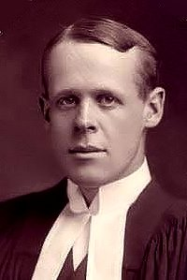
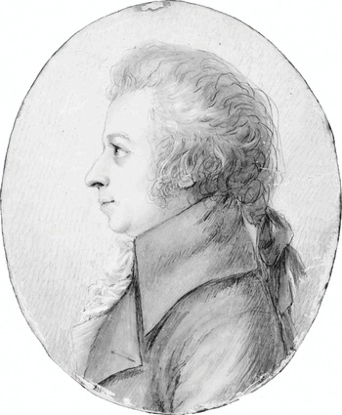
We Praise Thee, O God -- 2
Words by William P. MacKay (1863)
Music by J. J. Husband (1815)
Scriptures:
2 Chronicles 7:14; Psalm 85:6; Habakkuk 3:2; Titus 3:4-8

Slide 7
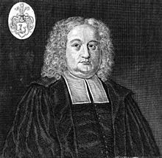
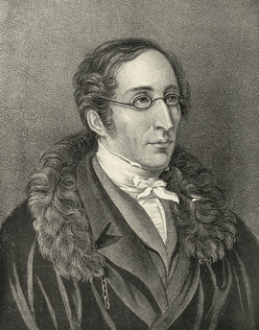
My Jesus, As Thou Wilt – 698
Words by Benjamin Schmolke (1704)
Music by Carl von Weber (1862)
Scriptures:
Psalm 40:8; Matthew 6:10; Luke 22:39-42

Slide 8
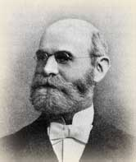
Lord, I’m Coming Home -- 936
Words & Music by William J Kirkpatrick (1892)
Scriptures:
Genesis 31:3; Luke 15:17-21; John 1:11-12

