Slide 1
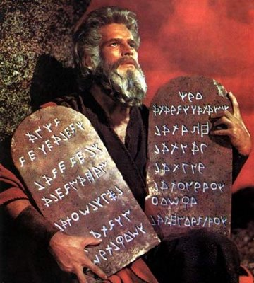
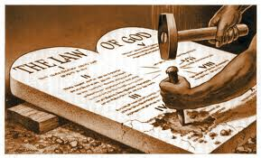
What if the 10 Commandments Were Still Binding?
Reading: Colossians 2:8-14

Slide 2
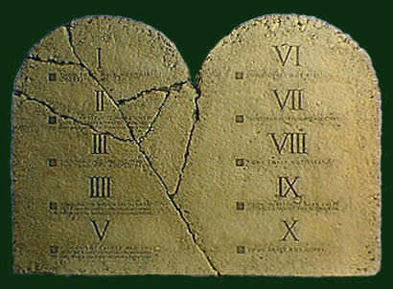
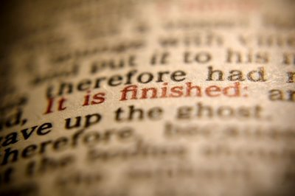
All EXCEPT the Ten Commandments
A majority of Americans believe that we need to adhere to the 10 Commandments.
We must come to the undeniable conclusion that the 10 Commandments are no longer binding.

Slide 3
What If They ARE Binding?
Some Logical Conclusions

Slide 4
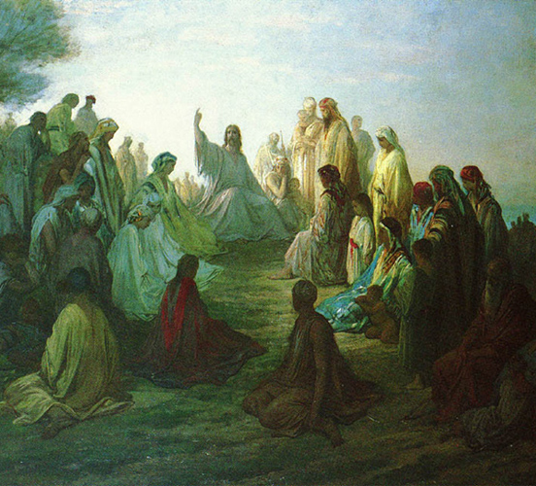
Moses would share with Jesus the authority to speak for God.
Matthew 28:8.

Slide 5
Moses & Jesus would serve as judges of the people of this age
(John 12:48)
(Acts 17:30-31)
I can find no record of where God raised Moses from the dead. Can you?

Slide 6
Moses & Jesus would be vines from which we, the branches, receive our spiritual life sustaining food.
Jesus teaches us that we have only one true vine.
(John 15:1)

Slide 7
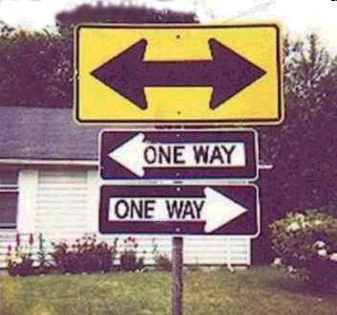
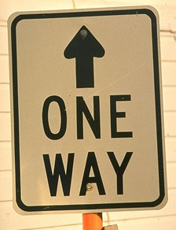
We could use either Moses or Jesus as our way to the Father
(John 14:6)
The Only One Way!

Slide 8
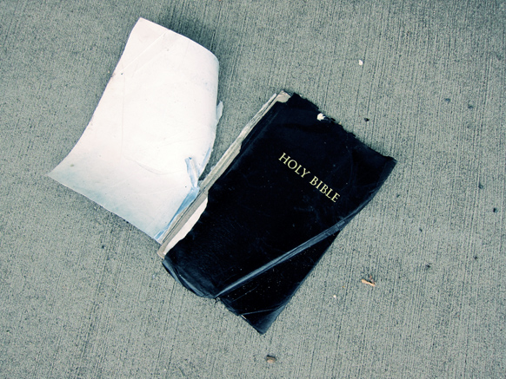
Moses would share with Jesus in having the words of life.
John 6:67-68
If the 10 Commandments given through Moses were still in force is to contend that the Bible is a book that is divided against itself.
We would be required to worship on the Sabbath day as well as the 1st day of the week.
If this is true, then it is not worth the paper it is printed on.

Slide 9
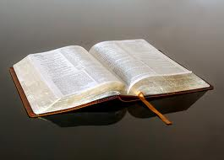
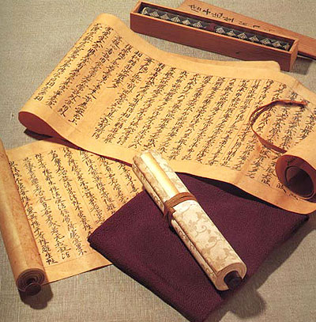
What The New Testament Says About the Old Testament
Romans 7:1-7

Slide 10
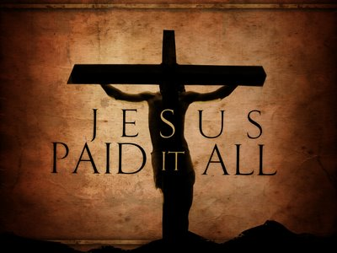
Jesus died on the cross to set the people free from complying to the Old Testament law.
Now they are married to [subject to] the law of Christ.
[Verse 6] -- to serve in newness of spirit, and not in the oldness of the letter.
In 2 Corinthians 3, you will find the 10 Commandments, as well as the rest of the law of Moses was that letter.
Go back again to our reading.
(Colossians 2:13-15)

Slide 11
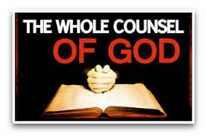
Acts 20:26-27
Paul and the Apostles no longer taught what they learned as children.
They used that knowledge to introduce the Newly Established Kingdom
(Galatians 1:11-12)
Go back again to our reading.
(Colossians 2:13-15)

Slide 12
Arguments for Keeping the 10 Commandments
“If they aren’t binding then we can…”

Slide 13
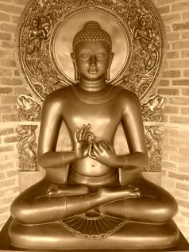
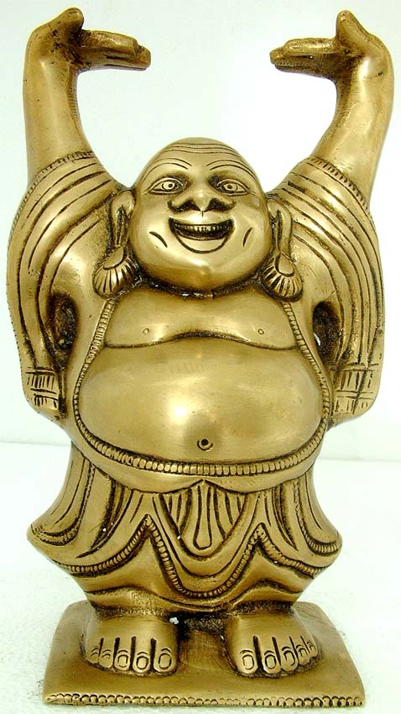
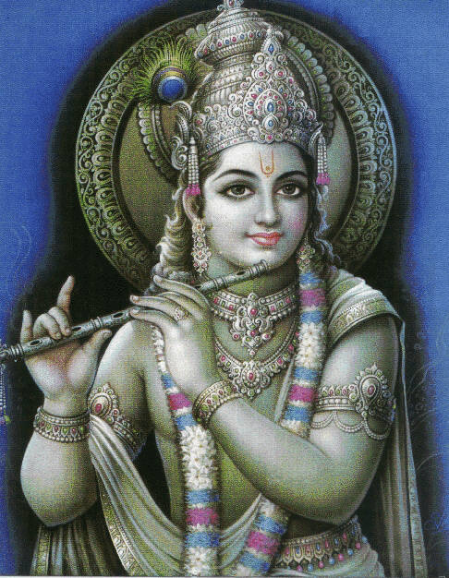
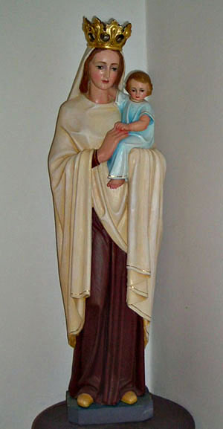
Have other gods & idols
(1 Corinthians 6:9)
“If they aren’t binding then we can…”

Slide 14
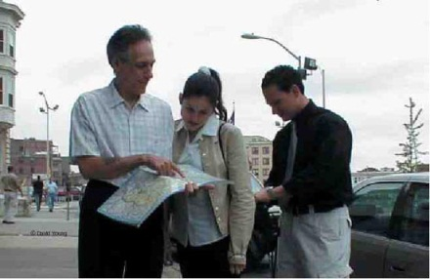
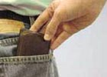
Steal
(Ephesians 4:28)
“If they aren’t binding then we can…”

Slide 15
Lie
(Colossians 3:9)
Commit Adultery – Galatians 5:19-20
Covet – (Colossians 3:5)
Dishonor Parents – (Ephesians 6:1-2)

Slide 16
The New Testament gave us an improved version of the Commandments.
(Hebrews 8:6)

Slide 17
“Jesus taught the people to keep the commandments.”
(Mark 10:17-19)
Jesus also told the people to comply with all of the Law’s teachings
(Matthew 23:2-3)
The truth is that all the Law of Moses was in force until Christ died on the cross.
(Hebrews 9:15-17)

Slide 18
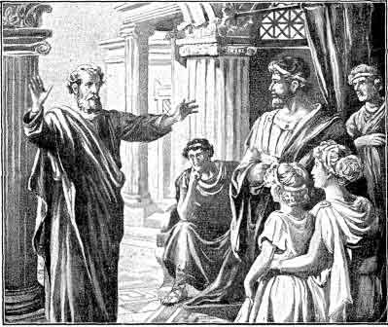
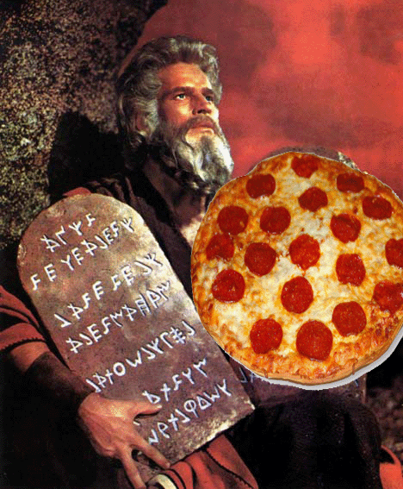
The Sabbath Observance
“Thou Shalt Do NO Work on Saturday”

Slide 19
The Sabbath was NEVER INTENDED for the Gentiles
The Sabbath observance was for the children of Israel whom God delivered from Egyptian bondage.
No one else was commanded to observe it before that.
Abraham did not keep a Sabbath.
The Gentiles were not commanded to keep the Sabbath before or after Jesus came.
There is a scripture directed towards Gentiles converted to Christianity that commands them not to keep it.
(Colossians 2:16)

Slide 20
What day is the Sabbath day?
Saturday
Do not let anyone tell you that Sunday is the Sabbath.
Sunday is the Lord’s Day, the 1st day of the week.
It is the day the early church recognized as the day to assemble to break bread in memorial to Christ.

Slide 21
What was necessary to keep Saturday holy?
Cannot do any work.
Employees and animals were to rest.
Could not kindle a fire.
The food must be prepared on Friday.
Cannot travel more than 7/8 of a mile
(Galatians 4:21) Tell me, you who desire to be under the law, do you not hear the law?
If we were still bound by the 10 Commandments how would that change your Saturday activities?

Slide 22
Respect
Is there any command or precept of God, which instructs us to keep almost all of His commands?
Yes, today we live in accordance to the nature of what was taught in the Ten Commandments.
Not because they are in the 10 Commandments, but because the same things are taught in the New Testament.

Slide 23
The next time someone tells you, “Just as long as we live by the 10 Commandments we’ll be pleasing to God,”
You’ll Know How To Answer Them!

