Slide 1
Only 2 Choices to Make
Reading – Mark 9:40-50

Slide 2
when only 2 options are presented, it makes it rather easy to choose
For instance, Do you want to go to heaven or to hell when you die?
The choice sounds rather simple doesn’t it?
However your decision will depend on how you answer a few more “Either Or” choices.

Slide 3
Who do you serve?
Satan (The Devil)
(2 Corinthians 4:3-4)
(Ephesians 2:1-2)
the prince of the power of the air, the spirit that now works in the children of disobedience:"...
(Ephesians 6:11-12)

Slide 4
Who do you serve?
Our best choice is Jesus The Christ:
(Matthew 28:18)"All authority is given unto Me in heaven and in earth."
(1 Corinthians 15:24-28)
(Ephesians 1:22-23)

Slide 5
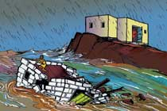
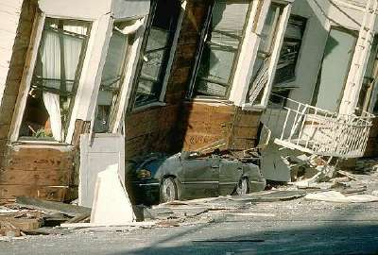
TWO FOUNDATIONS:
SHIFTING SAND:
(Matthew 7:26-27)

Slide 6
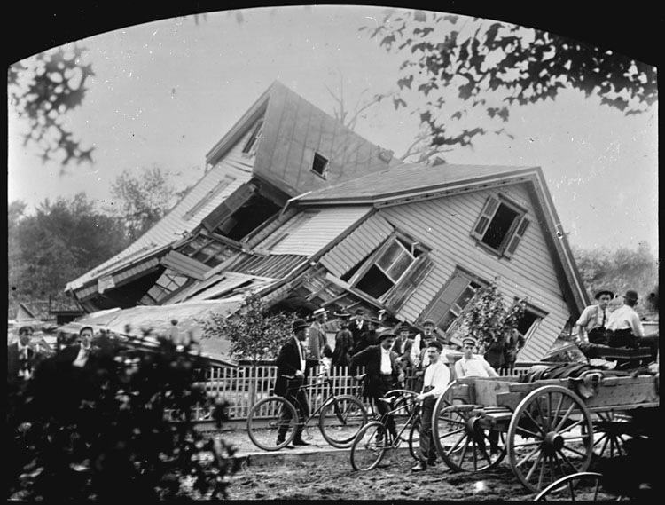
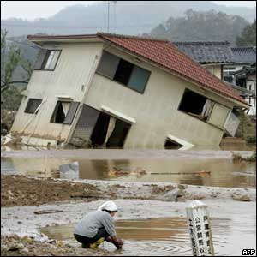
TWO FOUNDATIONS:
(Luke 6:46) "But why do you call Me 'Lord, Lord,' and do not do the things which I say?
No Foundation!

Slide 7
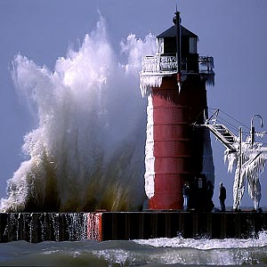
TWO FOUNDATIONS:
The only sound foundation is built upon SOLID ROCK:
(Matthew 7:24-25)

Slide 8
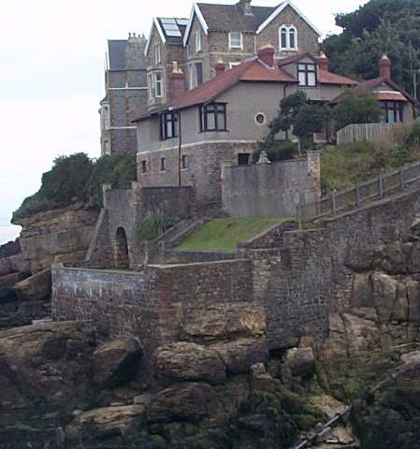
TWO FOUNDATIONS:
(1 Corinthians 3:11)

Slide 9
TWO ROADS AHEAD:
It’s not hard to choose the BROAD WAY: (Matthew 7:13-14)
It is more difficult to pick the NARROW WAY: (Matthew 7:21-23)
(Luke 13:24) "Strive to enter through the narrow gate, for many, I say to you, will seek to enter and will not be able.

Slide 10
Heaven
Born = Safe
Accountability
Enemies
Friends
Family
The Narrow Way is not a little side road
Hell

Slide 11
Heaven
Born = Safe
Accountability
Enemies
Friends
Family
The Narrow Way runs right through all that mess!
Hell

Slide 12
TWO GUIDES:
MAN'S OPINIONS:
(Proverbs 14:12)
(Matthew 15:8-9)
(2 John 1:9-11)

Slide 13
TWO GUIDES:
The 2nd choice requires FAITH IN GOD:
(2 Corinthians 5:7)"(For we walk by faith, not by sight;)"
(Romans 10:17)
(Hebrews 11:6)

Slide 14
TWO kinds of faith:
“FAITH ONLY" (ALONE):
(James 2:14-26)

Slide 15
TWO kinds of faith:
OBEDIENT FAITH:
(Hebrews 5:8-9)
(Romans 6:16-18)
(1 Peter 1:22-25)

Slide 16
TWO DEATHS TO DIE:
LOST IN SIN:
(John 8:21-24)
(Ezekiel 3:18-19)
(Psalm 9:17)

Slide 17
TWO DEATHS TO DIE:
SAVED "IN CHRIST:"
(Revelation 14:13)
(Revelation 22:14)
(1 Thessalonians 4:13-18)

Slide 18
TWO Eternal DESTINES:
TORMENT IN HELL:
(Matthew 25:41 & 46)
(2 Thessalonians 1:6-9)
We can read passages in Luke 16 where the rich man says he is "...Tormented in these flames..“

Slide 19
TWO Eternal DESTINES:
JOY IN HEAVEN:
(John 14:1-3)
(2 Corinthians 5:1)

Slide 20
TWO Eternal DESTINES:
(Matthew 25:34) "Then shall the King say unto them on the right hand, Come you blessed of My Father, inherit the kingdom prepared for you from the foundation of the world."

Slide 21
Have You Made Your Choice?
Decision Time!

