Slide 1
And while being reviled, He did not revile in return; while suffering, He uttered no threats, but kept entrusting Himself to Him who judges righteously; 1Pe 2:23

Slide 2
For you have been called for this purpose, since Christ also suffered for you, leaving you an example for you to follow in His steps… vs21
And while being reviled, He did not revile in return; while suffering, He uttered no threats, but kept entrusting Himself to Him who judges righteously; 1Pe 2:23

Slide 3
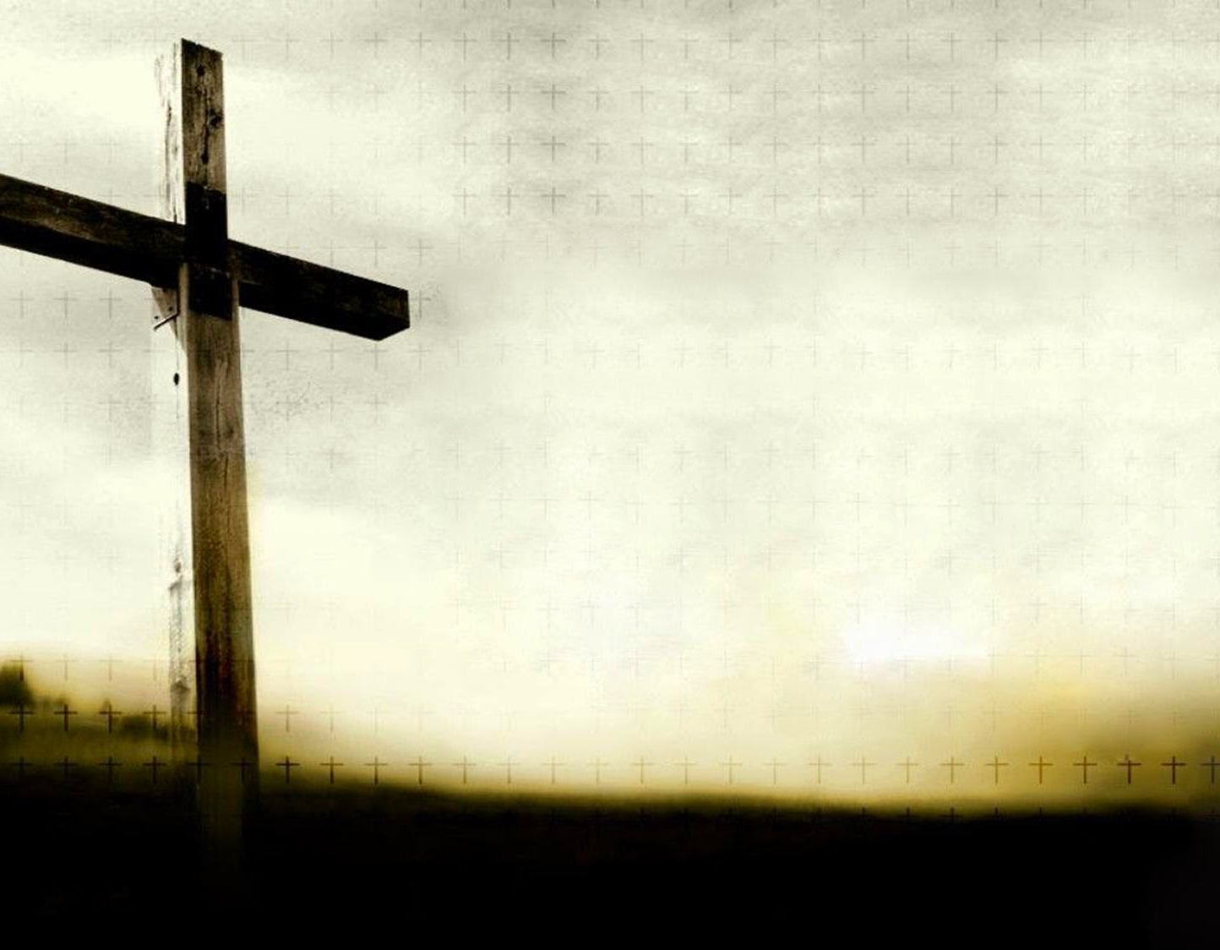
Matthew CH. 27:33-44
the first three hours…
35 And when they had crucified Him…
35 They casted lots for His garments
36 And sitting down, they kept watch over Him.
39 And those passing by were hurling abuse at Him.
43 "HE TRUSTS IN GOD; LET GOD RESCUE Him now…
44 The robbers who had been crucified with Him were also insulting Him with the same words.
Scene with His Mother
The Thief
His Prayers

Slide 4
And then the sixth hour…

Slide 5
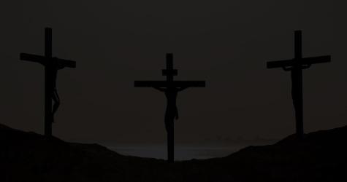
Matt. 27:45 Now from the sixth hour until the ninth hour there was darkness over all the earth.

Slide 6
Sceptics claim it was just a random eclipse.
Why the darkness?
It is not possible that there should be an eclipse of the sun at the time of the full moon.
An eclipse is localized and complete darkness would only remain for a few minutes.

Slide 7
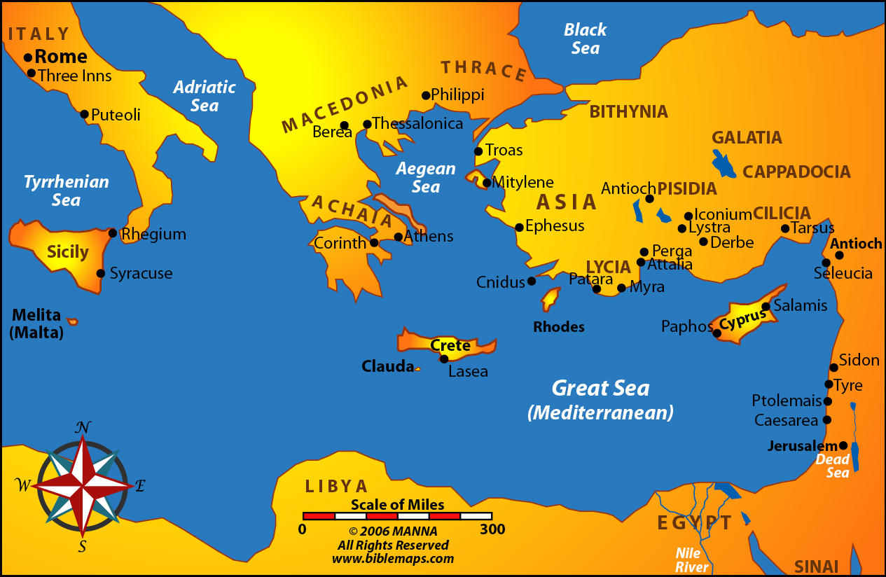
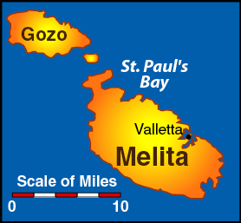
1500 miles

Slide 8
Why the darkness?
Was it to veil our mortal eyes from seeing the full redemptive work of Christ on the cross as He atoned for our sins?
Was this a sign of judgment on the people?
Was it simply that if He was the “light come into the world”, that the darkness was a sign of His pending death?
Or was this shroud of darkness the greatest effort by the devil to challenge the trust Jesus had in the Father?

Slide 9
For at the end of the three silent hours of darkness…
Mat 27:46 And about the ninth hour Jesus cried out with a loud voice, saying, "Eli, Eli, lama sabachthani?" that is, "MY GOD, MY GOD, WHY HAVE YOU FORSAKEN ME?"

Slide 10
Had God truly forsaken His Son?
Well Jesus said that He did!
It may have been just the opportunity for the evil one to perform his greatest temptation?
Jesus quoted word for word from the 22nd Palm

Slide 11
From Matthew’s crucifixion narrative there is no less than 6 references from the 22nd Psalm used.

Slide 12
Had God truly forsaken His Son?
A reading of the 22nd Psalm:
Psa 22:1,2 My God, My God, why have You forsaken Me? Why are You so far from helping Me, And from the words of My groaning? O My God, I cry in the daytime, but You do not hear; And in the night season, and am not silent.
The first verse bears out His humanity as He cried out of the darkness.
The second verse bears out His resolve though He goes unanswered.

Slide 13
Had God truly forsaken His Son?
A reading of the 22nd Psalm:
Overcoming His struggle, in verse 3 He recalls His Father’s position.
Psa 22:3 But You are holy, Enthroned in the praises of Israel.

Slide 14
Had God truly forsaken His Son?
A reading of the 22nd Psalm:
In order to find His courage, He recalls the great deliverance of God’s people when they trusted in Him:
Psa 22:4,5 Our fathers trusted in You; They trusted, and You delivered them. They cried to You, and were delivered; They trusted in You, and were not ashamed.

Slide 15
Had God truly forsaken His Son?
A reading of the 22nd Psalm:
Notice the mental anguish as He is drawn back to His current state:
Psa 22:6 But I am a worm, and no man; A reproach of men, and despised by the people.

Slide 16
Had God truly forsaken His Son?
A reading of the 22nd Psalm:
Even His trust in God was challenged:
Psa 22:7,8 All those who see Me ridicule Me; They shoot out the lip, they shake the head, saying, "He trusted in the LORD, let Him rescue Him; Let Him deliver Him, since He delights in Him!"
Circumstances DO NOT define God’s love for us!

Slide 17
Had God truly forsaken His Son?
A reading of the 22nd Psalm:
In verse 9 He recalls that from birth the Father taught Him to trust:
Psa 22:9,10 But You are He who took Me out of the womb; You made Me trust while on My mother's breasts. I was cast upon You from birth. From My mother's womb You have been My God.

Slide 18
Had God truly forsaken His Son?
A reading of the 22nd Psalm:
Knowing God had been with Him since childhood, He appeals to God to remain near as the Jewish leaders assail Him with verbal abuse:
Psa 22:11-13 Be not far from Me, For trouble is near; For there is none to help. Many bulls have surrounded Me; Strong bulls of Bashan have encircled Me. They gape at Me with their mouths, Like a raging and roaring lion.

Slide 19
Had God truly forsaken His Son?
A reading of the 22nd Psalm:
The physical trauma to his body is taking its toil distracting Him:
Psa 22:14,15 I am poured out like water, And all My bones are out of joint; My heart is like wax; It has melted within Me. My strength is dried up like a potsherd, And My tongue clings to My jaws; You have brought Me to the dust of death.

Slide 20
Had God truly forsaken His Son?
A reading of the 22nd Psalm:
He recounts the actions of the Romans:
Psa 22:16-18 For dogs have surrounded Me; The congregation of the wicked has enclosed Me. They pierced My hands and My feet; I can count all My bones. They look and stare at Me. They divide My garments among them, And for My clothing they cast lots.

Slide 21
Had God truly forsaken His Son?
A reading of the 22nd Psalm:
The Psalmist concludes this concerning the Savior:
Psa 22:24 For He has not despised nor abhorred the affliction of the afflicted; Nor has He hidden His face from Him; But when He cried to Him, He heard.
Though the world was blinded by darkness, the Father could see!

Slide 22
Had God truly forsaken His Son?
So Luke records the trust Jesus had in the Father:
Luke 23:46 And when Jesus had cried out with a loud voice, He said, "Father, 'INTO YOUR HANDS I COMMIT MY SPIRIT.' " Having said this, He breathed His last.

Slide 23
Had God truly forsaken His Son?
And while being reviled, He did not revile in return; while suffering, He uttered no threats, but kept entrusting Himself to Him who judges righteously; 1Pe 2:23
Does that sound like forsaken to you?

Slide 24
Has God forsaken you?
Do you feel truly abandoned by God, because of the place where you are right now?
Have circumstances in your life distracted you from achieving God’s purpose for you?
Has the evil one veiled your eyes from securing the faith your Savior has provided?
Are you fearful of death and of facing a wrathful God?

Slide 25
Heb 13:5 Let your conduct be without covetousness; be content with such things as you have. For He Himself has said, "I WILL NEVER LEAVE YOU NOR FORSAKE YOU."

