Slide 1
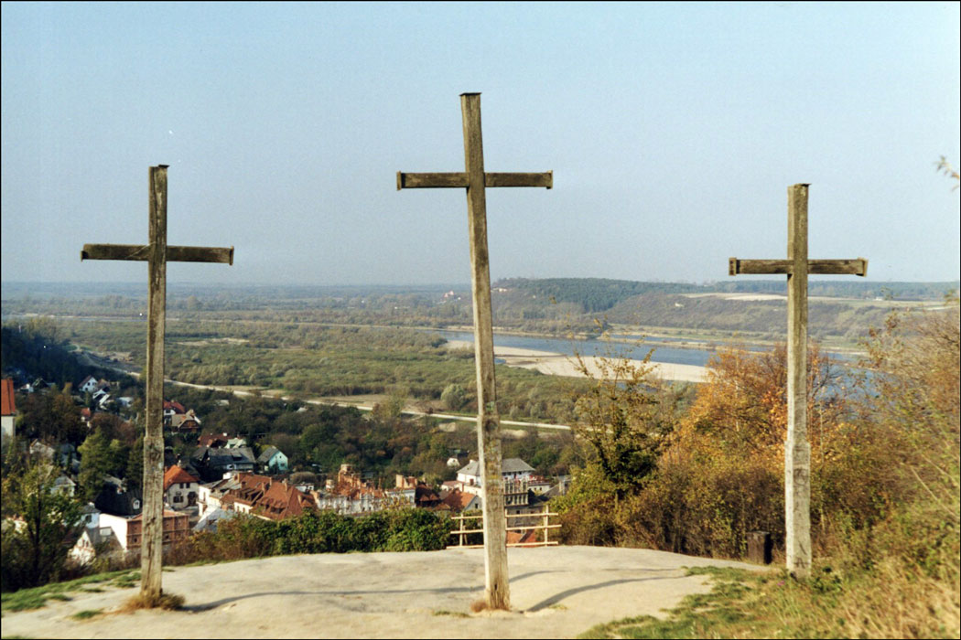
Lessons For Us From the Cross
Reading - Luke 23:33-43

Slide 2
We Are In The Presence Of Deity
Many do not recognize any deity at all in Jesus, considering him "just an ordinary man" with "extraordinary charisma and power." - Certainly not God in the flesh.

Slide 3
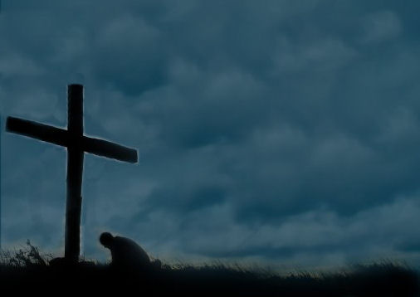
Men Can Say Anything They Like About Jesus Now…
Judgment will stop all this.
(Romans 14:11-12)
(Philippians 2:10-11)

Slide 4
Second Lesson

Slide 5
There Is Life After Death
"Lord, remember me when You come into Your kingdom."
Many do not recognize this.
(1 Timothy 4:1-2)

Slide 6
Redbook Magazine poll [2002] of our nation’s seminaries.
Of the ministers in training:
56 percent rejected the virgin birth of Jesus Christ,
71 percent rejected that there was life after death.
54 percent rejected the bodily resurrection of Jesus Christ.

Slide 7
Third Lesson

Slide 8
The Kingdom Would Soon Be Established
"Lord, remember me when You come into Your kingdom."
He knew Christ would soon set the kingdom up and that being in it was equal to going to Heaven.
(Luke 17:20)

Slide 9
There are many ways that the thief could have learned of the kingdom
John the Baptist preached concerning the coming of the Messiah and the kingdom.
Jesus preached about the kingdom to all of Judea & Galilee.
The Apostles were sent on a limited commission to do the same.
With the notoriety of all the happenings in this region a person would have had to be a hermit or a foreigner to NOT have heard about the kingdom.

Slide 10
Fourth Lesson

Slide 11
We Deserve To Be Punished For Our Crimes
"We are in same condemnation--and we justly.“
Could it be that we do not consider ourselves deserving of punishment?
It’s easy to justify our actions.
(1 Corinthians 11:31-32)

Slide 12
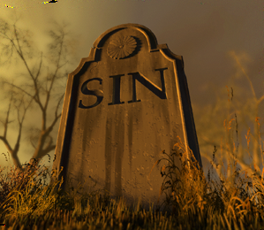
There is a penalty that must be paid.
(Romans 6:23)
Payday is coming. (Ecclesiastes 8:11)

Slide 13
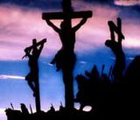
Final Lesson

Slide 14
Being With Jesus Is Better than living & dying in a sinful way
We can find evidence that the thief was also penitent.
(Matthew 27:44)
Repentance is a changed mind leading to change of action.
(Luke 13:3)

Slide 15
Forgiveness After Death?
Repentance? Sure.
But forgiveness? No way!
(Acts 17:30)

Slide 16
Had the thief waited a few more hours, or possibly even one more minute -- he could have forfeited his chance to be with Jesus forever.
What about you right now?

Slide 17
Can We look For a LOophole ?

Slide 18
The “Loophole”
“Is Baptism REALLY necessary?”
“What about the Thief on the Cross? He wasn’t baptized.”
Do you think that you can find salvation in a similar way to the thief on the cross?

Slide 19
What Is Wrong With Deathbed Repentance?
The danger lies in not knowing when you are scheduled to die.
(Acts 22:16)

Slide 20
Have you ever REALLY thought of receiving salvation just like the Thief on the Cross?
Baptism vs. Crucifixion – Which do you choose?

