Slide 1
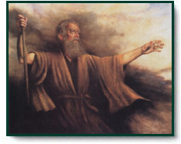
What We Gain From One Another
Reading - Exodus 17:8-13

Slide 2
Moses Could Not Do This Alone
The Amalekites come up to battle against them at Rephidim.
As long as Moses was able to keep his hands raised, the Israelites prevailed. But, you can't do that for very long! When his hands grew tired and he had to lower them, the Amalekites prevailed.

Slide 3
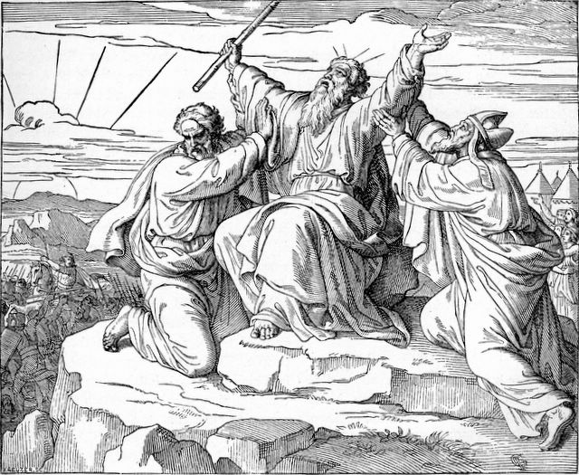
To The Rescue!
Aaron and Hur to stand on either side of him and support his hands.
Moses was able to keep his hands steady until evening.

Slide 4
All God's people need the support of brethren.
Moses knew what needed to be done--he needed to keep his hands raised!--but he needed help to do it.
Clearly we are stronger together than we are separate.
Here’s a Good Example

Slide 5
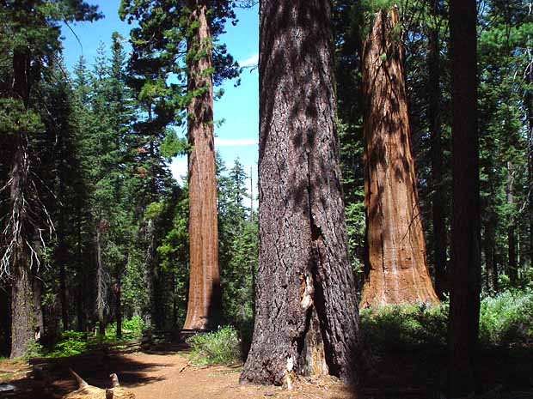
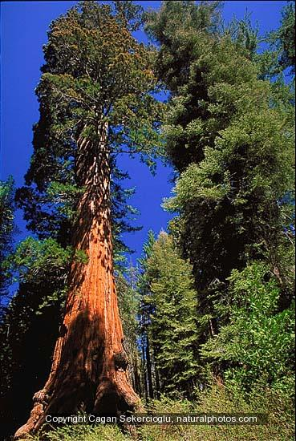
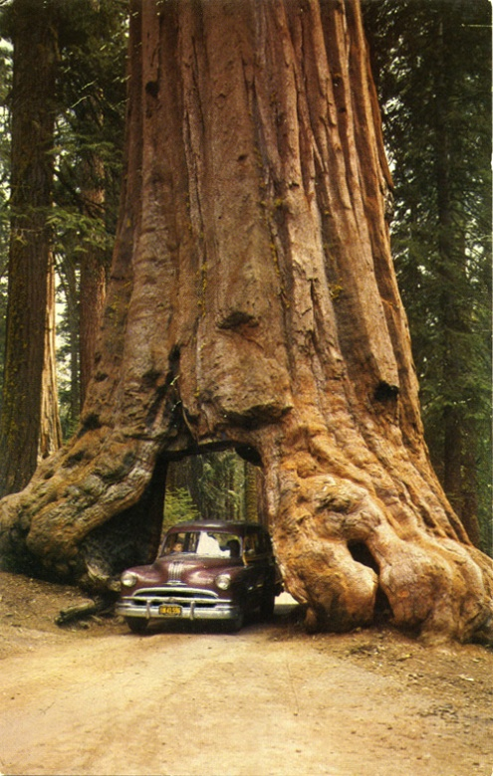
Sequoia Trees of California
Unusually shallow root systems that reach out in all directions to capture the greatest amount of surface moisture.
You will hardly ever see a redwood standing alone, because high winds would quickly uproot it.
That's why they grow in clusters.
Their intertwining roots provide support

Slide 6
We Gain Strength to Carry Out our Common Mission
Never forget that we are soldiers in the army of God. We are fighting a spiritual war, and we have a common objective. (Ephesians 6:10-13)
Just as Moses needed help to raise his hands during the physical battle with the Amalekites, you and I need help to strengthen our hands as we war against evil

Slide 7
What kind of army would you have if the soldiers were constantly fighting among themselves?
Instead the Bible teaches that we unite in a common cause and purpose--and we gain strength when we do!
1. (John 17:20-21)
2. (Ephesians 4:1-6)

Slide 8
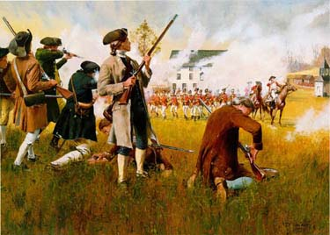
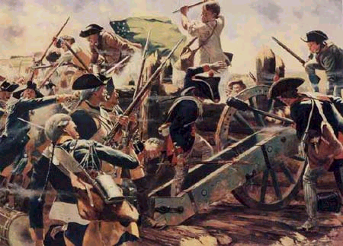
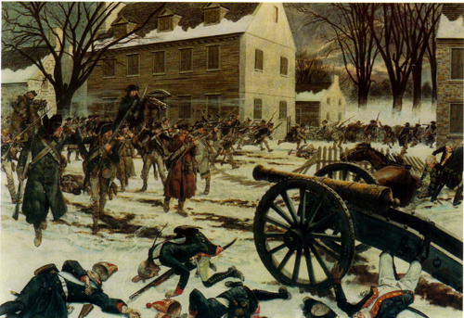
Fighting Together
IF all of the American colonies would have been more unified, we could have won the war for independence in 1 year;
Instead, because of division, it took 8 bloody years of battle.
(Colossians 3:12-14)

Slide 9
One reason we assemble is to gain strength from one another.
(Hebrews 10:23-25)

Slide 10
We Gain Comfort & Encouragement to Endure Trials.
(Philippians 4:15-18)

Slide 11
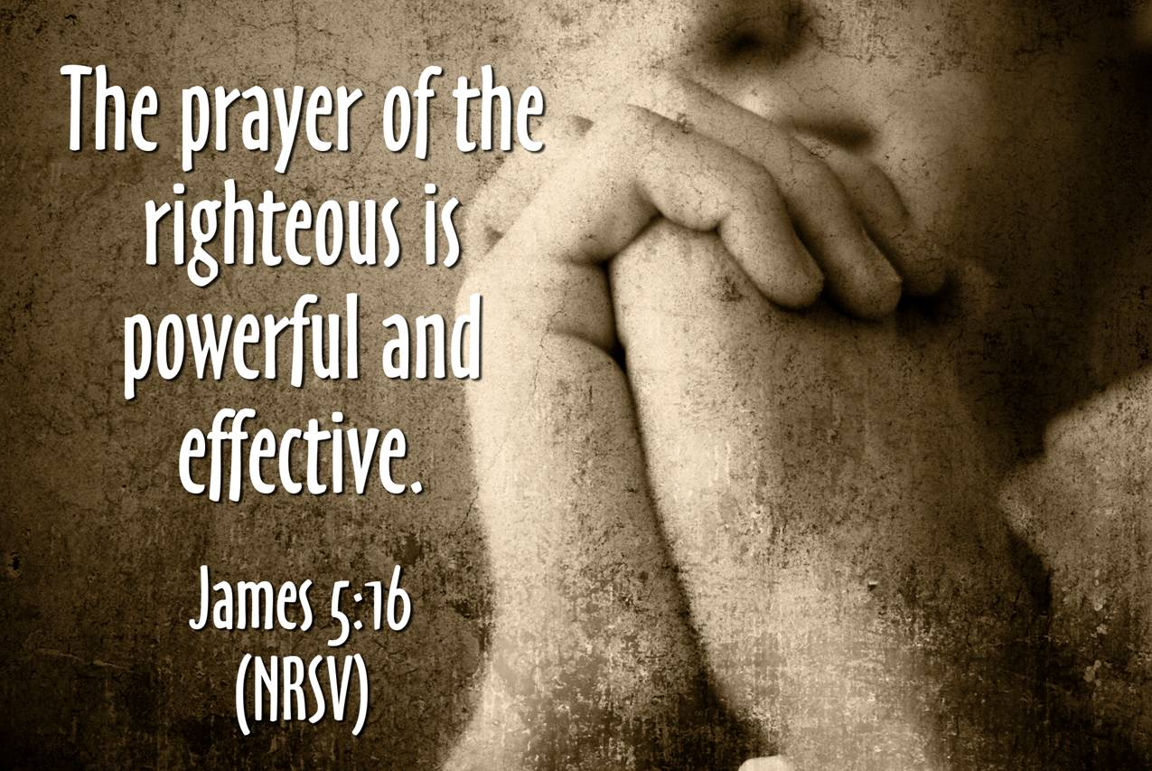
How about when sickness, temptation, & trials come our way?
A Christian has a support group second to none.
(Mark 10:29-30)
(James 5:16)

Slide 12
We Gain Wisdom to Grow in God's Word.
(1 Peter 2:1-2)
These verses tell me that I should search out opportunities for Bible study.

Slide 13
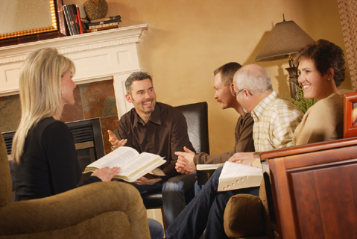
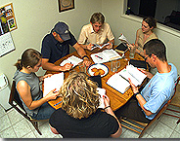
We Gain Wisdom to Grow in God's Word.
One of the best ways to study is with the help and insight of fellow Christians.
One of the greatest strengths of our congregation is the number of sound Bible scholars in our midst.

Slide 14
We Gain Correction & Admonition to Help Us Overcome Sin.
If Godly friends don't tell us the truth and warn us, who will?
(Proverbs 27:6)

Slide 15
We Gain Correction & Admonition to Help Us Overcome Sin.
As brothers & sisters who love and care for one another we’ll do everything in our power to prevent a brother from falling prey to Satan.
(Galatians 6:1-2)

Slide 16
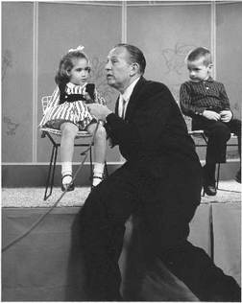
Art Linkletter
Dou You Have Any Pets?
"Well, I did have some goldfish but some water softener got into the aquarium and they softened to death.“

Slide 17
Without Correction ---
Self- indulgence, laziness, indifference and lack of self-discipline can become a part of our lives, and it shows when we don’t have the spiritual backbone to restore a wayward Christian.
Our spiritual muscles become flabby and we become easy prey to temptation and sin, just as our wayward brother.

Slide 18
We Gain Examples to Help Guide Our Life
Christ is our perfect example.
(1 Peter 2:21)

Slide 19
Christian love never settles for eye for an eye retribution.
It insists on giving mercy as well as justice.
(Romans 12:21)

Slide 20
We Gain Examples to Help Guide Our Life .
(1 Corinthians 11:1)
(1 Timothy 4:12)
One of the best ways to grow spiritually is to imitate the example of men and women who are sound in the faith.

Slide 21
Seeing all that we gain from one another--and knowing full well what the devil will try to do to stop us --
Let us Hold fast the profession of our faith without wavering."

