Slide 1
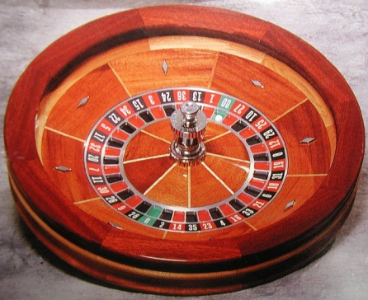
Chances of Making It To Heaven
Reading – Revelation 21:1-4

Slide 2
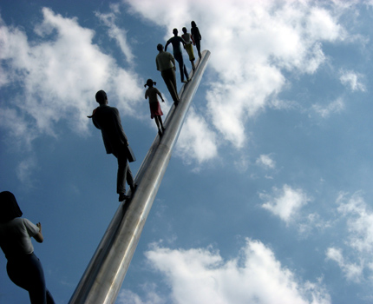
Revelation 21:4 And God shall wipe away all tears from their eyes; and there shall be no more death, neither sorrow, nor crying, neither shall there be any more pain: for the former things are passed away
Most people would LIKE to go to heaven.
A place of final reward where the problems of this life don't exist..
But what about you personally. What are your chances of going there?

Slide 3
WHAT ARE YOUR CHANCES OF GOING TO HEAVEN? December issue of USA WEEKEND
One person answered, "50 - 50. The older I get, the more I think my chances will improve."
A second person said, "85%. I don't think the entrance exam will be that tough."
A third person said, "My chances are kind of slim, 50 - 50 maybe. You have to be more than a nice person. But I'm still in the running."

Slide 4
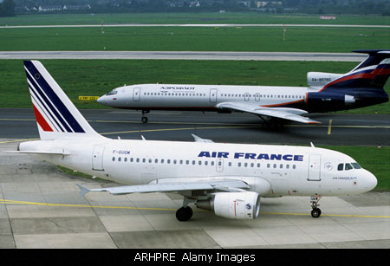
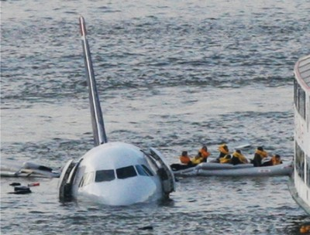
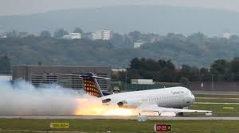
Do You Like 85% Odds?
If a plane was leaving here for Chicago and had a 50 - 50 or even 85% chance of making it, would you take the flight? Why not?

Slide 5
God provides a way that we can be sure of a heavenly reward.
We can be sure beyond any shadow of doubt.
2 Corinthians 5:1
2 Timothy 4:7

Slide 6
There is evidence that in order to insure a home in heaven, a certain amount of work involved.
"Let us labor, therefore, to enter into that rest.“ Hebrews 4:11
The Bible says there are commands to follow: Revelation 22:14

Slide 7
Taking the proper precautions
This lowers the odds of some people ever entering heaven knowing that work is involved
No one will just coast into heaven, nor sneak in.
Romans 2:6-10
Every scripture that makes any promises of heaven also mentions working toward that goal.
Some surely think that it is hard work, but 1 John 5:3 says that the commands of God are not grievous.

Slide 8
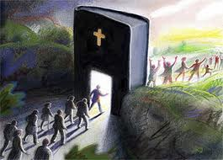
The Bible talks of a sure way that leads to eternal life:
(Matthew 7:13-14)
Jesus marked the trail
John 14:6 - I am the way, the truth, and the life; no man can come to the Father but by me.
So with these thoughts in mind we can greatly increase our odds by being obedient to God.
Indeed, we can make our salvation sure

Slide 9
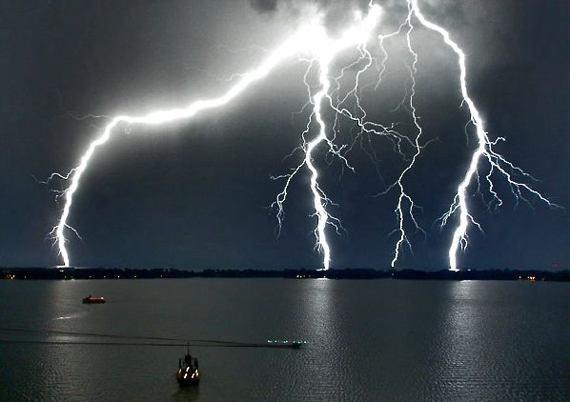
What then is it that God requires of us?
The “whole duty of man is to fear God and keep His commands.” [Ecclesiastes12:13 ]
But just what are these commands that we keep reading about?
“What can I do to be saved?” is the most important question asked in the life of a person.
The Bible answer is that there are commands to be obeyed.

Slide 10
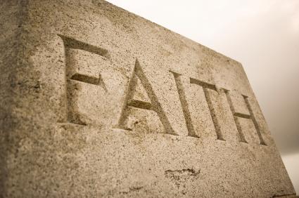
FAITH
Hebrews 11:6

Slide 11
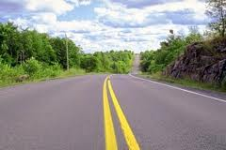
God created us to be creatures of faith
Faith and Trust are part of our nature.
But how do we get faith? There is no miracle here: (Romans 10:17) So then faith comes by hearing, and hearing by the word of God.
This faith, added to the realization that you are not what you should be and a sorrow for that will lead you to the next step:

Slide 12
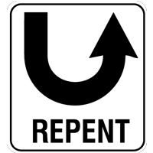
REPENTANCE
Luke 13:3

Slide 13
Repentance simply means “turning to God”
A result of a change of mind which in turn shows changes in your life.
It is impossible to change on the inside without changing on outside. That's why John the Baptist says, "Bring forth fruits meet for repentance." Matthew 3:8.
Repentance is not a suggestion: [Acts 17:30-31]
Repentance then prepares up for the next step

Slide 14
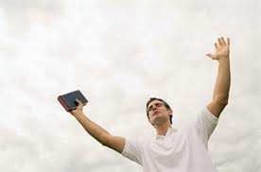
Confession
Matthew 10:32-33

Slide 15
Romans 10:9-10
Jesus says unless you believe that I am the Son of God you will die in your sins. In Acts 8:37 the Ethiopian Eunuch made that confession when He said, I believe that Jesus Christ is the Son of God."
So then confession is openly signifying that you believe that Jesus is the Christ in word AND deed.
Upon confession that Jesus is the Christ – What’s next?

Slide 16
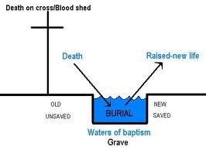
BAPTISM
Mark 16:15-16
Jesus’ Final Command

Slide 17
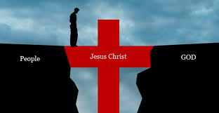
1 Peter 3:21
This action saves us. Its not any special effect of the water, just our obedience to God's commands.
The reason that Baptism saves us is that it takes our sins away: Acts 2:38
Cross Reference – Acts 22:16 And now why are you waiting? Arise and be baptized, and wash way your sins, calling on the name of the Lord,

Slide 18
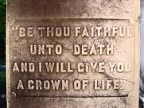
REMAIN FAITHFUL
Revelation 2:10
Baptism is not the end, but the beginning.

Slide 19
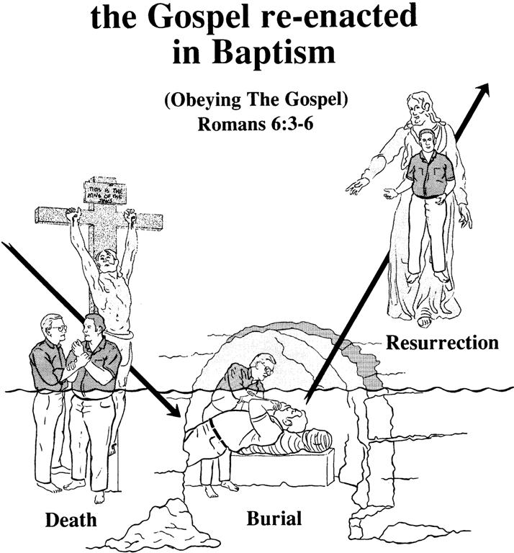
Romans 6:3-6
The Holy Spirit tells us what baptism is all about:
Then He concludes the thought with the benefits derived from Obedience.
Romans 6:17-18

Slide 20
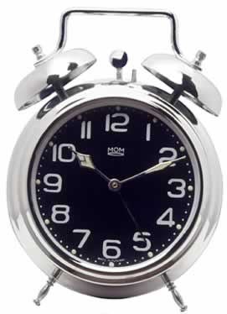
What Is The Best Time To Obey?
2 Corinthians 6:2
We are in trouble if we refuse God's plan:
Hebrews 2:3
Romans 1:20 …so that they are without excuse:
Anyone refusing after this has no one to blame for the consequences but themselves.
We ultimately get what we ask for.

Slide 21
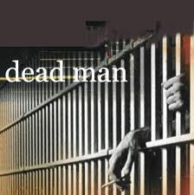
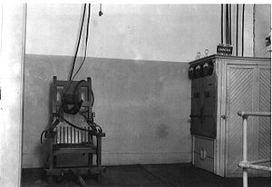
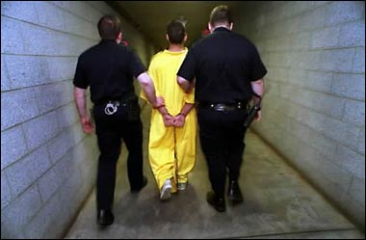
He Asked For It
Reporter: How Does It Feel To Be a Condemned Man?

Slide 22
Are We Going To Get What We Ask For In Judgment?
Are we “Christians on the inside” and just impersonating a worldly person?
Will anyone in the world believe you are a Christian by the way you conduct yourself?
Can we disobey God unrepentant and still expect to receive a reward for doing so?

Slide 23
Obeying God’s Commands Can Give Us Assurance !
When peace like a river, attendeth my way,
When sorrows, like sea billows roll:
Whatever my lot, thou has taught me to say
It is well, it is well with my soul!

