Slide 1
The Futility of Godless Pleasure
Reading – Ecclesiastes 11:1-10

Slide 2
Clearing up one misunderstanding
Many think that ungodly pleasure or entertainment should be easy to avoid because all entertainment and pleasure is optional. -- Not true.
We need pleasure, and we must have entertainment.
But choose carefully what kind of pleasure you seek, and be aware of the price of ungodly pleasure.
Realize that true pleasure and happiness can only come from places approved by God: Ecclesiastes 11:9.

Slide 3
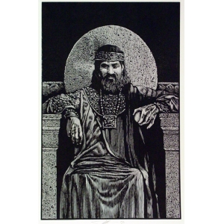
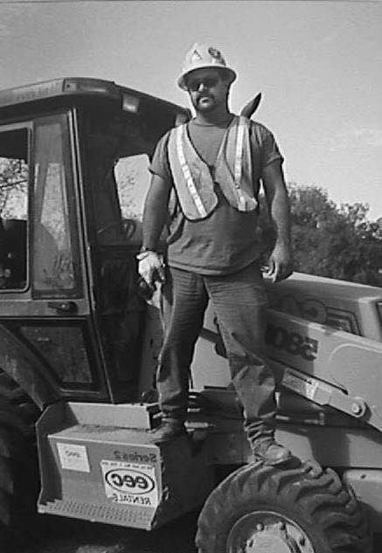
*
Two Stories of Pleasure Seekers
One is Solomon
The other comes from my generation--which is not really so far removed from your generation. We'll call him Joe.

Slide 4
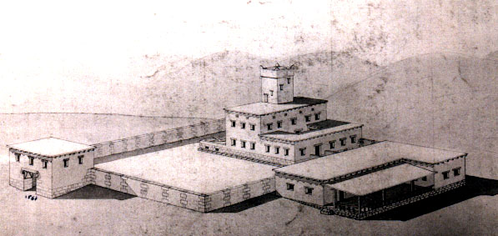
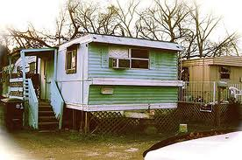
Background
Solomon was raised by a man after God's own heart. He had riches, glory, power, and wisdom.
Joe’s father lived from paycheck to paycheck and hung out in pool halls.
Joe was relatively poor and powerless, but he was intelligent.
Given these backgrounds, what course would you expect each to follow?

Slide 5
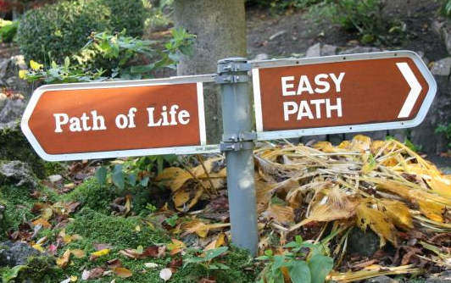
Both Choose The Same Path
They both opted to seek pleasure in hedonistic living.
Ecclesiastes records a time when Solomon tested every form of pleasure.
It is unclear if Solomon was young when he decided to do this, and it doesn't really matter.
He had a choice: follow the wisdom of God or search for satisfaction in the Easy Life.

Slide 6
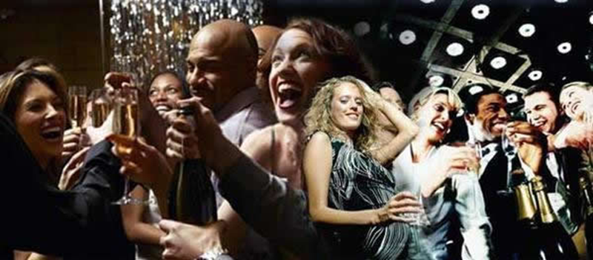
The Experiment - Solomon:
(Ecclesiastes 1:13)
(Ecclesiastes 2:1)
(Ecclesiastes 2:10) Whatever my eyes desired I did not keep from them. I did not withhold my heart from any pleasure, For my heart rejoiced in all my labor; And this was my reward from all my labor.

Slide 7
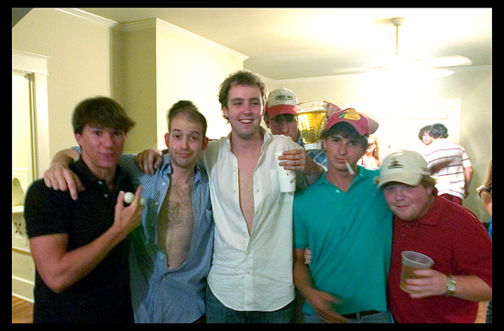
The Experiment - Joe
He tried to hang out with other buddies at work who were in a similar condition as he was in.
The life of the prodigal was sometimes fun, sometimes interesting, sometimes entertaining, but he was always left with feelings of uneasiness, and a terrible aching feeling of futility.
What did Solomon & Joe discover after tasting the pleasures of wine, women, and song?
Or of drugs, beer, and rock-n-roll?

Slide 8
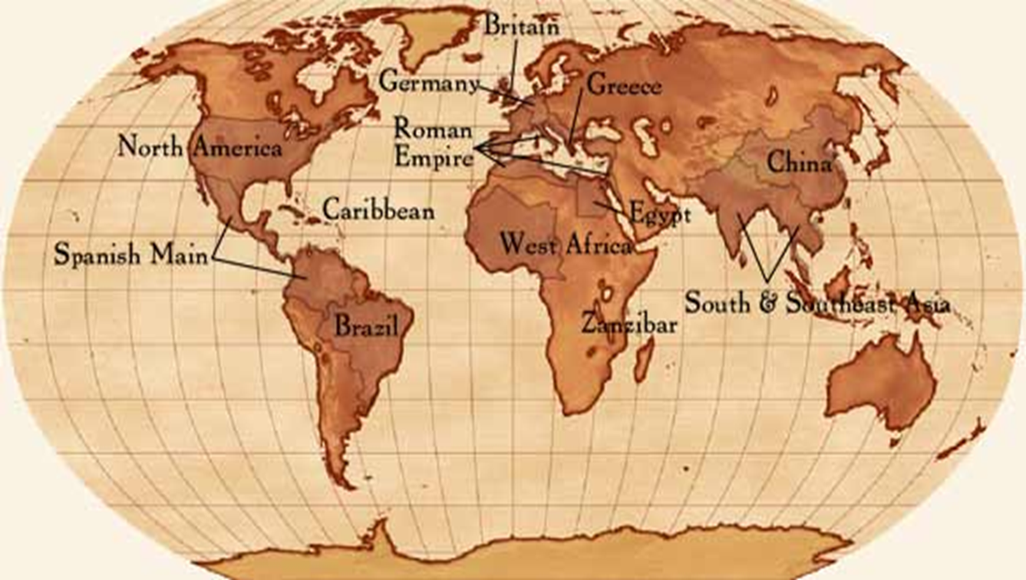
1 - Life Under the Sun Is Vanity:
(Ecclesiastes 1:4-8)
The water cycle is the same: the rivers flow to the sea but the sea never gets full but keeps evaporating and collecting in the clouds and raining all over again.
Life under the sun can be unutterable weariness!

Slide 9
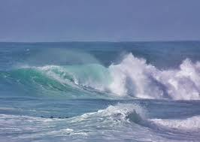
Life under the sun is vanity:
No matter what new things you do, see, or hear, tomorrow your hands, eyes, and ears will not be satisfied.
You can supply your senses with every conceivable stimulation, and you will never be satisfied.
No matter how much alcohol you pour into your body, just like the sea, it will never be satisfied.

Slide 10
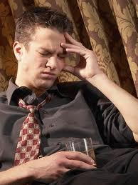
2 -There are some things you can't change:
(Ecclesiastes 1:13-15)
You may find yourself in a horrible situation with sorrows beyond measure. Drinking and doing drugs won't alter the situation.
There is no escape hatch from reality!
You cannot count what is not there; and there are no answers in escapism.

Slide 11
3 - Truth Does Not Reside in an Altered State of Consciousness:
(Ecclesiastes 2:1-3)
Life doesn't make any more sense when you alter your mind with chemicals. No, it makes even less sense.

Slide 12
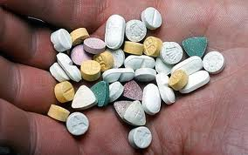
4 - Looking for truth in such places only brings frustration:
(Ecclesiastes 2:10-11)
And the harder you look, the more frustrating it is, until you wake up one morning and realize that you are never going to capture the meaning of life in a pill you swallow or a sensation of the flesh.

Slide 13
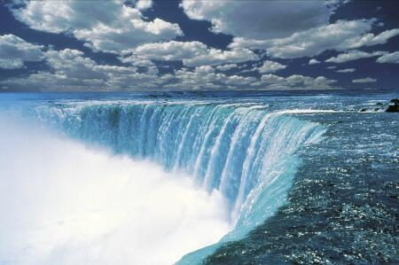
Addiction like a river

Slide 14
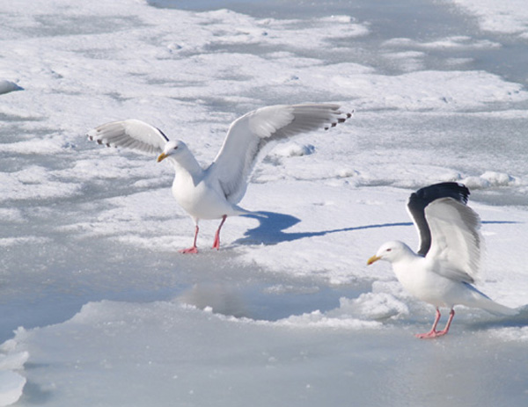
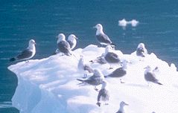
Unsuspecting Birds

Slide 15
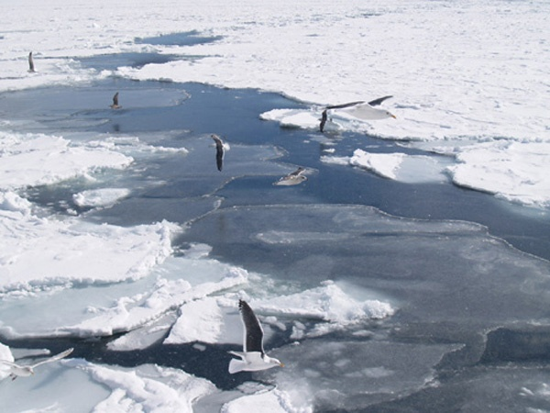
Hanging On Too Long Makes It Harder To Fly Away
Have you ever had your claws into something so deep you despaired of getting them out?

Slide 16
5 - Life Is Not Primarily About Pleasure:
Pleasure when rightly understood is good.
(Ecclesiastes 3:4) … A time to weep, And a time to laugh; A time to mourn, And a time to dance;

Slide 17
A Paradox:
Sorrow and Hardship are more important than pleasure:
(Ecclesiastes 7:1-5)

Slide 18
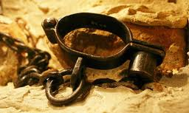
Ecclesiastes 7:26
It is possible that sexual immorality wrecks more lives than alcohol and drugs.
Disease – Pregnancy -- Marrying the wrong person for the wrong reason -- Loss of self-respect – Loss of a good name
Sexual immorality will cost you!

Slide 19
Conclusions

Slide 20
Enjoy the gifts of God: (Ecclesiastes 3:12-14)
Living in sin and futility is my fault not my fate: (Ecclesiastes 7:29)
Strive For Eternity: (Ecclesiastes 12:13-14)
(Ecclesiastes 5:20)

Slide 21
The End of the Story:
1 Kings 11 tells of how Solomon built temples to false gods of his wives.
It tells how angry God was with him for doing so.
It tells how God tears the kingdom away from his family.
I don't find any verses that say he repented and came back to God.
That indeed sounds like a tragic story!

Slide 22
The End of the Story:
I don’t know how Joe’s story will end because the last chapter remains to be written.
Have you found a little bit of Joe’s life in you?

Slide 23
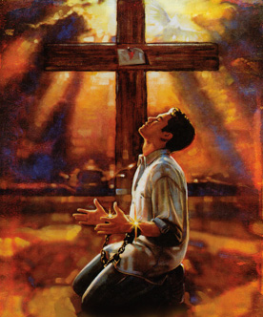
The End of the Story:
If you can see a lot of yourself in Joe, then you need to repent.
Christ will take you back.
There’s something we can say with certainty, if you are not in Christ, you will not make heaven as your eternal destination.

Slide 24
(Ecclesiastes 12:1) Remember now your Creator in the days of your youth, Before the difficult days come, And the years draw near when you say, "I have no pleasure in them":
(Ecclesiastes 12:7) Then the dust will return to the earth as it was, And the spirit will return to God who gave it.

