Slide 1
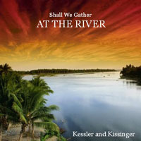
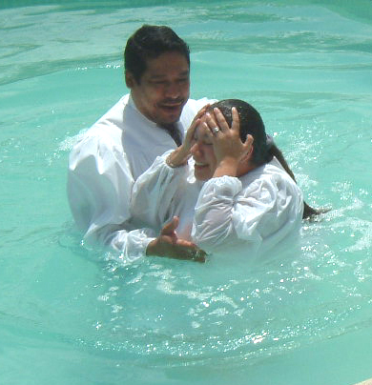
Shall We Gather At The River?
Reading: 1 Peter 3:18-21

Slide 2
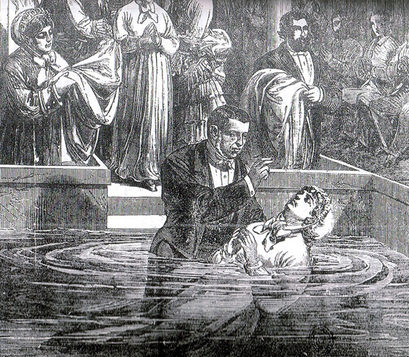
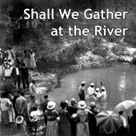
An Old-Timey Song.
Number 759 in our Song Book
Written by Robert Lowrey in 1864.

Slide 3
Origin of the Song.
An epidemic was sweeping New York the summer of 1864.
The heat that summer was oppressive
He buried many of his church members and others were near death.
He was exhausted, but knew he had to keep on giving comfort to the families that were left behind.

Slide 4
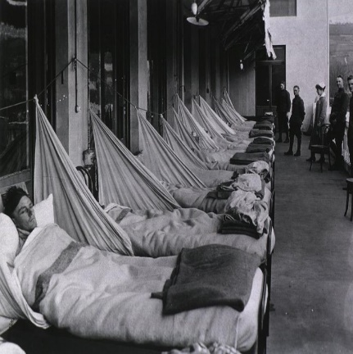
Visiting the Sick
He was reading a passage from Revelation
Revelation 22:1-2
People were preoccupied with the river of death and crossing Jordan.
Here was a passage that speaks of heaven and a river of the water of life.

Slide 5
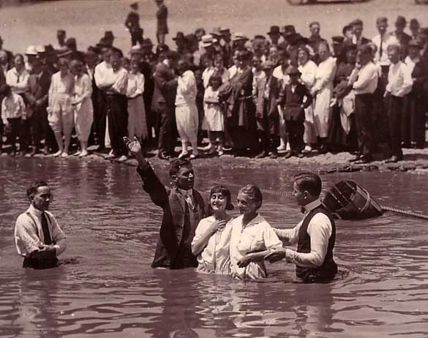
Words began to form
“Shall we gather?”
“Yes, we will gather at the river!”
At that river we will meet our loved ones again!
Ezekiel 47:1-7

Slide 6
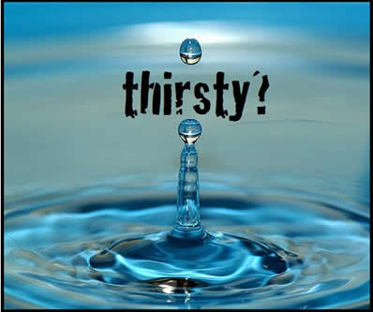
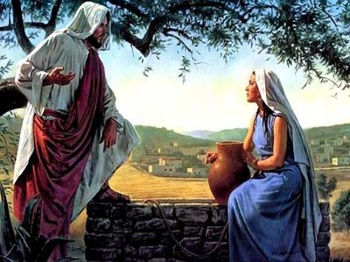
John 7:37-38
Without water we die in about 3 days.
Water makes up most of our bodies.
Jesus offers us so much more
John 4:7-14

Slide 7
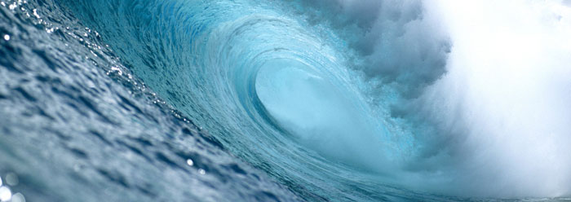
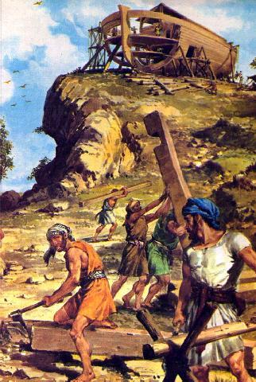
The Power of Water in Genesis 6
Repent!

Slide 8
(Genesis 6:1-3)
… yet his days shall be one hundred and twenty years.”
God reduced man’s life span at this time.
You read in Chapter 5 about people who lived for hundreds of years. [Methuselah]
The text and the context suggest that God is giving mankind 120 years to straighten up.
Noah was given the task of preaching this message.
Remember what Nineveh did when Jonah preached?
When Nineveh repented, so did God.

Slide 9
(Genesis 6:5) every intent of the thoughts of his heart was only evil continually.
Notice the absolutes you find in that verse. Every thought, every imagination, only evil
Verse 11 says that the earth was corrupt & full of violence
Because society was so bad... (Genesis 6:6-7) the LORD was sorry that He had made man on the earth, and He was grieved in His heart. {7} So the LORD said, “I will destroy man whom I have created from the face of the earth, both man and beast, creeping thing and birds of the air, for I am sorry that I have made them.

Slide 10
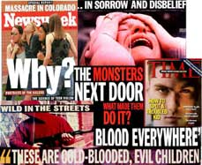
(v.13)“The end of all flesh has come…the earth is filled with violence… I will destroy them with the earth.
“Our generation is worse than Noah’s”
I disagree.
Lot of good, moral people in this area,
They haven’t obeyed the Gospel but they aren’t continually evil, wicked & filled with violence.

Slide 11
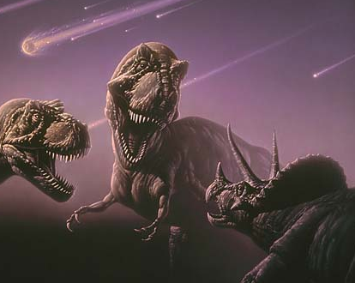
(v.13)“The end of all flesh has come…the earth is filled with violence… I will destroy them with the earth.
The time of Noah sounds like a Jurassic Park kind of society.
Our world is not completely filled with wickedness & violence.... YET!

Slide 12
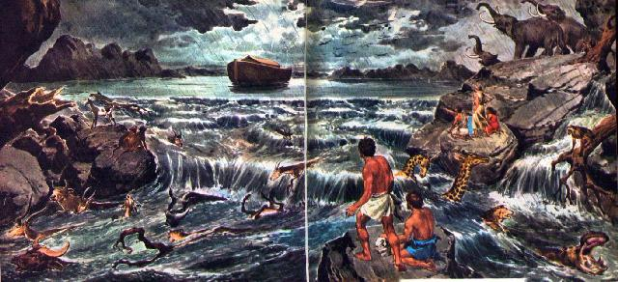
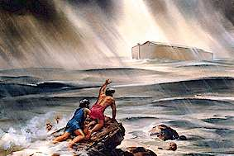
Water was God’s judgment...
(Genesis 6:17-18)

Slide 13
How can you know if God’s grace is working today?
... You’re still here!

Slide 14
(Genesis 6:22) Thus Noah did; according to all that God commanded him, so he did.
Noah was SAVED by the water that DESTROYED the rest of the world.
Do you have any alternative than to do ALL of what God says if you want to be saved?

Slide 15
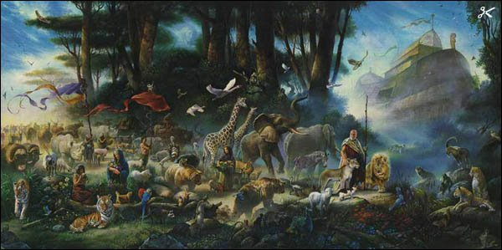
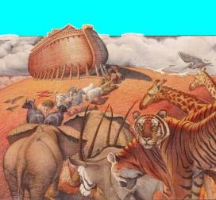
Salvation
(Chapter 7)

Slide 16
(Genesis 7:1) "Come into the ark, you and all your household, because I have seen that you are righteous.
It wasn’t until Noah did everything exactly as the Lord had said that he was counted as righteous?
He wasn’t saved BEFORE he obeyed God; he was saved because he obeyed God.
Some doctrines teach us that we get baptized BECAUSE we’re saved.
That is not consistent with the way God worked in the Old Testament, nor is it consistent with the way He works today.

Slide 17
Notice another consistency...
(Genesis 7:5 &16) And Noah did according to all that the LORD commanded him.... {16} So those that entered, male and female of all flesh, went in as God had commanded him; and the LORD shut him in.
It was the Lord who added those who would be saved just as He did when the church was established.
(Acts 2:47) And the Lord added to the church daily those who were being saved.

Slide 18
Main lesson of Chap. 7 --- It’s possible to wait around too long to repent.
When God says it’s too late... then it’s too bad!
Jesus Parables of the Rich man & Lazarus or Wise & foolish virgins. [Matthew 25]
Your challenge: Find one scripture that tells us that we will get a second chance after we draw our last breath here on earth.
Peter tells us that Noah was a preacher of righteousness while he was preparing the ark.
The sad part about this story is that he couldn’t let his neighbors in even if he wanted to.

Slide 19
(Genesis 7:18-21)
{20} The waters prevailed fifteen cubits upward, and the mountains were covered. {21} And all flesh died that moved on the earth: birds and cattle and beasts and every creeping thing that creeps on the earth, and every man.
Every man on earth died; but Noah wasn’t on the earth but in the water

Slide 20
(Genesis 7:22-23)
Only Noah and those who were with him in the ark remained alive.
It really doesn’t matter how many people died - What matters is that all who were obedient were saved.
It really doesn’t matter how many people who may be lost today. - What should matter is if you have obeyed God today.
Don’t fall prey to what I call the great smoke screen of Satan. Worry about all those lost in the world and forget about yourself.

Slide 21
The Story’s Impact on Peter
Reading: 1 Peter 3:15-22

Slide 22
Peter mentions this incident 3 times in his epistles.
(1 Peter 3:20-21) ... when once the Divine long-suffering waited in the days of Noah, while the ark was being prepared, in which a few, that is, eight souls, were saved [by the ark? No,] through water. {21} There is also an antitype which now saves us; baptism (not the removal of the filth of the flesh, but the answer of a good conscience toward God), through the resurrection of Jesus Christ,

Slide 23
the point of this lesson
God says He will destroy all men who are guilty of sin. (2 Thessalonians 1:8-9)
If you wish to avoid this destruction, like Noah, be saved BY water in obedience to God’s word.

Slide 24
What makes immersion so powerful?
It’s not the chemical makeup.
It’s not its cleansing nature [like taking a bath]
Thru the resurrection of Jesus Christ - THAT’S the power to deliver us from the sin of this world.

Slide 25
Baptism is the same type of an act of faith today as building the ark was in Noah’s day.
1 Peter 3:21

Slide 26
Shall We Gather At The River?
Reading: 1 Peter 3:18-21

