Slide 1
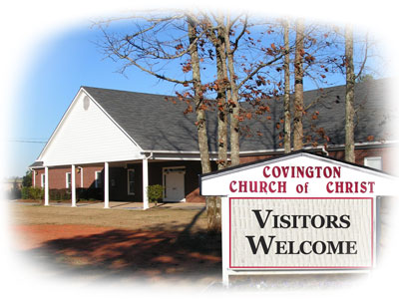
What It Takes To Be A Successful Church?
Reading –
Philippians 1:3-11

Slide 2
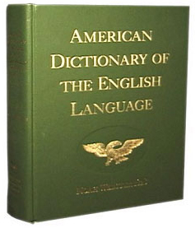
Success Defined:
The achievement of something desired, planned, or attempted; an event that accomplishes its intended purpose
The Philippian church seemed to fit this definition [refer to our reading]
Before we define our success, let’s look at some things that could misrepresent SUCCESS in a church.

Slide 3
Things That do not NECESSARILY indicate a successful church

Slide 4
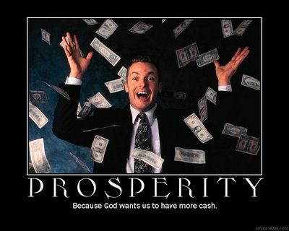
A Financially Rich Church
Revelation 2 & 3 – Laodicea v. Smyrna
Laodicea: rich yet “wretched, miserable, poor, blind, and naked”
Smyrna: working in tribulation and poverty, but Jesus calls them rich
Being rich is a modern day boast – yet no scriptural reference.

Slide 5
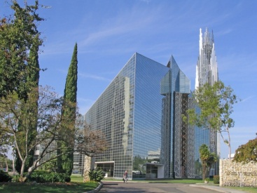
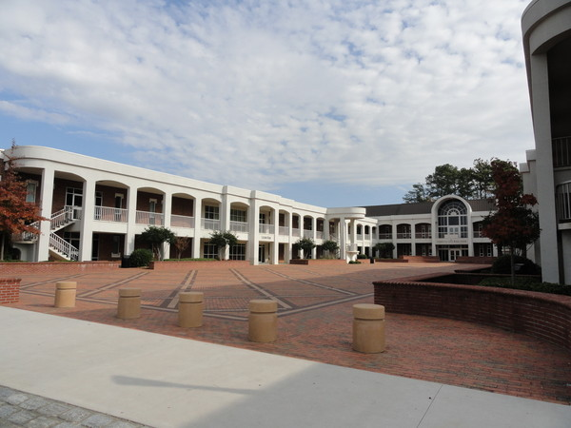
Having a large and impressive building and grounds.
Acts 2:46
The church assembled in the majesty of the temple, possibly an upper room, or private homes.
Large buildings are a modern day boast – yet no scriptural reference

Slide 6
Having a Large Membership.
(Give background of Jerusalem church) Acts 2:41 (3000); 4:4 (5000+); etc.
Most were dispersed at Stephen’s martyrdom
The church a Philippi began on the side of a riverbank and proceeded to the house of Lydia the “seller of purple” and a jailor’s household.
Large numbers are a modern day boast – yet no scriptural reference

Slide 7
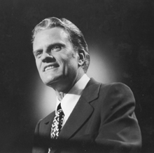
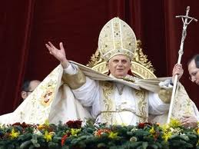
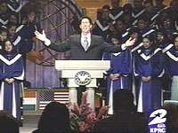
Having a Big Name Preacher.
1 Corinthians 1:12-13 – I am of Paul, I am of Apollos
Modern day boast – yet no scriptural reference.

Slide 8
Having a peaceful, unified and problem free church.
Revelation 2 & 3 – Compare Ephesus to Philadelphia
Ephesus was unified but fallen and called to repentance
Philadelphia had implied persecutions, but they persevere, are approved by God
A nice and hassle-free church is a modern day boast – yet no scriptural reference

Slide 9
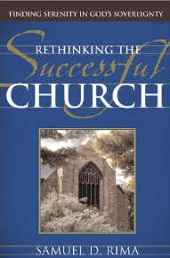
Having a church with universal approval that conforms to today’s “Standard Operating Procedures”
These writers would have us believe that social programs, contemporary services, creative organizational structure, tailoring the “message” to the target audience, etc. are the way to go if you want to succeed and grow.

Slide 10
Can Your Recall what the BIBLE has to say about:
“itching ears”
“proselytizing innocents, making them twice as bad”
“establishing your own righteousness while not submitting to God”
“preaching any other gospel other than what has been preached to you”?

Slide 11
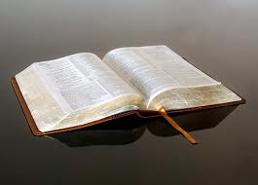
How many books on church success and growth have been done by conservative Christians?
Very few, mainly because there is no need … the best book on church success and growth has already been written… and, best of all, SUCCESS is GUARANTEED by its author, with documented evidence to prove it!

Slide 12
a successful church as defined in the bible

Slide 13
The successful church does the work prescribed by God:
Teaches God's word to those who are not Christians.
[Acts 13:1-3]

Slide 14
Provides opportunities for worship and praise to God.
[1 Corinthians 14:26-33]

Slide 15
Provides for physical needs of certain destitute members and fellow Christians.
[1 Timothy 5:3-8 &16]
See also 1Corinthians 16:1-4.

Slide 16
Edifies, instructs, and, if necessary, disciplines those who are members.
[Ephesians 4:16]

Slide 17
Most Important:
The church remembers Jesus on the first day of the week as He directed us to do.
[1 Corinthians 11:23-29]
Acts 20:7 established that fact.
Hebrews 10:25-31shows the utmost importance that we should place on this event.

Slide 18
The successful church exists in biblical purity
1 Corinthians 5:1-2 –There is to be no toleration for open and public sin
In Revelation 2, The churches in Thyatira and Pergamos received a severe rebuke for the toleration of sin and false teaching.
Today the trend in churches is toward “feel-good” preaching instead of convincing, rebuking, and exhorting.
[2 Timothy 4:1-4]

Slide 19
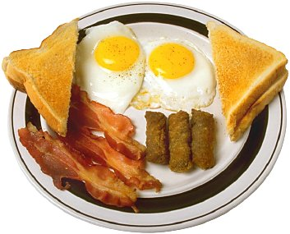
The successful church has members that are committed as opposed to merely being involved.
[1 Corinthians 12:12-26]

Slide 20
The successful church strives for unrelenting progress.
[Ephesians 4:15] grow up in every way
[Philippians 1:9] abound more and more
[Hebrews 5:12-14]

Slide 21
The Implications of Change

Slide 22
We must accept CHANGE as an inevitable and natural occurrence.
This church HAS changed
This church WILL change
This church MUST change
It is up to us as to what kind of change that will be.

Slide 23
Give Us Feedback

