Slide 1
Are Some Lies OK With God?
Reading – Genesis 12:10-20

Slide 2
Webster defined
Lie - "to make an untrue statement with the intent to deceive; to create a false or misleading impression.“
The word "lie" comes from the Greek word pseudos.
"Pseudo" means "being apparently rather than actually as stated.”

Slide 3
(Proverbs 6:16-19)
These six things the LORD hates, Yes, seven are an abomination to Him: {17} A proud look, A lying tongue, Hands that shed innocent blood, {18} A heart that devises wicked plans, Feet that are swift in running to evil, {19} A false witness who speaks lies, And one who sows discord among brethren.
Therefore, lying is a sin, and God does not excuse or overlook sinning.

Slide 4
GOD DID NOT EXCUSE LYING YESTERDAY
Genesis 12:13

Slide 5
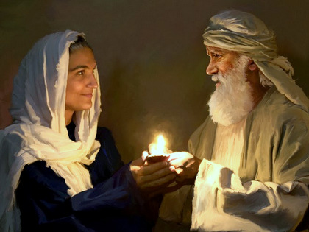
Genesis 12:13
Abraham lied by omission. He told a half-truth.
Abraham and Sarah did share the same father, but they had different mothers (We’ll read this later in Genesis 20:12).
Nevertheless, she was Abraham's wife.
Abraham deceived the Pharaoh.

Slide 6
What do Abraham's lies tell us about him at that time?
His faith in God was not what it should have been.
His respect for others was not what it should have been.
a. He jeopardized the safety of Sarah.
b. He jeopardized the lives of Pharaoh and his people (Genesis 12:17-18).
His value for himself was not what it should have been. (Matthew 16:24-26)

Slide 7
God did not excuse Abraham's lie.
God had to intervene to save everyone involved.
The situation did not determine whether the lie was right or wrong.
God will forgive lying, but He will not condone it.

Slide 8
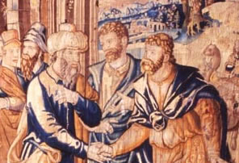
Once was not enough for Abraham.
He lied again by overt omission in (Genesis 20:2-16)

Slide 9
Believing A Lie
Abraham, a prophet of God, misled a very sincere man. His lie put these folks in danger.
On this occasion, Abimelech was more righteous than Abraham.
Abraham's explanation did not justify lying (verses 11-13).
I didn't think the fear of God was in this place.
I only told a half-lie.
I have told this story before.
Once again Abraham profits at someone else’s loss.

Slide 10
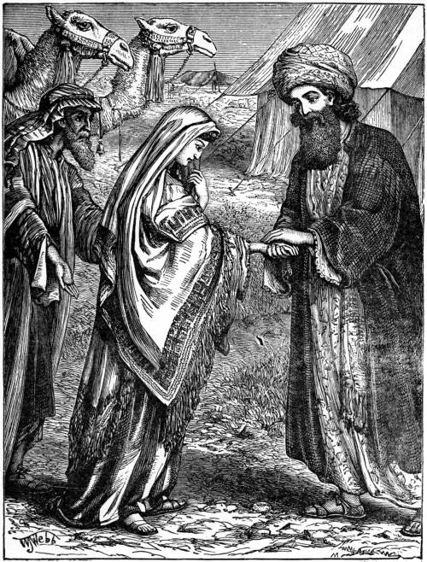
Like Father, Like Son
Isaac lied overtly in (Genesis 26:1-9)
Did you ever wonder where Isaac got that, “She’s my sister” story?

Slide 11
“Beware of the Hab-iru”
People always wondered why the Egyptians and Philistines hated the Hebrews so much, maybe you know now.
They had first-hand knowledge that the “hab-iru” [roughly translated: the northern stranger, the Hebrew] could not be trusted.
Why should we be surprised when Isaac’s son, Jacob lies to him?

Slide 12
GOD Does NOT EXCUSE LYING Today
John 8:44

Slide 13
Ethics, Rules & Principles
The Bible has a lot to say about ethics.
God has given us both rules and principles.
a. Rules are absolute, objective laws.
b. Principles are general guidelines used to decide what's right.

Slide 14
God determines what is right or wrong, not the situation.
Some things are generically right and others are inherently wrong.
God's unchanging truth about lying:
a. The Bible informs us that God hates lying.
b. The Bible tells us that Satan is the origin of lying (John 8:44) "You are of your father the devil, and the desires of your father you want to do. He was a murderer from the beginning, and does not stand in the truth, because there is no truth in him. When he speaks a lie, he speaks from his own resources, for he is a liar and the father of it.

Slide 15
How Lies Operate. (1 John 1:8-10)
If we say that we have no sin, we deceive ourselves, and the truth is not in us. {9} If we confess our sins, He is faithful and just to forgive us our sins and to cleanse us from all unrighteousness. {10} If we say that we have not sinned, we make Him a liar, and His word is not in us.
a. Men lie to other people.
b. Men lie to themselves (1 John 1:8).
c. Men lie to God (1 John 1:10).

Slide 16
The Outcome of Lying.
They can destroy our lives. (Proverbs 19:5) A false witness will not go unpunished, And he who speaks lies will not escape.
Eternally, lies destroy our souls.
(Revelation 21:8) "But the cowardly, unbelieving, abominable, murderers, sexually immoral, sorcerers, idolaters, and all liars shall have their part in the lake which burns with fire and brimstone, which is the second death."

Slide 17
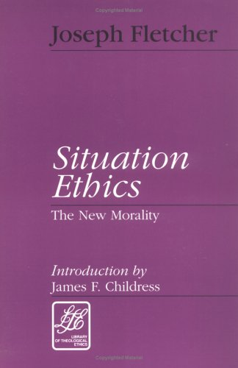
situation Ethics
John 8:44

Slide 18
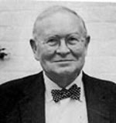
Joseph Fletcher
Prominent Humanist writer.
While serving as Professor of Situation Ethics at Episcopal Theological School at Cambridge, Fletcher wrote a book advancing situation ethics: "Situation Ethics: The New Morality."

Slide 19
Three Approaches in Making Moral Decisions
The legalistic approach. "...One enters into every decision-making situation encumbered with a whole apparatus of prefabricated rules and regulations.“
The antinomian approach. "...One enters into the decision-making situation armed with no principles or maxims whatsoever, to say nothing of rules.“
The situational approach. "The situationist enters into every decision-making situation fully armed with the ethical maxims of his community and its heritage, and he treats them with respect as illustrators of his problems. Just the same he is prepared in any situation to compromise them or set them aside in the situation if love seems better served by doing so."

Slide 20
“Love" is the sole factor in making moral judgments.
He makes law and love, at times, mutually exclusive.
The Bible says: Love is the motivating force behind all of God's law. (John 14:15) "If you love Me, keep My commandments.
(1 John 5:3) For this is the love of God, that we keep His commandments. And His commandments are not burdensome.

Slide 21
Christian Approach is Different
The Christian allows God's word to determine what is ethically right or wrong.
Christians recognize a higher principle than love for others, and that is love for God. (Matthew 22:37-40) Jesus said to him, " 'You shall love the LORD your God with all your heart, with all your soul, and with all your mind.' {38} "This is the first and great commandment. {39} "And the second is like it: 'You shall love your neighbor as yourself.' {40} "On these two commandments hang all the Law and the Prophets."
Something that is wrong is always wrong.

Slide 22
Man’s Arrogance
Situation ethics assumes that man is able to know what is the "loving thing to do" in a given situation without God's guidance. (Proverbs 14:12) There is a way that seems right to a man, But its end is the way of death.
The Bible is filled with examples that prove that the "end does not justify the means.“
Situation Ethics ignore the fact that the Bible is filled with absolute prohibitions.

Slide 23
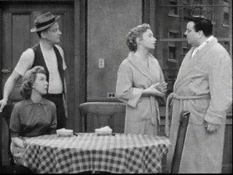
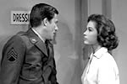
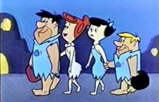
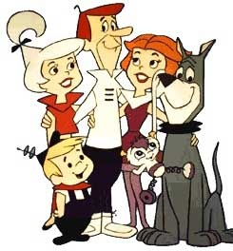
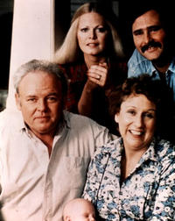
Obscuring Right and Wrong. (Isaiah 5:20-21)
Usually the premise of Situation Comedies
Somehow the situation calls for someone to tells a “little white lie”.

Slide 24
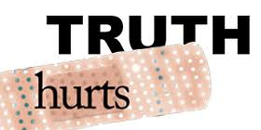
Telling The Truth Can Hurt ---
--- But knowing you have been deceived hurts even worse!

Slide 25
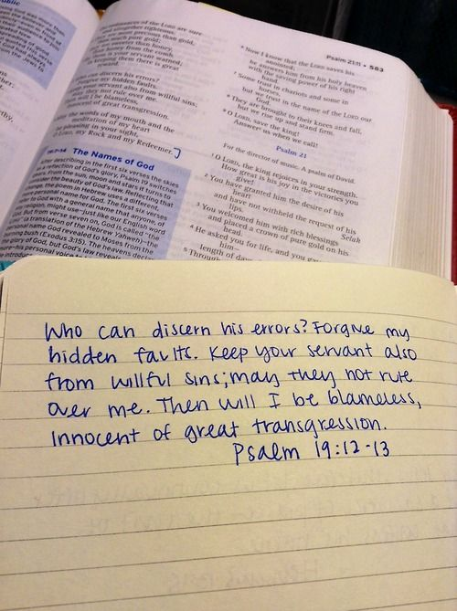
GOD Will NOT EXCUSE LYING Tomorrow
Psalm 19:12-13

Slide 26
Repent!
God did not ignore Abraham and Isaac's lies, but He did forgive them.
God will not ignore our lies; but He will forgive us if we will repent.
Let us always live by the encouraging words of the Apostle Paul. (Ephesians 4:25) Therefore, putting away lying, "Let each one of you speak truth with his neighbor," for we are members of one another.

Slide 27
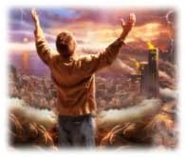
The Truth Will Set Us Free!
John 8:32

