Slide 1
Dealing With A Thorn In The Flesh
Reading - 2 Corinthians 12:6-10

Slide 2
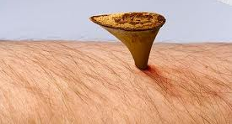
What Is A Thorn In The Flesh?
We might not be able to know exactly what the "thorn" is, but there are some valuable lessons to be gleaned as we consider...
1. Why is this "thorn" given to ME?
2. My initial reaction to the "thorn"
3. Our reaction to the answer given by the Lord

Slide 3
How About Paul’s Thorn?
Tertullian proposed that Paul had a pain in the ear or head.
Are migraine headaches YOUR thorn?
The medieval commentators attributed his thorn to unruly fleshly lusts.
Paul was not a woman hater, nor was he a homosexual. There is a good amount of historical evidence to support that Paul was a widower prior to being an Apostle, and being human these appetites were still alive. The opportunity to be with other women was still there.
(Acts 23:6) -- (Philippians 3:4-5)
Marriage was a requirement of the oral Pharisee law.
Is unruly fleshly lusts YOUR thorn?

Slide 4
How About Paul’s Thorn?
The commentator MacKnight attributes Paul’s stammering speech as the thorn he had to endure.
(1 Corinthians 2:1)
(2 Corinthians 10:10)
Ramsay came to the conclusion that Paul suffered recurring bouts of malarial fever.

Slide 5
How About Paul’s Thorn?
Farrar and others said that Paul had acute eye problems.
They claim he suffered a severe form of ophthalmia (inflammation of the eyeball) based upon Paul’s comments:
(Galatians 4:13-15)
(Galatians 6:11)
This eye condition was possibly brought on initially by the blinding vision on the Damascus road if you choose to follow that reasoning.

Slide 6
Maybe the “Thorn” is not a “Thing”?
Chrysostom proposed Paul thorn was his persecutors.
"And so by the "messenger of Satan," he means ... those who contended with and fought against him, those that cast him into a prison, those that beat him, that led him away to death); for they did Satan's business." (Homilies 26)
Reasons for this view:
In the OT adversaries are sometimes referred to as "thorns in your sides" (Numbers 33:55)
There is no metaphorical use of "thorn" for illness or temptation
The term "messenger" in Paul's writings always refer to a person and not to a thing such as an illness.
The basic topic of 3 chapters [2 Corinthians 10 -13] is Paul's opponents, those who were troubling the Corinthians and Paul himself.

Slide 7
What Did Paul Conclude?
A "thorn“ or "weakness" (infirmity) was an opportunity to glory.
In the context of 2 Corinthians Chapters 10-13 he connects his infirmities or weakness with persecution:-
(2 Corinthians 11:30-33)
(2 Corinthians 12:10)
(2 Corinthians 13:3-4)
Chrysostom’s conclusion: "the opponents who dogged Paul's tracks throughout his mission, confusing churches every time he left one church to plant another." (Hard Sayings Of The Bible)

Slide 8
"a messenger of Satan"
Whatever the "thorn", it was something with evil intent.
Yet it is evident that God allowed it to remain!
This leads us to ask...
WHY Are "THORNs" GIVEN?

Slide 9
LEST WE BE "EXALTED ABOVE MEASURE-" (2 Corinthians 12:7)
Paul had been blessed to receive many revelations...
On the road to Damascus - Acts 9:3-6
He received revelations in Jerusalem, at Troas, In Corinth and on way to Rome
Probably nothing could compare with the vision of Paradise (2 Corinthians 12:1-6)
It would have been quite easy for Paul to be filled with pride over these revelations.
It would have been just as easy for the church to exalt him too highly.
What position do we see ourselves in the church?

Slide 10
TO "BUFFET" US (2 Corinthians 12:7)
“Buffet" means, "to strike with the fist"; thus to strive against, contend
(1 Corinthians 9:27)
This buffeting is something brought upon by Satan.
This external "buffeting" is allowed to remain, to keep us humble

Slide 11
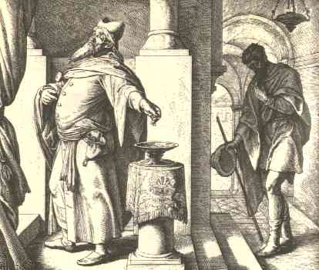
THERE IS A PRACTICAL LESSON RELATED TO HUMILITY...
Humility is a necessary trait for God's people
(Luke 18:13-14)
(1 Peter 5:5-6)
Sometimes it is useful to have "outside help" to keep us humble!

Slide 12
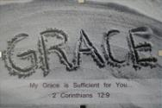
"My grace is sufficient for you" 2 Corinthians 12:9
The Lord gives us what we "need" but not necessarily what we "want"!
"My strength is made perfect in weakness"
It is in times of weakness and hardship that the Lord's strength can be experienced most completely!
For in such times we really come to depend upon the Lord, and not upon our own strength or wisdom!

Slide 13
"I will boast in my infirmities“ 2 Corinthians 12:9
Why “glory” in them?
We have the opportunity to experience the power of Christ in our life as He helps us deal with them!
"I take pleasure in infirmities ... for Christ's sake. For when I am weak, then I am strong. " - 2 Corinthians 12:10
Infirmities can be a time for rejoicing! (Romans 5:3)
This can be a time to experience the strength Jesus gives, and the development of character that pleases Him!
(James 1:2-4)

Slide 14
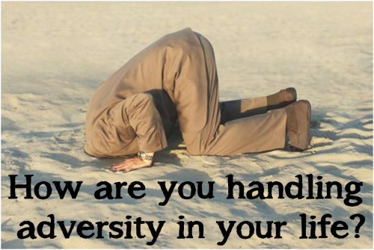
Could it be that you are seeing your infirmities in the wrong light?
If it weren’t for your thorns how many times would you think to consider prayer at all?

Slide 15
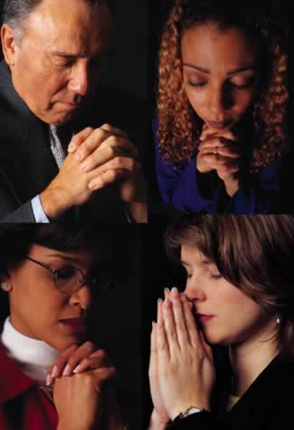
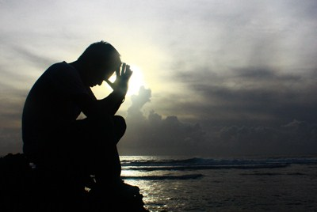
What do we glean from all of this?
In time of infirmity, pray!
But don't be surprised if the answer to your prayers are: "My grace is sufficient for you"
"My strength is made perfect in weakness“

Slide 16
The Lord may choose not to remove your thorn either...
Instead, He may choose to give you the strength to endure it
If so, then rejoice that power of Christ rests upon you!
Think about the Lord's statement as it relates to the problem of SIN, and the SALVATION He offers ("My grace is sufficient for you")...
(Titus 3:4-8)

Slide 17
Stop Trying To Do It By Yourself!

