Slide 1
Are You An Apatheist?
Reading – Revelation 2:1-5 and 3:14-19

Slide 2
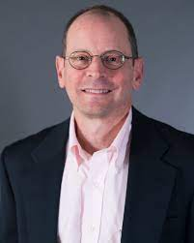
“I still don't believe in God, but the larger truth is that it has been years since I really cared one way or another.”
“In America, the proportion of people who say they never go to church or synagogue has tripled since 1972, to 33 percent in 2000.”

Slide 3
Larger Question: Are You An Apatheist?
Apatheism
Lack of interest towards belief or lack of belief in a deity or religion
Applies to both theism and atheism
The apatheist’s creed is “So what?”

Slide 4
Causes of Apatheism
Consider the Israelites
Deuteronomy 8:11-14
Amos 6:3-6
Hosea 12:8

Slide 5
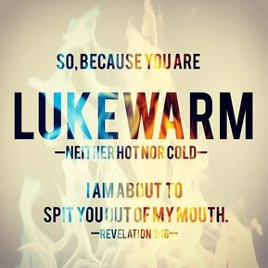
Causes of Apatheism
Consider the Laodiceans
Revelation 3:14-17 [text reading]
Material wellbeing can lead to spiritual apathy

Slide 6
What cures apatheism?
True repentance
2 Corinthians 7:9-11 [godly sorrow with diligence]
Romans 2:4-11 [grace AND penalty for sin]
Hebrews 10:26-31

Slide 7
What cures apatheism?
True religion
Many are apathetic because they have not seen or experienced true religion.
James 1:27

Slide 8
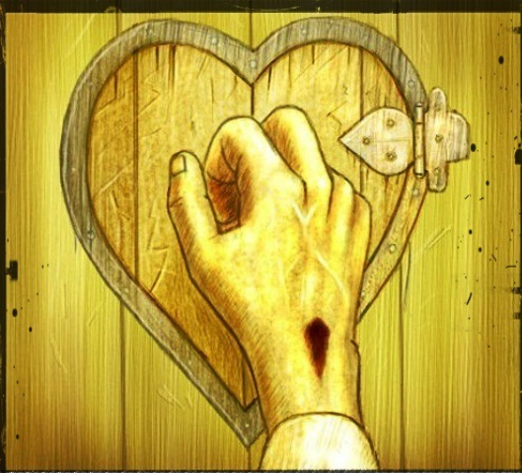
Jesus Offers What TRULY Satisfies
The water of life that quenches thirst – John 4:13-14; 7:37-39
The bread of life that eliminates hunger – John 6:35
Light that dispels darkness – John 8:12
Freedom from the guilt and bondage of sin – John 8:34-36
Abundant life, filled with joy and peace – John 10:10; 14:27; 16:33
He offered the same to LUKEWARM Laodiceans Revelation 3:18-21

Slide 9
The Word can cause a Positive Effect on the TRUE Believer
And they said to one another, “Did not our heart burn within us while He talked with us on the road, and while He opened the Scriptures to us?” ~ Luke 24:32
Then Peter said to them, “Repent, and let every one of you be baptized in the name of Jesus Christ for the remission of sins; and you shall receive the gift of the Holy Spirit. ~ Acts 2:38
But the fruit of the Spirit is love, joy, peace, longsuffering, kindness, goodness, faithfulness, gentleness, self- control. Against such there is no law. ~ Galatians 5:22-23
Now may the God of hope fill you with all joy and peace in believing, that you may abound in hope by the power of the Holy Spirit. ~ Romans 15:13

Slide 10
Don’t Be An Apatheist! Just Stay With it!
Know and experience salvation by grace!
Revelation 2:7 & 25-26

