Slide 1
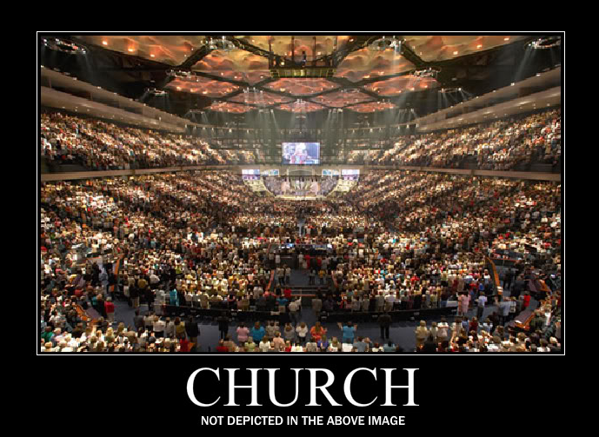
The Timeless Modern Church
Reading – 1 Corinthians 10: 1-13

Slide 2
When we try to live by values today, it seems as if we stick out.
The Bible, which never changes, says this will be so....
[1 Peter 2:9]
[Matthew 5:14 & 16]

Slide 3
“It’s not easy being a Christian today."
It wasn’t easy being a Christian in the 70’s
Just as it wasn’t easy being a Christian in the 40’s. WHY?
Because of the lust of the flesh, the lusts of the eye, and the pride of life [1 John 2:16] which knows no decade.

Slide 4
The Bible has given us a set of rules for conduct that challenge us to be faithful.
Jesus said, Heaven & earth will pass away, but my words will not pass away.
He also said, Whoever does not bear his cross and come after me, cannot be my disciple. [Luke 14:27].
We try to blame our times and our technology for not accepting the challenges that Jesus has asked us to bear.

Slide 5
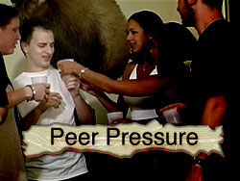
Peer pressure is not a new concept.
It caused Aaron to fashion the golden calf.
It caused King Saul to spare King Agag and the best livestock
It caused Peter to deny Christ 3 times
It caused Peter & Barnabas “to play the hypocrite” at Antioch

Slide 6
The Bible teaches of Timeless Worship.
Even in Jesus’ day men wanted to substitute their terms for worshipping God.
Jesus answered them by saying...
But in vain do they worship me, teaching for doctrines the commandments of men. [Matthew 15:9]

Slide 7
The Bible warns us about changing with the times

Slide 8
We live in the "last days" under a New Covenant that does not change.
God, who at different times and in different ways spoke in time past unto the fathers by the prophets, Has in these last days spoken unto us by his Son, whom He has appointed heir of all things, by whom also he made the worlds. [Hebrews 1:1-2]

Slide 9
Look at our Scripture Reading as an example.
(1 Corinthians 10:1-13) Moreover, brethren, I do not want you to be unaware that all our fathers were under the cloud, all passed through the sea, {2} all were baptized into Moses in the cloud and in the sea, {3} all ate the same spiritual food, {4} and all drank the same spiritual drink. For they drank of that spiritual Rock that followed them, and that Rock was Christ. {5} But with most of them God was not well pleased, for their bodies were scattered in the wilderness.;
vs. 6... {6} Now these things became our examples, to the intent that we should not lust after evil things as they also lusted. Is lust still around?

Slide 10
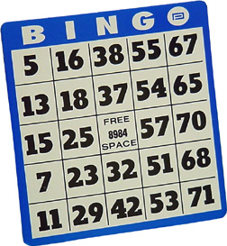
Look at our Scripture Reading as an example.
Verse 7... {7} And do not become idolaters as were some of them. As it is written, "The people sat down to eat and drink, and rose up to play.“
Church “fellowship halls” being used for
a. Gambling {Bingo}
b. Debauchery {Wedding Receptions}

Slide 11
Elements of American Life
Worship
Work
Play

Slide 12
Elements of American Life
Most Americans tend to
Worship their work,
Work at their play &
Play at their worship!

Slide 13
Back to our Scripture…
vs. 8... {8} Nor let us commit sexual immorality, as some of them did, and in one day twenty-three thousand fell.
What was true yesterday STILL holds true today.

Slide 14
Fruits of Immorality…
vs. 8... {8} Nor let us commit sexual immorality, as some of them did, and in one day twenty-three thousand fell.
Around the country, public schools mainstream pregnant girls.
Schools that try to express disapproval of teen motherhood run smack into the iron hand of the federal government.

Slide 15
Fruits of Immorality…
vs. 8... {8} Nor let us commit sexual immorality, as some of them did, and in one day twenty-three thousand fell.
Few recognize it yet, but our bumper crop of children having children is in part the delayed harvest of a 1972 federal law that made it illegal for schools receiving federal funds to discipline students because of pregnancy or parenthood.

Slide 16
So the government “can't legislate good morals”, but must it enforce bad ones?
Can you notice and compare the type of behavior today as described in Romans 1:26-32?

Slide 17
Listen & Learn
Verses 11-13 ... {11} Now all these things happened to them as examples, and they were written for our admonition, upon whom the ends of the ages have come. {12} Therefore let him who thinks he stands take heed lest he fall. {13} No temptation has overtaken you except such as is common to man; but God is faithful, who will not allow you to be tempted beyond what you are able, but with the temptation will also make the way of escape, that you may be able to bear it.
Is it really someone else’s fault if I’m hurt or lost or sick or tempted.
[Galatians 6:7 & 5]

Slide 18
consider the timeless warnings from the book of hebrews

Slide 19
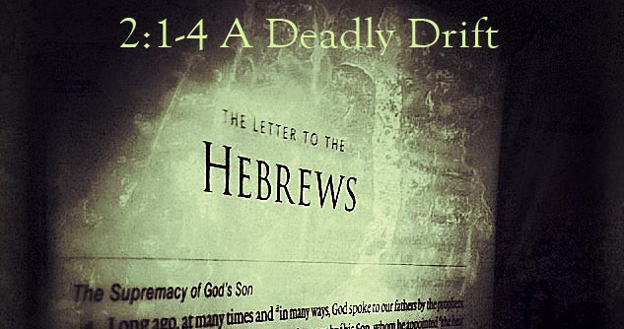
(Hebrews 2:1-4)

Slide 20
(Hebrews 3:12-15)

Slide 21
(Hebrews 4:7-12)

Slide 22
(Hebrews 10:23-31)
Let us hold fast the confession of our hope without wavering, for He who promised is faithful. {24} And let us consider one another in order to stir up love and good works, {25} not forsaking the assembling of ourselves together, as is the manner of some, but exhorting one another, and so much the more as you see the Day approaching. {26} For if we sin willfully after we have received the knowledge of the truth, there no longer remains a sacrifice for sins, {27} but a certain fearful expectation of judgment, and fiery indignation which will devour the adversaries. {28} Anyone who has rejected Moses' law dies without mercy on the testimony of two or three witnesses. {29} Of how much worse punishment, do you suppose, will he be thought worthy who has trampled the Son of God underfoot, counted the blood of the covenant by which he was sanctified a common thing, and insulted the Spirit of grace? {30} For we know Him who said, "Vengeance is Mine, I will repay," says the Lord. And again, "The LORD will judge His people." {31} It is a fearful thing to fall into the hands of the living God.

Slide 23
Get With The Times!
Since God's Word Is Truly Timeless, Then…

