Slide 1
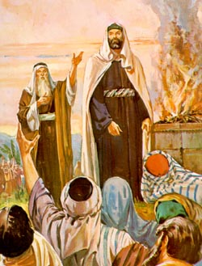
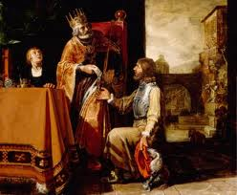
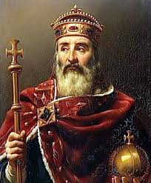
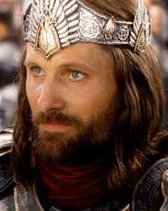
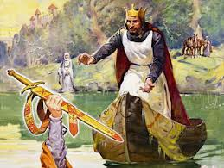
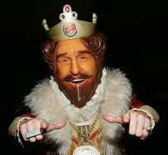
Kings
Reading: Acts 13:21-40

Slide 2
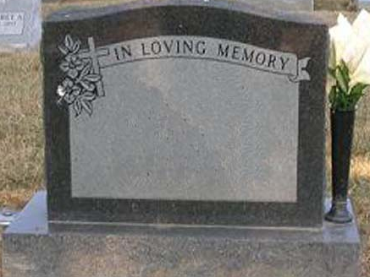
Our text serves to compare King David with our King, Jesus.
While David was alive He did not serve his own purposes.
He did not live to please himself
He lived by the will of God
This is where David found ultimate pleasure.
Wouldn’t you like this on your epitaph? “__________ served God in his/her lifetime.”

Slide 3
The “Secret to a Happy Life”
Live to serve others instead of yourself
Clinical example is found in the “Empty Nest Syndrome”
Skeptics say; “Of Course David served God because God made him King. If God made me King I’d serve Him too.”

Slide 4
David Didn’t Rule as King – He Served As King
Eventually his “Service” came to an end.
Hebrews 9:27

Slide 5
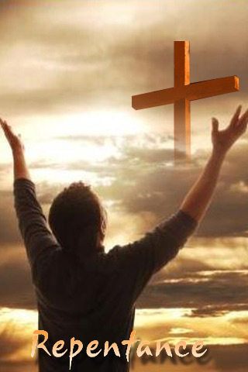
Contrasts & Comparisons to our King
Jesus serves in EVERY generation.
What is the cumulative effect of any man’s work on earth? Feeble by most standards.
The cumulative effect of Jesus goes on & on.
How does Jesus still serve us today?
By the forgiveness of our sins.
(Acts 13:38)

Slide 6
Contrasts & Comparisons to our King
David & Christ died but...
David saw corruption. (Acts 13:30)
(Acts 13:37) "but He whom God raised up saw no corruption.
Although Lazarus and others were raised from the dead, they still died again.
Jesus saw no corruption.

Slide 7
what about our own life?
(Acts 13:39-41)
Forgiveness of sins is our greatest need.
We must first “believe” that we are sinners. You have to believe you are sick before you see a doctor.
Verse 39 says all who believe are justified.
Paul was preaching to people who did not believe they needed any sins removed.
(Acts 13:44-46)

Slide 8
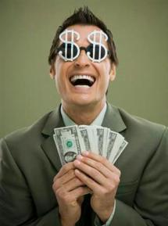
More $$ is not our Greatest Need
Money will buy a bed but not sleep;
Books but not brains;
Food but not appetite;
A house but not a home;
Medicine but not health;
Luxuries but not culture;
Religion but not salvation;
A passport to everywhere but heaven.

Slide 9
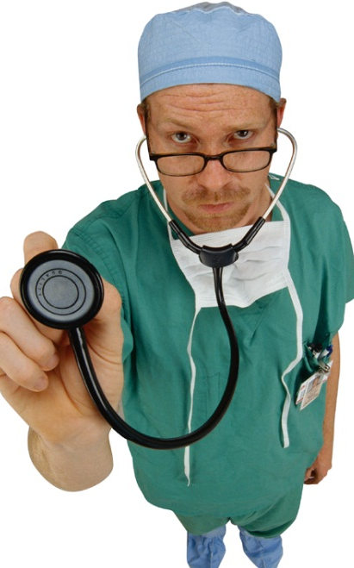
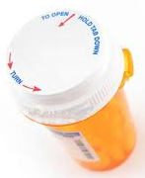
Our greatest need is to get rid of our sins!
When you believe you’re sick then you’ll take action to affect a cure.
Belief itself does not cure you.
The doctor does not cure you.
Following a prescribed remedy will cure you

Slide 10
Service should be our Greatest Purpose
Service is what makes a Christian special (peculiar).
[Titus 2:14]
When a person finds himself in a position to serve the Lord and then DECLINES:
1. He has refused God.
2. He has betrayed his brethren.
3. He has short-changed himself of fulfillment.

Slide 11
Faulty Thinking:
“Since I’m not an elder or a deacon, or a preacher {ladies} or a man, then I can’t serve.” --- WRONG!
Take an example of the wristwatch.
Most of the time we only concentrate on the face because that is all we see.
If it weren’t for all the gears & springs that we DON’T see, the watch, although it may look pretty, would be useless.

Slide 12
Greatest fate is Eternal Life
Physical Death is The Great Equalizer.
We have a constant reminder all around us.
Plants to pets.
Strangers to loved ones.
As Christ was raised again, so can we if we obey his word.
Romans 6:3-18

Slide 13
In Christ You Should Lead The Life Of A King!
Jesus serves in EVERY generation.
Shouldn’t you be serving in this generation?
The Servant mentality is the mindset of a king.
How can He/we help you?

