Slide 1
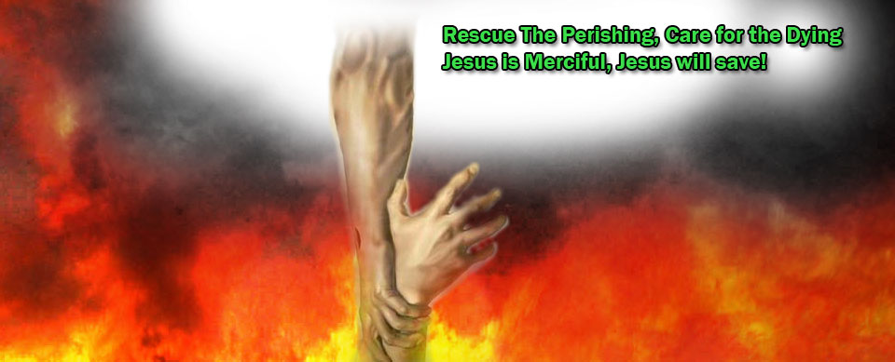
Free Them!
Reading – Ezekiel 3:16-21

Slide 2
Millions of People are SLAVES to Self & Sin!
We are desperate to get free from the hold that the world has on us.

Slide 3
Why don’t more people rescue the perishing?
Free Them or Let Them Die?

Slide 4
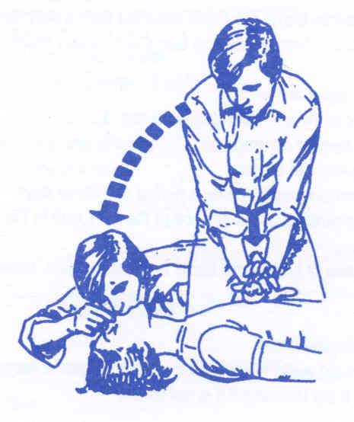
LACK OF KNOWLEDGE
Don’t Know How To Save Them

Slide 5
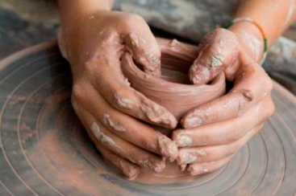
You learn what you want to learn.
You learn how to cook.
Were you born with the knowledge of how to drive a car?
You learned how to pass a school exam.
The only way to learn pottery is by getting your hands dirty!

Slide 6
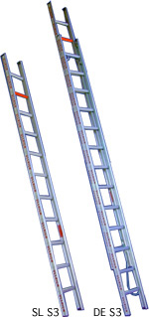
We can learn the word of God as well.
2 Timothy 2:15
2 Timothy 3:16‑17
Hebrews 5:12
The rung of a ladder was never meant to rest upon, but only to hold a man's foot long enough to enable him to put the other somewhat higher.

Slide 7
LACK OF LOST SOULS
“I DON’T KNOW ANYONE”

Slide 8
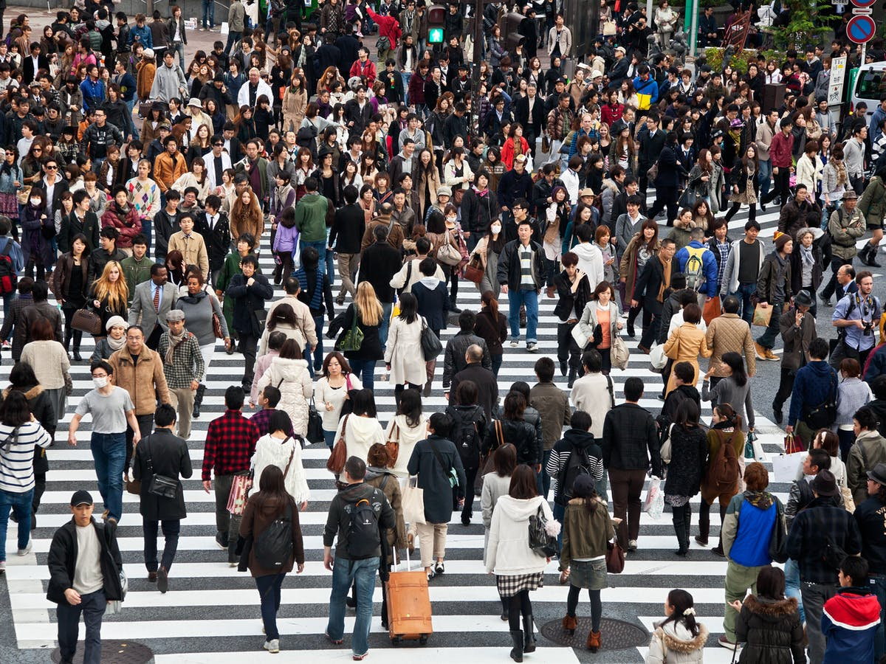
We May Know More People Than We Think
Service station owner
Day care manager
School teachers
Fellow workers
Postman
Grocery store clerk
Trash collector
Neighbors
In-laws, out-laws, etc

Slide 9
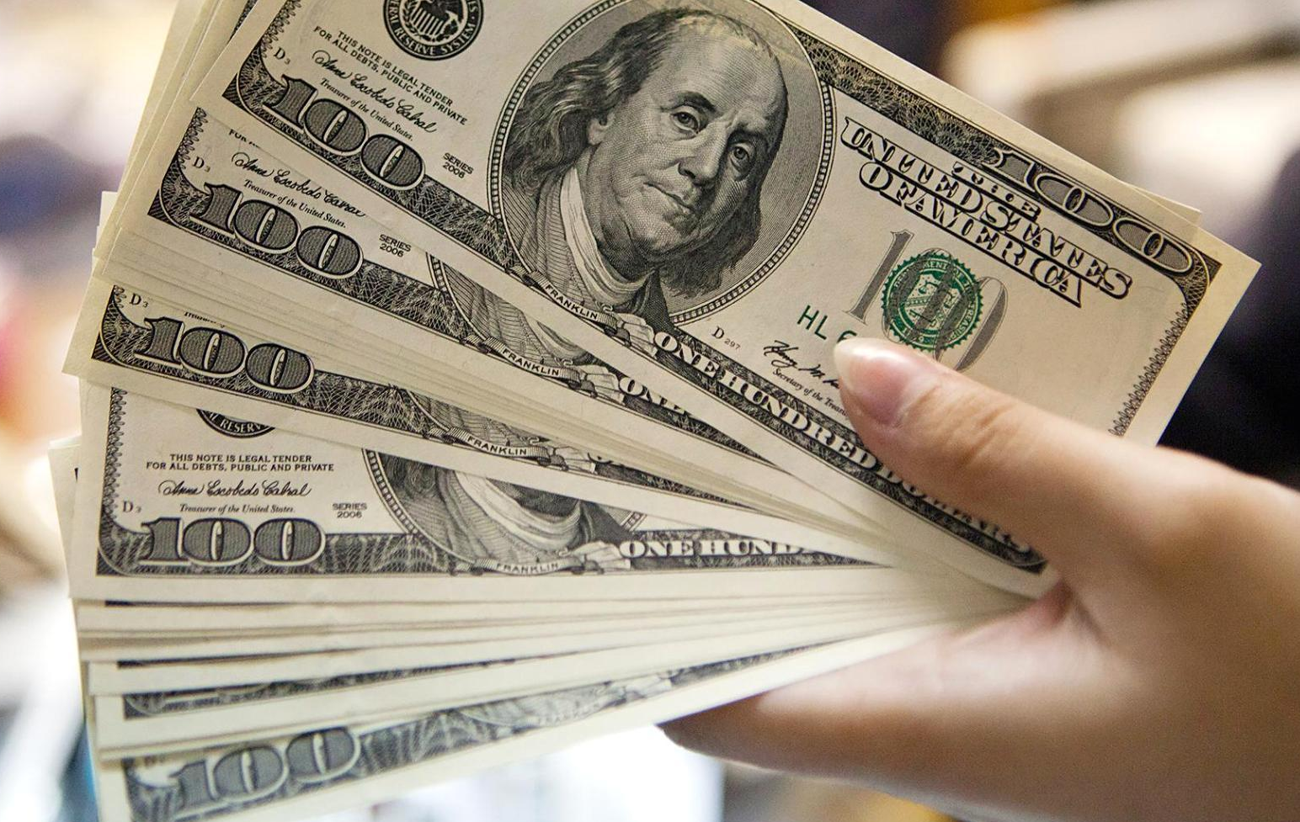
Could It Be We Lack Incentive?
Could you use some extra cash?
What if you made $100 every time someone let you talk to them about a product or service.
How many people would you find?

Slide 10
A Christian is as a Christian does
Have you ever met a salesman who doesn’t sell?
Have you ever met a ball player who plays no games?
Neither should you meet a Christian who doesn’t evangelize!
If you had some good news to share (new child or grandchild, new car, etc.) could you find someone to listen and share the joy with you?

Slide 11
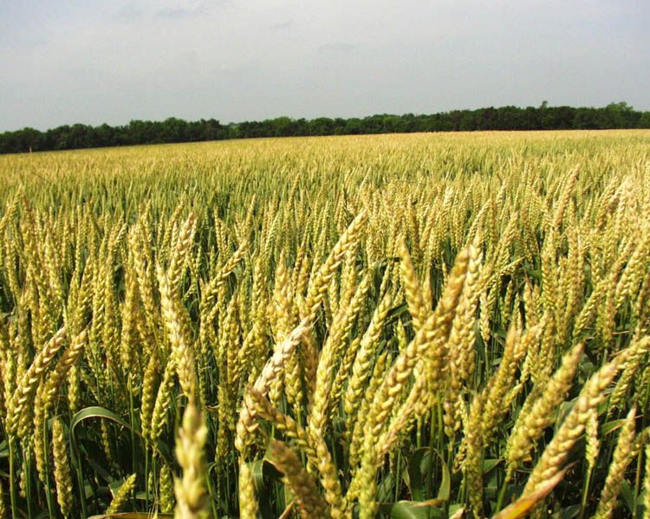
Where Can We Go To Find The Lost?
Jesus said the world is the field in which to sow the seed of the kingdom.
Matthew 13:38 "The field is the world…

Slide 12
“If anyone.”
John 6:51 "I am the living bread which came down from heaven. If anyone eats of this bread, he will live forever; and the bread that I shall give is My flesh, which I shall give for the life of the world." (NKJV)
John 7:17 "If anyone wants to do His will, he shall know concerning the doctrine, whether it is from God or [whether] I speak on My own [authority.] (NKJV)
John 7:37 On the last day, that great [day] of the feast, Jesus stood and cried out, saying, "If anyone thirsts, let him come to Me and drink. (NKJV)
John 10:9 "I am the door. If anyone enters by Me, he will be saved, and will go in and out and find pasture. (NKJV)
1 Peter 3:15

Slide 13
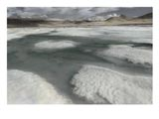
How are some Christians like the Arctic River?
– Frozen Over At The Mouth – they just don’t say anything.

Slide 14
FEAR OF REJECTION
LACK OF SELF-CONFIDENCE

Slide 15
Rejection is not a personal matter.
Luke 10:16 "He who hears you hears Me, he who rejects you rejects Me, and he who rejects Me rejects Him who sent Me.“
Consider the case of Samuel. 1 Samuel 8:7
The Lord knew that truth would not always be received. Matthew 10:22
He warned us of the possibility. Matthew 10:34‑36

Slide 16
These facts did not deter the heroes of the faith.
Joshua 24:15

Slide 17
We cannot be cowards with the truth
Fear rejection by the Lord more than rejection by man.
We must learn to rely upon the power. Romans 1:16 For I am not ashamed of the gospel of Christ, for it is the power of God to salvation for everyone who believes…,
If your friend rejects the gospel feel sorry for him, not for your wounded ego.

Slide 18
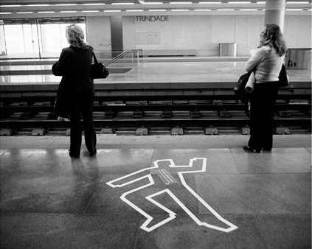
Indifference
The Opposite Of Love

Slide 19
“People Are Dying & I Don’t Care!”
Jesus gave His life, His blood, to save men from the fires of Hell.
Yet some people will not lift a finger to try to save a soul.
Revelation 3:15‑16 "I know your works, that you are neither cold nor hot. I could wish you were cold or hot. 16 "So then, because you are lukewarm, and neither cold nor hot, I will vomit you out of My mouth. (NKJV)

Slide 20
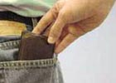
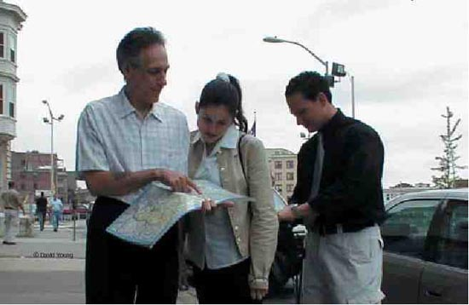
“Intervention Rate”[Bodinger Research]
What would YOU do?

Slide 21
If a study of our spiritual “intervention rate” was done how would we score?
You Probably Know This Song.
“When in the better land before the judgment bar we stand, How deeply grieved our souls may be; if any lost one there should cry in deep despair, ‘You never mentioned Him to me.
You never mentioned him to me, You helped me not the light to see; You met me day by day and knew I was astray, Yet never mentioned Him to me.’”

Slide 22
Their blood will be required at our hands.
Ezekiel 3:18 "When I say to the wicked, 'You shall surely die,' and you give him no warning, nor speak to warn the wicked from his wicked way, to save his life, that same wicked [man] shall die in his iniquity; but his blood I will require at your hand. (NKJV)
Don’t be cut off. John 15:1‑2a "I am the true vine, and My Father is the vinedresser. 2 "Every branch in Me that does not bear fruit He takes away;...”

Slide 23
What are you doing about these vital matters?
Free Them- Don’t Let Them Die?

