Slide 1
Fault Finding
Reading: John 9:1-3

Slide 2
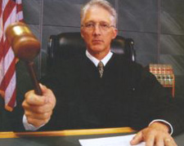
Who are You to be the Judge?
We need to be careful when in God’s court?

Slide 3
Does it matter if you disagree?
Can you provide a scripture to someone that you disagree with?
Poor judgment or attitude could be just as bad as fornication or drunkenness
Mistakes or things YOU don’t like may not be sins

Slide 4
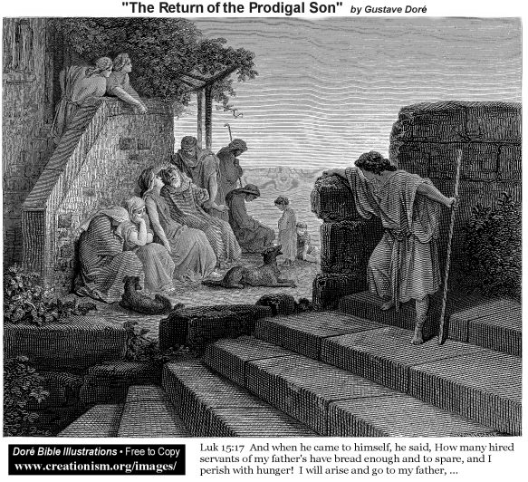
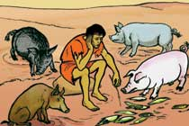
[1 John 3:4] Every one who commits sin is guilty of lawlessness; sin is lawlessness.
Luke 15:25-32 [The Prodigal Brother]

Slide 5
Who was wrong in this story?
The answer is obvious…
BOTH brothers were.
A lot of us can see the sin in the younger brother. Someone who lives an open lifestyle of prodigal living is evident to all.
Why or how did the elder [“faithful”] do wrong?

Slide 6
He Was Preoccupied With The Shortcoming Of His brother.
(Romans 2:1-3)
God will render every man according to his deeds. [Vs. 6]

Slide 7
Preoccupied With Finding Fault In Others
(Matthew 7:1-5 Jesus is talking about hypocritical judgment.
The Bible is described as a mirror in which we see ourselves to make the necessary corrections. (James 1:22-25)
[2 Corinthians 13:5] Examine yourselves to see whether you are holding to your faith.
You Be The Judge!

Slide 8
Example #1
You think you saw someone in Atlanta having an adulterous affair.
What Do You Do?

Slide 9
#1
You go back home and call everyone & tell them what you saw. [1 Timothy 5:13]
Who’s wrong here?
(Proverbs 16:27) (Proverbs 17:9)
What should you do if you think a brother was having an adulterous affair?
(Matthew 18:15-17)

Slide 10
Example #2
You see a known drunkard & adulterer coming out of the newsstand with a pornographic magazine and you look upon him in disgust.
You compliment yourself for not stooping so low.
But you Grumble, Gripe, Fuss & Nag at home & work...constantly. Who’s right to act that way?
[Ephesians 4:32]
[James 1:19]

Slide 11
What Else Did the Prodigal Brother Do Wrong? He Compares Other’s Faults To His spotless record [Vs 29]
“I’ve never been that bad” attitude.
Maybe he did not consort with harlots but what he did to his fathers was just as bad.

Slide 12
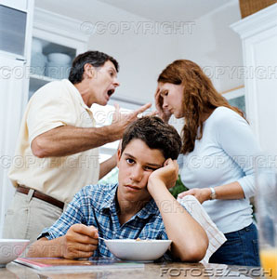
Example #3
Your teenager is disobedient and you lose control.

Slide 13
Example #3
You feel justified because “I never did that when I was their age”.
Who sinned? -- You both did.
(Ephesians 6:1-4)
Both parties have a responsibility to the other.

Slide 14
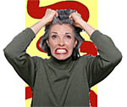
#3
Do we act as if nothing has happened?
(Ephesians 4:26)
We are allowed to get angry if our children are disobedient, just be careful how you vent that anger.
[2 Peter 1:5-6] Add to your faith virtue, and to virtue knowledge, and to knowledge Temperance (self-control).

Slide 15
Example #4
A car mechanic cheats you & you blow up.
You let everyone within shouting distance know that you’re upset.
Is that the right thing to do? [1 Timothy 4:12] ...Set the believers an example in speech, in conduct, in love in faith, in purity.

Slide 16
How Will You Be Judged?
We will all stand before the great tribunal one day.

