Slide 1
Preparing to Fly Away!
Readings - John 14:1-15 – Psalm 90:1-10

Slide 2
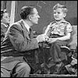
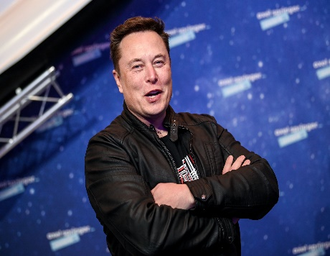
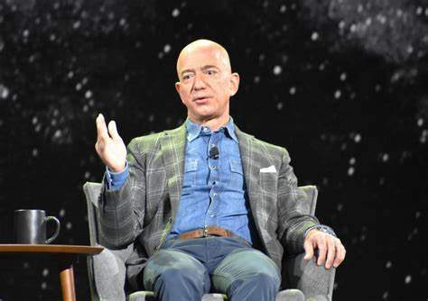
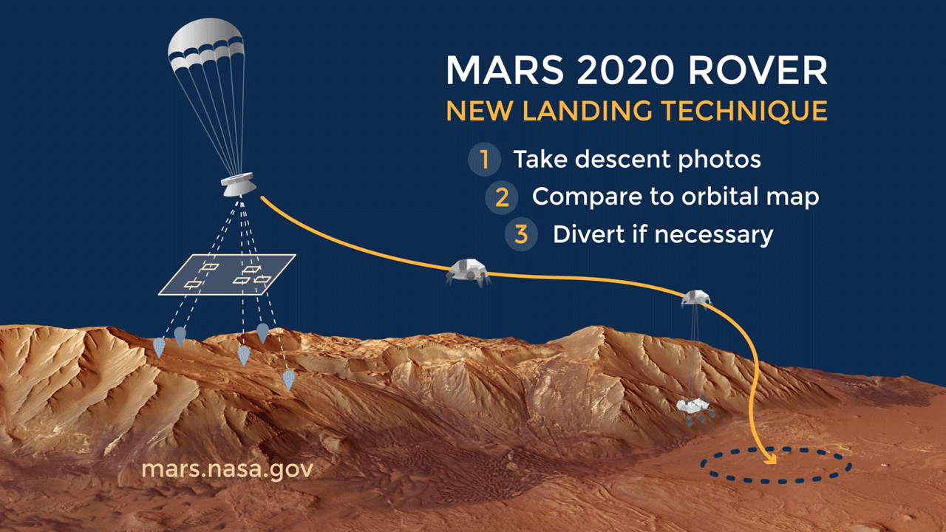
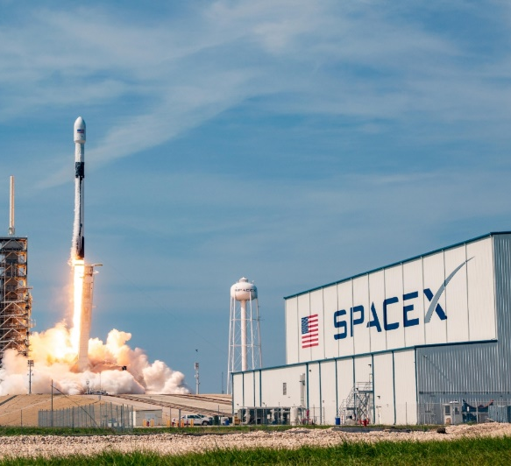
“I Want To Be An Astronaut”
Elon Musk and Jeff Bezos are making plans for colonizing Mars in 2024.
NASA made a successful landing on Feb 18 2021

Slide 3
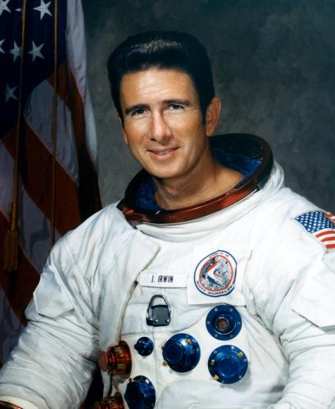
Quote From Colonel James Irwin
"More important than man walking on the moon, is that God walked on earth."
(John 1:14) And the Word became flesh and dwelt among us, and we beheld His glory, the glory as of the only begotten of the Father, full of grace and truth.

Slide 4
Just what will heaven be like?
*

Slide 5
Childhood descriptions of heaven can be amusing.
Big baseball field.
One huge TV.
Front row seats.
Your team always won.

Slide 6
Childhood descriptions of heaven can be amusing.
(1 Corinthians 13:11) When I was a child, I spoke as a child, I understood as a child, I thought as a child; but when I became a man, I put away childish things

Slide 7
Heaven is a place that Jesus has prepared for us.
Text describes it as a mansion.
It will be a 1000 times better than we could ever imagine.
The best way I could think of passing the time in the afterlife is cruising the galaxy.

Slide 8
What will it take to get there?
Preparation

Slide 9
Preparation
Just like earth's pilots, we must train, prepare, and qualify for our mission.
We must carry out our responsibilities like good workmen.
(John 9:4)
Attitude is important.
(Philippians 3:13-14)

Slide 10
Preparation
(Galatians 6:9-10) And let us not grow weary while doing good, for in due season we shall reap if we do not lose heart. {10} Therefore, as we have opportunity, let us do good to all, especially to those who are of the household of faith.
We must DO GOOD and BE GOOD. Pure and undefiled religion before God and the Father is this: to visit orphans and widows in their trouble, and to keep oneself unspotted from the world. (James 1:27)

Slide 11
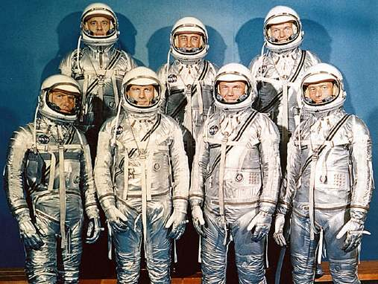
After wanting to fly Only a few were chosen!
Those first Mercury and Gemini astronauts went through rigorous psychological and physical tests.

Slide 12
Jesus said only a small percentage of people will make it Happen.
(Matthew 7:13-14)… "Because narrow is the gate and difficult is the way which leads to life, and there are few who find it.

Slide 13
We still have no excuse!
Those who fail to make it to heaven can't say they didn't have an open invitation.
(Matthew 11:28) "Come to Me, all you who labor and are heavy laden, and I will give you rest.
No one will be able to say that God didn't WANT them to be saved!
(1 Timothy 2:3-4) For this is good and acceptable in the sight of God our Savior, {4} who desires all men to be saved and to come to the knowledge of the truth.

Slide 14
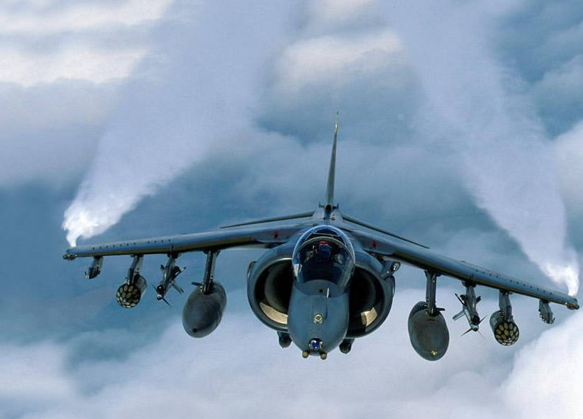
Passing the Test
Jet pilots must pass strenuous physical and mental tests to qualify.
If we don't pass the test it will be because we didn't LOVE God enough to OBEY Him!
(1 Peter 4:17-18)
Jesus couldn’t have been any plainer when He said, (John 14:15) "If you love Me, keep My commandments.

Slide 15
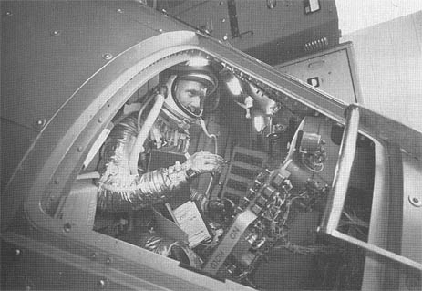
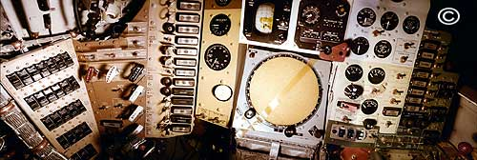
Dedication
To get into NASA you must be dedicated to the task of learning all you can about your mission.
There's no such thing as a half-hearted astronaut.

Slide 16
No Room for Goldilocks religion
"Not too hot, not too cold, just right."
Just enough religion to soothe our conscience while we go about living our lives the way we want to.

Slide 17
No Room for Goldilocks religion
(Revelation 3:15-16) "I know your works, that you are neither cold nor hot. I could wish you were cold or hot. {16} "So then, because you are lukewarm, and neither cold nor hot, I will vomit you out of My mouth.

Slide 18
It takes Faith to climb aboard a craft you did not design or one you are not able to control.
*

Slide 19
God’s People need the same kind of faith To Fly
Isn't God the Greatest Engineer of all?
Consider (Hebrews 11:6-10)
Those were examples of those who were called out to trust the One who sent them on a journey to the unknown.
God is calling us to make a similar journey, and He asks us to trust Him.
(Psalm 40:4)
(Psalm 18:2)

Slide 20
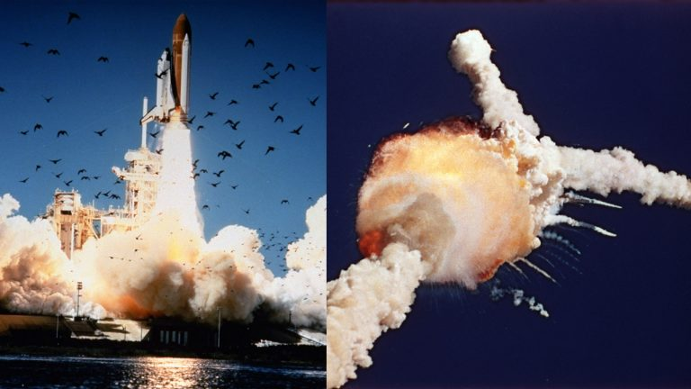
Sometimes tragically, man will fail
Why did this have to happen?" Because fallible man was in charge.
God, on the other hand, will never fail us or forsake us.
Hebrews 13:5 … for he has said, “I will never leave you nor forsake you.”

Slide 21
the big payoff
*

Slide 22
We Fly Away!
A reward that stretches beyond imagination.
(Ephesians 3:20)
(Romans 8:18)

Slide 23
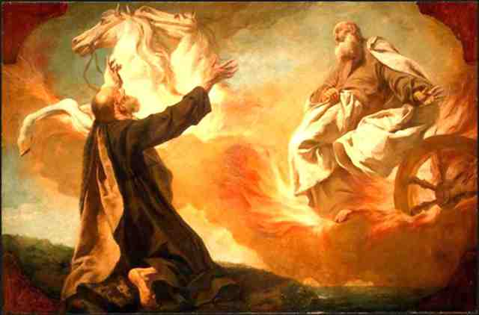
Think about Elisha witnessing the departure of Elijah
(2 Kings 2:11-12) "The chariot of Israel and the horsemen thereof"
Contemplate the glory of the moment.

Slide 24
Wouldn’t You Like To Experience That as well?
(2 Kings 2:11-12) "The chariot of Israel and the horsemen thereof"

