Slide 1
The Wrong Kind Of Pride
Reading - Proverbs 6:12-19

Slide 2
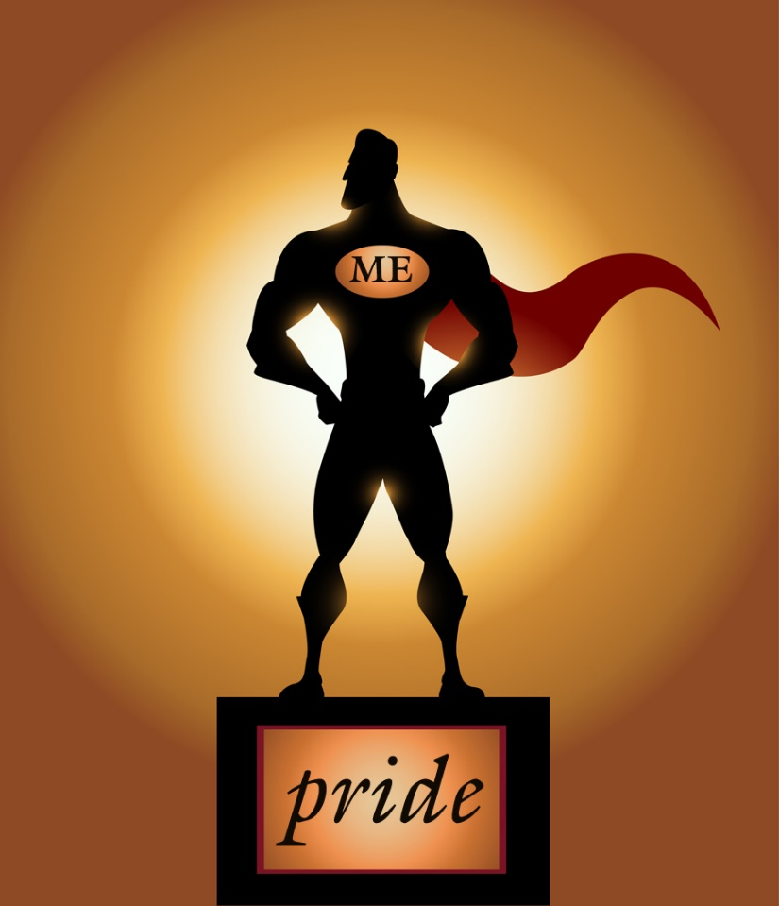
Two aspects of sinful pride:
1. The Countenance, (Proverbs 6:16-17) ------ A proud look…
2. The Heart, (Mark 7:20-23)

Slide 3
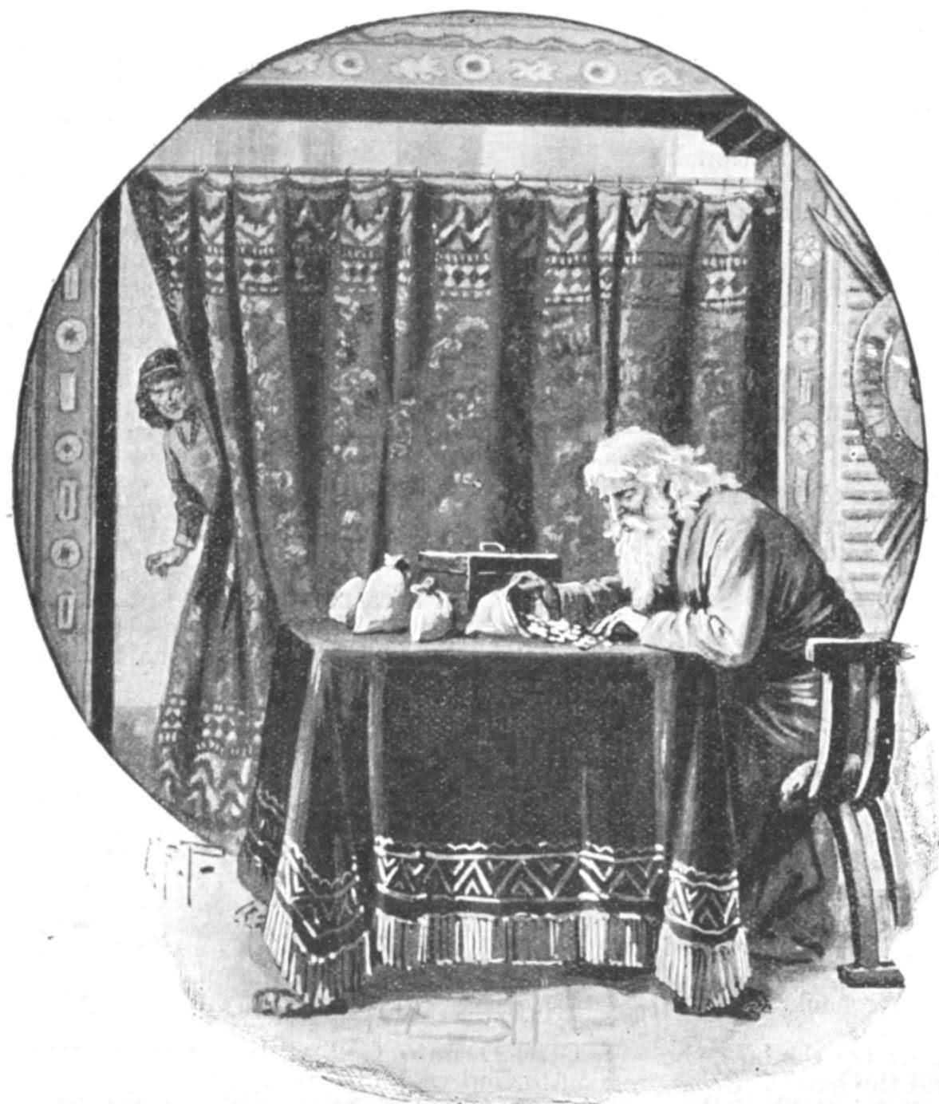
Aesop’s Fable Illustration
The Greedy Man and the Envious Man

Slide 4
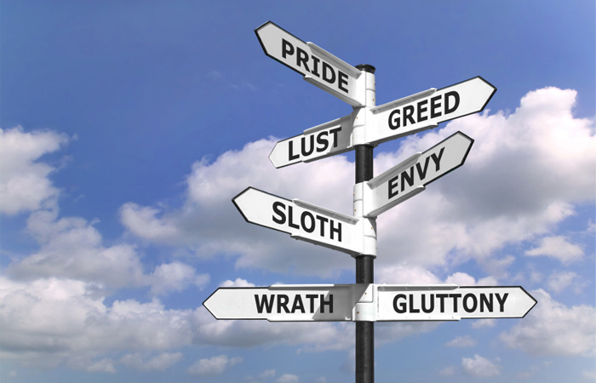
The List of sins in Mark 7
You find "pride" there in that list of sins.
Consider the "list" where you find it.

Slide 5
Warnings against "pride"
Jeremiah 13:15, “Hear and give ear: Do not be proud …”
“God resists the proud, but gives grace to the humble" (I Peter 5:5)
James 4:6 says the same thing, therefore it must have been important.

Slide 6
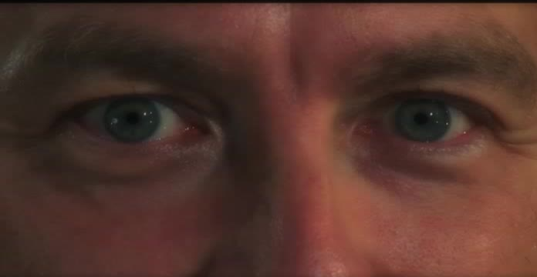
The Proud Look -
Pride of the Countenance

Slide 7
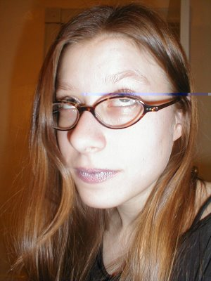
We find "countenance" and "heart” together again.
(Proverbs 21:4) A haughty look, a proud heart, And the plowing of the wicked are sin.
(Proverbs 30:11-13)

Slide 8
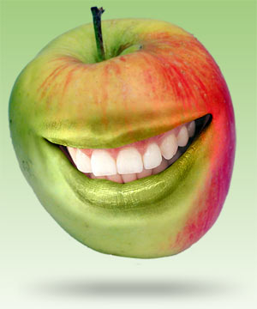
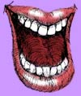
The boastful Words of the proud-
(Proverbs 27:1-2)

Slide 9
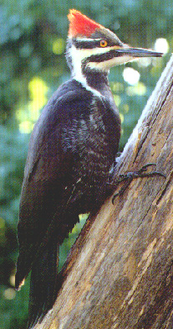
The Deception of Pride
(Proverbs 30:12)

Slide 10
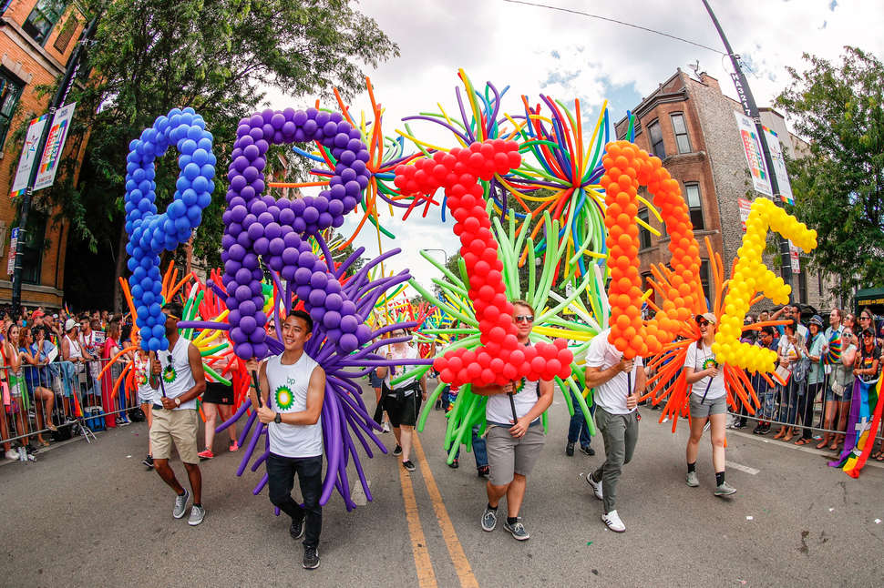
(Romans 12:3) …not to think of himself more highly than he ought to think…
Those who chose to be deceived support and encourage one another to show off their pride to admit to an openly sinful lifestyle.
(Jeremiah 8:12) Were they ashamed when they had committed abomination? No! They were not at all ashamed, Nor did they know how to blush.

Slide 11
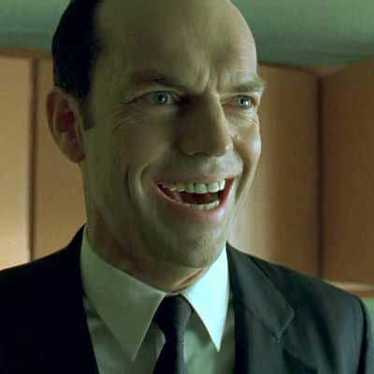
The Resistance of Pride. The "scoffer" -
(Proverbs 13:1)

Slide 12
Good lessons are found in the Proverbs
(Proverbs 15:12)
What punishment due? (Proverbs 15:10)
Seeks wisdom in vain (Proverbs 14:6)
The proud man is even given a "name" in (Proverbs 21:24) A proud and haughty man; "Scoffer" is his name; He acts with arrogant pride.

Slide 13
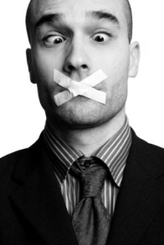
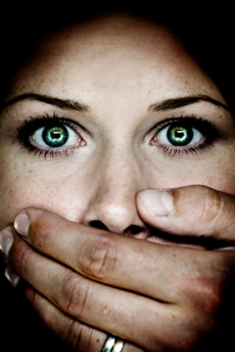
Fall & Penalty of Pride.
Pride keeps me from saying I'm wrong.

Slide 14
Christ's invitation is so plain:
(Matthew 11:28-30) "Come to Me, all you who labor and are heavy laden, and I will give you rest. {29} "Take My yoke upon you and learn from Me, for I am gentle and lowly in heart, and you will find rest for your souls. {30} "For My yoke is easy and My burden is light.“
(Revelation 22:17) And the Spirit and the bride say, "Come!" And let him who hears say, "Come!" And let him who thirsts come. Whoever desires, let him take the water of life freely.

Slide 15
Two things that keep one from coming to Jesus:
1. Price –
What you have to pay to give up the world
2. Pride –
“Coming" involves overcoming one's pride.

Slide 16
Why won't some folks listen or hear?
(Matthew 18:15)
Pride makes it difficult for someone to admit being wrong.
Instead of things being done privately, 2 or more people become involved, ultimately the whole church may become involved.
With King Agrippa the word "almost" stood between him and salvation. What else do you suppose stood with him there? (Proverbs 16:18)
Even in the face of eternal destruction, pride can cause you to lose your soul.

Slide 17
The opposite of pride is humility.
Proverbs 29:33 "A man's pride will bring him low, but the humble in spirit will retain honor."

Slide 18
The opposite of pride is humility.
Won’t you humbly come to Jesus now?

