Slide 1
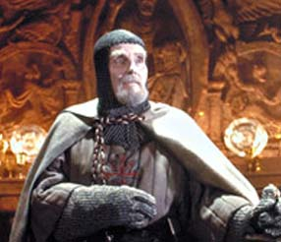
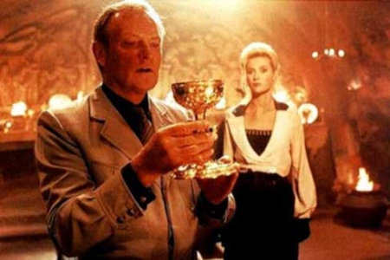
Choosing Wisely
Reading - Romans 14:5-12

Slide 2
"Multitudes, multitudes in the valley of decision! For the day of the LORD is near in the valley of decision" (Joel 3:14).
We must exercise great care in our choice...
a. Of friends,
b. Of an occupation, and
c. Of a spouse.

Slide 3
THE CHOICE OF FRIENDS
(Proverbs 12:26) The righteous should choose his friends carefully, For the way of the wicked leads them astray.

Slide 4
THE CHOICE OF FRIENDS
(Proverbs 27:17) As iron sharpens iron, So a man sharpens the countenance of his friend

Slide 5
THE CHOICE OF FRIENDS
A Key Factor in being a “Good” friend

Slide 6
Not Just Our Problem
(Proverbs 1:10-19)

Slide 7
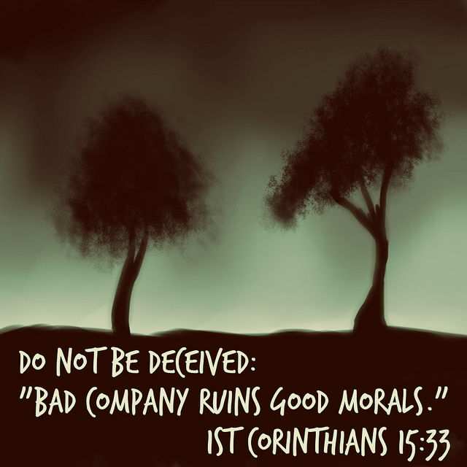
THE CHOICE OF FRIENDS
(1 Corinthians 15:33-34) “Evil company corrupts good habits.”

Slide 8
“Come out and be separate” (2 Corinthians 6:14-18)

Slide 9
Don't walk in front of me. I may not follow. Don't walk behind me, I may not lead. Just walk beside me and be my friend.
(Ecclesiastes 4:9-10)
(Proverbs 18:24)

Slide 10
THE CHOICE OF AN OCCUPATION
Which Job To Take?
(Matthew 6:33)
(Matthew 16:26)

Slide 11
Criteria: [1] Honorable, [2] Consistent with our faith, [3] Allows time for serving God and man.
(Proverbs 13:11)
(Ephesians 4:28)

Slide 12
Ephesians 6:5-8
Bondservants, be obedient to those who are your masters according to the flesh, with fear and trembling, in sincerity of heart, as to Christ; {6} not with eyeservice, as men-pleasers, but as bondservants of Christ, doing the will of God from the heart, {7} with goodwill doing service, as to the Lord, and not to men, {8} knowing that whatever good anyone does, he will receive the same from the Lord, whether he is a slave or free.

Slide 13
THE CHOICE OF A SPOUSE
This can be the best or worst decision you will ever make.

Slide 14
Wisely Chosen?

Slide 15
Wisely Chosen?
(Proverbs 12:4)
(Proverbs 27:15-16)
(Proverbs 21:9 & 19)

Slide 16
Who can you rightfully marry?
You may marry a person who has never been married;
You may marry a person whose first spouse has died (Romans 7:2-3)
These are the safest alternatives.

Slide 17
The Case of Infidelity
(Matthew 19:3-9) The Pharisees also came to Him, testing Him, and saying to Him, “Is it lawful for a man to divorce his wife for just any reason?” ……….. From the beginning it was not so.
{9} “And I say to you, whoever divorces his wife, except for sexual immorality, and marries another, commits adultery; and whoever marries her who is divorced commits adultery.”

Slide 18
Choosing Mutual Subjection & Respect
(Ephesians 5:22-33)

Slide 19
Choosing Mutual Subjection & Respect
(1 Peter 3:1-7)

Slide 20
"Multitudes, multitudes in the valley of decision! For the day of the LORD is near in the valley of decision" (Joel 3:14)
Friends
Occupation
Spouse

Slide 21
The Most Important Decision
Is your decision to become a Christian.
This decision will help you in making all other decisions.

Slide 22
1 Kings 18:21 "How long will you falter between two opinions? If the LORD is God, follow Him...

