Slide 1
You Can Do What You Want! Or you can do God’s Will
Readings – John 15:7 & 16; 1 John 5:14-16

Slide 2
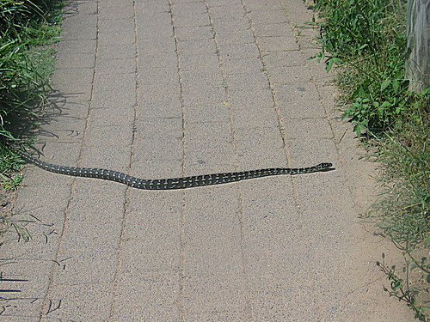
Prayer Is no Guarantee of finding the will of GOd
James 4:1-4
The answers to our prayers are directly related to doing the will of God.
What’s so complicated about the will of God? – Nothing really!!
Ephesians 5:15-17

Slide 3
It is God’s Will That…
You Are Saved!
1 Timothy 2:3-4
Acts 2:37-40

Slide 4
It is God’s Will That…
You Are Spirit Filled
Romans 8:9
1 Corinthians 3:16
Ephesians 5:18-21

Slide 5
It is God’s Will That…
You Are Sanctified!
1 Thessalonians 4:3-8

Slide 6
It is God’s Will That…
You Submit To Authority!
1 Peter 2:13-17

Slide 7
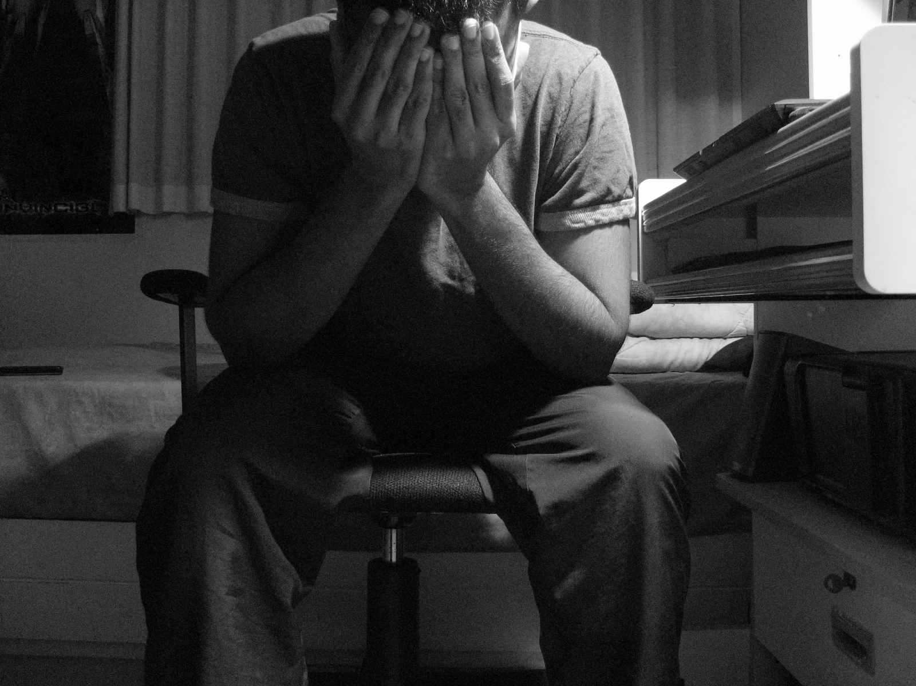
It is God’s Will That…
You Suffer????
1 Peter 4:12-19
2 Timothy 3:10-12

Slide 8
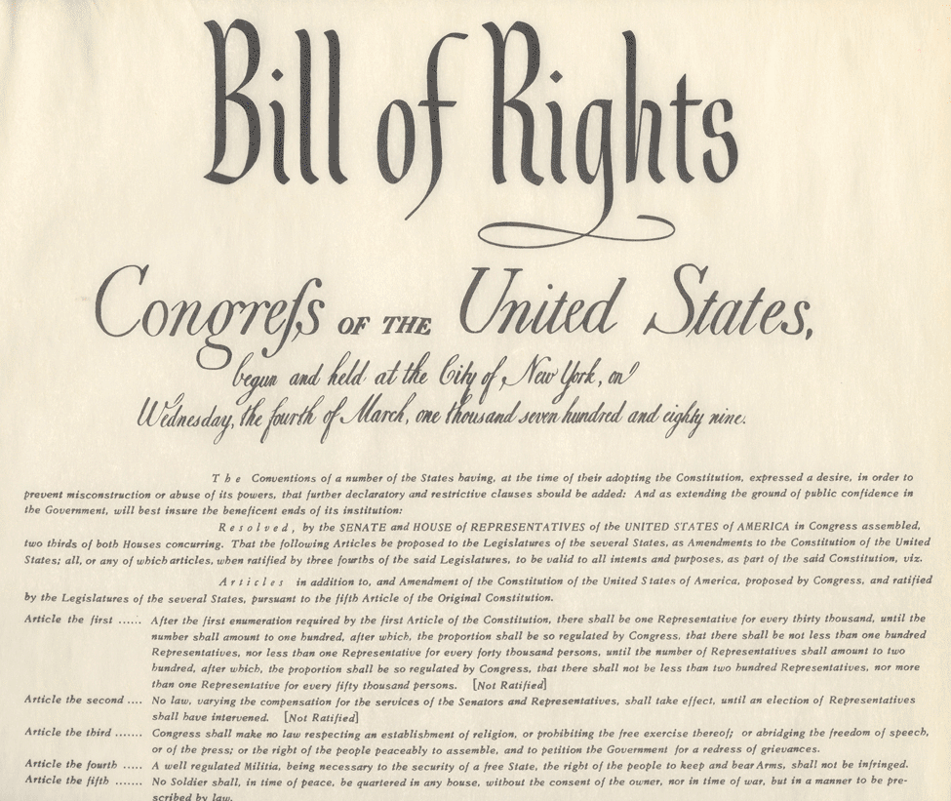
Do WE Have Rights in God’s Kingdom?
We Have Responsibilities
Romans 12:1-2

Slide 9
When You Are In God’s Will…
You Can Do What You Want!
Psalm 37:3-4
Proverbs 3:5-6

