Slide 1
The Spirit & The Understanding Part 29
Reading -- 1Corinthians 14:1-15

Slide 2
Singing Is Not An Afterthought
Exodus recalls the song of freedom
The Psalms were all meant to be sung.
Isaiah has 17 references to singing in various ways.
Ephesians 5:17-20 Therefore do not be unwise, but understand what the will of the Lord is. And do not be drunk with wine, in which is dissipation; but be filled with the Spirit, speaking to one another in psalms and hymns and spiritual songs, singing and making melody in your heart to the Lord, giving thanks always for all things to God the Father in the name of our Lord Jesus Christ,
See also Colossians 3:16

Slide 3
Let’s Examine 5 Songs We Sing
When We All Get To Heaven # 853
And Can It Be That I Should Gain? # 371
Jesus! What A Friend For Sinners # 257
Blessed Redeemer # 331
Ivory Palaces # 896

Slide 4
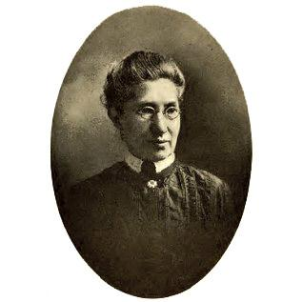
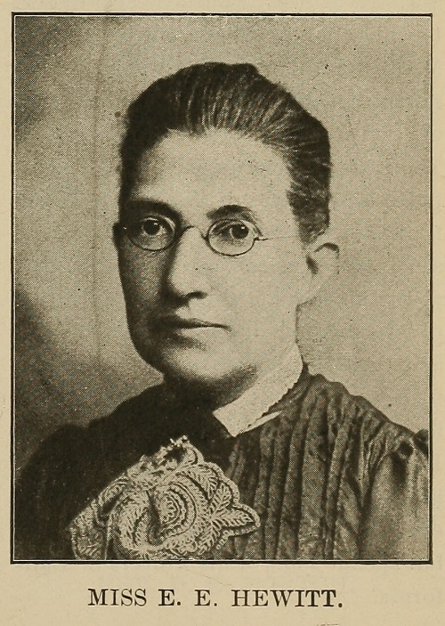
When We All Get To Heaven - 853
Words By Eliza E. Hewitt (1898)
Music By Emily D. Wilson (1898)
Scriptures:
2 Corinthians 4:17-18; 1 Thessalonians 4:17-18; 1John 3:2

Slide 5
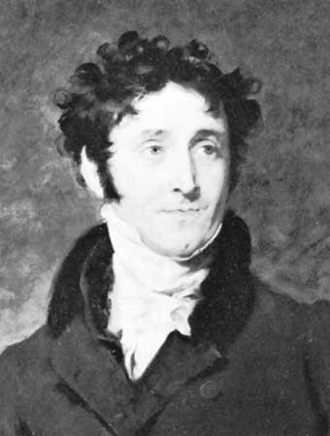
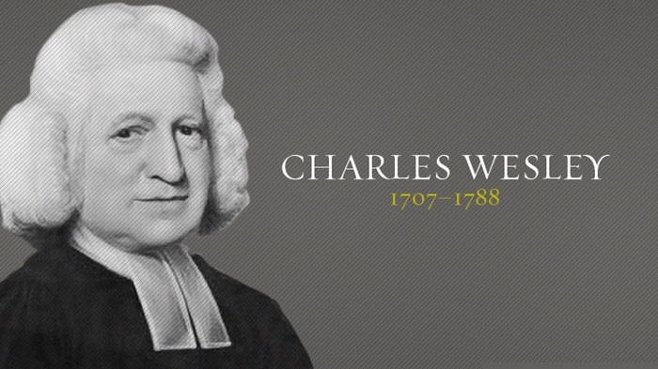
And Can It Be That I Should Gain? 371
Words By Charles Wesley (1738)
Music By Thomas Campbell (1825)
Scriptures:
Romans 5:8; Romans 8:1-3; Hebrews 9:11-12; 1 Peter 1:18-19

Slide 6
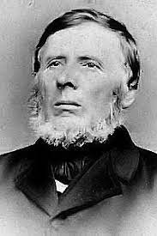
Jesus! What A Friend For Sinners -- 257
Words by John Wilbur Chapman (1910)
Music by Rowland H Prichard (1830)
Scriptures:
Luke 5:30-32; John 15:13-16; Ephesians 1:3-5

Slide 7
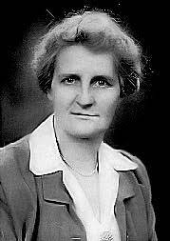
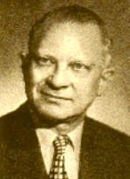
Blessed Redeemer – 331
Words by Avis Burgeson Christiansen (1921)
Music by Harry Dixon Loes (1921)
Scriptures:
Isaiah 54:5-8; John 19:17-18; Colossians 2:13-15

Slide 8
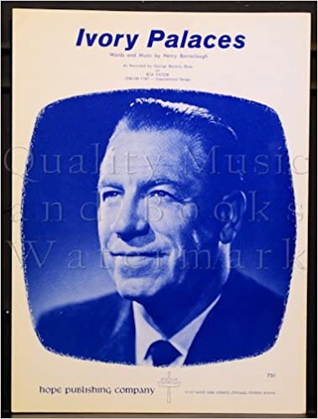
Ivory Palaces -- 896
Words & Music by Henry Barraclough (1915)
Scriptures:
Psalm 45:8; John 1:14; 2 Corinthians 2:14-15; Hebrews 10:5-7

