Slide 1
Reading:
1 Peter 2:11-12

Slide 2
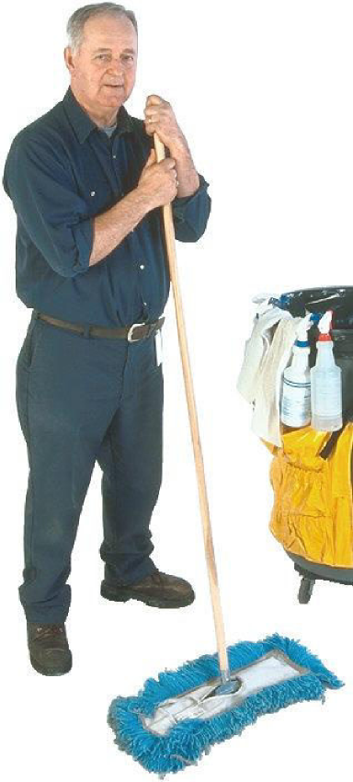
You May Not Realize That You Are Being Watched By the Boss
Hebrews 4:13

Slide 3
You May Not Realize That You Are Being Watched By the Boss
Hebrews 4:13 Psalm 139:7-12

Slide 4
You May Not Realize That You Are Being Watched By the Boss
Hebrews 4:13 Psalm 139:7-12 John 3:19-21

Slide 5
You May Not Realize That You Are Being Watched By the Boss
Hebrews 4:13 Psalm 139:7-12 John 3:19-21 Job 34:21-22

Slide 6
Employees of The Lord
Ephesians 6:5-8

Slide 7
Employees of The Lord
Colossians 3:22-25

Slide 8
Employees of The Lord
1 Timothy 6:1-2

Slide 9
Employees of The Lord
1 Peter 2:18-20

Slide 10
Employees of The Lord
Titus 2:9-10

Slide 11
What If I’m In Charge?
Ephesians 6:9

Slide 12
What If I’m In Charge?
Colossians 4:1

Slide 13
What If I’m In Charge?
Jeremiah 22:13-17

Slide 14
Our Primary Responsibility
Matthew 5:14-16

Slide 15
Our Primary Responsibility
2 Corinthians 4:6

Slide 16
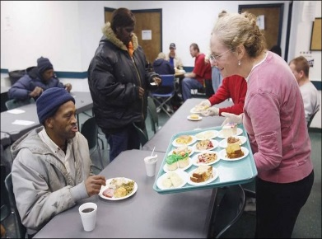
Our Primary Responsibility
Hebrews 13:2

Slide 17
Our Primary Responsibility
Matthew 7:12

Slide 18
Matthew 25:31-40

Slide 19
Undercover Boss Revealed
Jesus will be revealed in the Final Chapter. How well will you score in your Performance Review? Have you followed instructions?

Slide 20
Matthew 28:18
Hebrews 5:9

