Slide 1
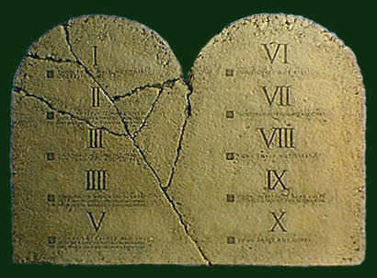
The "New" Ten Commandments
Reading - 1 Peter 4:7-19

Slide 2
"Thou shalt be of sound judgment" "Thou shalt be of sober spirit for the purpose of prayer" "Thou shalt keep fervent in your love toward one another" "Thou shalt be hospitable" “Thou shalt be good stewards of God's gifts" "Thou shalt speak as the oracles of God" "Thou shalt not be surprised at fiery ordeals" "Thou shalt not be ashamed to suffer as a Christian" "Thou shalt glorify God in the name 'Christian'" "Thou shalt entrust thy soul unto God"

Slide 3
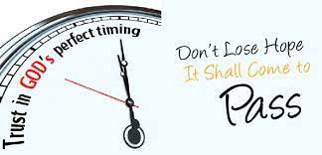
These Commandments relate to the fact that Jesus could come again at any time.
The N.T. talks about the last days. (Acts 2:16-17)
(Hebrews 1:1-2)
Jesus' coming will mark the end of this world as we know it.
(2 Peter 3:8-14)

Slide 4
The "ten commandments" begin with the statement "The end of all things is at hand; therefore..."

Slide 5
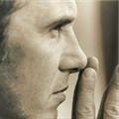
BE OF SOUND JUDGMENT (vs.7)
Good decisions are not often made abruptly, in anger or surprise.
There are more important considerations to life than how much he possesses. (LUKE 12:15).
A decision that makes you richer but takes you farther away from God is not one that comes from sound judgment.

Slide 6
BE OF SOBER SPIRIT FOR THE PURPOSE OF PRAYER (vs.7)
Even though life has its upheavals, the Christian is to remain calm. (James 1:2-8)
How to distinguish between being tempted and being tested or tried:
"Tempted" conveys the idea of appealing to the worst part of man
“Tested” means an appeal to the better part of man

Slide 7
KEEP FERVENT IN YOUR LOVE (vs.8)
"Above all, keep fervent in your love for one another, because love covers a multitude of sins.“
“Fervent" means to be intense.
(1 John 4:20-21)

Slide 8
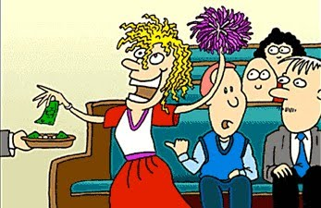
BE HOSPITABLE (vs.9)
To show kindness to those outside one's immediate household.
Our attitude? "without complaint."
(2 Corinthians 9:7)

Slide 9
"The end of all things is at hand; therefore..."

Slide 10
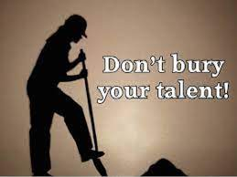
BE GOOD STEWARDs (vs.10)
"As each one has received a gift, employ it in serving one another, as good stewards of the manifold grace of God.“
(Romans 12:9-16)
It is not being a good steward to bury one's talent

Slide 11
SPEAK AS THE UTTERANCES OF GOD (vs.11)
“Prophesy” Because "the end of all things is at hand,“
We do not have the luxury of each going his own way and doing his own thing. (1 Timothy 4:16)

Slide 12
"The end of all things is at hand; therefore..."

Slide 13
BE NOT SURPRISED AT FIERY ORDEALS (vs.12)
Beloved, do not be surprised at the fiery ordeal among you, which comes upon you for your testing, as though some strange thing were happening to you.“
Jesus had explained that it would be this way: (John 15:18-20)
In hard times you need your faith as much as ever. (1 John 5:2-5)

Slide 14
don’t BE ASHAMED (vs.16)
"...but if anyone suffers as a Christian, let him not feel ashamed...“
There is absolutely nothing in the gospel to be ashamed of. (Romans 1:16)
Anyone is a disgrace to the name "Christian" if they are afraid to tell others about Him.
If one-tenth of what you believe is true, you ought to be ten times as excited as you are.

Slide 15
"The end of all things is at hand; therefore..."

Slide 16
GLORIFY GOD (vs.16)
It is much better to be persecuted for righteousness than it is to be the persecutor!
Note the example of the apostles: "So they went on their way from the presence of the council, rejoicing that they had been counted worthy to suffer shame in His name." (Acts 5:41).

Slide 17
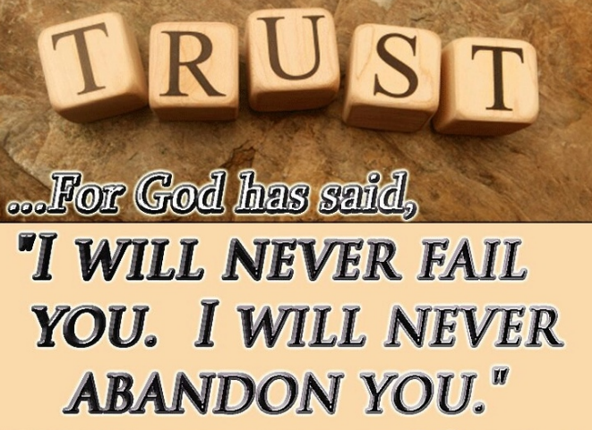
ENTRUST YOUR SOUL TO GOD (vs.19)
"Therefore, let those who suffer according to the will of God entrust their souls to a faithful Creator in doing what is right."
Whatever the cost, whatever the sacrifice, even unto death, the disciple knows that by faith he is secure.
"I will never desert you, nor will I ever forsake you." (Hebrews 13:5)

Slide 18
Jesus is coming again.
Are you ready to "entrust your soul to faithful creator in doing what is right”?

