Slide 1
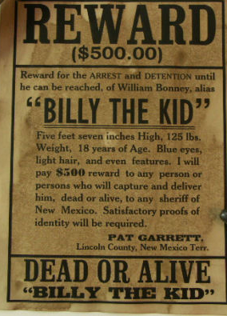
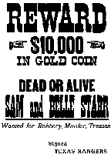
Dead and/or Alive?
Reading - Mark 8:27-38

Slide 2
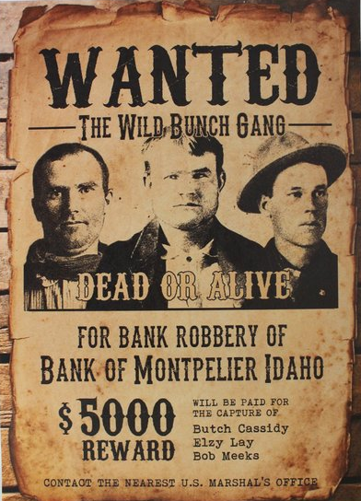
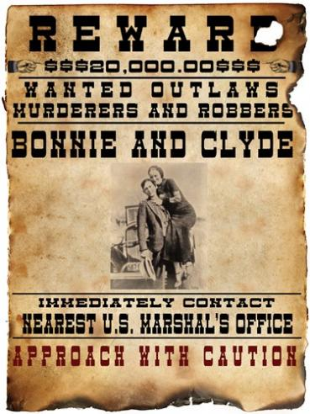
All of these people were well known = Notorious
*

Slide 3
Have you ever done something notorious to warrant this?
Your Name Here

Slide 4
What does it mean to be wanted dead or alive spiritually speaking?
Who would want you dead? [Satan]
Is it possible to be alive & dead at the same time?
Let us look briefly at the word “dead” in its various uses.

Slide 5
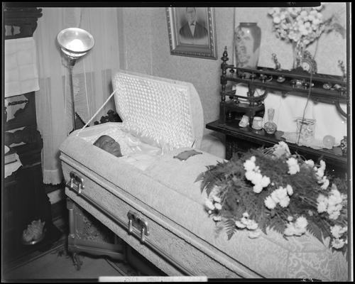
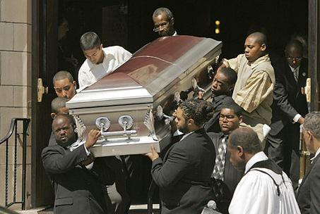
The Physical Body
(James 2:26) For as the body without the spirit is dead, so faith without works is dead also.
Equation: body - spirit = corpse

Slide 6
Spiritual Condition of The Unsaved:
The dead “spiritually” hold funerals for their own all of the time. (Matthew 8:22)
The Gospel is preached to the dead so that they might hear, obey, and live. (John 5:25)
Death does not always mean non-existence. (1 Timothy 5:6)

Slide 7
Luke 15:24
A beloved brother in Christ had to withdraw from his own son because he practiced homosexuality. He said, “I believe he is hopelessly and eternally lost.”
There is such a state! (Hebrews 6:4-6)

Slide 8
The Spiritual Condition of A Church In Decline
(Revelation 3:1)
Perception: “We’re Alive”
Reality: “You are dead.”

Slide 9
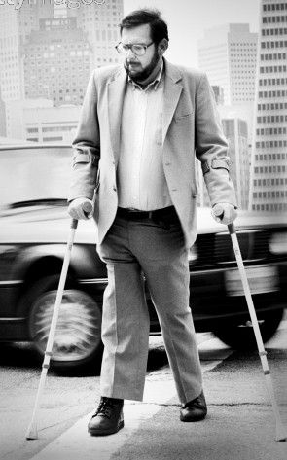
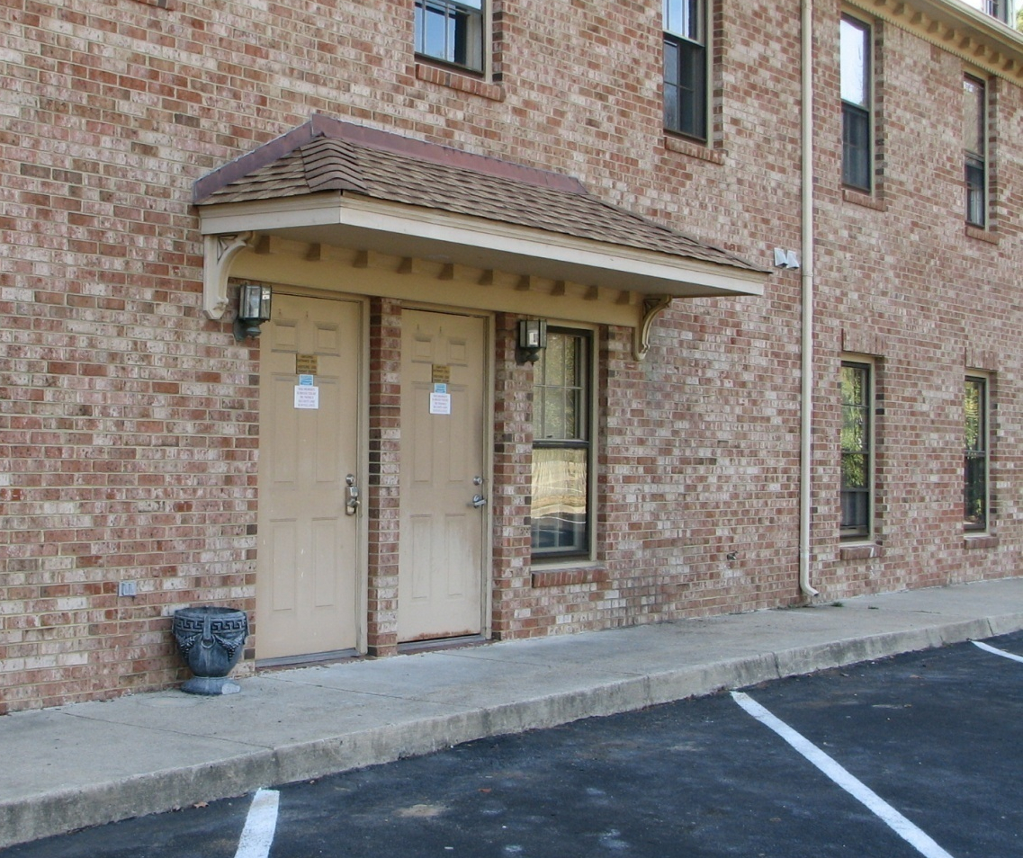
Being Well-Organized
You get hurt and need attention
You make it to the clinic.

Slide 10
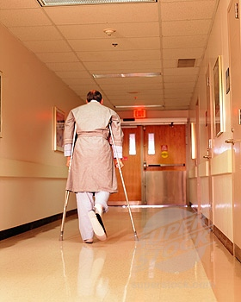
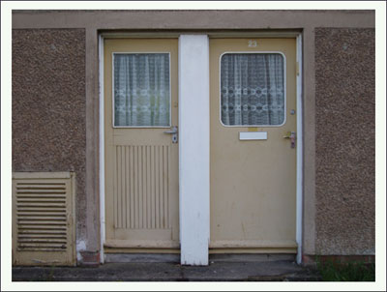
A Story On Being Well-Organized
You make you way down a hall to two more doors.
Emergency/ Non-Emergency

Slide 11
A Story On Being Well-Organized
You go down a long corridor and find two more doors.
Medicare/ Non-Medicare

Slide 12
A Story On Being Well-Organized
Insurance/ Self-Pay
Choose a door and walk through to find….

Slide 13
You’re Back Out On The Street!
You didn’t get any attention BUT THEY SURE ARE ORGANIZED!
Ministers & Ministries galore!

Slide 14
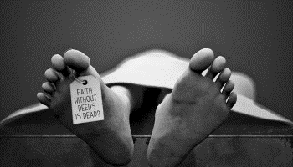
Faith Without Works
(James 2:20-26)
One of the most important lessons in the Bible on “dead.”

Slide 15
Jewish Christians Are Dead to The Old Law
(Romans 7:4) Therefore, my brethren, you also have become dead to the law through the body of Christ, that you may be married to another; to Him who was raised from the dead, that we should bear fruit to God.
Dead to Catholicism, Mormonism, Methodism, Calvinism, etc.

Slide 16
Christian Is Dead In Regards To Living In Sin
(Romans 6:11) Likewise you also, reckon yourselves to be dead indeed to sin, but alive to God in Christ Jesus our Lord.
We are dead today by way of a surrogate.

Slide 17
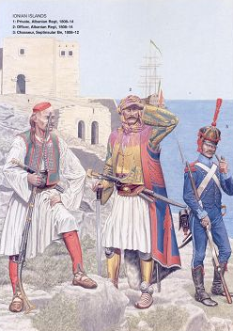
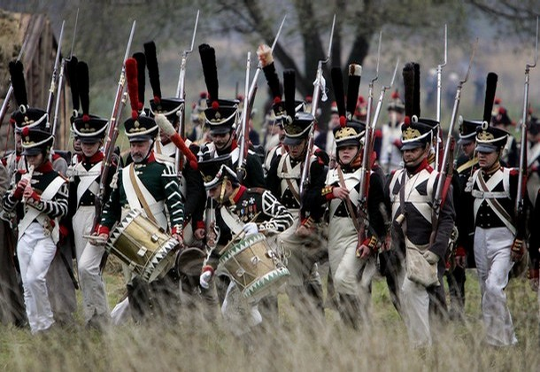
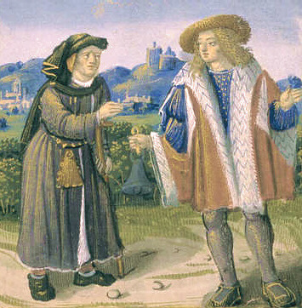
Christian Is Dead by Means of a Surrogate
"You can't take me. I'm dead. I died on the battlefield."
After checking the record they found his name, with another name written beside it.

Slide 18
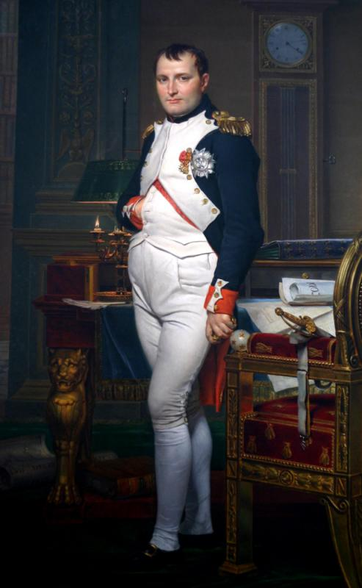
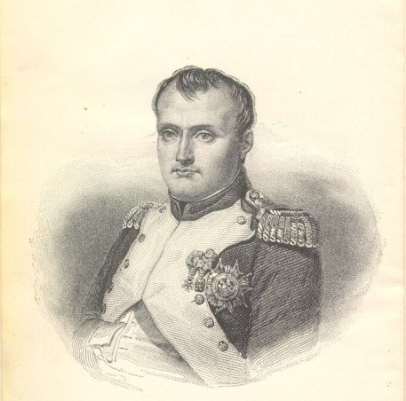
Christian Is Dead by Means of a Surrogate
"Through a surrogate, this man has not only fought, but has died in his country's service. No man can die more than once, therefore the law has no claim on him.“

Slide 19
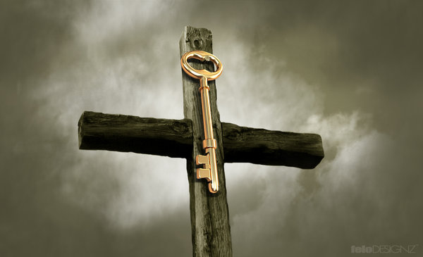
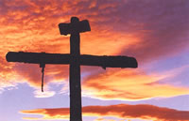
Christian Is Dead by Means of a Surrogate
Jesus went to a cross to bear the penalty that rightly belonged to us. He died in our place. And through Him, our names are written in the book, with His name written beside ours.

Slide 20
developing the wrong ideas about being alive?
Life never means mere existence.
Our lives can be divided into three categories:
worship, work, and play

Slide 21
We Tend To:
Worship our work,
Work at our play, and
Play at our worship

Slide 22
The tragedy of life is not that it ends so soon, but that we wait so long to begin it.
(James 4:13-14)
How much more of your life can you afford to waste?
Science may be able to add years to your life, but only Christ can add life to your years.
(John 14:6) Jesus said …, "I am the way, the truth, and the life. No one comes to the Father except through Me.

Slide 23
Four Important Things to Remember About Being Alive:
OPPORTUNITY: (Ephesians 5:16) redeem the time, because the days are evil.
FAITH: Romans 10:17
FEAR: The Christian must fearlessly live in fear. (Acts 18:9-10) (1 Corinthians 2:3-5) (Matthew 10:28)
PERSECUTION: (2 Timothy 3:12)

Slide 24
Christians That Are Dead To Sin!

Slide 25
Christians That Are Alive in Christ!

Slide 26
Do You Fit The Description?

