Slide 1
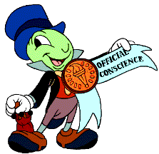
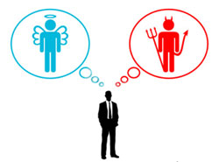
Let Your Conscience Be Your Guide
Reading -- Romans 14:14-23

Slide 2
Cliché: “Let your conscience be your guide”
CONSCIENCE: a moral awareness that judges an action right or wrong.

Slide 3
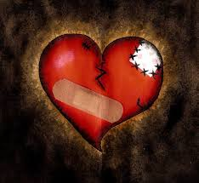
Old Testament, the Hebrew word is usually translated "heart“.
For example, (2 Samuel 24:10) And David's heart condemned him after he had numbered the people.
Romans 14 follows closely what we find in (1 John 3:20-21) For if our heart condemns us, God is greater than our heart, and knows all things. {21} Beloved, if our heart does not condemn us, we have confidence toward God.

Slide 4
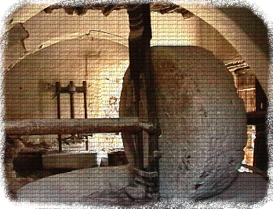
A person can react wrongly because of wrong information, wrong environment, and wrong habit.
European Gypsy children are taught to steal by their parents.
When mama praises you for the amount of things you took from the store, you have no concept of stealing as being wrong.
Some consciences have been seared from a very young age.
(Luke 17:2)

Slide 5
The sinful conscience is "defiled"
(Titus 1:15) To the pure all things are pure, but to those who are defiled and unbelieving nothing is pure; but even their mind and conscience are defiled.
Just because we had a bad start in life, doesn’t mean that we must finish that course.
(Hebrews 10:22)

Slide 6
The conscience is not the ultimate guide.
God’s Word is the standard and not ourselves. (Proverbs 14:12) There is a way that seems right to a man, But its end is the way of death.
If the conscience is not active in judging past acts, it is called “weak”
Consider what the Holy Spirit had to say to the Corinthians, which tie into the same things he says to the Romans.
(1 Corinthians 8:6-13)

Slide 7
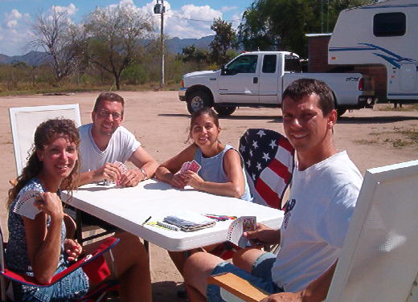
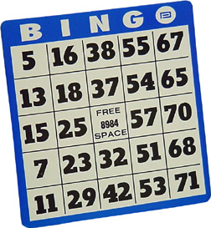
Instead of eating meat offered to idols substitute
Playing Pinochle.
Bingo poses a problem with people converted from Catholicism.

Slide 8
A conscience is something that is formed and shaped from the outside & then internalized.
Notice where Paul said his conscience came from.
1 Corinthians 4:4
A pure conscience is valuable, but Jesus is the final standard by which a person is judged.

Slide 9
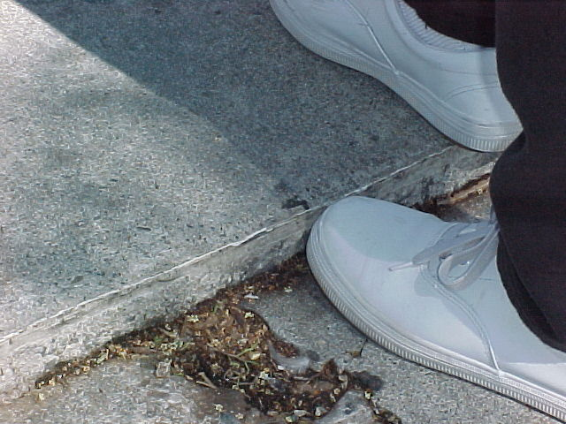
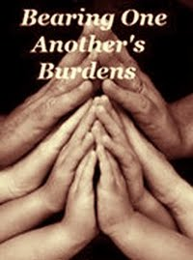
the relationship between the strong and the weak
Romans 14:1-4

Slide 10
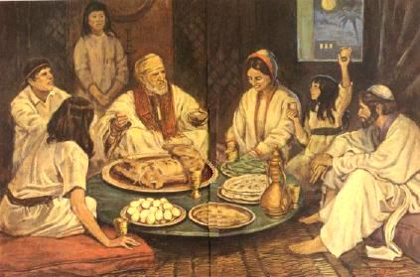
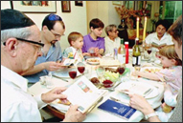
In such matters, each brother should be true to their conscience.
Whatever you do you should do as service rendered to the Lord.
(Ephesians 6:5-6)
Now Read (Romans 14:5-9)

Slide 11
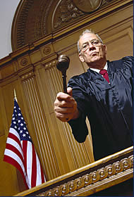
There is no place for condemning or despising one another in matters of conscience.
Jesus will be the judge (Romans 14:10-12)
We all can be guilty of judging our brethren’s motives for missing services.
It doesn’t matter what he or she does or doesn’t do.... They must answer for it themselves.

Slide 12
Your primary concern is not to put stumbling blocks in a brother’s way.
(Romans 14:13) Therefore let us not judge one another anymore, but rather resolve this, not to put a stumbling block or a cause to fall in our brother’s way.

Slide 13
Now you may understand why this is one of the things that the Lord hates.
(Proverbs 6:16-19) These six things the LORD hates… And one who sows discord among brethren.
That is one reason why we withdraw our company from one who is called a brother.
(2 Thessalonians 3:6)

Slide 14
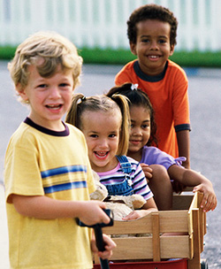
we are our brother’s keeper
Life would be easier if we only had to look out for ourselves.

Slide 15
Things harmless within themselves can destroy those whose consciences do not permit them.
(Romans 14:14-16)
Now substitute dancing as the activity in the place of eating meats. {15} Yet if your brother is grieved because of your dancing, you are no longer walking in love. Do not destroy with your dancing the one for whom Christ died. {16} Therefore do not let your good be spoken of as evil;

Slide 16
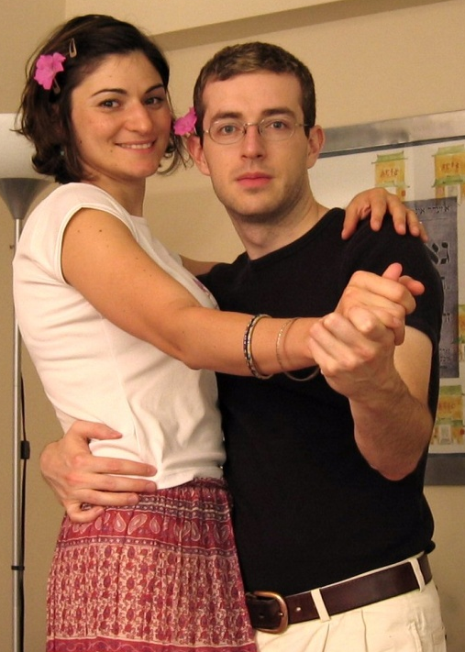
Your motives may be innocent.
You enjoy listening to the music and having your friends around.
You aren’t looking to attract someone or steal anyone’s spouse,
You’re not looking to drink or smoke or “get lucky”
You don’t wear immodest apparel nor do you engage in suggestive or provocative movements.
You look at dancing [like swing dancing] as simply a form of exercise.
Given all those guidelines you are at liberty to participate in this activity in all good conscience, however....

Slide 17
[1 Thessalonians 5:22]
Where can you go where there isn’t other incriminating elements that make you guilty by association?
You have weaker brethren who associate dancing with the drinking, smoking and lasciviousness in the clubs.
To encourage them to dance is their invitation to go back to the old man they are so desperately trying to put behind. {15} Yet if your brother is grieved because of your dancing, you are no longer walking in love. Do not destroy with your dancing the one for whom Christ died.

Slide 18
“Well, I just won’t invite them when I go dancing”
How many Christians can you find who would be willing to go to the clubs with you?
So, even if you want to assert your liberty to go out dancing who do you have to accompany you?
Other non-Christians!
(1 Corinthians 15:33) Do not be deceived: "Evil company corrupts good habits."

Slide 19
Those who understand the true nature of the kingdom of God will be willing to forego personal liberties to maintain peace and build up their weaker brethren.
{17} for the kingdom of God is not eating and drinking, [it’s not playing cards or dancing] but righteousness and peace and joy in the Holy Spirit. {18} For he who serves Christ in these things is acceptable to God and approved by men. {19} Therefore let us pursue the things which make for peace and the things by which one may edify another.

Slide 20
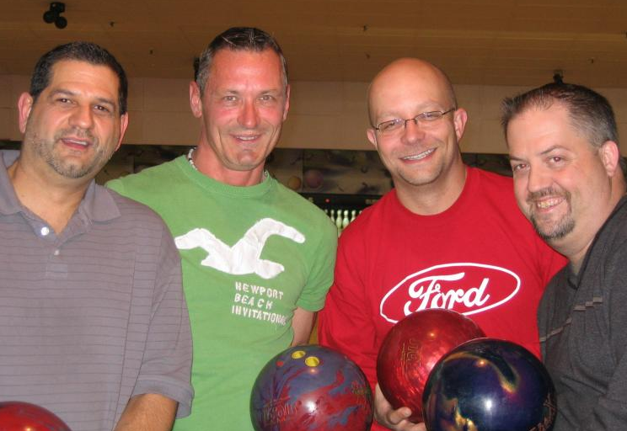
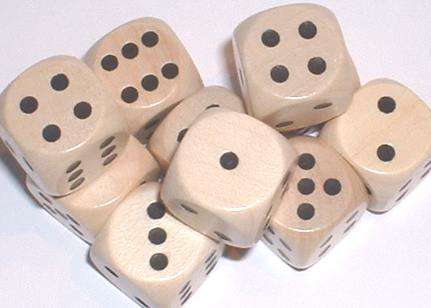
Other Situations
Gambling or Recreation?
Bowling League
Golf Tournament
Dice games – Bunco!
{20} Do not destroy the work of God for the sake of food. [Entertainment] All things indeed are pure, but it is evil for the man who eats with offense.
James said it this way (James 4:17) Therefore, to him who knows to do good and does not do it, to him it is sin.

Slide 21
It is a sin to cause your weaker brother to stumble.
...{21} It is good neither to eat meat nor drink wine nor to do anything by which your brother stumbles or is offended or is made weak. {22} Do you have faith? Have it to yourself before God.
This is exactly the message of Chapter 12 - to present our bodies a living sacrifice.
What kind of mature Christian is it who has to have his way all the time?
{22..cont’d} Happy is he who does not condemn himself in what he approves.

Slide 22
The best rule of thumb is “When in doubt, avoid it.”
{23} But he who doubts is condemned if he eats, because he does not eat from faith; for whatever is not from faith is sin.
Whatever we do in our life must be from faith.
If we do anything outside of that, we are standing on shaky ground

