Slide 1
Placing Limits On God
Reading – Revelation 19:1-6

Slide 2
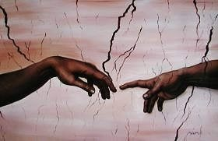
We worship and serve an omnipotent, omnipresent and omniscient God!
He created man in His own image. [Genesis 1:26]
God then gave man the power of choice, for good or evil.
This free choice gave man has the power to place limitations on God.

Slide 3
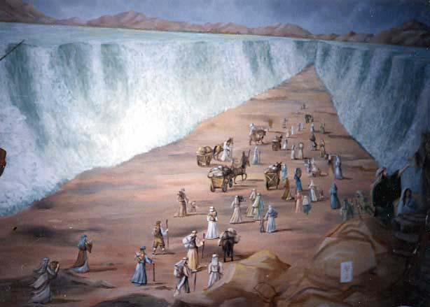
Israel rebelled against God's directions as He guided them toward the land of promise.
In doing this Israel placed limitations on the blessings He sought to bestow upon them. [Psalms 78:40-62]

Slide 4
A sad commentary on this [Hebrews 4:1-11]
The consequences: {Hebrews 3:19} So we see that they were unable to enter because of unbelief.

Slide 5
How Did the CHILDREN OF ISRAEL LIMIT GOD?
By their lack of faith, the children of Israel placed a limitation upon God's intended blessings. [Psalms 106:13-15]
Through their lack of faith they had actually robbed themselves of the goodness and mercy that God had intended for them.

Slide 6
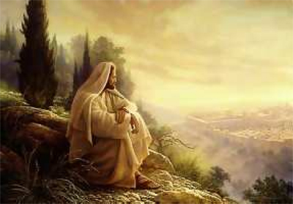
Hundreds of years later Jesus meets the same obstacle of unbelief
{Matthew 13:54-58}
Listen to Jesus’ lament!
[Luke 13:34-35]

Slide 7
Our iniquities put limitations on GOD.
When we stand in open disobedience to God, we place limitations on the Holy One. [Isaiah 59:1-2]
God desires to bless us; but let it be understood there are conditions to meet. [2 Peter 3:9]
Without repentance we place limitations on what God would do for us!

Slide 8
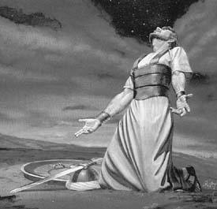
Our failure to pray limits the Lord !
Many of us are destitute of the Lord's blessings simply because we have failed to pray! “The effectual, fervent prayer of a righteous man avails much." [James 5:16].
Then when we DO pray it can be for the wrong reasons.
[James 4:2-3]

Slide 9
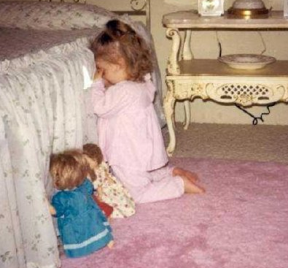
Our failure to pray limits the Lord !
Jesus was very plain in His promise.
[Matthew 7:7-11]
CF> Matthew 6:33]
We put limitations on the Lord by lack of faith in His promises!
Can you imagine saying this? [Psalms 66:16-20]

Slide 10
Choosing Fellowship with the world Limits God !
As Israel began their trek toward Canaan land, God put this choice before them:
[Deuteronomy 11:26-28]
They had a free choice to let the blessings and mercy of God flow upon them, or they could limit those blessings by disobedience.
They made the wrong choice. [Jeremiah 11:7-8]

Slide 11
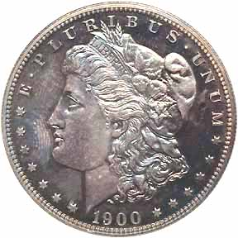
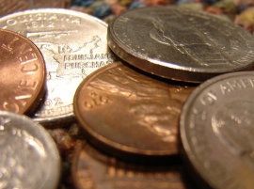
We have the same freedom of choice to deal with God or be short changed by the Devil!
What would your prefer to have?

Slide 12
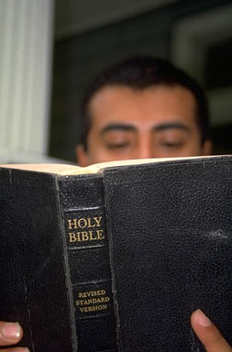
Lack of time in the WORD Limits God’s Blessings !
Psalm 19:1-3 -- God’s presence can be everywhere but in your heart.
You cannot enjoy the blessings of God’s handiwork while being a captive to the world imprisoned by ignorance. [John 8:31-32]
Ignorance of God’s word does not produce bliss. -- [Hosea 4:6]
Saul was a penitent, praying, man but he was told to arise and wash away his sins, calling on the name of the Lord. {Acts 22:16} ‘

Slide 13
We have the power to Limit God’s Word !
Are we guilty of closing the mouth of the Lord by keeping our Bibles closed all during the week?
[2 Timothy 2:15]
Do we close the mouth of the Lord by not being able to tell others why we are Christians and how that they can have eternity too?
[1 Peter 3:15]

Slide 14
We have the power to Limit God’s Word !
Are you closing the mouth of the Lord when you are afraid to defend the truth? [Jude 3]
Have we become so involved in all the material things of this life that we stop the Lord’s mouth from speaking to us?
[Luke 8:14]

Slide 15
We can Limit God’s mission on earth today
[Matthew 28:19-20]
The apostles did just what He told them to do even to the giving of their lives in the process.
Are we willing to limit the effects of the word of God upon our lives and the lives of others by refusing to do what we are told?

Slide 16
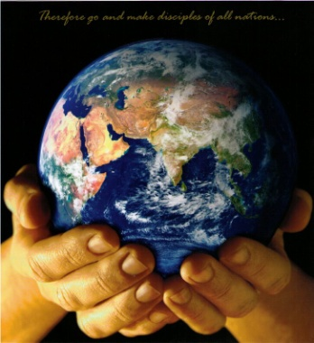
Ability + opportunity = responsibility
Christians represent the hands, feet, and mouth of God, upon this earth.
God’s plan for the lost involves you to take an active role.
If you have been limiting His mission do you wish to continue to do so?

Slide 17
Ability + opportunity = responsibility
The choice is yours!

