Slide 1
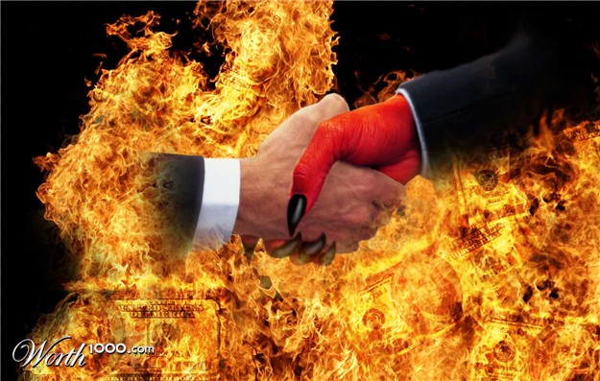
Reading -- Hebrews 11:24-26
Dealing With The Devil

Slide 2
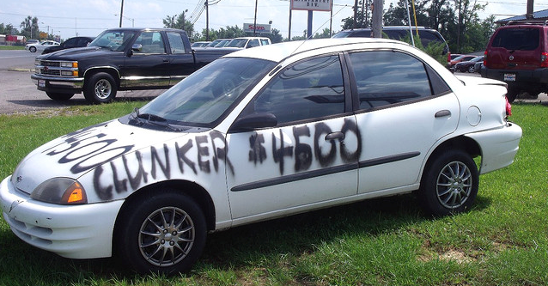
Just Pretend ----
I have within my power to offer you some great deals!
MY FIRST OFFER
I will give you $100,000 CASH for your car right now!
But wait ---- before you spend the money, I have another deal to offer you ------

Slide 3
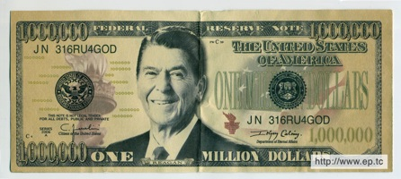
MY SECOND OFFER...
I will give you $1,000,000 for your car.
BUT ----
You must give back the $100,000 I just "gave" you,
You must wait six weeks,
You must leave your car where it is parked right now,
You must be back here the next six Sundays to receive the money!

Slide 4
Reward NOW or Later?
The terms of the deal is that you would have to be on-time at Bible Studies and the Evening Services as well.
Would you make the “Sacrifice” ?

Slide 5
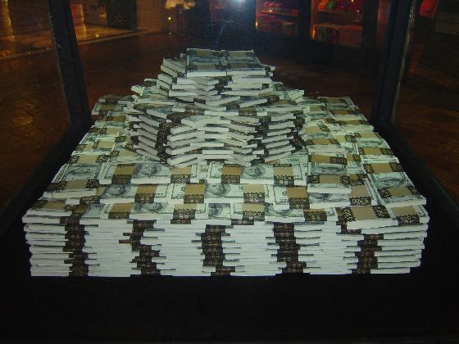
Would anyone turn the second offer down? --- Maybe
MOST of you would be willing to exchange $100,000 for $1,000,000
Not even the conditions would deter you
For the sake of illustration, let's assume you accepted the second offer.

Slide 6
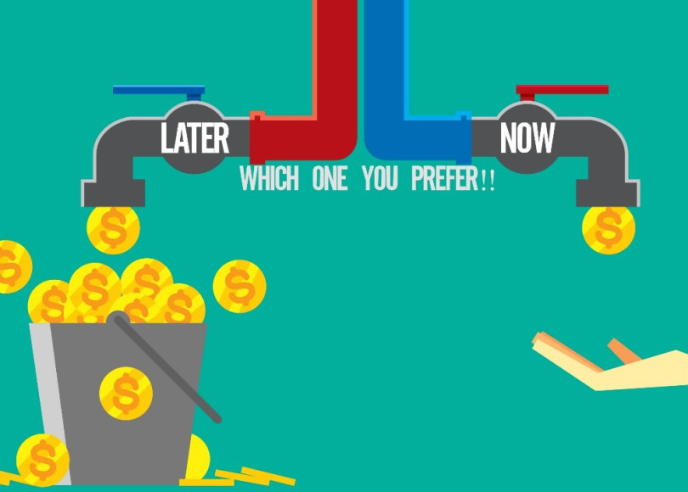
Let's analyze this...
The first offer sounded exciting at first, but paled in comparison to the second offer.
By accepting the second offer, you have turned down an offer of immediate gain for a much larger offer of future gain
An offer requiring no effort or sacrifice for a much larger offer requiring some effort and sacrifice

Slide 7
With this illustration in mind, let's begin making the application.
Making Deals All The Time

Slide 8
Satan offers you deals all the time.
He will give you immediate pleasures and rewards. [1 John 2:15-17]
Lust of the Flesh - the “Deal” of the pleasures that can be found in immorality.
Lusts of the Eyes - the “Deal” of the things that are in the world (materialism)
Pride of Life – the “Deal” of self- glorification.

Slide 9
Satan offers you deals all the time.
His deal requires virtually no effort or self-discipline on your part
If it feels good, do it!
If it looks good, take it!
If it sounds good, go for it!
Our text refers to this deal as "the passing pleasures of sin."

Slide 10
Our Lord offers you a deal as well.
[John 14:1-3]

Slide 11
Our Lord offers you a deal as well.
“An eternity of bliss far exceeding the pleasures and rewards of this life can be yours if the Price is Right!” [Romans 12:1-2]
He requires much effort and sacrifice on your part. [Matthew 16:24-27]

Slide 12
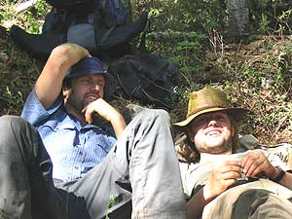
You will be rewarded according to your deeds of faithful service
Will God give you a full-time paycheck for doing part-time work?
Imagine how you would pay someone based on the same way you work for the Lord. [Galatians 6:7-8]

Slide 13
Jesus “Choice Rewards”
Resisting temptation. [1 Corinthians 10:13]
Enduring persecution. [Matthew 5:10-12]
The Big Payoff - "eternal life in Christ Jesus our Lord" [Romans 6:23]

Slide 14
Why do so many accept Satan’s deal over God's?
“The wages of Sin is Death”

Slide 15
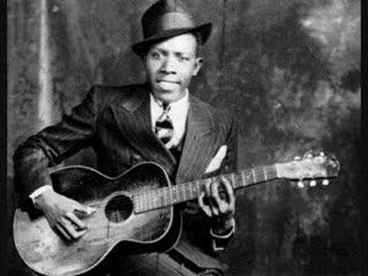
Illogical Reasons
The promises of Satan last only a lifetime (if that)
The promises of God last forever. [1 Timothy 4:8]
Many people literally "sell their souls" to accept the deal Satan offers!

Slide 16
What Deals Have You Made?
To accept Satan’s deal all you have to do is NOTHING!
There have been far too many used-to-be and far too many wannabe Christians who would have gladly accepted a first deal of $1000 in exchange for their soul.
What is your price? [Ephesians 5:3-5]

Slide 17
unfair exchange
We exchange our soul for the evil associates we hang with.
(1 Corinthians 15:33)
(1 Corinthians 5:6)

Slide 18
unfair exchange
In the realm of religion many sell their soul for the allure of feel-good false doctrines.
(Matthew 15:9) And in vain they worship Me, Teaching as doctrines the commandments of men.

Slide 19
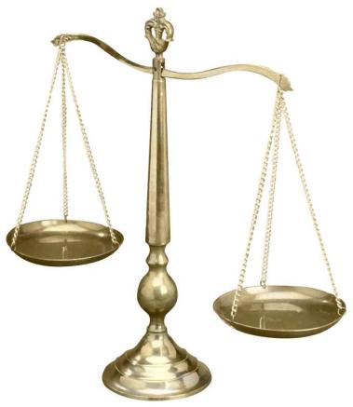
unfair exchange
Others sell their soul for a wanton life of sin
(John 3:19-20)
You’ve heard that the wages of sin is death.
If that’s all Devil is paying, then why are so many people working for him

Slide 20
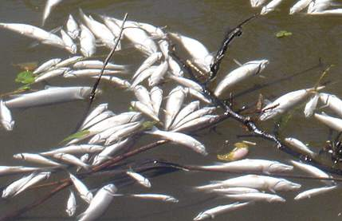
Desire is necessary
It takes effort to serve God. (Matthew 16:24) Then Jesus said to His disciples, “If anyone desires to come after Me, let him deny himself, and take up his cross, and follow Me.
Dead fish can only float downstream.

Slide 21
We are choosing to serve either Satan, Self or God.
What DEAL are you making?

Slide 22
Let’s Make A Deal----
Together we can help each other keep our priorities straight, and receive the best "deal" that one can make! [Hebrews 10:22-31]

