Slide 1

Part 3
Reading – Galatians 3:24-29

Slide 2
40 Authors…6 Major Empires…
1
THEME!
1500 Years… 66 Books…
3 Continents…3 Languages
God’s Plan of Redemption
Notes:
The Bible reflects one central theme from beginning to end. When viewed and understood in perspective it is an incredible evidence that the Bible is indeed from God.
This book could have never been created by man.
<Let’s start this overview on a mountaintop in Galilee>

Slide 3
GOD
GOD
SPIRITUAL UNION
SPIRITUAL FELLOWSHIP
Notes:
When man can exhibit the characteristic of holiness God has a union and relationship with man that is called spiritual fellowship.
We are really spirit beings that inhabit these earthly physical bodies. The earthly bodies are temporary and mortal. Our spirit bodies will soon leave these bodies and inhabit the true reality that God has prepared for eternity. Read 1 John 1:3-7
<TR> This relationship is only possible if man can be found in a state of holiness because this is the only realm of existence with God…but alas this is the problem of man

Slide 4
GOD
God exhibits an attitude of abhorrence and hatred to all that is wrong
“You are of purer eyes than to behold evil, and cannot look upon wickedness.”
Hab 1:13
Notes:
God is of such purity and sin is such a revulsion that he cannot look upon sin. (Charged filings when confronted with a magnet).
<TR> It is even worse

Slide 5
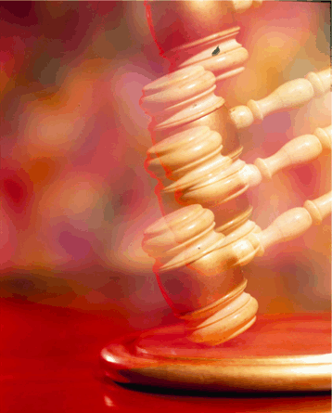

The Price is Right
We deserve to die for breaking the laws of the God of the universe!!!
SIN
DEATH
Notes:
Who deserves to die for my sins?

Slide 6
Remember….
The CONSEQUENCE of sin is
Spiritual Death
The PAYMENT or PRICE for sin is
Physical Death
Notes:
Remember the consequences and payment for sin – a fundamental principle

Slide 7
GOD
GOD
Atonement
“...for it is on this day that atonement shall be made for you to cleanse you; you will be clean from all your sins before the LORD” Leviticus 16:30
ATONEMENT
Notes:
When man can exhibit the characteristic of holiness God has a union and relationship with man that is called spiritual fellowship.
Holiness for man can only take place if the price for sin can be paid thereby removing sin.
<TR> This relationship is only possible if man can be found in a state of holiness because this is the only realm of existence with God…but alas this is the problem of man

Slide 8
Payment
REPRESENTS
BLOOD
LIFE
ATONES FOR
Innocent LIFE
SINNER
PAYS FOR
Guilty LIFE
Innocent LIFE
Hebrews 9:22 …without the shedding of blood there can be no forgiveness
Notes:
Sin demands a HEAVY price

Slide 9
Animal Sacrifice
SINS
(FIGURATIVE)
SINS
REPRESENTATIVE DEATH
JUSTICE
MERCY
DEATH
We will never appreciate God’s mercy
if we don’t understand His justice
Notes:
The amazing plan
<TR>So what made animal sacrifice work?

Slide 10
FAITH & WORKS Controversy
GRACE
ALONE
WORKS ALONE
HEBREWS 11
BELIEF-based ACTION
(SAVING FAITH)
Ephesians 2:8-10
Notes:
This concept is called trust or acceptance. This is only effective when it is belief-based action.
Most of our religious friends don’t really believe in the doctrine of belief only… they use words like you must trust…you must accept…
God again illustrates this point by asking the rhetorical question “Can such faith save him” Saving faith must be belief-based action.

Slide 11
“Behold the
Lamb of God
that takes away the sin of the world”
Notes:
There it is. The plan of redemption in a nutshell. --- Why did he call Jesus an animal? --- What was he communicating to the Jewish mind by calling Jesus and animal? Particularly a lamb? --- God’s lamb. Did Jesus come to die by accident? Hardly. He was announced to be God’s lamb which meant he had to be God’s sacrifice.
[Explain that OT contains much more information – the promises made to Abraham, the chosen people the Jews, the law and the covenants – but the reason for all of those was ultimately the choosing of His people through Christ]

Slide 12
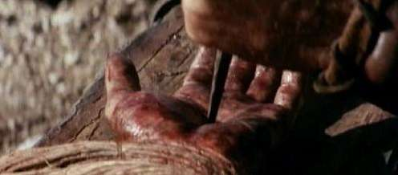
Christ’s Blood in Prophecy
Isaiah 53
Surely our griefs He Himself bore, And our sorrows He carried… He was pierced through for our transgressions, He was crushed for our iniquities; The chastening for our well-being fell upon Him, And by His scourging we are healed.
6 All of us like sheep have gone astray, Each of us has turned to his own way; But the LORD has caused the iniquity of us all To fall on Him.
8 He was cut off out of the land of the living For the transgression of my people, to whom the stroke was due
10 But the LORD was pleased To crush Him, putting Him to grief;
the Righteous One, My Servant, will justify the many, As He will bear their iniquities.
12 He poured out Himself to death, And was numbered with the transgressors; Yet He Himself bore the sin of many, And interceded for the transgressors.
Notes:
1

Slide 13
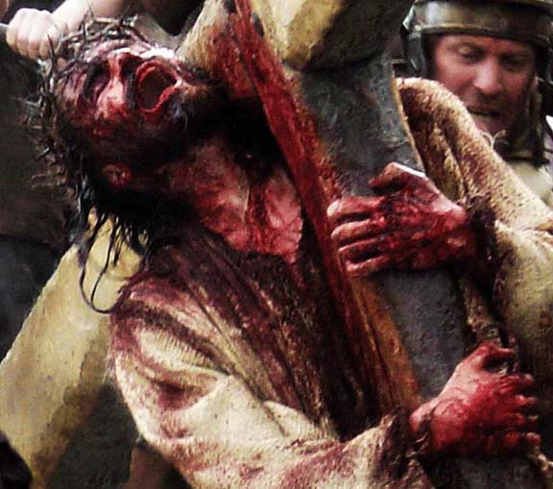
The Lamb of God
1 Peter 1:18-19
knowing that you were not redeemed with perishable things like silver or gold from your futile way of life inherited from your forefathers, but with precious blood, as of a lamb unblemished and spotless, the blood of Christ.
1 Corinthians 6:20
For you have been bought with a price

Slide 14
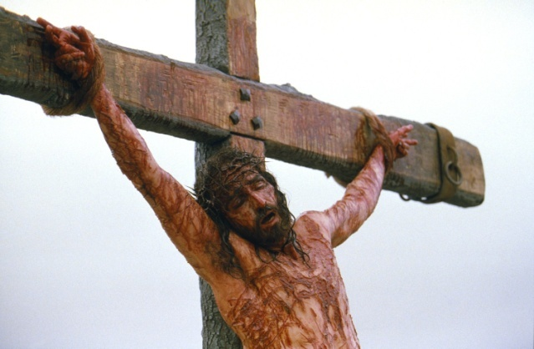
The Lamb of God
Matthew 20:28
the Son of Man did not come to be served, but to serve, and to give His life a ransom for many
Matthew 26:28
for this is My blood of the covenant, which is poured out for many for forgiveness of sins.
1 John 3:5
But you know that he appeared so that he might take away our sins. And in him is no sin.

Slide 15
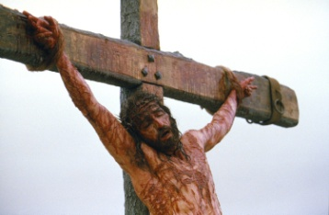
Christ’s Sacrifice
Hebrews 9:26-28 “…He has been manifested
to put away sin by the sacrifice of Himself.
...so Christ also, having been offered once to bear the sins of many…”
SINS
REPRESENTATIVE DEATH
United with Christ
In His death!
DEATH
Hebrews 9:22 …without the shedding of blood there is no remission.

Slide 16
Christ’s Sacrifice
2 Corinthians 5:21
He made Him who knew no sin to be sin on our behalf, so that we might become the righteousness of God in Him
SINS
REPRESENTATIVE DEATH
United with Christ
In His death!
DEATH
Hebrews 9:22 …without the shedding of blood there is no remission.

Slide 17

The Death of the Believer
“It is a trustworthy statement:
For if we died with Him,
we will also live with Him;”
… 2 Timothy 2:11
United with Christ
In His death!
Christ’s death results in the death of the believer!
Notes:
Notice these are things written by Christians referring to a point in time in the past where they died with Christ (past tense)

Slide 18
Our sins can not and will not be forgiven –
UNLESS:
We have died with Christ
We have been united with Christ in His death
We have been crucified with Christ
We have died to sin
This is according to the scheme of redemption for “without the shedding of blood there can be no remission of sins.”
Notes:
Whew all this death – the death of the believer!

Slide 19
The fundamental question of the gospel is:
When?
At what point in my faith
do I die to sin?
do I die with Christ?
When does God view me as
uniting with Christ in his death?
crucified with Christ?
Notes:
Now if you ask this to people today you get a lot of different answers. --- Do you suppose that God would put in place the scheme of redemption and have millions of animals killed over thousands of years just to prepare the way for His son (the Lamb of God) and then have Christ go through the anguish, suffering, and cruel death on the cross – to die in my place – and then leave us in confusion as to where Christ’s death became mine! Can you believe it? --- The confusion doesn’t come from God. It comes from man. --- We need a Bible answer, not an answer based on human reasoning, tradition, or human emotion. We want God to answer the question and we want to accept His answer. --- <TR> Let’s go to the book

Slide 20
The fundamental question of the gospel is:
When?
ROMANS 6
1 What shall we say then? Are we to continue in sin that grace might increase?
2 May it never be! How shall we who died to sin still live in it?
died to sin
Notes:
<TR> Let’s go to the book

Slide 21


3 Or don’t you know that all of us who have been baptized into Christ Jesus have been baptized into His death?
INTO DEATH
Baptized into Jesus Christ
Baptized into His Death!

Slide 22
4 Therefore we have been buried with Him through baptism into death,…
INTO DEATH
Buried with Christ through baptism…into death!

Slide 23
4 …in order that as Christ was raised from the dead through the glory of the Father,
so we too might walk in newness of life.
INTO DEATH
NEWNESS OF LIFE

Slide 24

5 For if we have become
united with Him in the likeness of His death, certainly we shall be also in the likeness of His resurrection,
INTO DEATH
NEWNESS OF LIFE
United with Him in the
likeness of His death

Slide 25
6 knowing this, that our old self was crucified with Him, that our body of sin might be done away with, that we should no longer be slaves to sin;
INTO DEATH
NEWNESS OF LIFE
United with Him in the
likeness of His death

Slide 26
7 for he who has died is freed from sin
INTO DEATH
NEWNESS OF LIFE
United with Him in the
likeness of His death

Slide 27
8 Now if we have
died with Christ, we believe that we shall also live with Him…
INTO DEATH
NEWNESS OF LIFE
United with Him in the
likeness of His death

Slide 28
10 For the death that He died, He died to sin, once for all; but the life that He lives, He lives to God.
INTO DEATH
NEWNESS OF LIFE
United with Him in the
likeness of His death

Slide 29
10 For the death that He died, He died to sin, once for all; but the life that He lives, He lives to God.
11 In the same way count yourselves to be dead to sin, but alive to God in Christ Jesus
INTO DEATH
NEWNESS OF LIFE
United with Him in the
likeness of His death

Slide 30
12 Therefore do not let sin reign in your mortal body that you should obey its lusts,….
INTO DEATH
NEWNESS OF LIFE
United with Him in the
likeness of His death

Slide 31
17 But thanks be to God that though you were slaves of sin,
you became obedient from the heart to that form of teaching to which you were committed,
INTO DEATH
NEWNESS OF LIFE
United with Him in the
likeness of His death

Slide 32
22 But now having been freed from sin and enslaved to God, you derive your benefit, resulting in sanctification, and the outcome, eternal life.
INTO DEATH
NEWNESS OF LIFE
United with Him in the
likeness of His death

Slide 33
23 For the wages of sin is death, but the free gift of God is eternal life in Christ Jesus our Lord..
INTO DEATH
NEWNESS OF LIFE
United with Him in the
likeness of His death

Slide 34
1 John 3:14 “We know that we have passed out of death into life…”
FROM DEATH INTO LIFE
INTO DEATH
NEWNESS OF LIFE
v5 united with Him in the
likeness of His death
Notes:
A beautiful illustration of what happens to Christian when he is baptized into Christ’s death!
<TR>Are we placing too much emphasis on baptism? I want us to look at an important list in Eph 4

Slide 35
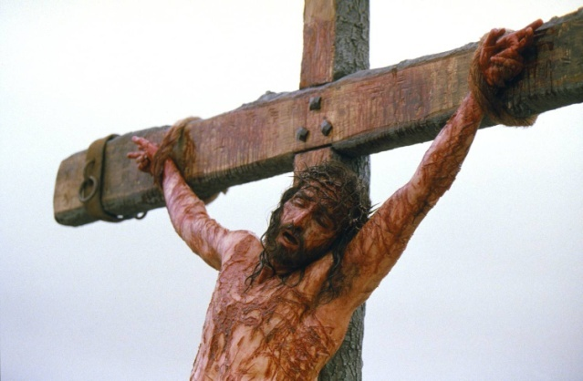
What can
wash away my sins?
Nothing -
but the blood of Jesus!
Notes:
This is the theme of the bible.
Christ came to be the sacrifice that would pay the price for sin so that God would be able to have a people that are holy and unblemished, a people for his possession and spiritual fellowship.

Slide 36
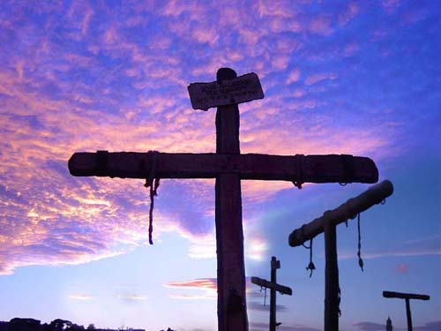

Have you died with Christ?
Notes:
Won’t you accept the promise and gift of God’s son today? And be baptized for the remission of your sins by faith in the blood of Christ. --- If you believe in Christ and have faith in His blood, and are willing to repent of your sins and confess His name… then you are ready to die with Him and have your sins removed, and enter His kingdom and live a life of faithful loving obedience to Christ as king and have every confidence that you will spend eternity in heaven.
But if you reject this gift there will be no hope for you… there is no other basis on which God will forgive sin…nothing but the blood of Jesus.
In the Seychelles a couple of years ago a young man responded to the gospel message and as they were about to immerse him in the Indian Ocean he looked up and said, “It is a good day to die.” He got the message. Did you?

