Slide 1
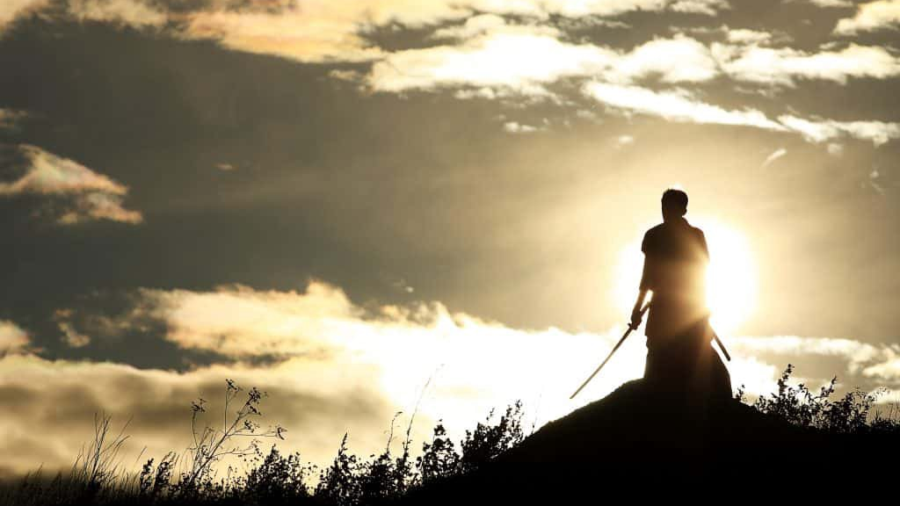
Epic Warrior – Defying the Odds
Scripture : Ephesians 6: 10-13

Slide 2
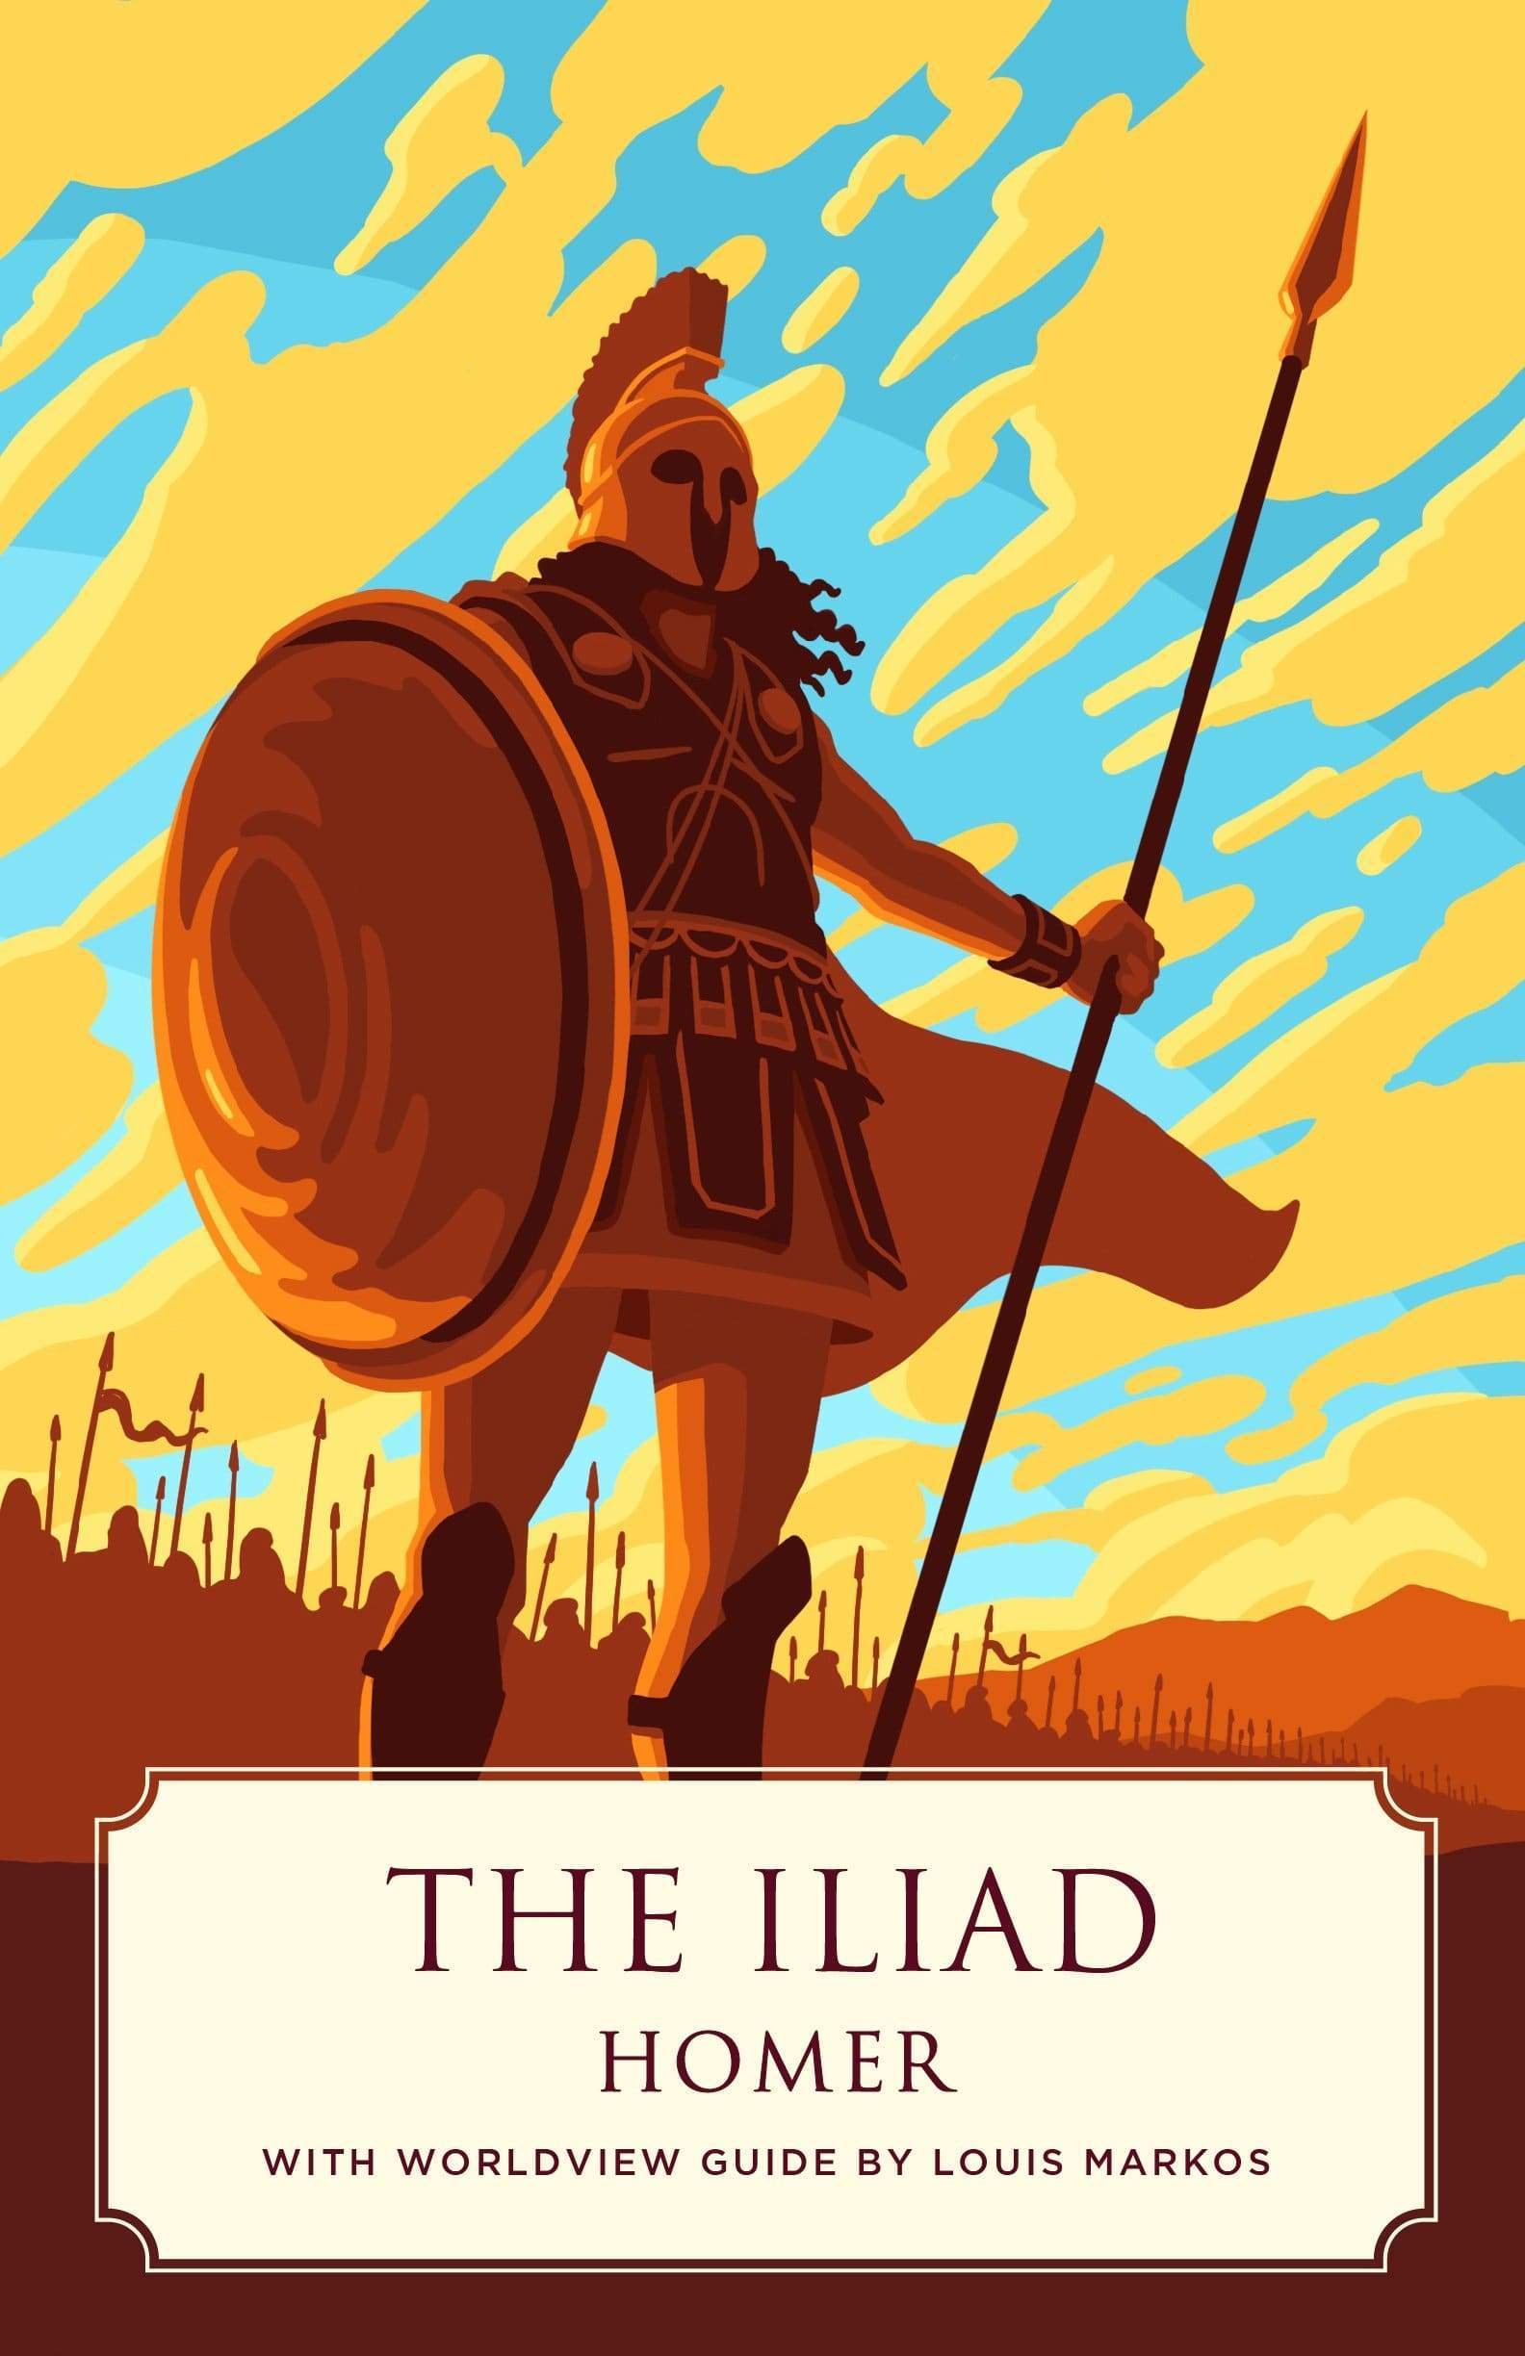
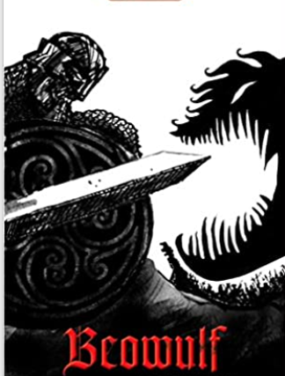
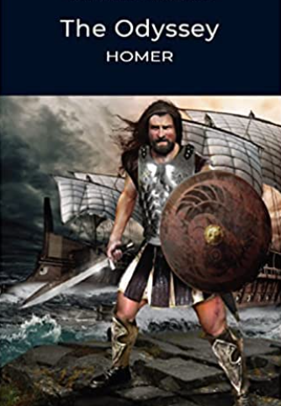

Slide 3
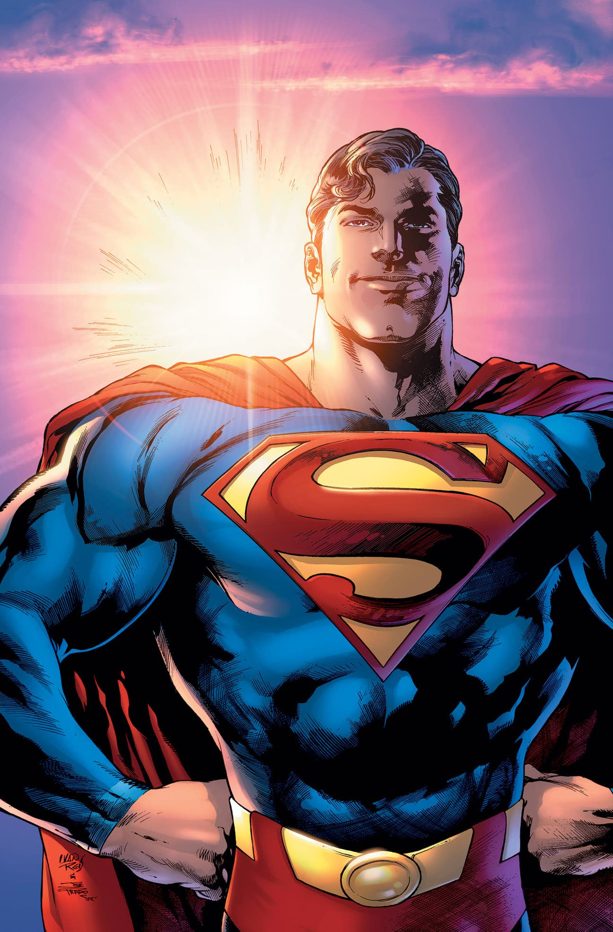

Slide 4
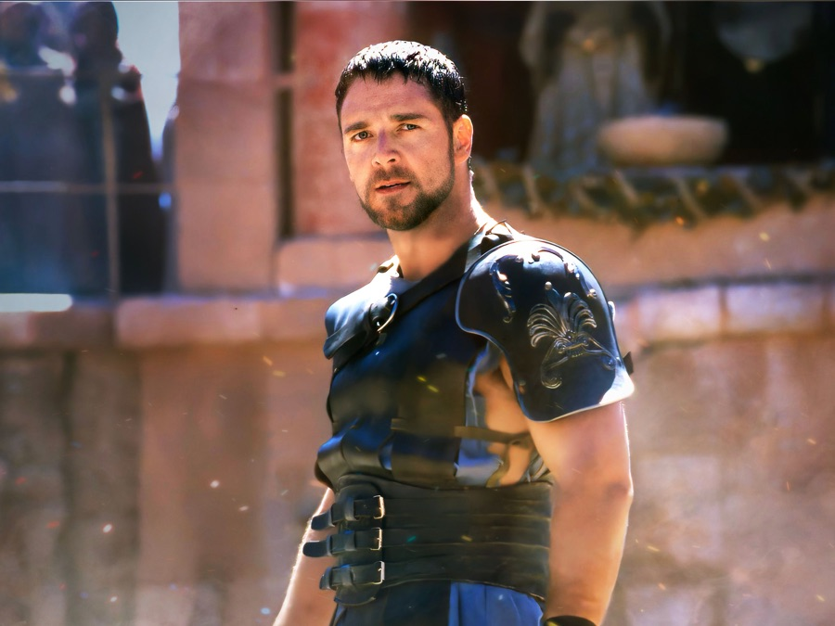
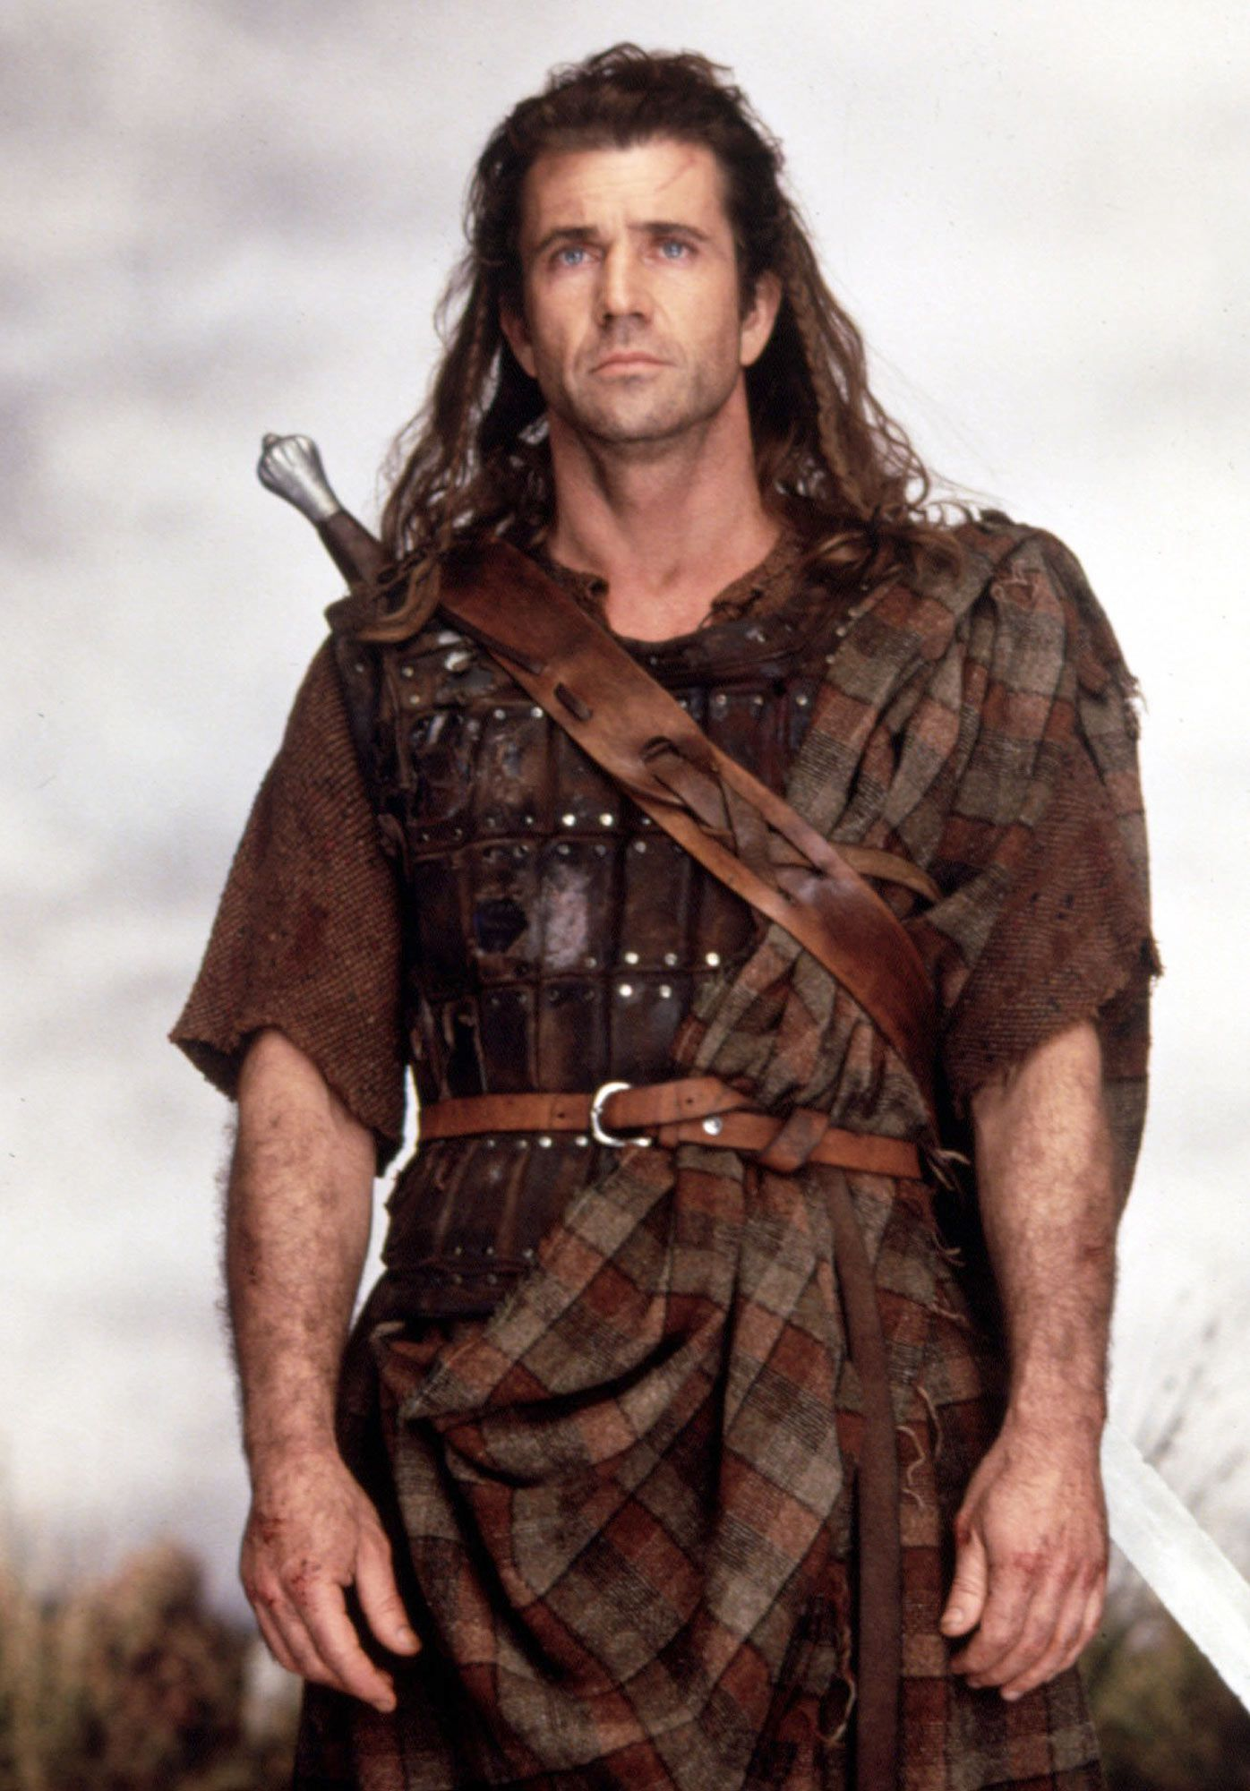
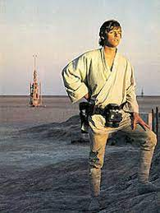
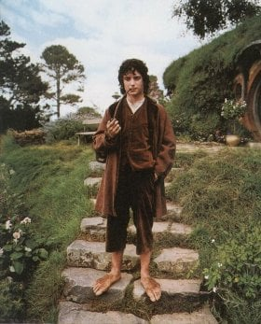

Slide 5
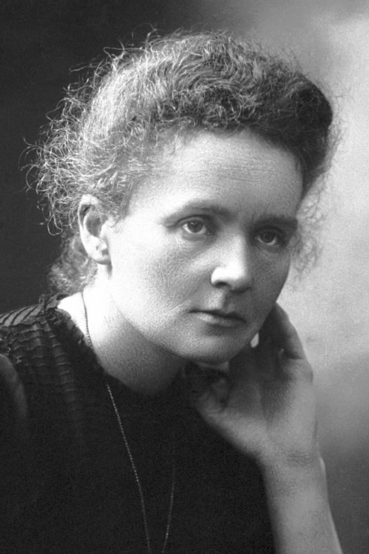
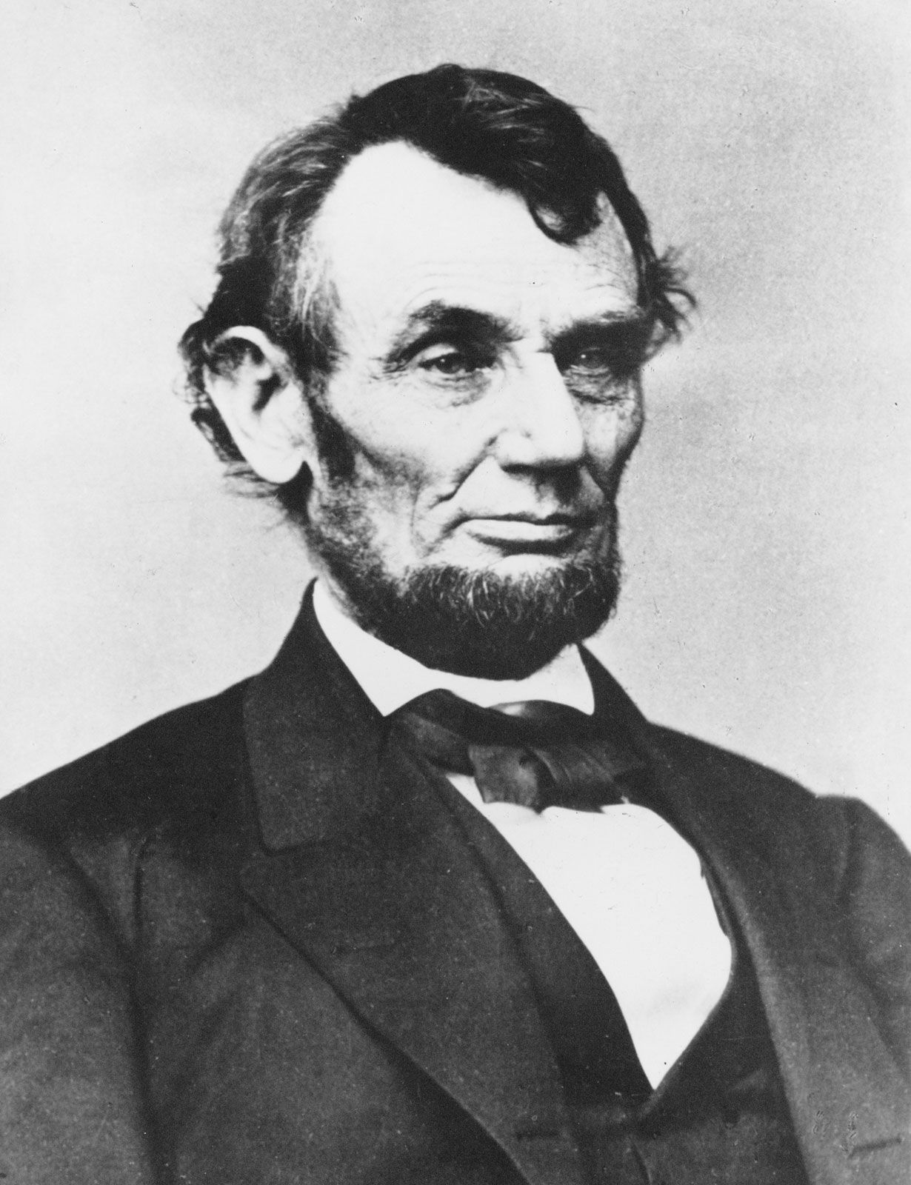
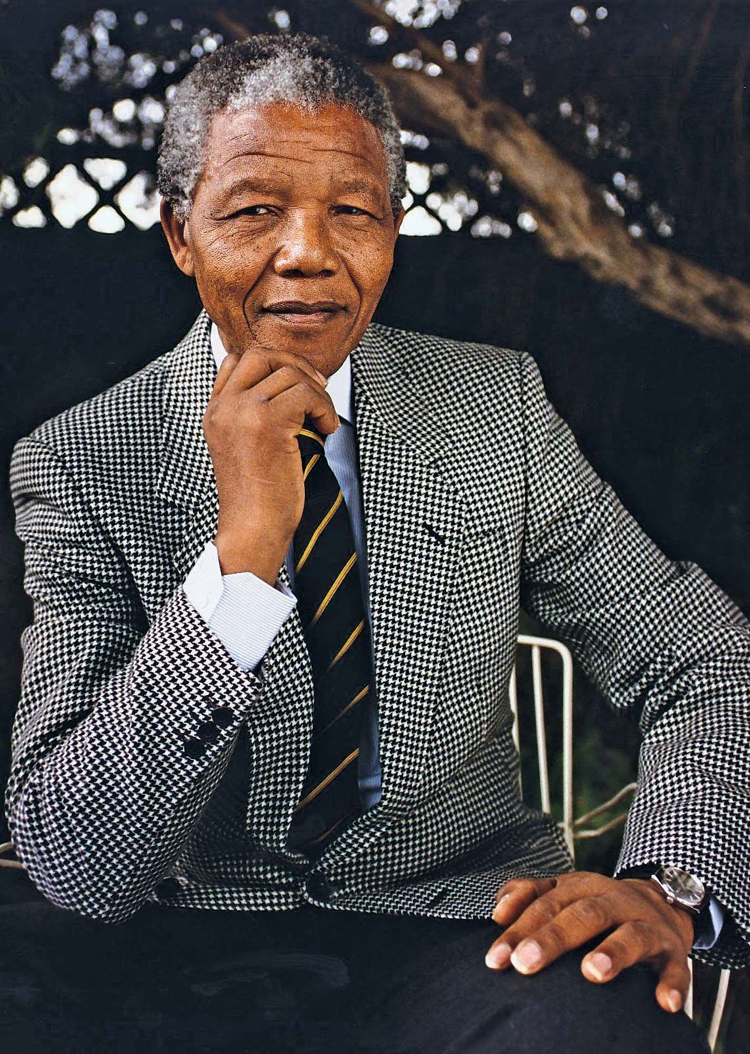
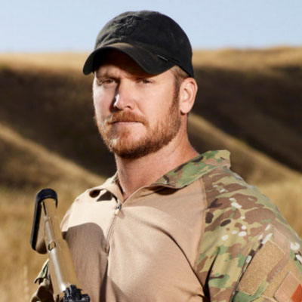
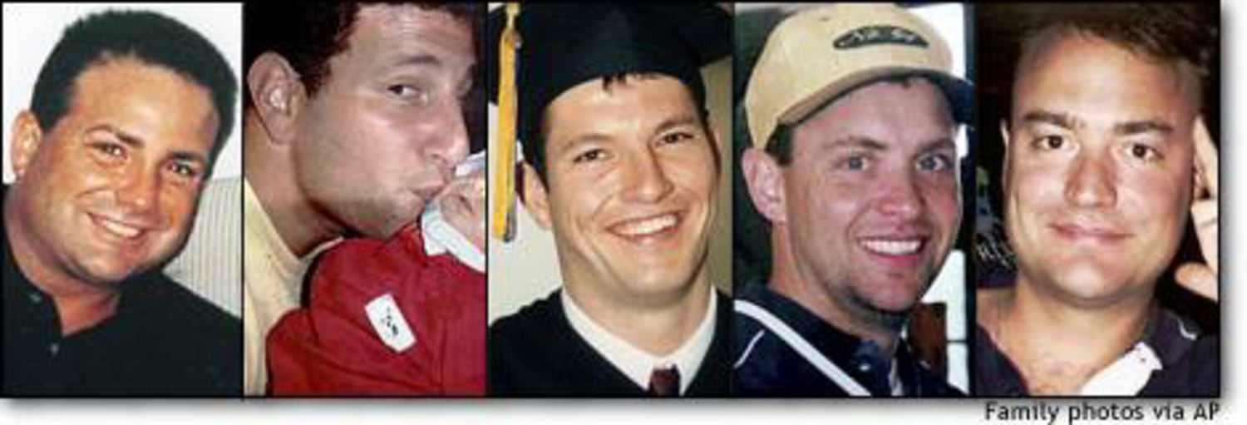

Slide 6
You; The Soldier, The Hero, The Heroin
Revelation 19:11-21
¹¹ And I saw heaven opened, and behold, a white horse, and He who sat on it is called Faithful and True, and in righteousness He judges and wages war. ¹² His eyes are a flame of fire, and on His head are many diadems; and He has a name written on Him which no one knows except Himself. ¹³ He is clothed with a robe dipped in blood, and His name is called The Word of God. ¹⁴ And the armies which are in heaven, clothed in fine linen, white and clean, were following Him on white horses. ¹⁵ From His mouth comes a sharp sword, so that with it He may strike down the nations, and He will rule them with a rod of iron; and He treads the wine press of the fierce wrath of God, the Almighty. ¹⁶ And on His robe and on His thigh He has a name written, “KING OF KINGS, AND LORD OF LORDS.”

Slide 7
You; The Soldier, The Hero, The Heroin
Revelation 19:11-21
¹⁷ Then I saw an angel standing in the sun, and he cried out with a loud voice, saying to all the birds which fly in midheaven, “Come, assemble for the great supper of God, ¹⁸ so that you may eat the flesh of kings and the flesh of commanders and the flesh of mighty men and the flesh of horses and of those who sit on them and the flesh of all men, both free men and slaves, and small and great.”
¹⁹ And I saw the beast and the kings of the earth and their armies assembled to make war against Him who sat on the horse and against His army. ²⁰ And the beast was seized, and with him the false prophet who performed the signs in his presence, by which he deceived those who had received the mark of the beast and those who worshiped his image; these two were thrown alive into the lake of fire which burns with brimstone. ²¹ And the rest were killed with the sword which came from the mouth of Him who sat on the horse, and all the birds were filled with their flesh.

Slide 8
You; The Soldier, The Hero, The Heroin
Ephesians 6:12
¹² For our struggle is not against flesh and blood, but against the rulers, against the powers, against the world forces of this darkness, against the spiritual forces of wickedness in the heavenly places.

Slide 9
You; The Soldier, The Hero, The Heroin
Revelation 12:7-9
⁷ And there was war in heaven, Michael and his angels waging war with the dragon. The dragon and his angels waged war, ⁸ and they were not strong enough, and there was no longer a place found for them in heaven. ⁹ And the great dragon was thrown down, the serpent of old who is called the devil and Satan, who deceives the whole world; he was thrown down to the earth, and his angels were thrown down with him.

Slide 10
The Battle Front Will Not Be Easy
Exodus 32:1; 7-14; 19-22
32 Now when the people saw that Moses delayed to come down from the mountain, the people assembled about Aaron and said to him, “Come, make us a god who will go before us; as for this Moses, the man who brought us up from the land of Egypt, we do not know what has become of him.”…
⁷ Then the Lord spoke to Moses, “Go down at once, for your people, whom you brought up from the land of Egypt, have corrupted themselves. ⁸ They have quickly turned aside from the way which I commanded them. They have made for themselves a molten calf, and have worshiped it and have sacrificed to it and said, ‘This is your god, O Israel, who brought you up from the land of Egypt!’” ⁹ The Lord said to Moses, “I have seen this people, and behold, they are an obstinate people. ¹⁰ Now then let Me alone, that My anger may burn against them and that I may destroy them; and I will make of you a great nation.”
¹¹ Then Moses entreated the Lord his God, and said, “O Lord, why does Your anger burn against Your people whom You have brought out from the land of Egypt with great power and with a mighty
hand?

Slide 11
The Battle Front Will Not Be Easy
Exodus 32:1; 7-14; 19-22
¹² Why should the Egyptians speak, saying, ‘With evil intent He brought them out to kill them in the mountains and to destroy them from the face of the earth’? Turn from Your burning anger and change Your
mind about doing harm to Your people. ¹³ Remember Abraham, Isaac, and Israel, Your servants to whom You swore by Yourself, and said to them, ‘I will multiply your descendants as the stars of the heavens, and all this land of which I have spoken I will give to your descendants, and they shall inherit it forever.’” ¹⁴ So the Lord changed His mind about the harm which He said He would do to His people…
¹⁹ It came about, as soon as Moses came near the camp, that he saw the calf and the dancing; and Moses’ anger burned, and he threw the tablets from his hands and shattered them at the foot of the mountain. ²⁰ He took the calf which they had made and burned it with fire, and ground it to powder, and scattered it over the surface of the water and made the sons of Israel drink it.
²¹ Then Moses said to Aaron, “What did this people do to you, that you have brought such great sin upon them?” ²² Aaron said,
“Do not let the anger of my lord burn; you know
the people yourself, that they are
prone to evil.

Slide 12
The Battle Front Will Not Be Easy
2 Samuel 12:1-13
12 Then the Lord sent Nathan to David. And he came to him and said,
“There were two men in one city, the one rich and the other poor. ² “The rich man had a great many flocks and herds. ³ “But the poor man had nothing except one little ewe lamb Which he bought and nourished; And it grew up together with him and his children. It would eat of his bread and drink of his cup and lie in his bosom, And was like a daughter to him. ⁴ “Now a traveler came to the rich man, And he was unwilling to take from his own flock or his own herd, To prepare for the wayfarer who had come to him; Rather he took the poor man’s ewe lamb and prepared it for the man
who had come to him.”
⁵ Then David’s anger burned greatly against the man, and he said to Nathan, “As the Lord lives, surely the man who has done this deserves to die. ⁶ He must make restitution for the lamb fourfold, because he did this thing and had no compassion.” ⁶ He must make restitution for the
lamb fourfold, because he did this thing and
had no compassion.”

Slide 13
The Battle Front Will Not Be Easy
2 Samuel 12:1-13
⁷ Nathan then said to David, “You are the man! Thus says the Lord God of Israel, ‘It is I who anointed you king over Israel and it is I who delivered you from the hand of Saul. ⁸ I also gave you your master’s house and your master’s wives into your care, and I gave you the house of Israel and Judah; and if that had been too little, I would have added to you many more things like these! ⁹ Why have you despised the word of the Lord by doing evil in His sight? You have struck down Uriah the Hittite with the sword, have taken his wife to be your wife, and have killed him with the sword of the sons of Ammon. ¹⁰ Now therefore, the sword shall never depart from your house, because you have despised Me and have taken the wife of Uriah the Hittite to be your wife.’ ¹¹ Thus says the Lord, ‘Behold, I will raise up evil against you from your own household; I will even take your wives before your eyes and give them to your companion, and he will lie with your wives in broad daylight. ¹² Indeed you did it secretly, but I will do this thing before all Israel, and under the sun.’” ¹³ Then David said to Nathan, “I have sinned against the Lord.” And Nathan said to David, “The Lord also has taken
away your sin; you shall not die.

Slide 14
The Battle Front Will Not Be Easy
Romans 7:14-25
¹⁴ For we know that the Law is spiritual, but I am of flesh, sold into bondage to sin. ¹⁵ For what I am doing, I do not understand; for I am not practicing what I would like to do, but I am doing the very thing I hate. ¹⁶ But if I do the very thing I do not want to do, I agree with the Law, confessing that the Law is good. ¹⁷ So now, no longer am I the one doing it, but sin which dwells in me. ¹⁸ For I know that nothing good dwells in me, that is, in my flesh; for the willing is present in me, but the doing of the good is not. ¹⁹ For the good that I want, I do not do, but I practice the very evil that I do not want. ²⁰ But if I am doing the very thing I do not want, I am no longer the one doing it, but sin which dwells in me. ²¹ I find then the principle that evil is present in me, the one who wants to do good. ²² For I joyfully concur with the law of God in the inner man, ²³ but I see a different law in ^{[d]}the members of my body, waging war against the law of my mind and making me a prisoner of the law of sin which is in my members. ²⁴ Wretched man that I am! Who will set me free from the body of this death? ²⁵ Thanks be to God through Jesus Christ our Lord! So then, on the one hand I myself with my mind am serving the law of
God, but on the other, with my flesh the law
of sin.

Slide 15
The Battle Front Will Not Be Easy
2 Corinthians 12: 1-9
12 Boasting is necessary, though it is not profitable; but I will go on to visions and revelations of the Lord. ² I know a man in Christ who fourteen years ago—whether in the body I do not know, or out of the body I do not know, God knows—such a man was caught up to the third heaven. ³ And I know how such a man—whether in the body or apart from the body I do not know, God knows— ⁴ was caught up into Paradise and heard inexpressible words, which a man is not permitted to speak. ⁵ On behalf of such a man I will boast; but on my own behalf I will not boast, except in regard to my weaknesses. ⁶ For if I do wish to boast I will not be foolish, for I will be speaking the truth; but I refrain from this, so that no one will credit me with more than he sees in me or hears from me.
⁷ Because of the surpassing greatness of the revelations, for this reason, to keep me from exalting myself, there was given me a thorn in the flesh, a messenger of Satan to torment me—to keep me from exalting myself! ⁸ Concerning this I implored the Lord three times that it might leave me. ⁹ And He has said to me, “My grace is sufficient for you, for power is perfected in weakness.” Most gladly, therefore, I will
rather boast about my weaknesses, so that the
power of Christ may dwell in me.

Slide 16
The Battle Front Will Not Be Easy
2 Timothy 4:6-8
⁶ For I am already being poured out as a drink offering, and the time of my departure has come. ⁷ I have fought the good fight, I have finished the course, I have kept the faith; ⁸ in the future there is laid up for me the crown of righteousness, which the Lord, the righteous Judge, will award to me on that day; and not only to me, but also to all who have loved His appearing.

Slide 17
The Battle Is In Front Of Us
2 Timothy 2:1-3
2 You therefore, my son, be strong in the grace that is in Christ Jesus. ² The things which you have heard from me in the presence of many witnesses, entrust these to faithful men who will be able to teach others also. ³ Suffer hardship with me, as a good soldier of Christ Jesus.

Slide 18
The Battle Is In Front Of Us
1 Peter 5:8-9
⁸ Be of sober spirit, be on the alert. Your adversary, the devil, prowls around like a roaring lion, seeking someone to devour. ⁹ But resist him, firm in your faith, knowing that the same experiences of suffering are being accomplished by your brethren who are in the world.

Slide 19
Defying the Odds – The ONE
Ephesians 6:13-18
¹³ Therefore, take up the full armor of God, so that you will be able to resist in the evil day, and having done everything, to stand firm. ¹⁴ Stand firm therefore, having girded your loins with truth, and having put on the breastplate of righteousness, ¹⁵ and having shod your feet with the preparation of the gospel of peace; ¹⁶ in addition to all, taking up the shield of faith with which you will be able to extinguish all the flaming arrows of the evil one. ¹⁷ And take the helmet of salvation, and the sword of the Spirit, which is the word of God.
¹⁸ With all prayer and petition pray at all times in the Spirit, and with this in view, be on the alert with all perseverance and petition for all the saints

