Slide 1
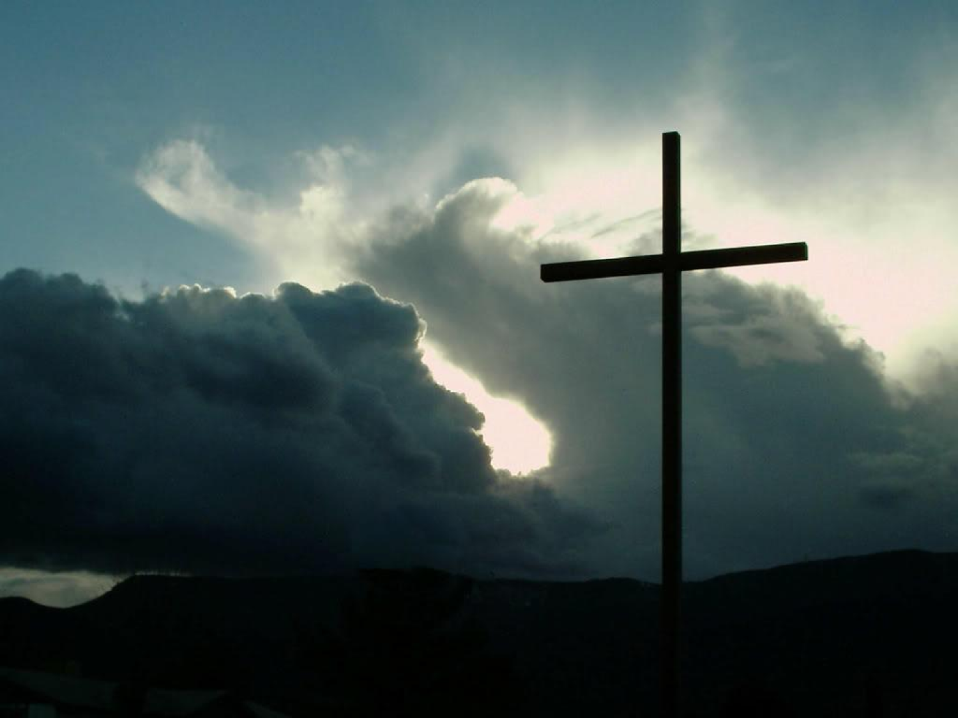
Reading – Matthew 27:38-47
Abandoned?

Slide 2
Forsaken?
A question or a quote?
–Psalm 22:1 - My God, My God, why have You forsaken Me?
–Psalm 22:31 - ...He has done this.
–John 19:30 - “It is finished!”

Slide 3
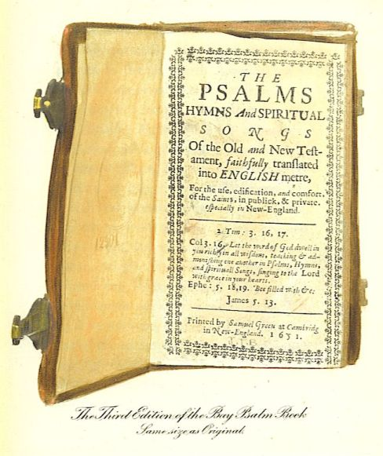
In the days of Jesus the Psalms were not yet numbered.
“A psalm was identified by its subject matter, referring to some passage within it, or by referring to the opening line”
(Barnett, M. (1996). The Person of Christ. Page 114)

Slide 4
Jesus knew He would be raised
Matthew 16:21
Matthew 17:22-23
Matthew 20:17-19
He quoted the Psalm to show that He was the fulfillment of it.
Psalm 22:7-8
Matthew 27:39-44

Slide 5
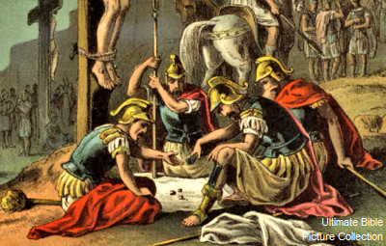
Jesus fulfills the prophesies
Psalm 22:14-17
Psalm 22:18
John 19:23-24

Slide 6
Men forsook Jesus ; not God
Isaiah 53:3-4
Psalm 22:22-24
John 8:28-29
John 16:32

Slide 7
Hardship is NOT an indication of God’s abandonment
John 15:18-21
1Peter 4:12-16
1 Peter 1:6-7
Romans 8:18, 26, 28, 31-39

Slide 8
God will NEVER abandon you!
Deuteronomy 31:7-8
Psalm 118:6
Proverbs 3:5-6 & 25-26

Slide 9
Abandoned?
John 14:23 - “If anyone loves Me, he will keep My word; and My Father will love him, and We will come to him and make Our home with him.

