Slide 1
Relighting Our Fire
Reading: Hebrews 12:1-11

Slide 2
Is There Any Zeal or Passion In Your Life?
Is the flame burning bright or has the flame burned low?

Slide 3
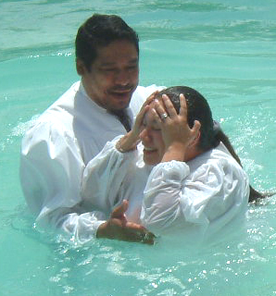
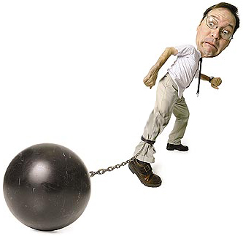
Christians Start Out Right
Most Christians start their journey as a Pilgrimage with great excitement and anticipation.
Only to end up in a rat race where it seems the Rats are winning.
It’s easy to lose the zeal and the wonderful feeling as time goes on.

Slide 4
The Bible is filled with people who felt discouragement and weariness.
David: (Psalm 51:12) Restore unto me the joy of your salvation;
(Psalm 6:2) (Psalm 77:7)
Solomon: (Proverbs 13:12) (Psalm 42:5)
Job: (Job 3:3)
Moses was singing the Preacher Blues: (Numbers 11:14-15)
Paul: (2 Corinthians 1:8)

Slide 5
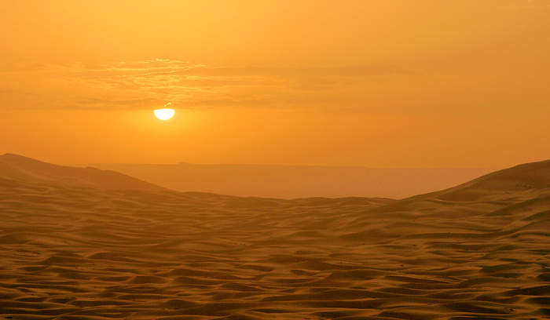
We Can’t Always Be Cheerful & Upbeat
We shouldn’t always be down either.
When you have sunshine all the time you have a desert.
That can be true in your spiritual life as well.

Slide 6
We Need To Have A Balance In Our Life
We need the rain as much as we need the sunshine.
We need the darkness as much as the light. (1 Thessalonians 5:16)
The Bible is full of promises of joy, (Galatians 5:22) But the fruit of the Spirit is love, joy, peace...

Slide 7
Reasons For Feeling Low
#1: Unconfessed & Unrepented Sin

Slide 8
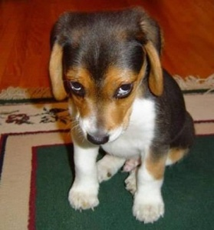
Even animals know when they have done something wrong.
You can tell it the minute you walk in the house.
Does that animal look like he’s comfortable?
Likewise when we, having a conscience, do something wrong, it causes us to feel uncomfortable inside.
Something drives us to either tell someone or go crazy.
Ex: Prisoner Confessions are fulfilling the need to tell someone

Slide 9
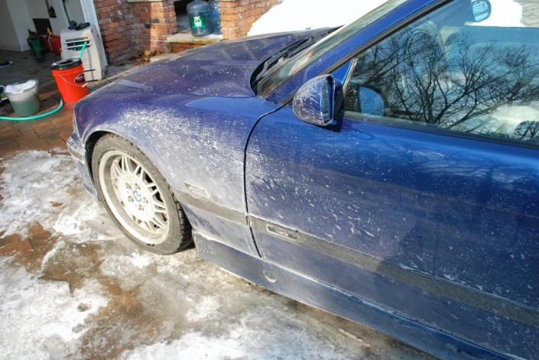
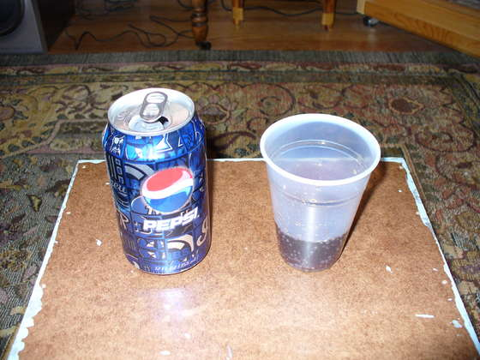
The Aftermath of Sin.
Sin seems to leave a dull coating on the soul.
Sin has a way of taking the fizz out of life.
The same thing happens to the soul when it is left uncapped through sin.
After the fizz is gone out all that is left is a syrupy sludge.

Slide 10
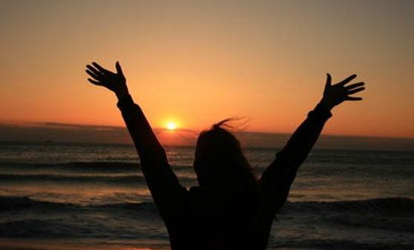
You’ll Never Know The Joy of the Lord Until You Confess That
You may not be guilty of something terrible, but the confessed criminal may be better off spiritually than you.
At least they can sleep at night.

Slide 11
Reasons For Feeling Low
#2: Too Busy Making A Living To Make A Life

Slide 12
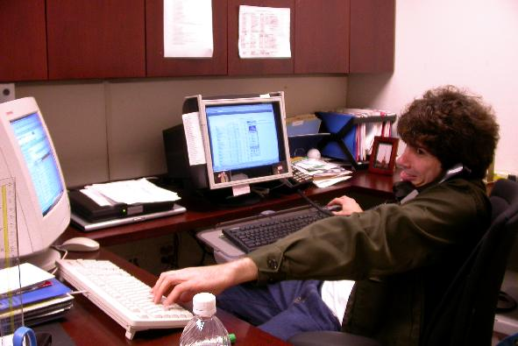
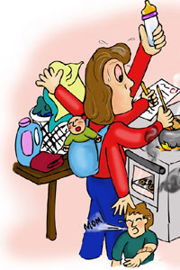
Those who are more zealous in their faith find more demands on their time.
Pretty soon they find themselves running on “empty”
As our personal schedule gets fuller our time for God gets less.
That quiet time with God gets squeezed down to very little.
Little devotions make for little Christians.
“If our output exceeds our input, then our upkeep will be our downfall.”

Slide 13
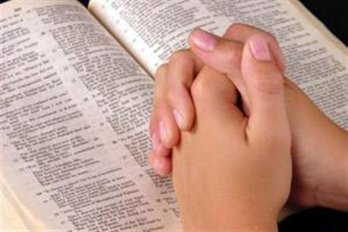
Make Time To Chat With God
“Don’t just do something, stand there.”
(Hebrews 12:1-2)
Jesus was never too busy to pray.
Although He took a vacation from His ministry, He did not take a vacation from prayer.
Christians need to follow this example.

Slide 14
Reasons For Feeling Low
#3: When You DON’T Do The Things You OUGHT To Do

Slide 15
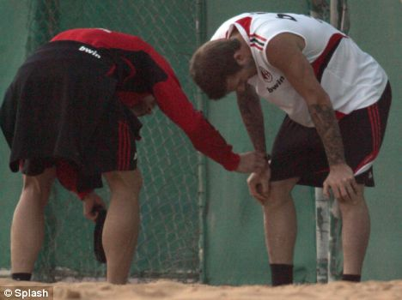
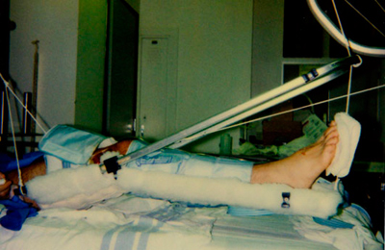
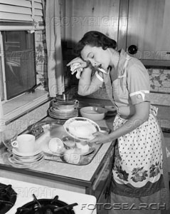
The Problem:
A person reaches a state of spiritual dryness and weariness and complete exhaustion.
It’s just like a person who just got hit by a truck.
He’s lying in the hospital with two broken legs and his back in traction.
Then his therapist comes in and says if he got some exercise he would no doubt be in better shape.
He’s not feeling like doing much exercise at that moment.
But don’t you know that whatever little exercise he can do will speed up his recovery.

Slide 16
Sometimes we get in that shape spiritually.
We hear the preacher or our teacher tell us that we need to exercise our minds through the Word.
(2 Timothy 2:15)
We are told we need to spend more time in prayer or telling others about Jesus.
And yet we can hardly lift our head from our pillow or get out of our easy chair in front of the TV.
Some of us have been there;
Some of us are there!

Slide 17
What can be done?
Look unto Jesus who is the author and finisher of our faith.
Do whatever little you can do.
(1 Corinthians 15:58)
Doing what little you can do strengthens you for a time to do a little more.

Slide 18
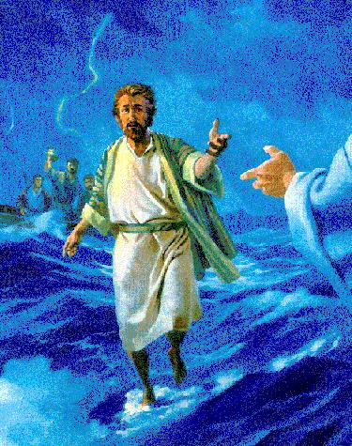
Look to Jesus to save us from the tempest that is boiling around us.
Remember Peter [Matthew 14] who walked out to meet Jesus on the water?
As long as he kept his eye on Jesus he was OK.

Slide 19
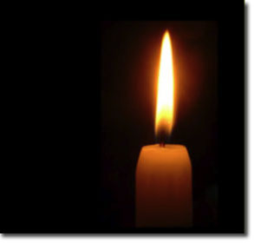
Recover Our Zeal
Light the Fire Again

Slide 20
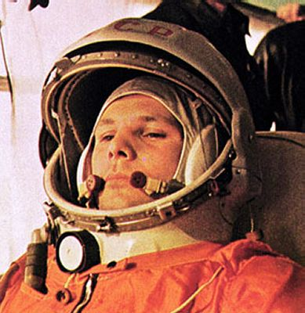
Lost Vision
The Russian Cosmonaut, Yuri Gagarin said, “I know that there is no God because I have circled the globe and looked into the stars and I haven’t seen him.”
I have a question for him; Are you pure in heart?
Jesus said, (Matthew 5:8) Blessed are the pure in heart: for they shall see God

Slide 21
Have You Lost Sight of God?
How high does your heart’s Pure-O-Meter register?
Perhaps your flame has burnt low through neglect.
This brings us right back to unconfessed and un-repented sins.
If you repent and come back to Jesus,
He will fill you with the Oil of the Spirit once again.
And then your flame can burn brightly once again.

Slide 22
The Wonderful Thing About Being A Christian
Even though you may fall down, you don’t have to stay down.
He will pick you up every time you fall IF you confess and repent.

Slide 23
Casting Our Sins In The Sea
[Micah 7:18-20] Who is a God like you, pardoning iniquity and passing over transgression for the remnant of his inheritance? He does not retain his anger forever, because he delights in steadfast love. He will again have compassion on us; he will tread our iniquities underfoot. You will cast all our sins into the depths of the sea. You will show faithfulness to Jacob and steadfast love to Abraham, as you have sworn to our fathers from the days of old.

Slide 24
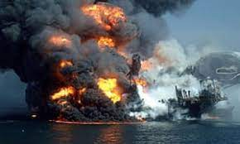
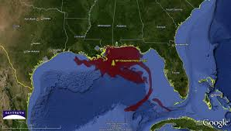
Casting Our Sins In The Sea
In 2010 the Deepwater Horizon oil spill (A.K.A. BP oil spill) dumped an estimated 210,000 gallons of oil into the Gulf of Mexico.
It was feared at the time that this unprecedented spill would spread oil all along the gulf coast and beyond.
Some even suggested that currents could possibly send it around the tip of Florida and up the East Coast.

Slide 25
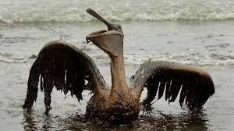
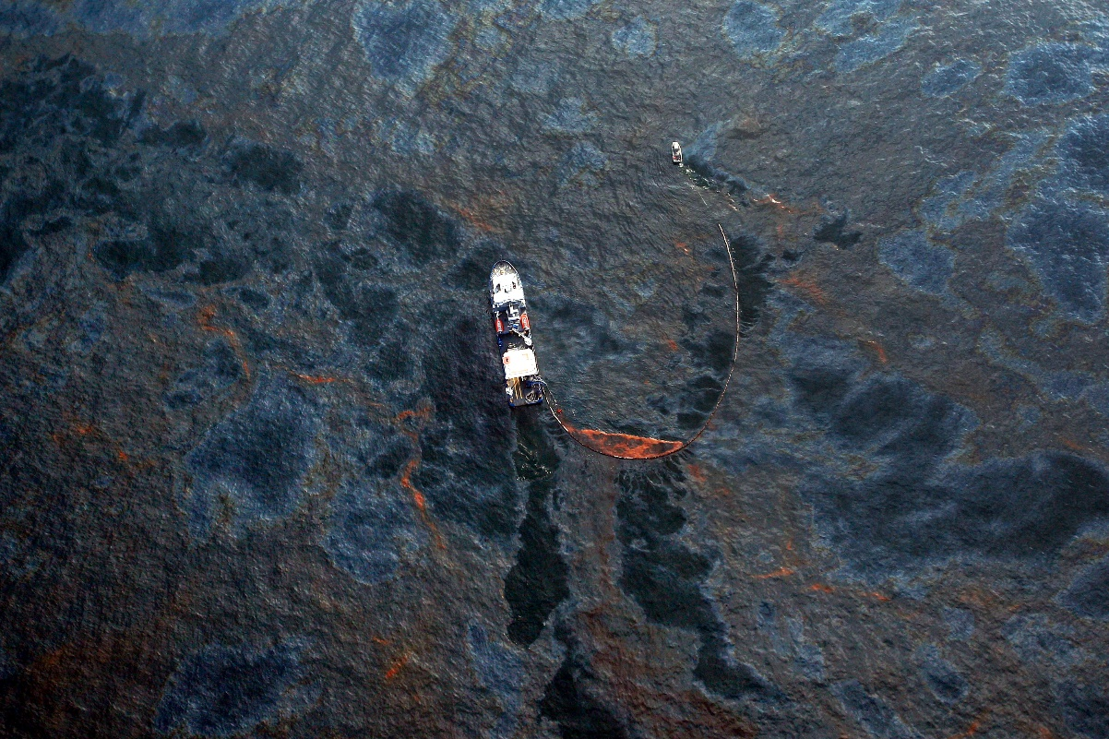
Casting Our Sins In The Sea
As it turned out, these dire predictions did not come to fruition.
When tourists finally came back to the beaches, they discovered that the water was clear and the beaches were clean. Where did all that oil go?
Most of it went to the bottom of the ocean.
You see, as massive as that oil spill was in volume, the volume of water in the Gulf of Mexico was larger.

Slide 26
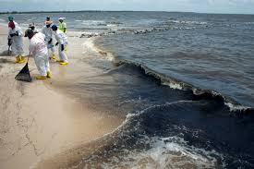
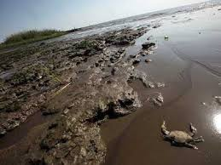
How Large?
643,000,000,000,000,000 gallons!
That's 643 quadrillion!
As deadly and destructive as the Deep Water Horizon oil spill was, our sins are much more deadly and destructive.

Slide 27
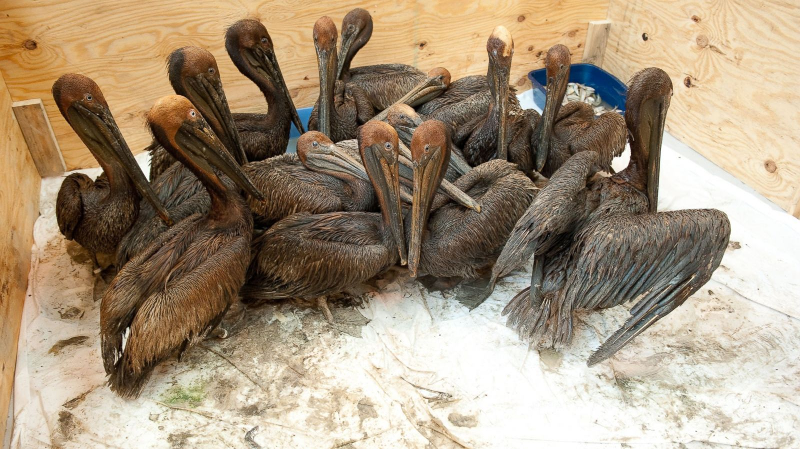
Casting Our Sins In The Sea
But as great as our sins are, when we cast them into the sea of God's love and grace those sins are nowhere to be found!
If you repent and come back to Jesus,
He will fill you with the Oil of the Spirit once again.
And then your flame can burn brightly once again.

Slide 28
Let Us Pray
Father, who is a God like you, pardoning our iniquities and passing over our transgressions?
Help us to never take your love and your incomprehensible grace for granted! In Jesus’ name ---

