Slide 1
The Best is Yet to Come!
Reading - Philippians 3:2-14

Slide 2
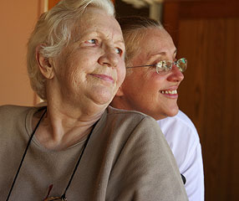
If there is any level where we fall down as a congregation is in our outlook regarding heaven.
Our text: “I press toward the goal for the prize of the upward call of God in Christ Jesus.” Vs.14

Slide 3
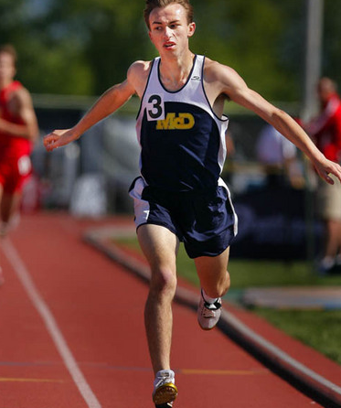
Have you ever considered the STRONG language that is found in our text?
The NKJ talks of “reaching forward”.
This is a very intensive expression in the Greek language.
Other translations render this passage:
“Straining every nerve” [20th Century Christian]

Slide 4
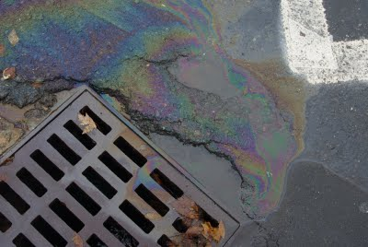
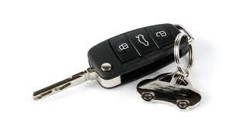
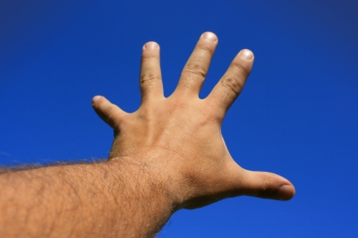
Dropped Car Keys

Slide 5
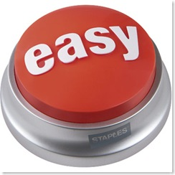
This is more than a casual or convenient approach to God.
We are bordering on being spiritual “couch potatoes”
Notice how prone we are to take the difficulty out of everything?
We almost define what the Bible teaches in terms of what can be convenient. Case in point : [Matthew 19:1-10]

Slide 6
The “End”
This word is not mentioned in Philippians 3 but it will help us understand the passage much better.

Slide 7
Relevance of numbers:
4-1-3-5-2
They have no particular pattern and the last or end number in this example is 2.
Now reorder the sequence ----

Slide 8
Relevance of numbers:
1-2-3-4-5
Now 5 is the “End” --
It is the number all the others were leading up to.

Slide 9
[1 Peter 4:7]
The “end” is at hand. This does not necessarily mean the final judgment.
The end of all things as far as YOU are concerned are at Hand. [James 4:13-15]
The Holy Spirit is telling us that your life is leading toward a consequence, a result, an “end” that everything was building up to.

Slide 10
[1 Peter 1:9]
receiving the end of your faith—the salvation of your souls.
Our lives are moving toward a purposeful “end”.
When Paul talks about “reaching forward” THAT is what he is talking about.

Slide 11
Excited?
If reaching the goal of heaven is what it’s all about WHY are we so reluctant to get there?

Slide 12
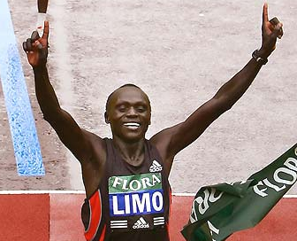
Why don’t we strain every nerve to get there sooner as opposed to later?
The Christian doesn’t dread death any more than a runner doesn’t dread the finish line.
The Olympic runner doesn’t hesitate to cross the line because he enjoys running so much.
Getting to the finish line was what it was all about from the sounding of the starter’s gun.

Slide 13
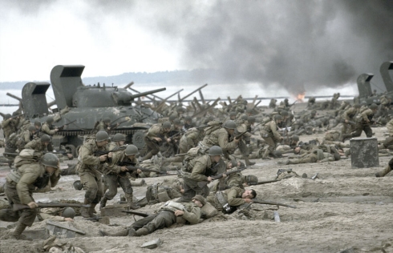
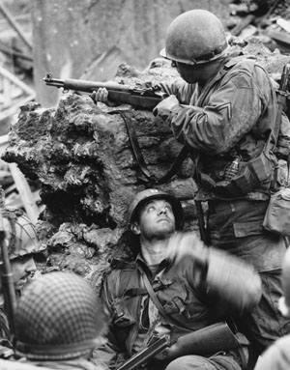
A Soldier Strains to Get TO Safety.
We are in a spiritual battle.
Get to safety NOW!

Slide 14
Baby Steps or Giant Leaps
“The next step you take is always the most important!”

Slide 15
Why is the next step you take the most important?
Because that is the one that moves you to the future!
Along the path to the “end” there is always some next step you need to take.
Even when we dig ourselves into a hole then next step is to stop digging!
No matter how small if that step puts you on the path to heaven then that is the most important step you have taken.
Do you have the courage to take that next step?

Slide 16
Dreading the Best?
[Romans 8:18-19]

Slide 17
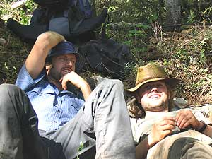
Comfortably numb
Maybe we just see the sacrifices we must make to be in Christ to be too difficult or not worth the effort to have heaven as the reward.
[Philippians 3:7-11]

Slide 18
[John 9:4]
[2 Thessalonians 3:7-13]
Those who refuse to work have no reward in the Present world or in the one to come!

Slide 19
Forward Oriented
Contentment vs. Yearning

Slide 20
Being content is NOT our problem – yearning for heaven is.
Understand your basic orientation:
Past – Present – Future.
The Gospel perspective is future oriented.
Yes – but ---

Slide 21
Having The Mind of Christ
[Philippians 2:5-8]

Slide 22
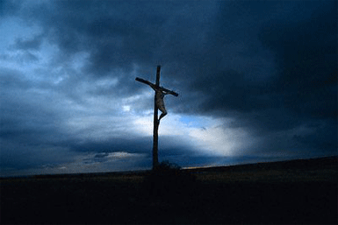
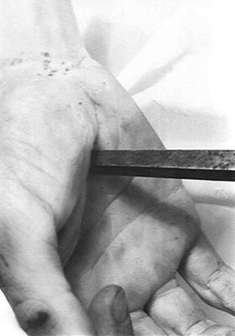
[Hebrews 12:2] -- who for the joy that was set before Him endured the cross
Just as Jesus had a choice to make we do also.
Do we look forward to the joy set before us?

Slide 23
Choose your basic perspective to emphasize. Not either/or
1. Present kingdom of the Lord OR the eternal kingdom?
2. The earnest [down payment] of our inheritance OR the full inheritance?
3. Happiness now OR glory in eternity?

Slide 24
Lip Service
[Philippians 1:21-23]

Slide 25
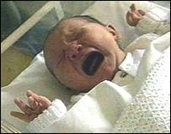
Could you say “Good-bye” right now?

Slide 26
Do we really yearn for the right things?
[Matthew 6:33]
[John 14:1-3]
[2 Timothy 4:8] Do you ever LOVE the thought of the Lord’s appearing?
The Aramaic word maranatha is used ..
[1 Corinthians 16:22]

Slide 27
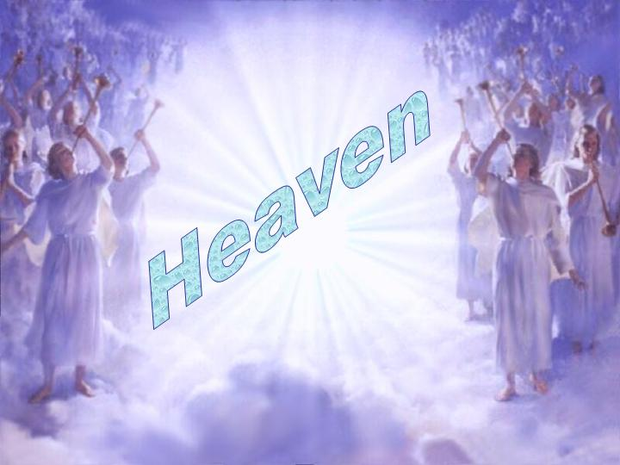
Those words need to ring true to what we really are in our innermost being!
The next step you take will be the most important!

