Slide 1
How To Handle The Lord’s Money
Reading – Psalm 50:7-12

Slide 2
10 Reasons Why Divorce Happens
Lack of communication.
Finances.
Feeling constrained.
Trust.
Expectations from each other.
Your spouse doesn’t understand. / your needs and desires.
Quick change in lifestyle.
Insecurity.
Religious and cultural differences.
Abuse.

Slide 3
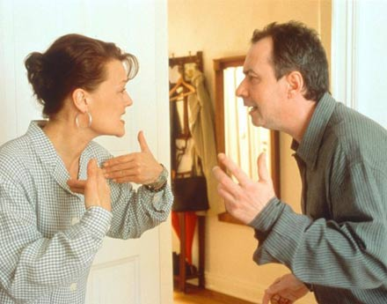
FInances
Selfishness is often the ROOT of the problem.

Slide 4
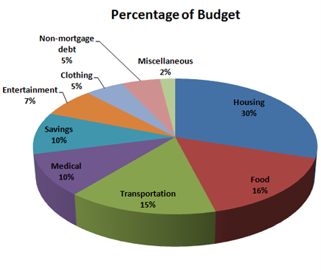
Where Does The Money Go?
Problems arise when spending gets out of proportion.
“But I NEED it!!!”
“I earned it; It’s MINE!!!”

Slide 5
Our Scripture Reading Holds The Answer
Reading – Psalm 50:7-12

Slide 6
It’s ALL The Lord’s Money!!!
We Need to be Good Stewards of His Money

Slide 7
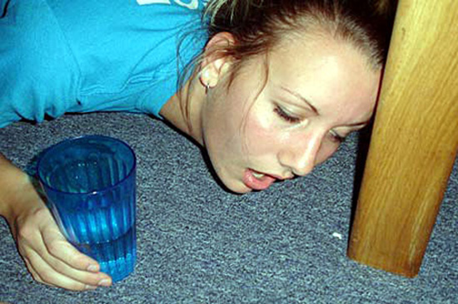
Ephesians 5:17-18
Taking the Lord's money and getting drunk is an unscriptural use of the Lord’s money!
Proverbs 20:1

Slide 8
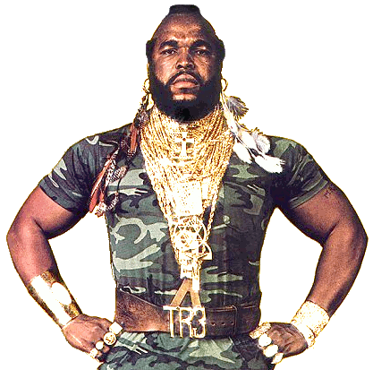
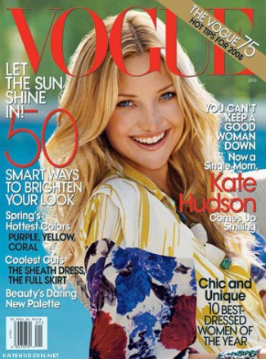
1 Timothy 2:9-10
When you use the Lord’s money for indecent and immodest clothing, that is an unscriptural use of the Lord’s money.
1 Peter 3:1-4
When you let your world of fashion become your god that is an unscriptural use of the Lord’s money.

Slide 9
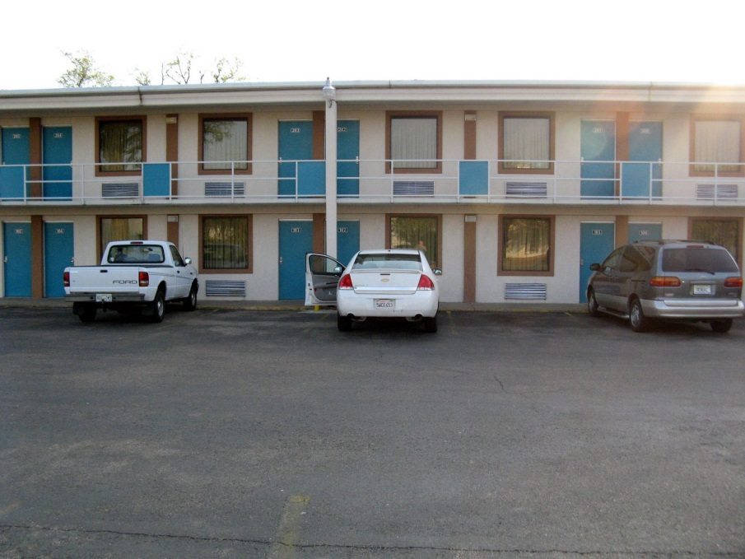
1 Corinthians 6:9-10
Hebrews 13:4
Taking the Lord’s money to rent a room at the “No-Tell Motel” is an unscriptural use of the Lord’s money.

Slide 10
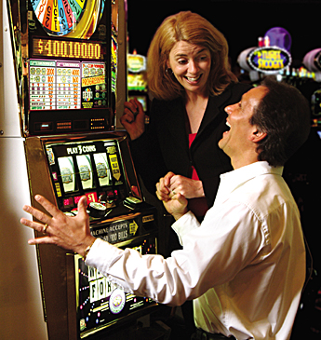
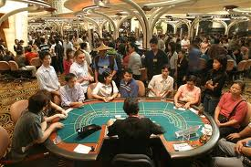
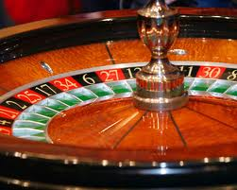
1 Timothy 5:8
Taking the Lord's money and gambling it away is an unscriptural use of the Lord’s money.

Slide 11
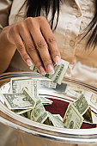
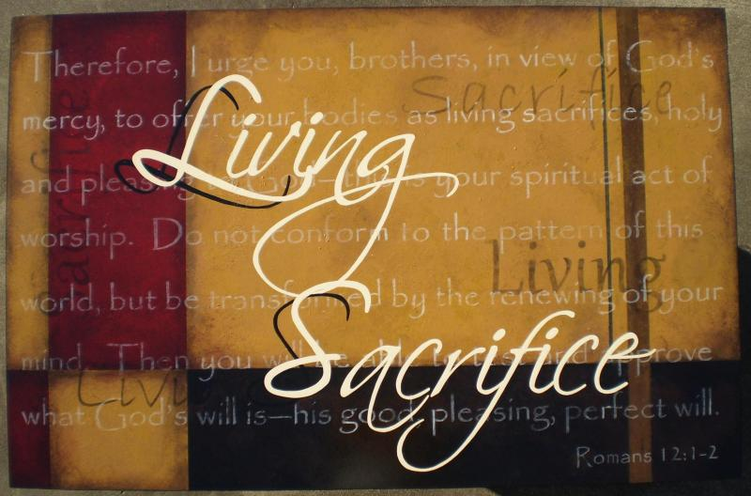
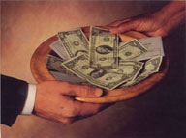
It’s ALL The Lord’s Money!!!
Romans 12:1 – “A Living Sacrifice”

Slide 12
Misunderstood Concepts
We cannot take the Lord’s money and use it in an unscriptural way.
Building a Fellowship Hall is an unscriptural use of the Lord’s money.
Building orphanages and nursing homes is an unscriptural use of the Lord’s money.
Many others can be cited.

Slide 13
The Key to the matter is understanding
Authority &
Fellowship

Slide 14
Let’s Use scriptural Terms for Scriptural Things
Fellowship
Christian
Church
Child of God
Reverend
Awesome

Slide 15
1 Corinthians 6:20
Not only is all the money in the world the Lord’s He allows YOU to be part of His possessions.
If you don’t belong to Him you belong to the god of this world by default.
Romans 12:1-2

