Slide 1
Are We Up To The Task Before Us ?
Time to Get to the Work At Hand
Each Individual Has A Job To Do

Slide 2
Memory Verse Hebrews 3:12
12 Take care, brothers, lest there be in any of you an evil, unbelieving heart, leading you to fall away from the living God.
Get rid of Trey

Slide 3
The Task Before Us
Time to Get to the Work At Hand
Scripture Reading – Matthew 9:35-38

Slide 4
The Task of the Local Congregation
The Work For the Local Church to do:
TO EQUIP THE SAINTS FOR MINISTRY (EDIFICATION)...
TO PROVIDE FOR NEEDY SAINTS (BENEVOLENCE)...
TO SOUND FORTH THE GOSPEL OF JESUS (EVANGELISM)...

Slide 5
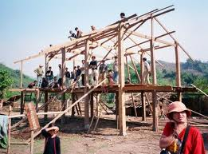
Edification
Defined as:
Instruction
A building up
Spiritual growth
What are we building?

Slide 6
Edification
TO EQUIP THE SAINTS FOR MINISTRY
We are to provide for the spiritual growth of each member - Ephesians 4:11-12
This is how the body continues to grow up - Ephesians 4:15-16
We are to provoke one another to love and good works, - Hebrews 10:24-25
Each one must grow ourselves, and do what we can to help other Christians grow

Slide 7
Evangelism
Matthew 28:18 – 20 / And Jesus came and spoke to them, saying, “All authority has been given to Me in heaven and on earth. [19] Go therefore and make disciples of all the nations, baptizing them in the name of the Father and of the Son and of the Holy Spirit, [20] teaching them to observe all things that I have commanded you; and lo, I am with you always, even to the end of the age.”
Are We Really Doing This?

Slide 8
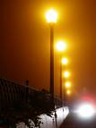
Evangelism
OUR TASK: To Light The Darkness
[2 Corinthians 4:3 – 6] But even if our gospel is veiled, it is veiled to those who are perishing, [4] whose minds the god of this age has blinded, who do not believe, lest the light of the gospel of the glory of Christ, who is the image of God, ourselves should shine on them. [5] For we do not preach ourselves, but Christ Jesus the Lord, and your bondservants for Jesus’ sake. [6] For it is the God who commanded light to shine out of darkness, who has shone in our hearts to give the light of the knowledge of the glory of God in the face of Jesus Christ.
Notes:
At age twelve, Robert Louis Stevenson was looking out into the dark from his upstairs window watching a man light the streetlamps. Stevenson’s governess came into the room and asked what he was doing. He replied, “I am watching a man cut holes in the darkness.” I see this as a marvelous picture of what our task should be as sharers of God’s light—people who are busy cutting holes in the spiritual darkness of our world.

Slide 9
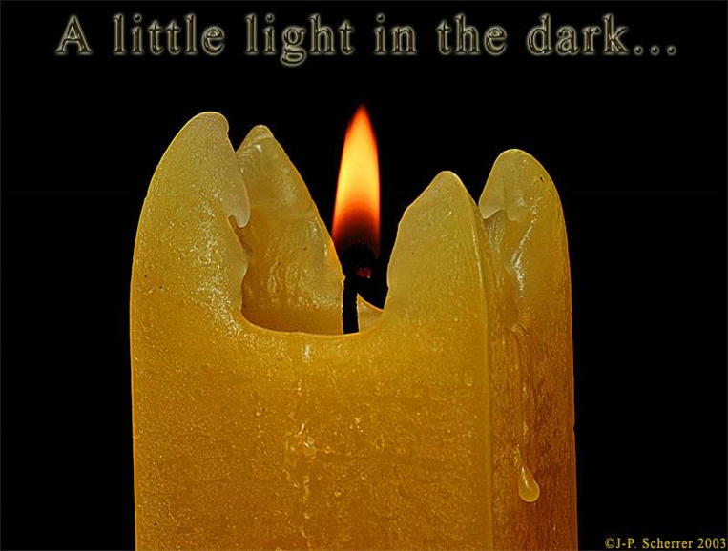
Evangelism
OUR TASK: To Light The Darkness
[Philippians 2:14 – 15]
Do all things without complaining and disputing, [15] that you may become blameless and harmless, children of God without fault in the midst of a crooked and perverse generation, among whom you shine as lights in the world,
Notes:
At age twelve, Robert Louis Stevenson was looking out into the dark from his upstairs window watching a man light the streetlamps. Stevenson’s governess came into the room and asked what he was doing. He replied, “I am watching a man cut holes in the darkness.” I see this as a marvelous picture of what our task should be as sharers of God’s light—people who are busy cutting holes in the spiritual darkness of our world.

Slide 10
Local Evangelism
Everyone is an Evangelist
Extends to close friends
Moves outward to the neighborhood, school & workplace
Eventually to the community and surrounding areas – [Acts 8:4] Therefore those who were scattered went everywhere preaching the word

Slide 11
Local Evangelism
Begins at church services with fellowship [Colossians 3:16] Speak to one another…
Extends to social encounters [Acts 2:46-47]
Prove our Lord to the neighborhood, school & workplace [John 13:34]

Slide 12
Collective Evangelism
Gospel Meetings for the community in view
Gospel Meetings for edification of the church
Support preaching outside of the area
Our goal is to reach out to as many as we can

Slide 13
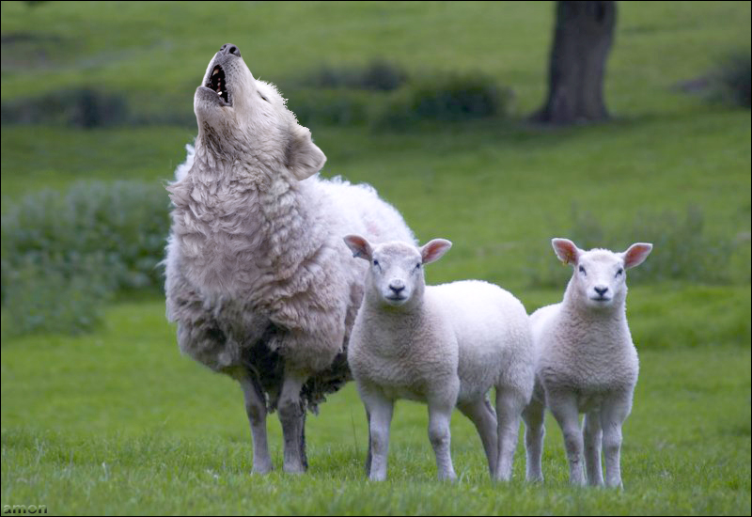
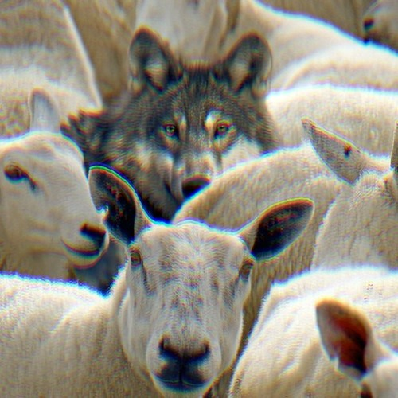
Know Your Bible!
Why????
Always being on guard for the wolves
Acts 20:28-30
Are we able to do that?

Slide 14
Evangelism
OUR TASK: To Light The Darkness
[2 Corinthians 4:3 – 6] But even if our gospel is veiled, it is veiled to those who are perishing, [4] whose minds the god of this age has blinded, who do not believe, lest the light of the gospel of the glory of Christ, who is the image of God, ourselves should shine on them. [5] For we do not preach ourselves, but Christ Jesus the Lord, and your bondservants for Jesus’ sake. [6] For it is the God who commanded light to shine out of darkness, who has shone in our hearts to give the light of the knowledge of the glory of God in the face of Jesus Christ.
Notes:
At age twelve, Robert Louis Stevenson was looking out into the dark from his upstairs window watching a man light the streetlamps. Stevenson’s governess came into the room and asked what he was doing. He replied, “I am watching a man cut holes in the darkness.” I see this as a marvelous picture of what our task should be as sharers of God’s light—people who are busy cutting holes in the spiritual darkness of our world.

