Slide 1
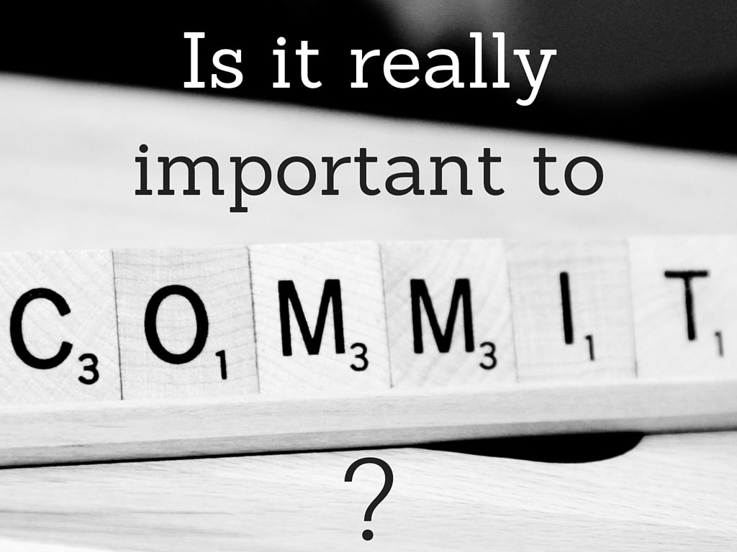
Are We really Committed?
Reading – Ephesians 6:10-12

Slide 2
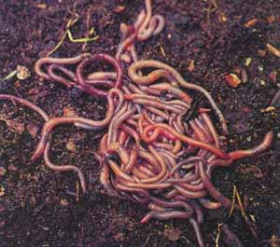
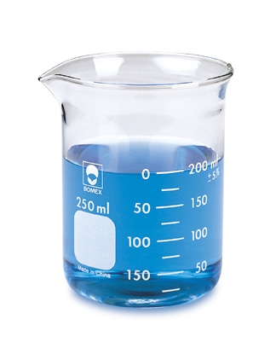
Missing The Point
High School Science Lab Project
Water
Alcohol

Slide 3
Conclusion
“If you drink enough alcohol you won’t get worms”

Slide 4
Christians need to know how to think properly
God expects us to use our minds to process evidence and come to reasonable conclusions.
We must have the judgment to discern properly between right and wrong.
[Hebrews 5:14]

Slide 5
Our minds are a battlefield.
Satan is an active enemy who is trying his best to gain control of our thinking.
If he can get himself in control of your thinking, he is in charge of you.
"as he thinks in his heart, so is he"
[Proverbs 23:7]
You are what you think!

Slide 6
. [Matthew 5:27-30]
Jesus addressed the problem of our thinking . . . especially the matter of lustful thoughts.
He addresses the desire to commit the sin, even if the act were never perpetrated.

Slide 7
Christians are expected to be Committed
Here are four areas of Preparation.

Slide 8
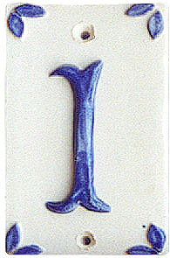
COMMIT YOURSELF TO BE CHRIST-MINDED Philippians 4:8
Philippians 2:5

Slide 9
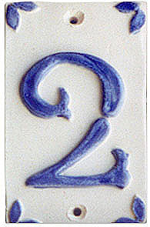
COMMIT TO Control Your Eyes
Job 31:1

Slide 10
Example: 2 Samuel 11
King David allowed lustful thoughts to take control of his mind.
Verse 3 says he inquired about the identity of the woman.
Knowing that she was another man's wife should have been enough to stop him. Adultery started in the heart.
[James 1:15]

Slide 11
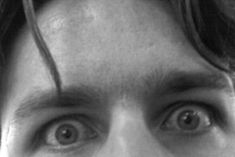
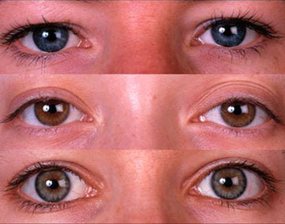
"Be careful, little eyes, what you see"
Movies & TV programs
Magazines & Billboards
Internet
Beach & Swimming Pools
Cheerleading & Dancing

Slide 12
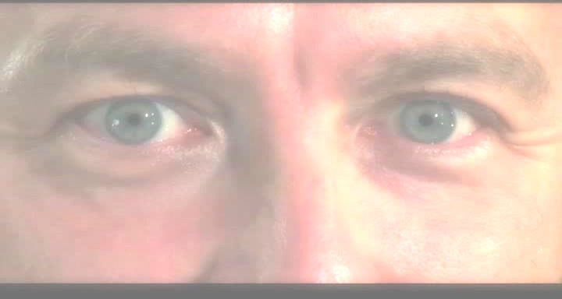
Remember Job 31:1
Make a covenant with your eyes.

Slide 13
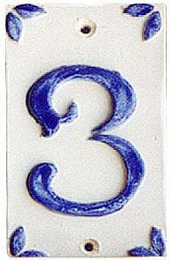
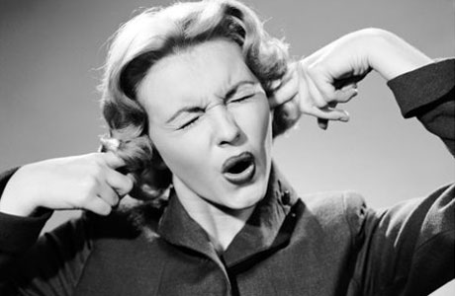
COMMIT TO Control Your Listening
You Are the One In Control!

Slide 14
The Difference
Profanity: Making that which is holy a common thing.
Cursing: Wishing something evil or harmful to another.
Swearing: Using God as a witness.
It is virtually impossible to avoid HEARING profanity and dirty language, but we don’t have to LISTEN to it.

Slide 15
The Cycle -- Step 1
It bothers us – BUT ---
Sensitivity lessens as we continue to hear that kind of language.
Can you remember a time when TV shows and movies had ONLY clean language?
Today the most vulgar words have become commonplace.

Slide 16
The Cycle -- Step 2
Tolerance of bad language.
We become defensive of those who use those words.
"They are really good people. It’s a Cultural Thing. We shouldn't judge them because they just talk like everyone else does"

Slide 17
The Cycle -- Step 3
Acceptance
“Bad language is not sinful – just annoying.”

Slide 18
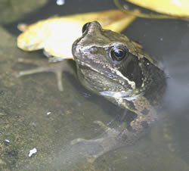
The Cycle -- Step 4
Participation
Almost without noticing, the words have slipped into our own vocabularies.

Slide 19
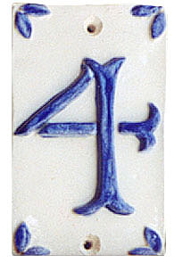
COMMIT TO Control Your Attitude Philippians 4:6-8
Philippians 4:13

Slide 20
You Are Not Powerless
Commit to stamp out Negativity in your lifetime.
You CAN influence others for good.
You CAN reflect Jesus in your life.
You CAN be an example of a believer.

Slide 21
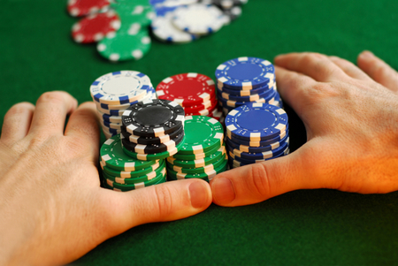
Are We Really Committed?
Now is the time to resolve to go “all-in” to doing it right!

