Slide 1
Feminism
Reading – 1 Timothy 2:8-15

Slide 2
Three controversial N.T. passages
God chose to make men and women different and they have different responsibilities as they work together to serve God.
1 Timothy 2:11-14
1 Corinthians 14:34-35
1 Corinthians 11:3-9

Slide 3
THE ISSUE IS NOT ONE OF EQUALITY, BUT OF ROLES
The Bible teaches an equality of men and women. Both men and women:
Are made in the image of God
Have dominion over the earth
Are joint heirs in Christ.
[Galatians 3:28]
The Bible clearly teaches a distinction in the roles of men and women.
Much of what is being promoted today does not come from a careful reading of the Bible, but is an effort to make the Bible to fit the views of the culture in which we live.

Slide 4
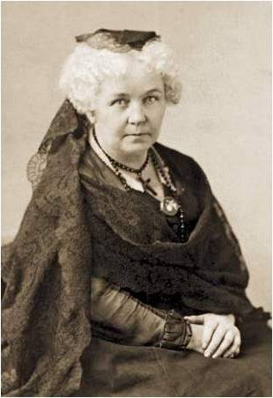
THE "FIRST WAVE" OF FEMINISM
The feminist movement of the nineteenth century effectively began July 19-20,1848 at a women's convention that was held in the Wesleyan Methodist Chapel in Seneca Falls, New York. About 300 attended.
Elizabeth Stanton wrote the "Declaration on Women's Rights," and it was signed by 68 women and 32 men.
Two weeks later, a second convention was held in Rochester, New York, during which the movement began to be more formally organized.
The third meeting was in 1850 at Worcester, Massachusetts. It was the first to claim to be a national women's rights convention, having delegates from nine states.

Slide 5
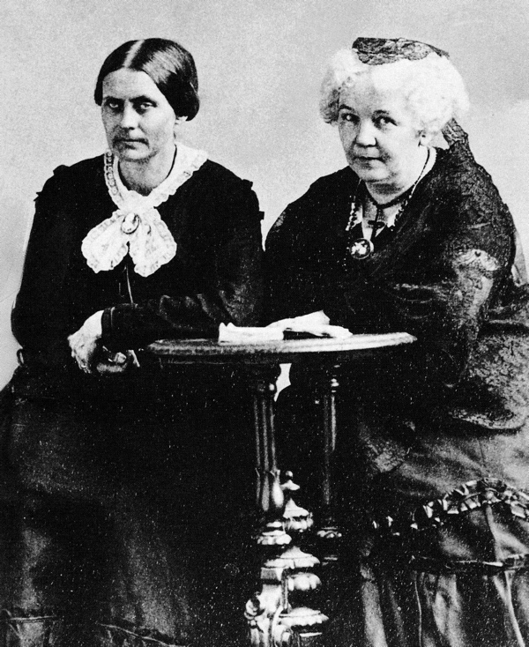
THE "FIRST WAVE" OF FEMINISM
In 1852, Elizabeth Stanton and Susan B. Anthony joined forces. They remained a team for nearly fifty years, with Anthony managing the business affairs and Stanton doing most of the writing.

Slide 6
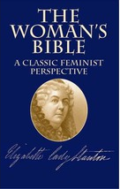
FEMINIST VEIWS REGARDING THE BIBLE
Moderate View
Liberal View
Radical View
This was Elizabeth Stanton's view. She believed that the Bible must be destroyed if women were to be free.
"In plain English, the Bible itself is simply degrading to women. No mystical symbolism can enable one to twist out of the Old or New Testaments a message of justice, liberty or equality from God to the women of the nineteenth century." Elizabeth Stanton, The Woman's Bible, I:61, II:66

Slide 7
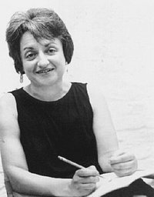
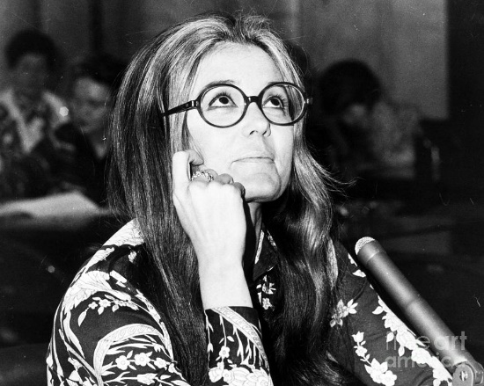
THE "SECOND WAVE" OF FEMINISM
Two of the most influential leaders of this new movement are Betty Friedan and Gloria Steinem.
Betty Friedan has been called the "Mother Superior to Women's Lib."
Publication of "The Feminine Mystique", in 1963.
Founded the National Organization for Women (NOW), on June 29, 1966.
Initiated the Women's March for Equality in August 1970 and the National Women's Political Caucus in March 1971.

Slide 8
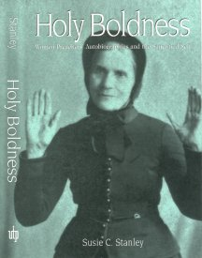
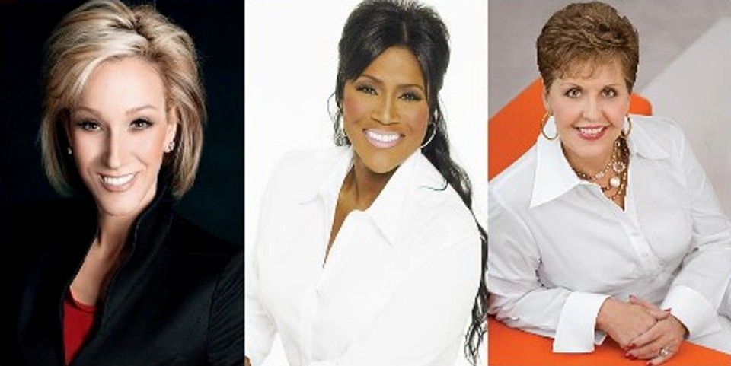
Women Preachers
The most common “proof text” is Galatians 3:28-29
The point of Galatians 3:28 is that all now receive the inheritance if they are in Christ.
A slave was still a slave after conversion and a free man was still a free man after conversion.
In the same way, a man is still a man and a woman is still a woman. Roles do not change.

Slide 9
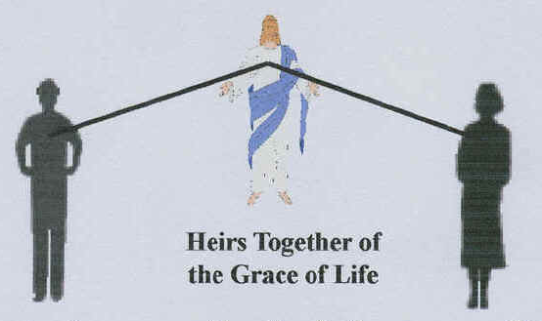
1st Peter 3:1-7 Argument --
“As being heirs together” simply repeats the message from Galatians 3.
The context clearly defines the difference in the roles of men and women.

Slide 10
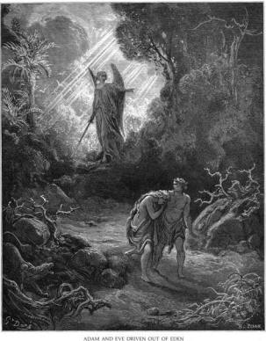
2nd Argument: Galatians 3:13
“Redeeming us from the curse” --
Since woman was cursed with subjection in Genesis 3:16, she is no longer under subjection since she has been redeemed from the curse.
The curse of the Law is that if you do not obey it completely, there is condemnation.
Did God Remove Only One Of The Curses, And That Was Just For The Woman?
Genesis 3:16-19

Slide 11
Argument of Mutual Submission
Feminists claim that Ephesians 5:21 teaches a mutual submitting of the husband and wife to each other, and that they are to submit equally to each other in the same way. Ephesians 5:21 submitting to one another in the fear of God.
There are six passages in the N.T. that teaches either wives are to submit to their husbands, or that there is a general submission of women to men.
1 Corinthians 14:34
Ephesians 5:22-24
Colossians 3:18
1 Timothy 2:11-12
Titus 2:3-5
1 Peter 3:1 & 5

Slide 12
Argument of Mutual Submission
The text mentions three other pairs in the same context. To be consistent, this idea of mutual submission must be applied to all pairs if it is to be applied to one pair.
1. Fathers & Children : Ephesians 6:1-4
Who can believe that the Bible teaches that fathers are to submit to their children in the same way that their children submit to them?
2. Masters & Servants: Ephesians 6:5-9
Are masters to submit to their servants in the same way their servants are to submit to them?
3. Jesus & The Church: Ephesians 5:22-33
This one is the most important because it is the model for the relationship between the husband and wife.
The wife is told to submit to her husband "as the church is subject to Christ". (5:24).
For the feminists theory of mutual submission to be true, then Jesus must be in submission to the church!

Slide 13
Mutual Submission
Ephesian 5:21 is not teaching a mutual submission in which both parties submit to one another in the same way as feminism claims, but it does teaches that we are to submit ourselves to one another where our circumstances call for it.
Hebrews 13:17
A wife may submit to her husband, but he is to submit to the elders of the church.
It would be possible for a slave in the home to be an elder in the church in which the master is a member, with both yielding and receiving submission to each other.
Romans 13:1
Like it or not, we are all to submit to ‘the powers that be”

Slide 14
Unconditional Submission
No matter what our position is in this life, all must submit to the Lordship of Jesus Christ.
He makes the rules, and we must come to Him on His terms.

