Slide 1
The Spirit & The Understanding Part 34
Reading -- 1Corinthians 14:1-15

Slide 2
Singing Is Not An Afterthought
Exodus recalls the song of freedom
The Psalms were all meant to be sung.
Isaiah has 17 references to singing in various ways.
Ephesians 5:17-20 Therefore do not be unwise, but understand what the will of the Lord is. And do not be drunk with wine, in which is dissipation; but be filled with the Spirit, speaking to one another in psalms and hymns and spiritual songs, singing and making melody in your heart to the Lord, giving thanks always for all things to God the Father in the name of our Lord Jesus Christ,
See also Colossians 3:16

Slide 3
Let’s Examine 5 Songs We Sing
O To Be Like Thee # 429
Open My Eyes, That I May See # 830
Open Our Eyes, Lord # 766
Precious Lord, Take My Hand # 786
Cleanse Me # 420

Slide 4
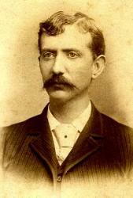
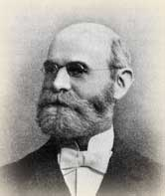
O To Be Like Thee - 429
Words By T.O. Chisholm (1897)
Music By William J Kirkpatrick (1897)
Scriptures:
Romans 8:29; Ephesians 2:10; 1 John 3:1-2

Slide 5
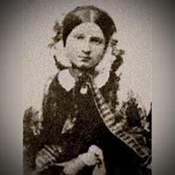
Open My Eyes, That I May See -- 830
Words & Music By Clara H. Scott (1895)
Scriptures:
2 Kings 6:17; Psalm 40:8; Psalm 119:17-20; James 1:22

Slide 6
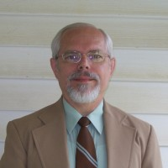
Open Our Eyes, Lord -- 766
Words & Music by Robert Cull (1976)
Scriptures:
Psalm 119:18; Matthew 9:27-31; Luke 24:31-32

Slide 7
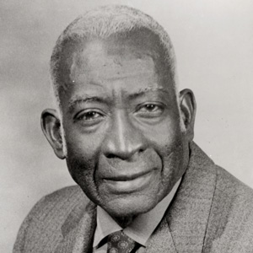
Precious Lord, Take My Hand – 786
Words & Music by Thomas A Dorsey (1938)
Scriptures:
Psalm 27:9-11; Isaiah 41:13; John 10:3-4

Slide 8
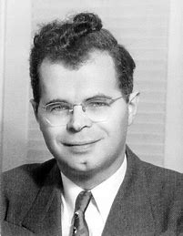
Cleanse Me -- 420
Words by James Edwin Orr (1936)
Music: Maori Folk Melody
Scriptures:
Psalm 51:7; Psalm 139:1-2; John 1:9

