Slide 1
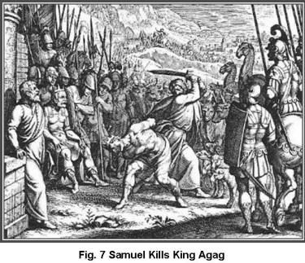
Hacking Agag To Pieces
Reading 1 Samuel 15:1-33

Slide 2
Pivotal event – disobeying command to annihilate the Amalekites
This wasn’t the first time he sinned
He sinned by offering sacrifice at Gilgal.
He later proved to be cowardly in dealing with Goliath,
God pointed to this episode as the decisive turning point in Saul's reign (1 Samuel 15:28) So Samuel said to him, "The LORD has torn the kingdom of Israel from you today, and has given it to a neighbor of yours, who is better than you.

Slide 3
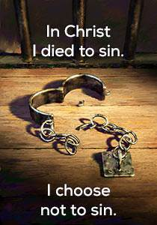
This is a great illustration of the Christian's war with sin.
It’s not that I can’t sin – it’s that I won’t sin!

Slide 4
The Amalekites
What did they do to get on God’s bad side?
They were descendants of Esau (Genesis 36:12)
They attacked Israel in the wilderness (Exodus 17).
Whole story recorded in
(Deuteronomy 25:17-19)

Slide 5
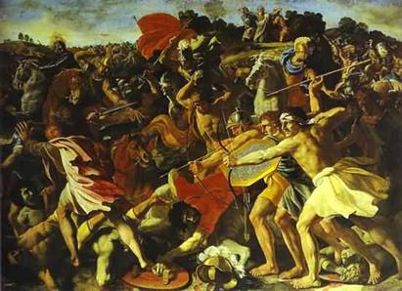
They attacked the weakest, most vulnerable Israelites
Now God was going to use Saul as a minister of His vengeance.

Slide 6
Saul starts out right
(1 Samuel 15:7-8)
But then he proved to be disobedient
(1 Samuel 15:9)

Slide 7
Samuel confronts Saul and condemns him (vs.10-11, 26)
Then, Samuel took matters into his own hands (vs.32-33).

Slide 8
Like Saul, Christians are to put sin to death—completely!
Our conversion is really an execution, the old man of sin put to death in baptism
(Romans 6:3-6)

Slide 9
Baptism does not end our conflict with sin.
The old man constantly tries to revive and ruin us.
So, God commands us to put sin to death!
(Romans 8:12-13)
(Colossians 3:5-6)

Slide 10
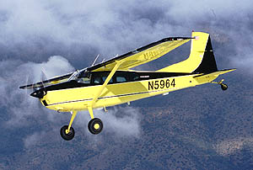
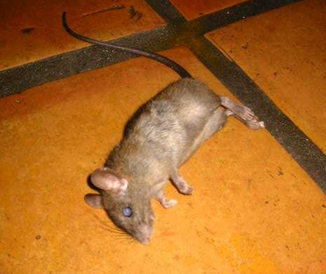
Sin must be dealt with ruthlessly and without mercy
Sinful appetites can't survive in spiritual heights.
Listen to our Lord as He calls us to come up higher!
Do you want to destroy the power of evil in your life? Then get into God’s Word regularly, meditate upon its truths, and actively do God's will.

Slide 11
How does this happen?
But just like Saul, sometimes Christians refuse to put sin to death, giving Agag a reprieve.

Slide 12
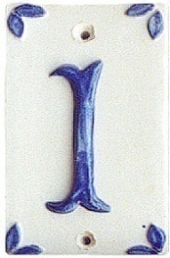
By denying it
Saul acted as if he had not sinned, "I have obeyed the command of the Lord" – (vs.10-13).
Dishonest people like Ananias and Sapphira who engaged in deliberate deception.
If you deny your sin you will eventually delude yourself
(James 1:22 & 26)

Slide 13
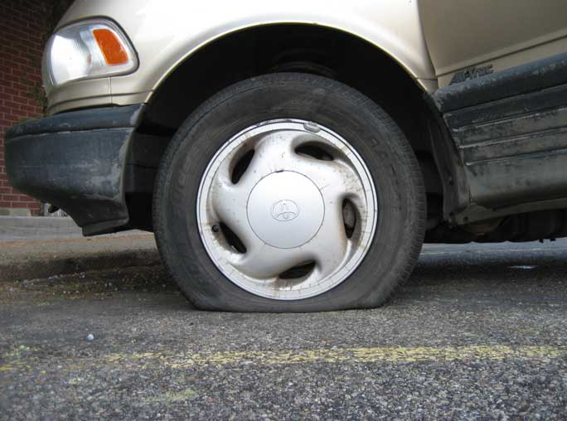
If you merely deny sin it will eventually destroy you
(Proverbs 28:13) He who covers his sins will not prosper, But whoever confesses and forsakes them will have mercy.
Which tire was flat???

Slide 14
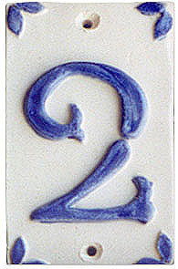
By justifying it.
Saul attempted to justify his sin by claiming to offer the spoil as a sacrifice—(vs.14-15).
The end does not justify the means. The means must justify themselves.
The catch phrase today is, "God would not want me to be unhappy." This phrase is used to justify things God flatly condemns:
EXAMPLE "I am unhappy in my marriage, so since God would not want me to be unhappy I can divorce", thus justifying something God says He hates (Malachi 2:16).

Slide 15
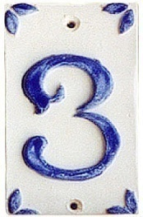
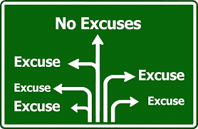
By excusing it.
Saul attempted to place the blame on the people—(15:20-21, 34).
The blame game was first played in the garden of Eden when Adam says to God... ("the woman you gave me....").
Since we are more sophisticated now, we can blame genetics, "Bad temper, alcoholism, homosexuality [name your sin] runs in my family".

Slide 16
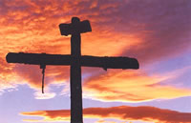
So How Do We Put Sin To Death?

Slide 17
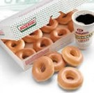
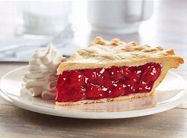
Recognize how horrible sin is
We don’t fully understand the COST.
Want to know what sin looks like?
1. Have you noticed with the rash of novels and movies portraying murderers and attempting to draw sympathy for them.
2. Perhaps you’d feel different when you see the pain and cost of their murder in the lives of the victim's families.
3. From that perspective, we would have no problem executing justice.
What pain did our crimes cost? The death of Jesus!

Slide 18
Do whatever it takes.
Make no provision for the flesh to fulfill its lusts (Romans 13:14)
Immorality, greed, drugs, alcohol, pornography, etc.
Jesus once told a man who had a problem with covetousness to sell his goods and give to the poor (Matthew. 19).
Extreme? Not in comparison to avoiding hell! There will be weeping and gnashing of teeth.' (Matthew 5:30)

Slide 19
We must crucify our old man of sin.
(Galatians 6:14)

Slide 20
Get busy doing what is right.
Put on righteousness.
(Romans 6:12-13)

Slide 21
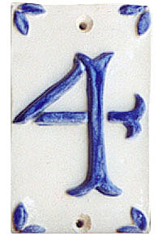
Become Zealous About Righteousness
In (Titus 2:14) we are told of Jesus who gave Himself for us, that He might redeem us from every lawless deed and purify for Himself His own special people, zealous for good works.
(Titus 3:14)
How zealous have you been lately?

Slide 22
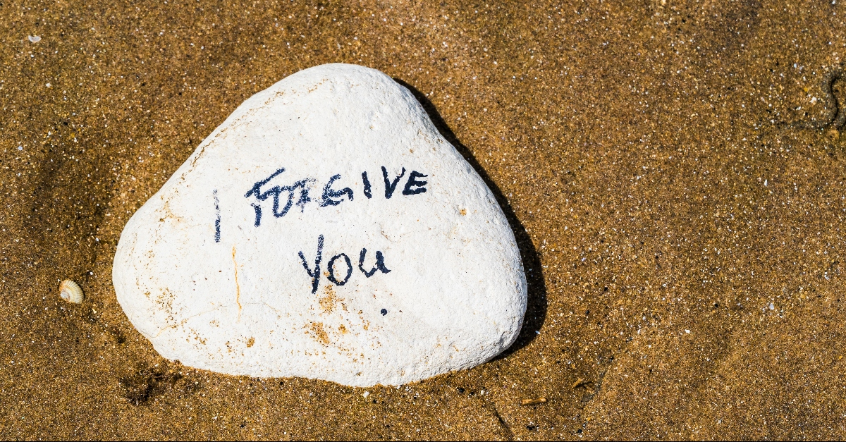
We should not deny our sins but confess them.
(1 John 1:8-9)
AND He will do it EVERY time!

Slide 23
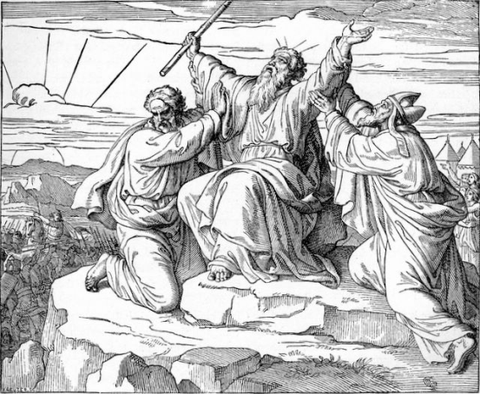
Thanks Be to God Who Gives Us The Victory!
1 Corinthians 15:57

