Slide 1
The Life of Saul of Tarsus —Part 1
Biography
Reading: 2 Timothy 4:1-8

Slide 2
Background:
Biography
Born about the same time as our Lord.
Circumcision name was Saul.
Notes:
Overview
Put your lesson notes here

Slide 3
Background:
Biography
He was a native of Tarsus, the capital of Cilicia, a Roman province in the south-east of Asia Minor, that stood on the banks of the navigable river Cydnus.
Notes:
Overview
Put your lesson notes here

Slide 4
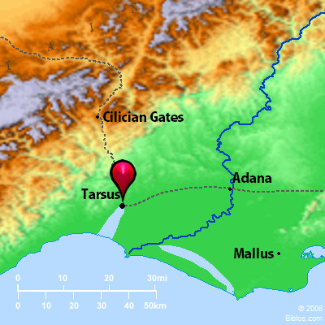
A commercial port city. Wealthy inhabitants. Location of a famous university.
Biography
Tarsus
Notes:
Key Places
Put your notes on key places here

Slide 5
Family
Father - was of the straightest sect, a Pharisee
Acts 23:6
Philippians 3:5
Mother – was like-minded with her husband.
Together - he could afterwards speak of himself as being, from his youth up, “touching the righteousness which is in the law, blameless” (Philippians 3:6).
Notes:
Key Verses
Put your Key verses here

Slide 6
Family
Siblings- We read of his sister and his sister’s son (Acts 23:16), and of other relatives (Romans 16:7, 11, 12).
Though a Jew, his father was a Roman citizen. A valuable privilege, and one that was to prove of great use to Paul, although not in the way his father might have expected or wanted. (Acts 16:35-39; 25:9-12)
Notes:
Key Verses
Put your Key verses here

Slide 7
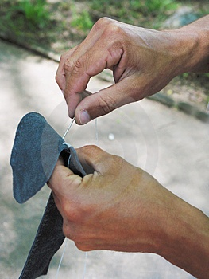
Growing Up In Tarsus
Merchant or Rabbi?
According to Jewish custom he learned a worldly trade [a fall back strategy].
The trade he acquired was the making of tents from goats’ hair cloth, a trade quite common to Tarsus.
Notes:
Key Verses
Put your Key verses here

Slide 8
Going To The Big City
At thirteen years of age, sent to the great Jewish school of sacred learning at Jerusalem.
As a student of the law he became a pupil of the celebrated rabbi Gamaliel
Acts 22:3
Here he would spend many years in an elaborate study of the Scriptures, learning the rabbinic method of reasoning, questioning, and orating.
Notes:
Key Verses
Put your Key verses here

Slide 9
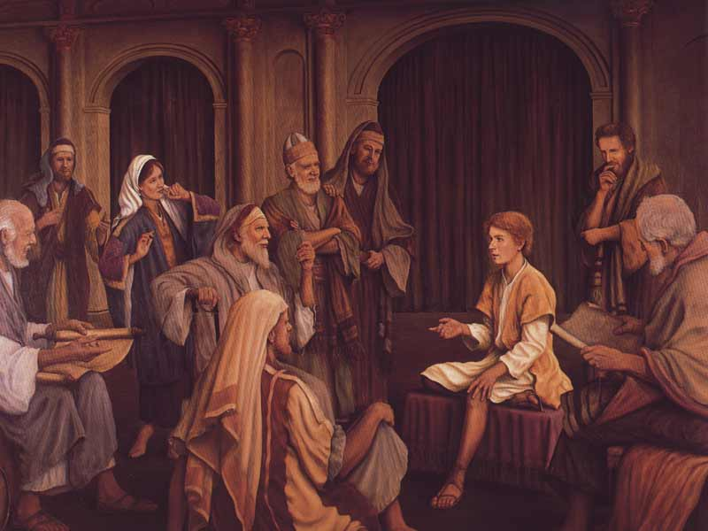
Luke 2:46
It would not be too hard to imagine the student Saul earnestly attentive to instruction, perhaps in the same audience with Jesus.
During these years of diligent study he lived “in all good conscience” (Acts 23:1), unstained by the vices that had come to the great city Jerusalem.
Notes:
Key Verses
Put your Key verses here

Slide 10
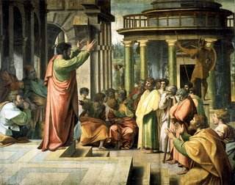
Back Home Again
He is now approximately 20 years old and as a “son of a Pharisee” he would have been expected to marry and start producing little Pharisees of his own.
For some years it is likely he faithfully serves the Law in connection with some synagogue
Notes:
Key Verses
Put your Key verses here

Slide 11
Chance Encounters With Jesus
Luke 2:41-42
Because of his devotion to “Keeping the Law” he probably made the annual trek to Jerusalem to keep the “fast” [Feast of the Passover].
He alludes to this practice in Acts, according to the law of their fathers (Acts 13:3; 14:23; Acts 20:6; Acts 27:9; 2 Corinthians 6:5).
Notes:
Key Verses
Put your Key verses here

Slide 12
Chance Encounters With Jesus
So it is likely that he was in Jerusalem at the time of the crucifixion and also present on the day of Pentecost.
Should he have encountered Jesus by chance it is clear that Jesus did not make much of an impression on him.
2 Corinthians 5:16
John 1:46
Notes:
Key Verses
Put your Key verses here

Slide 13
Soon After Pentecost
He learns the particulars regarding the crucifixion, and the rise of the new sect of the “Nazarenes”
For two years after Pentecost, Christianity was quietly spreading its influence in Jerusalem.
At length Stephen, one of the seven, gave forth more public and aggressive testimony that Jesus was the Messiah.
This ended in Stephen's stoning.
Notes:
Key Verses
Put your Key verses here

Slide 14
Acts 7:58
Notes:
Key Verses
Put your Key verses here

Slide 15
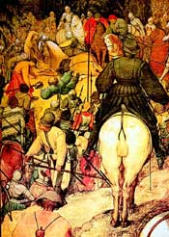
A Murderer & Blasphemer
Saul of Tarsus, being a “young man” was not a member of the great Sanhedrin, but with their encouragement he became the active leader in the furious persecution.
The result: They that were scattered abroad went everywhere preaching the word. Acts 8:4.
Notes:
Key Verses
Put your Key verses here

Slide 16
A Murderer & Blasphemer
The anger of the persecutor was fanned into a fiercer flame.
1 Timothy 1:13-15
Hearing that fugitives had taken refuge in Damascus, he obtained from the chief priest letters authorizing him to proceed to that place to continue his persecuting career.
Notes:
Key Verses
Put your Key verses here

Slide 17
A Conversion: This was a long journey of about 130 miles that would occupy perhaps six days. With his few attendants he steadily went onward, breathing out threatening and slaughter (Acts 9:1). He had reached the last stage of his journey, and was within sight of Damascus.
The Way To Damascus
Notes:
Key Places
Put your notes on key places here

Slide 18
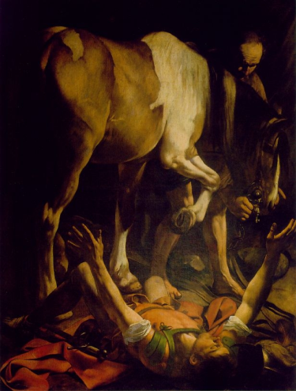
His Conversion
At mid-day a brilliant light shone round them, and Saul crumpled prostrate in terror on the ground. A voice sounded in his ears, “Saul, Saul, why are you persecuting me?” In answer to this inquiry he anxiously replies, “Who are you, Lord?” The commanding voice replies, “I am Jesus whom you are persecuting.” (Acts 9:5; 22:8; 26:15)
Notes:
Key Verses
Put your Key verses here

Slide 19
His Conversion
Blinded by the dazzling light (Acts 9:8), his companions led him into the city.
For 3 days of deep thought and prayer, he neither ate nor drank (Acts 9:11).
Ananias was sent to Saul to open his eyes and instruct him concerning baptism into the Lord’s body (Acts 9:11-16).
Notes:
Key Verses
Put your Key verses here

Slide 20
The Life of Saul of Tarsus – End of Part 1
Biography
Reading: 2 Timothy 4:1-8

Slide 21
The Life of Saul of Tarsus – Part 2
Biography
Reading: 2 Timothy 4:1-8

Slide 22
After his Conversion: Wilderness Wanderings
Immediately after his conversion Saul retired into the wilderness of Arabia
Galatians 1:16-19
What happened there is generally unknown, but we can characterize it as the “calm before the storm.”
Goes back to Damascus and remains there for 3 years
Notes:
Key Verses
Put your Key verses here

Slide 23
3 years in Damascus
Biography
After His Conversion
Notes:
Key Places
Put your notes on key places here

Slide 24
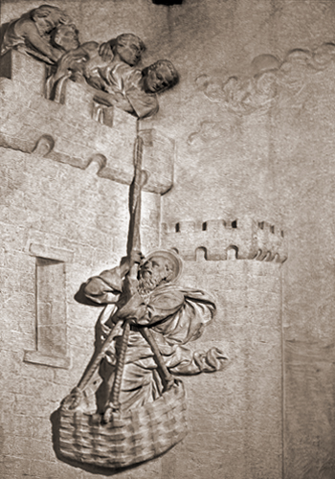
What Goes Around….
In Damascus he began to preach the gospel “boldly in the name of Jesus” (Acts 9:27).
Out of jealousy and rage the Jews sought to kill him, so he was obliged to flee (Acts 9:23-25; 2 Corinthians 11:33) by escaping over the city wall in a basket.
Notes:
Key Verses
Put your Key verses here

Slide 25
Acts 9:26-29:
What Goes Around…
Barnabas vouches for and encourages Saul. Again, having only been in the city for three weeks, he was forced to flee from persecution.
Notes:
Key Places
Put your notes on key places here

Slide 26
Where to Go? – Back Home!
Galatians 1:21-24
For another three years, we lose sight of him.
There is speculation that while in Tarsus he has the ability to reason with some of his family members as they become Christians, as well.
{SPECULATION} When his wife passes away he has nothing to hold him back from doing the Lord’s work.
[Pharisee of the Pharisees tradition of being married].
Notes:
Key Verses
Put your Key verses here

Slide 27
Called Back Into Service
Barnabas seeks out Saul to help him with the work in Antioch. Saul readily responded to the call and came down to Antioch, where he labored for “a whole year.” The Antioch disciples were the first believers to be called “Christians” (Acts 11:26). The church there now proposed to send out missionaries to the Gentiles. Barnabas and Saul, with John Mark as their attendant, were chosen for this work.
Notes:
Key Places
Put your notes on key places here

Slide 28
Mark 16:15
The disciples now began to put this command into practice. Barnabas, Saul, and John Mark sail from Seleucia across to Cyprus. At Paphos, the Roman proconsul Sergius Paulus was converted.
Notes:
Key Places
Put your notes on key places here

Slide 29
What’s In A Name?
It is at this time that Saul took the lead and was ever afterwards called Paul.
It is interesting that he chose to give himself a new name.
Instead of his namesake, King Saul – the greatest of the tribe of Benjamin, he chooses to call himself “paulos” which in translation means “little.”
1 Corinthians 15:9
Ephesians 3:8
Notes:
Key Verses
Put your Key verses here

Slide 30
John Mark leaves for Jerusalem at Perga
First Mission Trip
Notes:
Key Places
Put your notes on key places here

Slide 31
After the Jerusalem Conference
Paul said to Barnabas: “Let us now go back and visit our brethren in every city where we have preached the word of the Lord, and see how they are doing (Acts 15:36).
Mark proposed again to accompany them; but Paul balked at Barnabas’ idea.
They separated, and never again met. Years later though, Paul speaks with honor of Barnabas, and sends for Mark to come to him at Rome (Colossians 4:10; 2 Timothy 4:11).
Notes:
Key Verses
Put your Key verses here

Slide 32
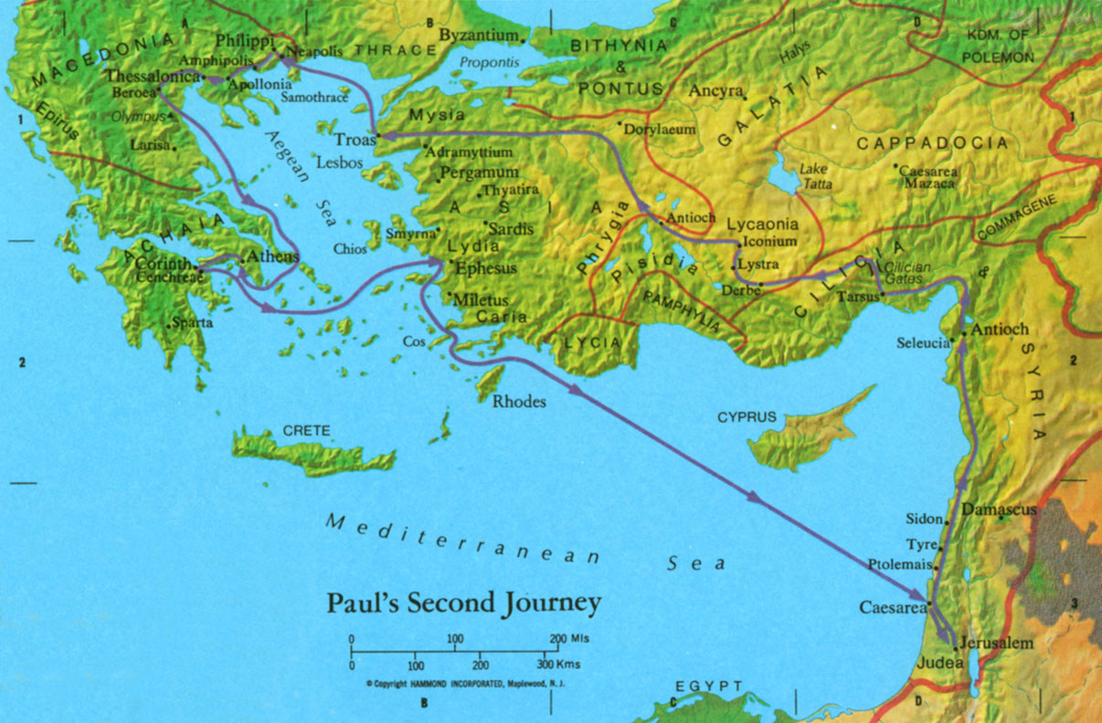
John Mark leaves for Jerusalem at Perga
On The Road Again
Notes:
Key Places
Put your notes on key places here

Slide 33
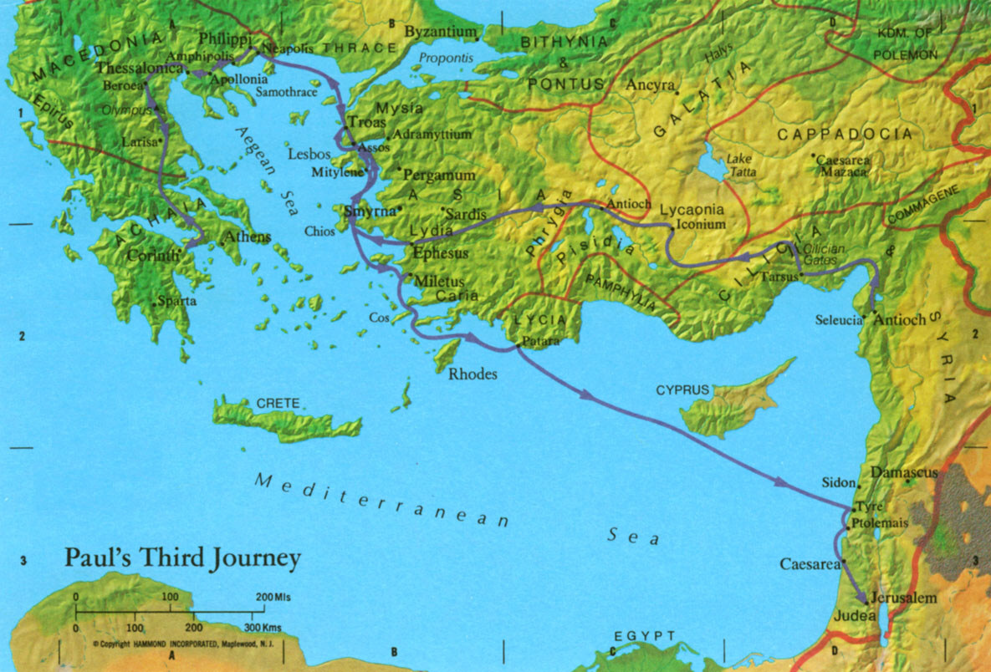
John Mark leaves for Jerusalem at Perga
Third Mission Trip
Notes:
Key Places
Put your notes on key places here

Slide 34
Things Get Ugly
At Jerusalem, again for the feast of Pentecost, he was almost murdered by a Jewish mob in the temple.
Rescued from their violence by the Roman commandant, he was conveyed as a prisoner to Caesarea.
Notes:
Key Verses
Put your Key verses here

Slide 35
Paul In Prison
For various reasons he was detained a prisoner for two years in Herod’s Praetorium (Acts 23:35).
During these two years he wrote nothing.
Could it be that after 20 years of evangelism, he was ready to hang it up?
Notes:
Key Verses
Put your Key verses here

Slide 36
Appeals to Caesar – Off To Rome
Notes:
Key Verses
Put your Key verses here

Slide 37
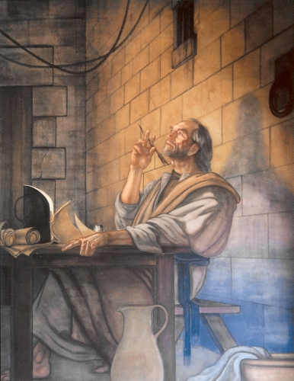
Under House Arrest
At Rome he was permitted to occupy his own hired house.
This privilege was accorded to him, no doubt, because he was a Roman citizen.
He could not be put into prison without a trial.
Notes:
Key Verses
Put your Key verses here

Slide 38
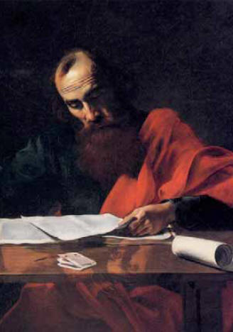
Who’s the Prisoner?
The soldiers who guarded Paul were changed at frequent intervals, and thus he had the opportunity of preaching the gospel to many of them during these “two whole years.”
The result was that the truth was spread among the imperial guards and even in Caesar’s household (Philippians 1:13).
Notes:
Key Verses
Put your Key verses here

Slide 39
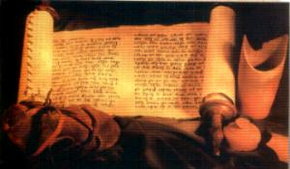
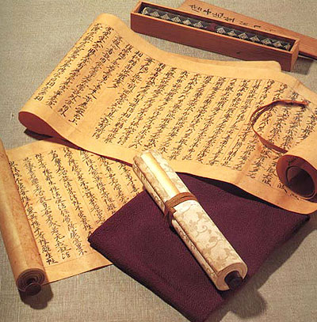
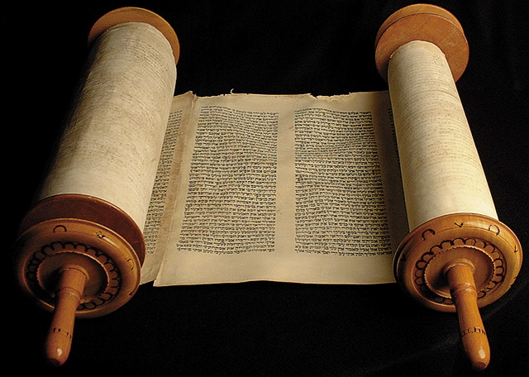
Prolific Writer
During this period the apostle wrote his epistles to the Colossians, Ephesians, Philippians, and to Philemon, and probably also to the Hebrews.
Notes:
Key Verses
Put your Key verses here

Slide 40
Acquitted & Released?
Paul had always dreamed of traveling to Spain.
Romans 15:19-29
Notes:
Key Verses
Put your Key verses here

Slide 41
Acquitted & Released?
He may have had opportunity to do so for this first imprisonment may have come to a close.
It is theorized that Paul could have been acquitted because no witnesses appeared against him.
Also, he writes to Timothy as if he is a free man - or at least soon to be a freed man
1 Timothy 3:14; 4:13
During this period of freedom he wrote his first epistle to Timothy and his epistle to Titus.
Both epistles have an upbeat tone as if Paul were under a release
Notes:
Key Verses
Put your Key verses here

Slide 42
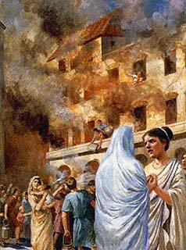
Did Not Get Very Far
The year of his release [if indeed he saw freedom for a season] was marked by the burning of Rome, which Nero saw fit to blame on the Christians.
A fierce persecution now broke out against the Christians.
Paul was seized, and once more conveyed to Rome as a prisoner.
Notes:
Key Verses
Put your Key verses here

Slide 43
Did Not Get Very Far
During this imprisonment it is supposed he wrote the second epistle to Timothy … the last he ever wrote.
2 Timothy 4:1-8
He appeared again at Nero’s bar, and this time the charge did not break down.
He was "guilty" of being a Christian and executed in AD 66.
(4 yrs prior to the destruction of Jerusalem)
Notes:
Key Verses
Put your Key verses here

