Slide 1
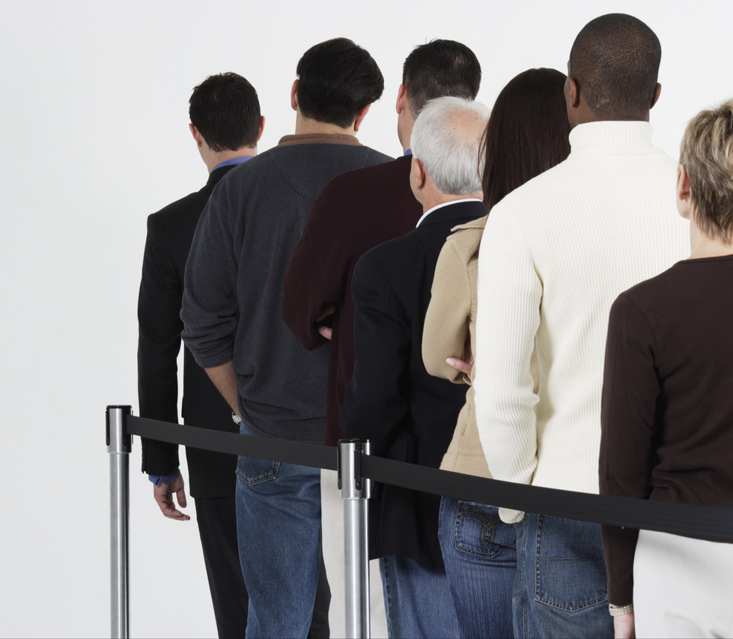
The Cost of Losing
Get In Line!
Reading Text: Mark 8:36-38

Slide 2
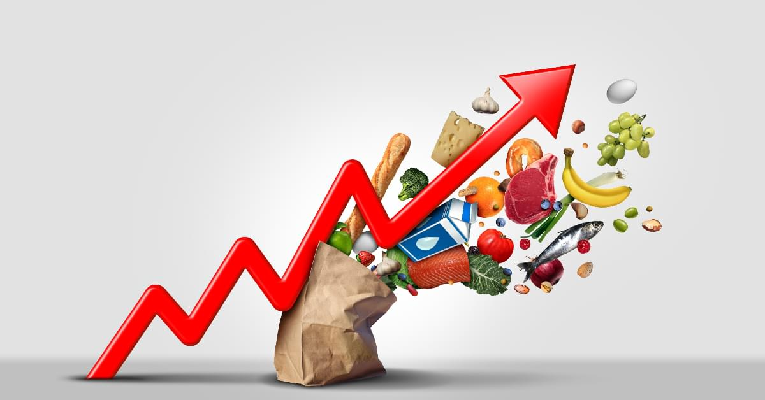
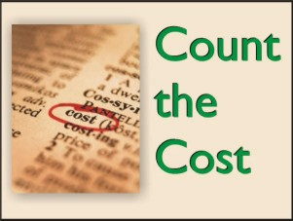
Issues to Consider
1. Inflation gives us concerns for the COST OF LIVING
2. From our text we should see the true cost – THE COST OF LOSING!
Notes:
Answers to these questions will allow the firm to adequately design a queuing system that will provide acceptable service to customers while minimizing service system cost and the cost of lost and disgruntled customers.

Slide 3
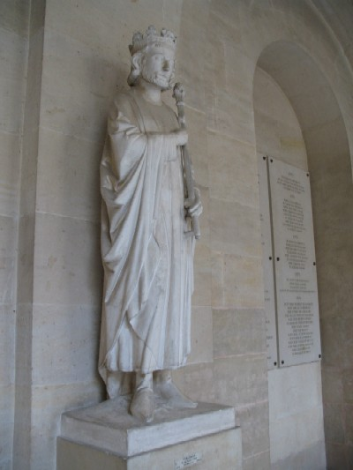
King Charlemagne
(James 5:1-6)
Tomb was opened to find him sitting on his throne , bible opened to Mark 8:36
Notes:
Made necessary by varying arrival rates and service requirements.
Properly thought out and designed queuing systems decrease waiting times and subsequently the need for further managing waiting times; however, occasionally, waiting time management tactics must be utilized to decrease perceived waiting times.

Slide 4
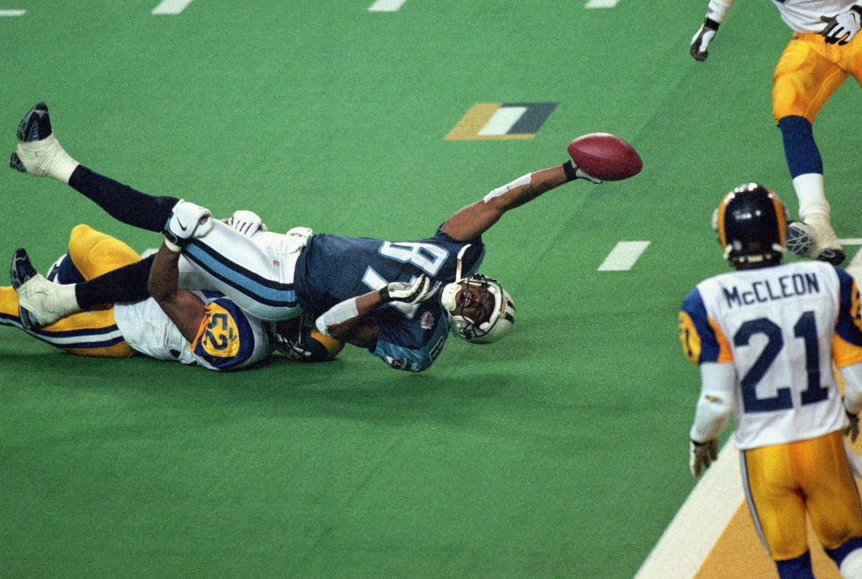
Others who refused to follow the Lord.
John 6:66 -- From that time many of His disciples went back and walked with Him no more.
(John 12:42-43)
(Acts 26:28) Then Agrippa said to Paul, "You almost persuade me to become a Christian."

Slide 5
Your life is full of sacrifices whether you are a Christian or not.
If you are a Christian you present your bodies a living sacrifice, holy, acceptable to God, which is your reasonable service (Romans 12:1)
If you are not a Christian or one who is not faithful any longer you are making sacrifices as well!
Here’s what you sacrifice..............

Slide 6
What Else Do You Sacrifice?
Your Soul
What happens when we fail to heed God’s repeated warnings?
(1 Timothy 6:20-21) (2 Timothy 2:16-17)
Hell is prepared for the unbelieving
(Matthew 10:28)
(Ezekiel 18:20)
(Romans 6:23)

Slide 7
We Rob God Also
Greatest Joy
If we will put God first, we can have the greatest joy known to man.
(Psalms 16:8-11)
Psalm 116:15
God wants to bring men to Himself.
By disobeying God we rob not only ourselves of the greatest joy.

Slide 8
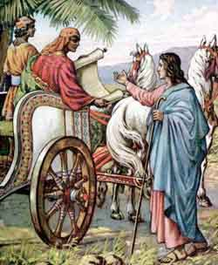
There is a great joy in knowing that you can start all over again
(Acts 8:39)

Slide 9
You Would Rejoice if ---
Someone had just paid off the balances on your mortgage, your car and your credit cards?
The Philippian jailer knew the feeling of relief after an earthquake.
(Acts 16:34)

Slide 10
We rob ourselves from a great expectation as well.
(Philippians 1:21-23)
Have you counted the awful cost of throwing that all away?

Slide 11
Here's what else you give up
Are You Happy Now?
(Galatians 5:22-23)
(Philippians 4:4)
Have you counted the cost of losing real joy?

Slide 12
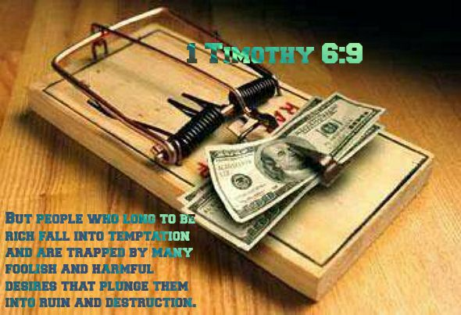
*
Contentment
The Real Success in life
(1 Timothy 6:6-8)
(Hebrews 13:5)
Too many of us are overcome by self-made problems and the devil wins out.
(1 Timothy 6:9)

Slide 13
The final thing you lose
How Much Is Inner Peace Worth?
(Philippians 4:10-14)

Slide 14
Any Hope of Heaven
Those who do not have Christ have no hope-
(Ephesians 2:12)

Slide 15
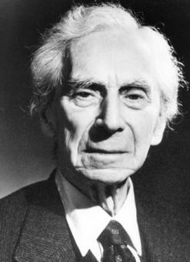
Atheist writer--Bertrand Russell
"The life of man is a long march through the night, surrounded by invisible foes, tortured by weariness and pain, towards a goal that few can hope to reach and where none can tarry long…
Notes:
Calling population – customers seeking to obtain a service / people in line for service
Arrival process – calculating the arrival time, and the interval between arrivals (Poisson distribution)
variation in demand intensity affects the requirements for service capacity
service capacity should be adjusted to meet demand when possible
this can be made possible through cross training employees or having the customers serve themselves (grocery store)
Queuing configuration – number of servers, their location, spatial requirements and their effects on customer behavior
virtual queue – no visual indication of your place in line
finite queue – not enough space to accommodate all customers
Service process – overall service performance
Most queuing models assume that customers stay in the line once they join it.
In other words, customers do not exhibit balking ( refusing to join the queue once they see how long it is) or reneging ( leaving the line before completing the service).
4/15/2023 3:09 PM
© 2007 Microsoft Corporation. All rights reserved. Microsoft, Windows, Windows Vista and other product names are or may be registered trademarks and/or trademarks in the U.S. and/or other countries.
The information herein is for informational purposes only and represents the current view of Microsoft Corporation as of the date of this presentation. Because Microsoft must respond to changing market conditions, it should not be interpreted to be a commitment on the part of Microsoft, and Microsoft cannot guarantee the accuracy of any information provided after the date of this presentation. MICROSOFT MAKES NO WARRANTIES, EXPRESS, IMPLIED OR STATUTORY, AS TO THE INFORMATION IN THIS PRESENTATION.
15

Slide 16
Bertrand Russell
… One by one, as they march, our comrades vanish from our sight, seized by the silent orders of omnipotent death…
Notes:
Calling population – customers seeking to obtain a service / people in line for service
Arrival process – calculating the arrival time, and the interval between arrivals (Poisson distribution)
variation in demand intensity affects the requirements for service capacity
service capacity should be adjusted to meet demand when possible
this can be made possible through cross training employees or having the customers serve themselves (grocery store)
Queuing configuration – number of servers, their location, spatial requirements and their effects on customer behavior
virtual queue – no visual indication of your place in line
finite queue – not enough space to accommodate all customers
Service process – overall service performance
Most queuing models assume that customers stay in the line once they join it.
In other words, customers do not exhibit balking ( refusing to join the queue once they see how long it is) or reneging ( leaving the line before completing the service).
4/15/2023 3:09 PM
© 2007 Microsoft Corporation. All rights reserved. Microsoft, Windows, Windows Vista and other product names are or may be registered trademarks and/or trademarks in the U.S. and/or other countries.
The information herein is for informational purposes only and represents the current view of Microsoft Corporation as of the date of this presentation. Because Microsoft must respond to changing market conditions, it should not be interpreted to be a commitment on the part of Microsoft, and Microsoft cannot guarantee the accuracy of any information provided after the date of this presentation. MICROSOFT MAKES NO WARRANTIES, EXPRESS, IMPLIED OR STATUTORY, AS TO THE INFORMATION IN THIS PRESENTATION.
16

Slide 17
Bertrand Russell
Brief and powerless is man's life, on his and all his race the slow, sure doom falls, pitiless and dark. Blind to good and evil, reckless of destruction, omnipotent matter rolls on its relentless way….
Notes:
Calling population – customers seeking to obtain a service / people in line for service
Arrival process – calculating the arrival time, and the interval between arrivals (Poisson distribution)
variation in demand intensity affects the requirements for service capacity
service capacity should be adjusted to meet demand when possible
this can be made possible through cross training employees or having the customers serve themselves (grocery store)
Queuing configuration – number of servers, their location, spatial requirements and their effects on customer behavior
virtual queue – no visual indication of your place in line
finite queue – not enough space to accommodate all customers
Service process – overall service performance
Most queuing models assume that customers stay in the line once they join it.
In other words, customers do not exhibit balking ( refusing to join the queue once they see how long it is) or reneging ( leaving the line before completing the service).
4/15/2023 3:09 PM
© 2007 Microsoft Corporation. All rights reserved. Microsoft, Windows, Windows Vista and other product names are or may be registered trademarks and/or trademarks in the U.S. and/or other countries.
The information herein is for informational purposes only and represents the current view of Microsoft Corporation as of the date of this presentation. Because Microsoft must respond to changing market conditions, it should not be interpreted to be a commitment on the part of Microsoft, and Microsoft cannot guarantee the accuracy of any information provided after the date of this presentation. MICROSOFT MAKES NO WARRANTIES, EXPRESS, IMPLIED OR STATUTORY, AS TO THE INFORMATION IN THIS PRESENTATION.
17

Slide 18
Bertrand Russell
…. For man, condemned today to lose his dearest, tomorrow himself to pass through the gates of darkness, it remains only to cherish, ere yet the blow falls, the lofty thoughts that ennoble his little day".
Notes:
Calling population – customers seeking to obtain a service / people in line for service
Arrival process – calculating the arrival time, and the interval between arrivals (Poisson distribution)
variation in demand intensity affects the requirements for service capacity
service capacity should be adjusted to meet demand when possible
this can be made possible through cross training employees or having the customers serve themselves (grocery store)
Queuing configuration – number of servers, their location, spatial requirements and their effects on customer behavior
virtual queue – no visual indication of your place in line
finite queue – not enough space to accommodate all customers
Service process – overall service performance
Most queuing models assume that customers stay in the line once they join it.
In other words, customers do not exhibit balking ( refusing to join the queue once they see how long it is) or reneging ( leaving the line before completing the service).
4/15/2023 3:09 PM
© 2007 Microsoft Corporation. All rights reserved. Microsoft, Windows, Windows Vista and other product names are or may be registered trademarks and/or trademarks in the U.S. and/or other countries.
The information herein is for informational purposes only and represents the current view of Microsoft Corporation as of the date of this presentation. Because Microsoft must respond to changing market conditions, it should not be interpreted to be a commitment on the part of Microsoft, and Microsoft cannot guarantee the accuracy of any information provided after the date of this presentation. MICROSOFT MAKES NO WARRANTIES, EXPRESS, IMPLIED OR STATUTORY, AS TO THE INFORMATION IN THIS PRESENTATION.
18

Slide 19
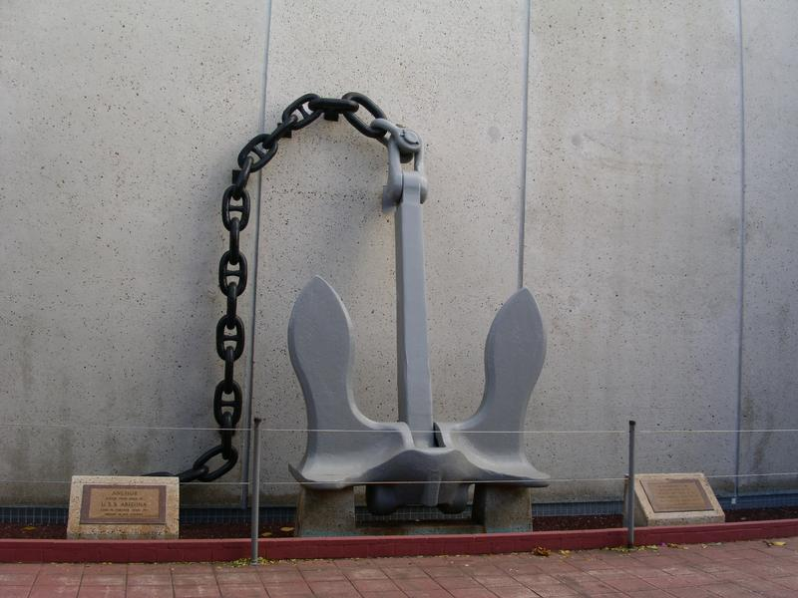
That is the logical end thinking of a man without hope.
(1 Corinthians 15:16-19)
Those who have turned away from the way of truth have turned loose of the anchor of the soul- Hebrews 6:18-20
Notes:
4/15/2023 3:09 PM
© 2007 Microsoft Corporation. All rights reserved. Microsoft, Windows, Windows Vista and other product names are or may be registered trademarks and/or trademarks in the U.S. and/or other countries.
The information herein is for informational purposes only and represents the current view of Microsoft Corporation as of the date of this presentation. Because Microsoft must respond to changing market conditions, it should not be interpreted to be a commitment on the part of Microsoft, and Microsoft cannot guarantee the accuracy of any information provided after the date of this presentation. MICROSOFT MAKES NO WARRANTIES, EXPRESS, IMPLIED OR STATUTORY, AS TO THE INFORMATION IN THIS PRESENTATION.
19

Slide 20
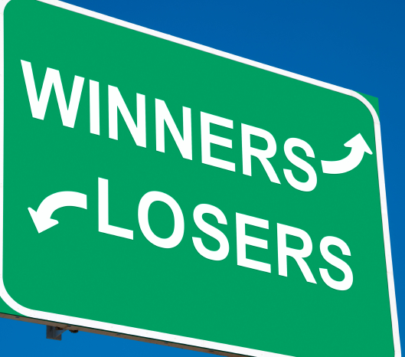
Are You A Christian?
Are You Faithful?
If not, you are making a tragic & tremendous sacrifice!

