Slide 1
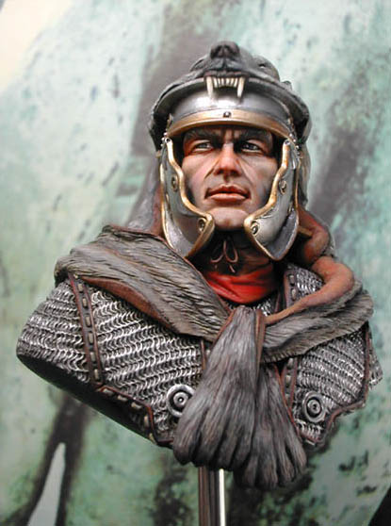
Cornelius
Reading: ACTS 10 :1-7 ; 22

Slide 2
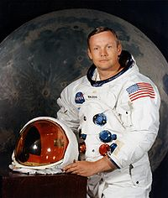
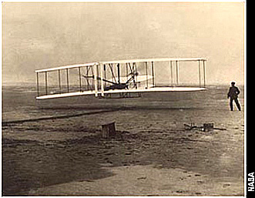
We Tend To Remember the First
Neil Armstrong was the first man walking on the surface of the moon. July 21, 1969.
We think of the Wright Brothers as the first to fly.

Slide 3
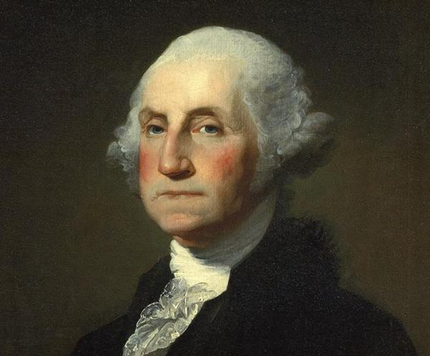
We Tend To Remember the First
George Washington was the first president.

Slide 4
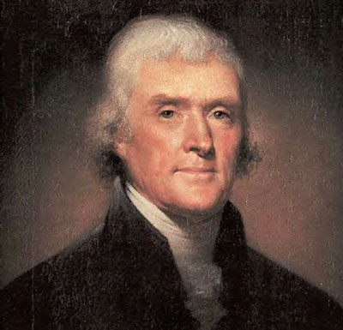
We Tend To Remember the First
George Washington was the first president.
Who was the 2nd?

Slide 5
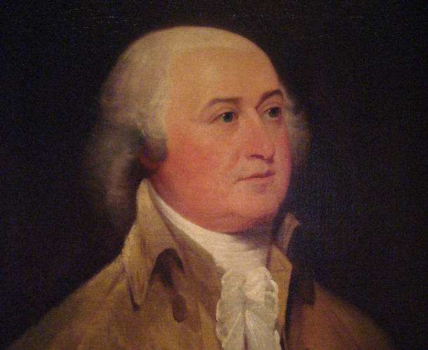
We Tend To Remember the First
George Washington was the first president.
Who was the 2nd?
It wasn’t Thomas Jefferson, it was John Adams.
It’s amazing how those who came first almost overshadowed those who come next.

Slide 6
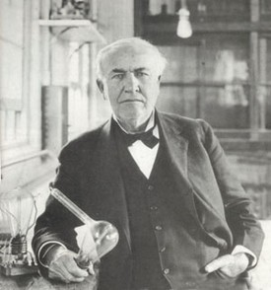
We Tend To Remember the First
The inventor of the light bulb -Thomas Edison.
It took hundreds of failures until he finally succeeded.
“The reason the school of experience is so difficult is because you get the test first, then you get the lesson.”

Slide 7
These men had special attributes that enabled them to be first.
The Wright's had faith in their ability to fly.
Washington had the respect of his fellow countrymen allowing him to be the first leader of the new country.
Edison had a burning desire to succeed, which was the driving force behind his inventing the light bulb.

Slide 8
Cornelius possessed all these traits.
First Gentile convert.
Had great faith, great desire and had great respect.
God chose Cornelius to lead the way for the rest of the Gentile world.
God made use of every one of his attributes.

Slide 9
Faith
Faith was not in his own abilities.

Slide 10
Faith motivated his prayer life.
(Acts 10:2) a devout man and one who feared God with all his household, who gave alms generously to the people, and prayed to God always.
God answered the prayers of Cornelius by providing him the way of salvation.
(Acts 10:4)
Not just for Cornelius
(James 1:5-8)

Slide 11
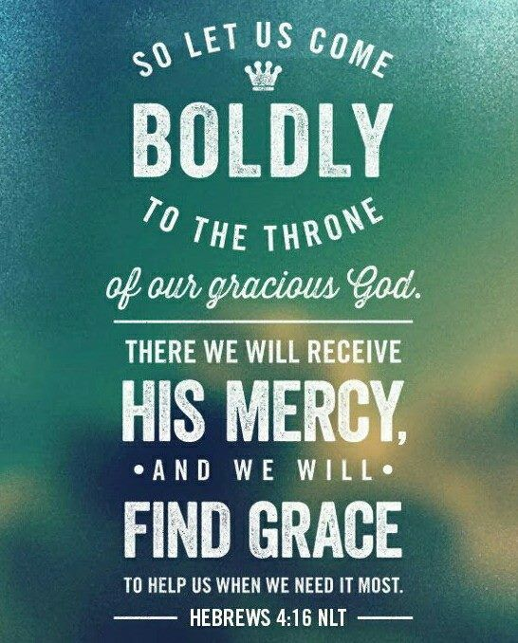
How is your prayer life?
Why aren’t you boldly approaching the throne of grace?
(Hebrews 4:15-16)

Slide 12
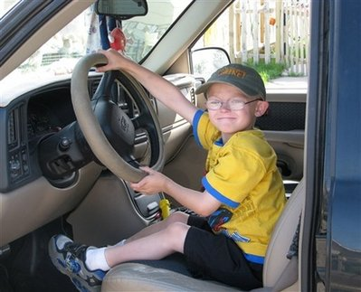
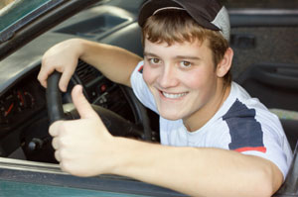
God will listen & respond to your request as well.
Sometimes His answer is “no” and sometimes it is “not now”
If your 6-year-old asks for the keys to the car you will tell him “no”.
10 years later, when he’s ready the answer may be yes.

Slide 13
The motto of some: To keep from failing -- don't try!
Instead of being filled with fear, go forward in faith. Problems are merely challenges.
Benjamin Franklin -- "The man who does things makes many mistakes, but he never makes the biggest mistake of all -- doing nothing."
(Philippians 3:12-14)

Slide 14
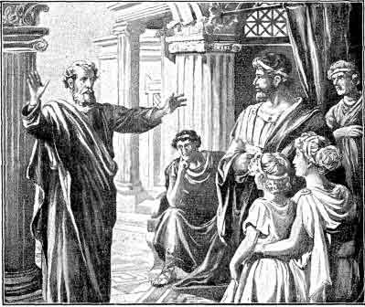
Obedience
Acts 10:33

Slide 15
In answer to a prayer of faith
An Angel appeared to him in a vision to send for Peter.
Cornelius’s response, “So I sent to you immediately… and you have done well to come.
The fact he sent for Peter showed his faith in God.
Now therefore, we are all present before God, to hear all the things commanded you by God.”
The fact that he submitted himself to be baptized showed his faith
(Acts 10:44-48)

Slide 16
Speaking In Tongues does NOT save.
If they were already saved, then why did Peter COMMAND that Cornelius and his household be baptized?
Cornelius's trust in God was one factor that allowed him to be the first Gentile convert.

Slide 17
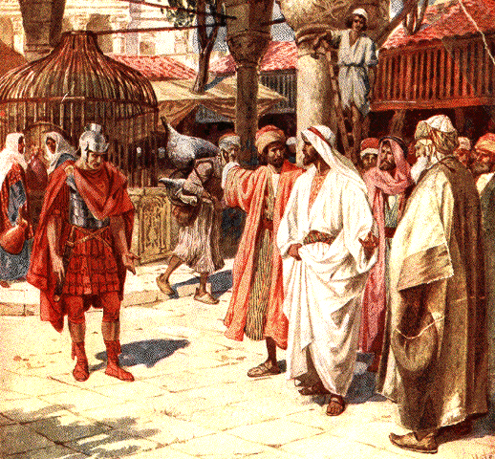
Respect
People LISTEN to those they RESPECT

Slide 18
Respect
Not anything we can buy; it is something we must earn.
One of our past presidents will go down in history for being an adulterer and liar. - Who can respect that?
Our current President’s actions will determine his legacy.
Cornelius was great, but not because of his position in government [Centurion].
He had the respect of those around him.
(Acts 10:22)

Slide 19
As Christians we need a good reputation.
(1 Peter 2:12)
A man who understands the power of the Lord will make him thirst for God.
(Psalms 42:1-2)

Slide 20
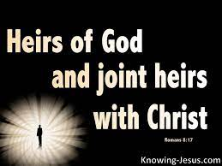
Service to Others
Our greatest opportunity for service is to tell others about the wonderful blessings we possess as Children of God.
(Romans 8:17)
Let's be praying for opportunities to be the first to serve.

